Slide 1






PROSPECT INFORMATION SESSION
STAFF TRAINING WEBINAR
Notes:
Hi, everyone. Thank you for joining me for today's training. My name is XX, and I work for MP&F Strategic Communications.
We are the communications support contractor for Job Corps, and are responsible for creating national recruitment materials, coordinating Job Corps’ national advertising campaigns, and managing the program’s social media accounts on Facebook, YouTube and Instagram. We also do many other things as well, but these are some of the main ways that we support the Job Corps National Office.
Today, we’re going to discuss the Prospect Information Session deck that is available for all Job Corps staff, but specifically Admissions staff, to use in Job Corps information sessions and orientation meetings. The deck also comes with script notes and a tip sheet on presentation best practices, materials to have on hand to accompany presentations and other tips to set you up for success in your meetings with prospective students. We'll go over all of that later in this presentation.
But, before I do that, I want to give a little background as to what got us to this point.

Slide 2

/// A NEED FOR CONSISTENT COMUNICATION
GOAL 1: Provide a clear, standardized message in information sessions.
GOAL 2: Make information sessions informative and compelling and accurately set expectations about the Job Corps experience.
THE RESULT: A clear, single message for students that echoes across their Job Corps journey—including their admissions, on-campus and placement experience.
Notes:
As many of you know, over the past few months, Job Corps has launched several new policies, initiatives and resources aimed at standardizing practices across the Job Corps program as part of the larger Job Corps 2.0 plan.
A major focus of that plan is on Job Corps’ messaging, ensuring there is consistency across Job Corps’ communications, to help provide a clear, single message for students that echoes across their Job Corps journey—including their admissions, on-campus and placement experience.
From a comms perspective, ensuring we are consistent in how we talk about our program is crucial to our path forward. By doing so, this helps provide a clear, standardized message for prospective students that will build on what they’ve seen already or will see during their Job Corps journey. There is also a lot of new software and integration being introduced during Job Corps 2.0 plan. This webinar will cover how to market Job Corps to prospective students, not the admissions process.

Slide 3
/// THE PRESENTATION EXPERIENCE
JOB CORPS 101
JOB CORPS SERVICES
ELIGIBILITY
JOB CORPS JOURNEY
NEXT STEPS
Learn the skills to be successful
Industry training
Center-specific highlights
Personal Career Development Plans
Housing and meals
Basic medical care
Training supplies
Living allowance
Supportive community
Requirements
Background check
Application process
Arriving to campus
Getting settled in
Learning and training
Post-graduation
Getting started
Continuing the conversation
Notes:
In order to do that, we're going to spend most of today's discussion actually walking you through Job Corps' new orientation presentation for prospective students. At the 10,000-foot level, the new presentation covers the following components of Job Corps:
A general introduction to what Job Corps is and the career training and education opportunities available
An overview of the wrap-around services Job Corps provides
Who is eligible and some of the expectations to meet that eligibility
What the Job Corps journey from application to graduation looks like for them
And then next steps on getting started on your application process, or resources and some "homework" if you will to keep considering Job Corps.
Remember, the goal is for all admissions staff to provide every single Job Corps prospective student a clear, single message about what Job Corps is and accurately set expectations about the Job Corps experience. So let's align on some of those messages now.

Slide 4




/// DID YOU KNOW?
LEARN
the skills and resources to be successful in a career.
EARN
a high school diploma
or equivalent.
TRAIN
in one of 10
different industries.
ENGAGE
with a supportive community to access graduate resources
and connections.
Notes:
First, not every student is going to know what Job Corps is. And that’s okay!
To lay the foundation, it's good to start with an overview of the impact Job Corps truly offers. Despite what someone may (or may not know), we need to make sure they know that Job Corps has helped more than 3 million young people get training and education to help put them on a path to a successful career.
In fact, with Job Corps’ support, students can:
Learn skills and resources to be successful in a career, not just a job
Earn a high school diploma or equivalent (if they haven’t already)
Earn a driver’s license (if they haven’t already)
Train in one of 10 growing industries
Start building a supportive community of peers
Graduate prepared to start working immediately
Or maybe consider going to college, taking the skills they've learned and joining the military, becoming an apprentice, or joining a union
This helps prove the validity of the program from the start. It also highlights a lot of the ROI a student can get from the program, which helps sell the program as they're making the decision to enroll. These are two components we've heard in focus groups with prospective students they want (and honestly expect to hear) when considering enrolling in a program like Job Corps.
And make sure to remind students Job Corps is completely FREE. This means that meals, supplies, uniforms, a place to stay, basic medical care and other essentials they may need while enrolled in the program will be provided for them at no cost. I’m going to talk more about these benefits in a little bit.

Slide 5


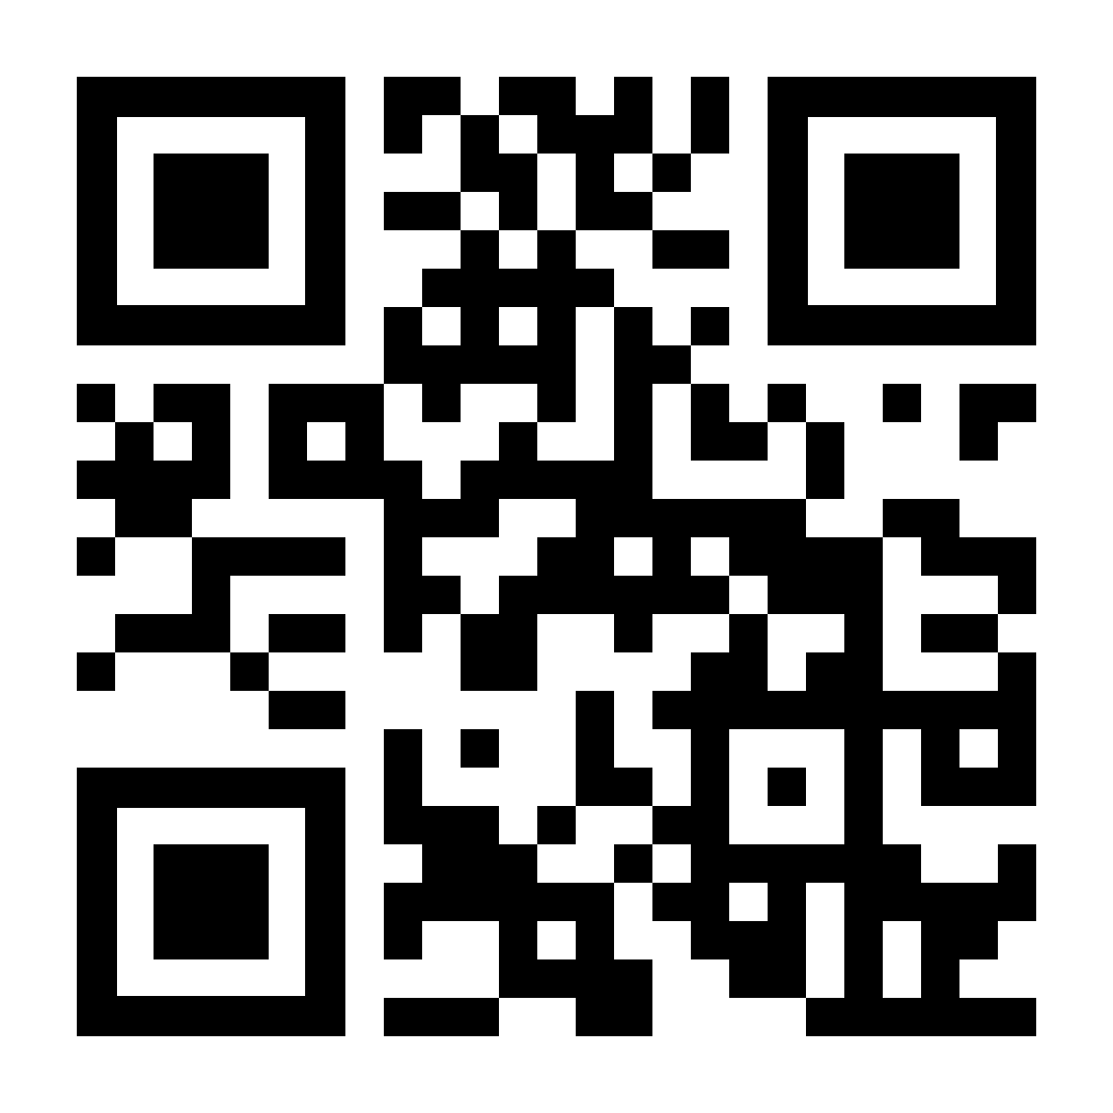
/// DID YOU KNOW?
CAMPUS
OBS
TRAINING OFFERED
Training Area Offered 1
Training Area Offered 1
Training Area Offered 1
Training Area Offered 1
Training Area Offered 1
Training Area Offered 1
Training Area Offered 1
Training Area Offered 1
EMPLOYER PARTNERS
99%
9,999 Students
9,999 Capacity
Notes:
Second, we need them to know what they’re apart of. There are over 120 Job Corps campuses across the United States and Puerto Rico. That's something to recognize.
In the same breath, I also recognize every center is completely different in how its looks and feels. In fact, many times, your specific center characteristics are what graduates say they loved about the program and what made their time on campus meaningful.
This slide is a bit of a template for you to customize, and more importantly is an opportunity for you to talk about the training areas offered at your center, your employer partners, how many students are enrolled and anything else you'd like to include. Make sure to include pictures! We'll talk a bit more later on in this presentation about some of the non-training components of your center you'll want to highlight.

Slide 6
/// DID YOU KNOW?
Job Corps offers over 100 training programs across 10 in-demand industries.
Automotive and Machine Repair
Construction
Finance and Business
Health Care
Homeland Security
Hospitality
Information Technology
Advanced Manufacturing
Renewable Resources and Energy
Transportation
Notes:
And lastly, they need to know Job Corps is a career training program meant to achieve their personal career goals.
Job Corps offers hands-on, in-person career training in 10 high-growth industries, from health care to IT, to construction. You can use this slide to go over all of the training programs Job Corps offers, while highlighting or calling out the specific industries that you offer at your center.
You may have students in the room that know exactly what they want to do at Job Corps already. That's great. Chances are, more may not know exactly at this time. They're still feeling us out, right? This is where you come in to support. Did you know the Job Corps website has a brief quiz students can take to start thinking about what paths might be of interest to them? It doesn't promise anything, it just gets them in the mindset to start thinking about opportunities. But this is something to make sure they're aware of during this "discovery" phase.
This is also a good time to introduce Job Corps’ Personal Career Development Plans and reassure students that it's okay that they don't know which career training they want to pursue. Every student will have the opportunity to explore career pathways and discover their passion once they've been accepted to the program.

Slide 7






/// JOB CORPS OFFERS YOU:
HOUSING
BASIC
MEDICAL CARE
NUTRITIOUS MEALS
BOOKS & SUPPLIES
LIVING ALLOWANCE
TRAINING CLOTHING
SUPPORTIVE COMMUNITY
Notes:
Deciding to come to Job Corps is a big decision. And something our students don't take lightly. On a daily basis, prospective students are engaging with Job Corps social media platforms, website and chatbot to ask questions about the enrollment process and what life at Job Corps really looks like.
The wrap-around services Job Corps provides are often times major selling points for why a student decides to join Job Corps. So don't forget to highlight those.
We want our students to focus on their goals and future and not have to worry about anything else, so make sure they're aware of the benefits Job Corps students receive:
Furnished dorms
Basic medical, dental and eye care
Mental health services
Breakfast, lunch and dinner every day
Books and supplies for academic and career training
Basic uniforms and specialized safety equipment
A network of supportive instructors and staff
And most importantly, all of this will be all be provided for them at no cost.

Slide 8





/// YOUR JOB CORPS JOURNEY
1
2
3
4
5
APPLICATION PROCESS
PREPARING TO ARRIVE
GETTING
SETTLED IN
LEARNING AND TRAINING
BEGINNING YOUR NEW PATH
Notes:
Every Job Corps student embarks on what is called the “Job Corps Journey.” It begins the moment a prospective student first learns about the program and starts to consider it as an option. And the journey continues even after graduation, as students receive transition services, stay in contact with mentors and connect with fellow Job Corps alumni while they begin their careers.
I imagine one of the first questions you may get asked is, "how long does Job Corps take?" It's important to share that while Job Corps is a self-paced program, the most successful students typically complete the program in eight to 15 months. That said, there are phases of the program that every prospective students should know about. This is where the idea of the journey comes in.
The next few slides dig into each phase of the journey and what it looks like from start to finish—from applying to graduating. As you're introducing and setting up the journey in your presentations, I think it's important to let prospective students know this journey is also a resource for them moving forward. The journey was recently added to jobcorps.gov so prospective students could learn about the process during their "discovery" phase of Job Corps. Additionally, fliers and posters are currently being printed and distributed to centers to be shared with both current students and prospective students. This is an opportunity for all students to reference where they are in the journey, and more importantly, stay motivated to continue moving forward.
So let's dig into the actual phases of the journey.

Slide 9

/// APPLICATION PROCESS:
Express your interest
Determine your eligibility
Discuss your goals
Start your application
Track your status online
1
Notes:
The first phase in a student's Job Corps journey is the application process.
Here, you should remind students that Job Corps is an open-enrollment program, meaning that you can start the application process at any time. You don’t need to wait until an official semester or school year begins.
The very first step is to assist the student in filling out the MyJobCorps Express Interest Tool if they haven't already. Remind students this is their way of telling us, “Hey, I’m interested in Job Corps.” and share some general information, it is NOT the formal application to Job Corps.
After they express interest, you will help eligible students create their official Job Corps account and complete the formal application process. This is the time to remind students that this is a detailed process and they will be asked to provide several documents, like health records and school transcripts.
Your role during this application phase is to help it seem less daunting, answer questions, and make sure they get everything they need to apply successfully.

Slide 10

/// PREPARING TO ARRIVE:
Explore career training programs
Explore campuses closest to you
Discuss benefits of living on campus
Determine your arrival date
2
Notes:
Once a student is accepted to Job Corps, they begin the second phase of their Job Corps journey – preparing to arrive on campus. Here, you will discuss working together to select a career training area and center based on their goals and interests all the way to setting an arrival date.
At this point, share with students the resources available to make their arrival seamless – they can explore career possibilities on JobCorps.gov, see virtual tours of campuses, and more.
Once you help them determine the right program and campus, students will receive an official date for their arrival on campus.
You may have also already discussed Job Corps' zero-tolerance policy on drugs, drug use, alcohol and violence on campus, but if you haven’t this is also a great time to bring it up.

Slide 11

/// GETTING SETTLED IN:
Get used to center life
Jump into orientation
Start career prep classes
Continue to explore career options
Develop your career plan
3
Notes:
After arriving on campus, students begin the third phase of their Job Corps journey – getting settled in.
Explain that this is the phase where students are getting accustomed to life on campus, meeting new people, and beginning their career training and education classes.
This is a good time to introduce Job Corps' student-only Facebook group that students can join to get connected to even more students across the country.
It's important to also discuss how during this phase, students will begin mapping out their Personal Career Development Plan, which helps students identify strengths, interests and career goals.

Slide 12

/// LEARNING & TRAINING:
Focus on your future
Build your academic skills
  High school diploma
  Tests of Adult Basic Education (TABE)
    Mathematics and reading proficiency tests
  Possible college certification program enrollment
4
Notes:
After students finish their Career Planning Period, it's during the actual hands-on learning and training period where most of the students feel like their futures really take off, and when the greatest part of the Job Corps experience happens.
Let's touch on the learning and education piece of Job Corps for a minute. It's important to share with students on the front-end that they will take some basic education classes to start. If they already have their high school diploma, they may find themselves moving more quickly through this academic phase; but should expect some classroom requirements in addition to learning their trade.
And if they don’t already have their high school diploma (or an equivalent), this is time that they'll start working on that. Remember, every student who graduates from Job Corps should do so with a high school diploma.
In addition to taking those basic education classes, they will also take the Test of Adult Basic Education (TABE) to measure their basic math and reading proficiency. These tests will assist in making decisions about their training and academic coursework. Additionally, there may be some opportunities for concurrent college enrollment.
They may question, why a Mathematics and Reading proficiency tests if I already have a high school diploma? Well, the proficiency tests ensures you have the current basic reading and math skills needed to succeed in your career training, on the job and in life.
Next, I'll touch on the training component of this phase.

Slide 13
/// LEARNING & TRAINING:
Build your career skills
Build your life skills
Build your support community
4
Notes:
Depending on the number of prospective students you're meeting with, you may be able to tailor this to exactly what information they are interested in, but this is the opportunity to introduce some local on-the-ground center personality.
Consider mentioning a few of the WBL opportunities offered at your center. You could even show some photos of the types of work being done.
And remember, it’s also not all work. Job Corps also offers many ways for students to get involved, have new experiences, meet new people and sharpen their leadership skills. Specific activities will vary by campus; but some options that every center should offer include Student Government Association, dorm leadership, special interest clubs, recreation activities and intramural sports.
Consider mentioning a few additional clubs or interest groups offered at your center. Again, maybe include some photos or examples of what these clubs do.
If I can give you one piece of advice ... make sure to emphasize that students should take this time at Job Corps to take on new challenges and make meaningful connections with peers, instructors and counselors. So much of this plays into creating a positive experience for them on center. And a lot of what your centers are doing have such a positive impact. Let's highlight it in a way that entices other students to want to join.

Slide 14

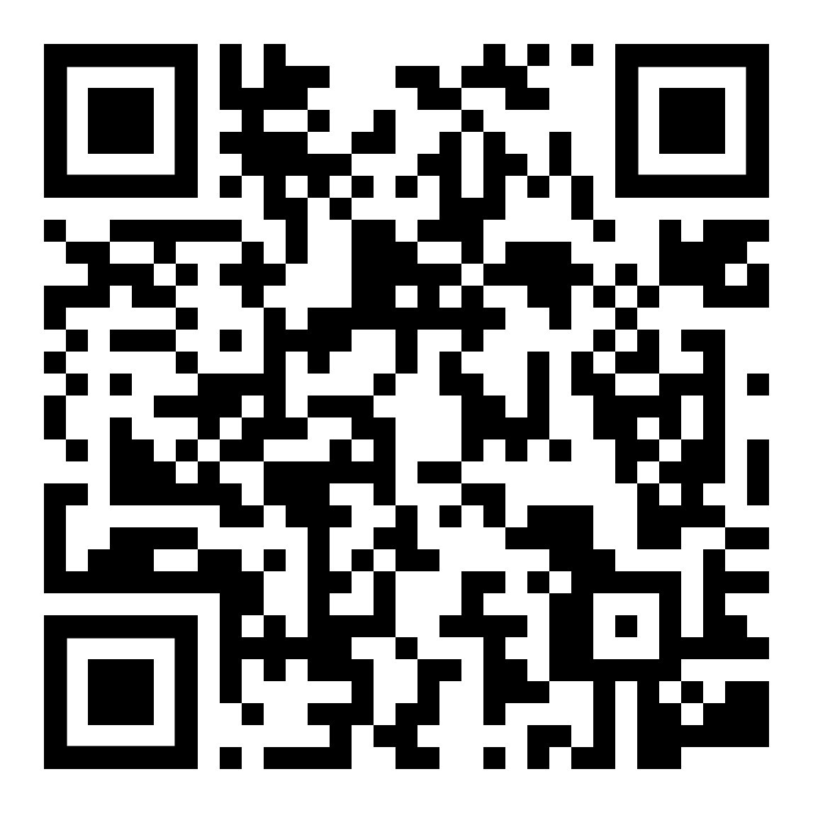
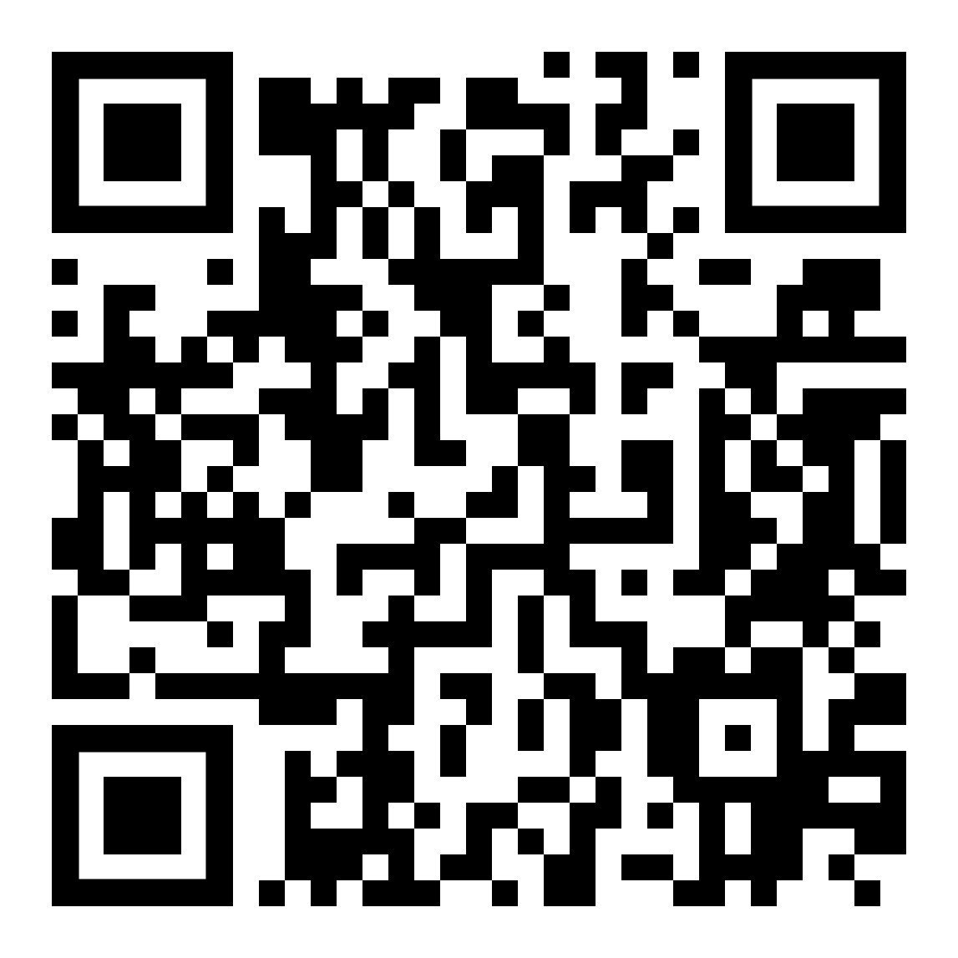
/// A DAY IN THE LIFE AT JOB CORPS
Notes:
Up to this point in the presentation, theoretically, you've been doing a lot of the talking about the program, specifically about what their life on campus will look like. That's also where we know prospects have the most questions. We know they want to know what a typical day looks like. So, show it to them. In this video, they'll be able to follow along with a few Job Corps students as they take you through a typical day in the life of a Job Corps student.
While I'm not going to show this video, I will say the presentation deck has the video already linked to play from Job Corps YouTube account (which is accessible to everyone) and we've included QR codes for quick access if a student wants to watch it on their phone. Or... You can scan that code yourself and use it as a text follow up to any prospect.

Slide 15

/// BEGINNING YOUR NEW PATH:
Plan for life after Job Corps
Graduate from Job Corps
Begin your journey
Stay connected
5
Notes:
The last phase of the Job Corps Journey is where you can talk about how all that hard work will eventually pay off.
You should highlight how Job Corps helps our graduates with their job search, the transition to life off campus, accessing services, finding housing, and saving money for those initial expenses.
Make sure to share the different opportunities for Job Corps students following graduation. For example, they can pursue apprenticeship programs, local college programs, a career in the military, or Advanced Training at Job Corps.
I also don't think it's a bad idea to have a few graduate success story examples ready to share. Who are they? Where did they come from? What impact did Job Corps make on them, and where are they now?

Slide 16

/// WHY JOB CORPS WORKS:
Notes:
The truth is, you can talk all day about Job Corps and how it’s a great opportunity, but I think it’s more important for prospective students to hear from actual Job Corps graduates who have sat exactly where they are.
This is a video from a real Job Corps student named Cinque (pronounced "Sin-eek") talking about how her life is changing because of Job Corps.

Slide 17

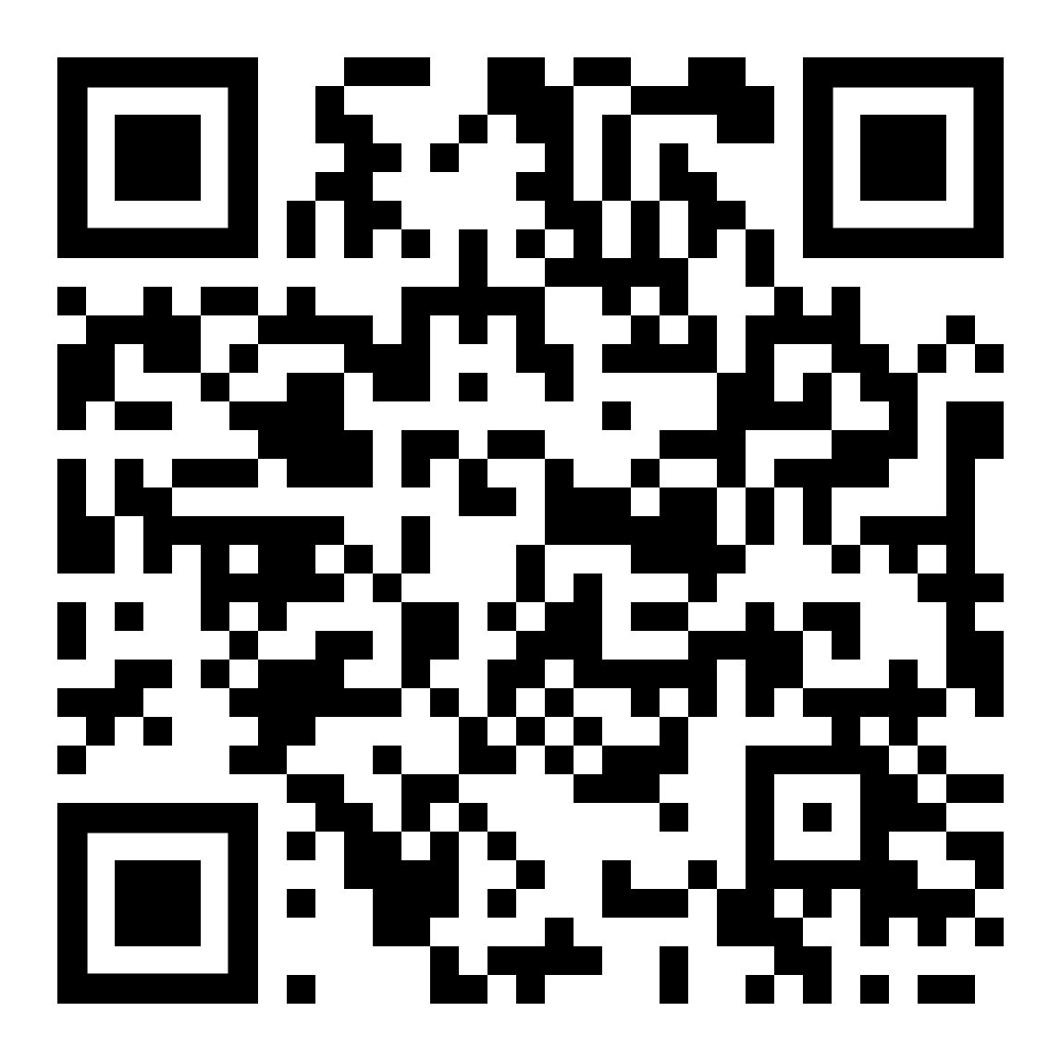
/// WHY JOB CORPS WORKS:
Notes:
I started the presentation talking about the reach and impact Job Corps has.
This video does a nice job of showing the lasting effects the program can provide.
This is a video from WNBA player Nakia Sanford-Lawson talking about how her career wouldn't have been possible without her mother, Jackie, going to Job Corps.

Slide 18
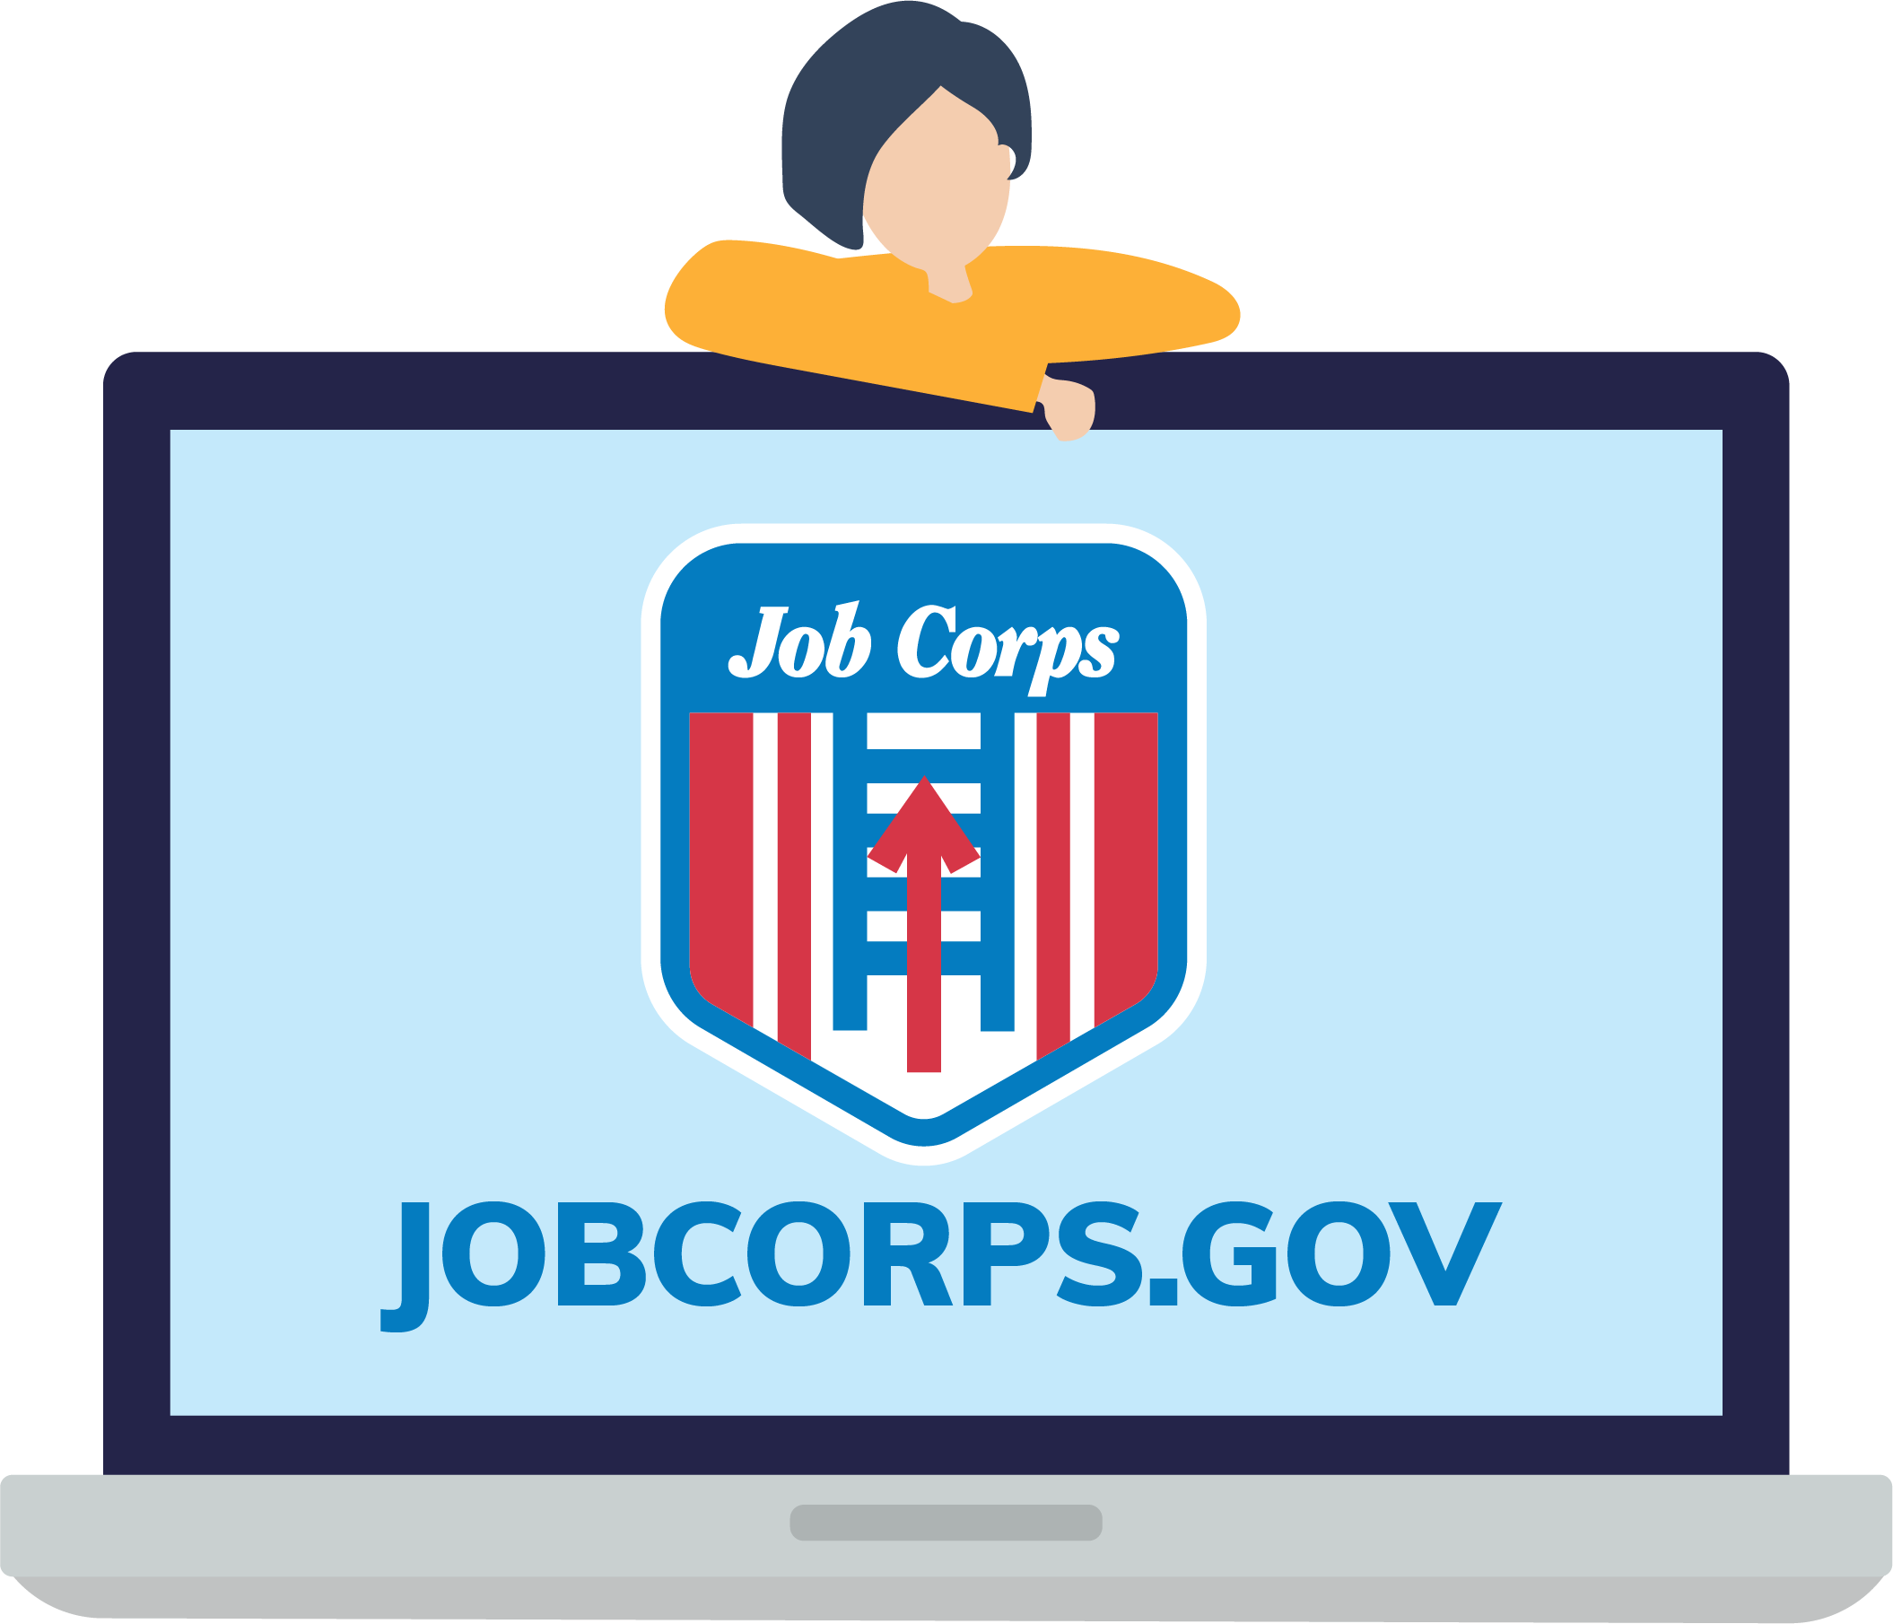

/// WHAT'S NEXT?
GET STARTED TODAY!
CHECK OUT JOBCORPS.GOV
to explore virtual tours, FAQs, industries and more!
FOLLOW US
Notes:
Enrolling in Job Corps is a decision they have to make. All we can do is provide them with the most meaningful information that proves Job Corps can benefit them.
Circle back to the original questions you asked them at the beginning of your presentation, but know they know a bit more about Job Corps.
What are their goals for the future?
How are they prepared to make those goals happen?
What skills training and education do they need to achieve their goals?
Are they committed to putting in the work to achieve their goals?
The goal is, now with all this information about what Job Corps is, they can say yes easily.
If you have a prospect that believes Job Corps is the right fit for them, take advantage of the opportunity right there and work with them to complete the MyJobCorps Express Interest Tool.
But not all prospects may be easily convinced. And that's okay too. This is a big decision. If you're working with a prospect that is still hesitant, there are a few ways to share information about Job Corps so that they can organically determine if this is a program they want to pursue. You can encourage them to...
Visit JobCorps.gov and learn more about the Job Corps Journey and the various training opportunities that are available.
Follow Job Corps on social media (Facebook, Instagram, YouTube, Twitter and LinkedIn) to learn more about our training and what life on center looks like, and to hear from students just like them who have already begun their journey.
Take a virtual tour of any of our campuses.

Slide 19
/// MAKE THE MOST OF YOUR PRESENTATION
You are the first impression to the program and guide students through the decision-making and application process.
Supporting materials from the Materials Marketplace reinforce your points and provide visual context.
Digital materials and social media allow students to learn more in their own time.
Don’t forget to leverage your student supporter resources.
Consider giving something fun to take home.
Notes:
So we've talked about the presentation itself, but I want to take a minute and talk about the Job Corps orientation "experience" too.
At a Job Corps information session or orientation meeting, you are arming prospective students with the information they need to choose Job Corps as their path toward a brighter future. I said it earlier, but approach your presentation with enthusiasm and professionalism so that prospective students will feel welcome, motivated and excited to join Job Corps!
Here are five tips for elevating your information session or orientation meeting:
1. Remember, for many prospective students, you will be their first introduction to the program. And even more importantly, admissions staff also guide students through the decision-making and application process for Job Corps. Use business card and e-mail signature templates to make sure your contact information is branded and easy to share, so students know how to reach you. Your office and meeting space are equally important for establishing what Job Corps is to prospective students too. A suite of customizable event materials, including yard signs, banners and templates, is available to help brand your spaces inside and outside.
2. Bring supporting materials to your presentation to add more information, reinforce your points and provide visual context. Printed materials make great takeaways, so prospective students have something to revisit as they contemplate choosing Job Corps. The Materials Marketplace is your one-stop shop for nationally approved marketing materials. Not sure where to begin? That's okay too. The Materials Marketplace Cheat Sheet breaks down the phases within a student’s Job Corps journey—from learning about the program to working with Admissions, to arriving on campus—and the materials and resources best suited to nurturing prospective students each step of the way.
3. Meeting prospective students where they are is an important part of educating them about Job Corps. For an age group that’s so online, digital materials can be great tools to use. Plus, not every prospective student you meet will be ready to choose Job Corps immediately, so these online resources serve as a place for students to refer to and learn more in their own time during the decision-making process. JobCorps.gov is a hub of information on Job Corps and serves as a great recruitment tool. Job Corps’ social media can also give students a glimpse into what life on campus is like and what kinds of successes they might hope to achieve. And materials like Center Fliers and CTT Sheets are great pieces to hand out, but also to send as post-presentation follow-ups via text and e-mail.
4. Choosing Job Corps is a big decision for a student’s future. Many prospective students will have conversations with family members or other supporters in their lives after your presentation. You can provide materials designed to speak to those “student supporters” too, so they can assist in a student’s decision-making process.
5. In addition to fliers and other informational handouts, give prospective students something fun to take home while they consider Job Corps. Logo files for Begin Here and Signing Day T-shirts, hats and stickers are available to download to produce Job Corps branded items. Just remember that centers are responsible for contacting vendors for production and any costs associated.

Slide 20
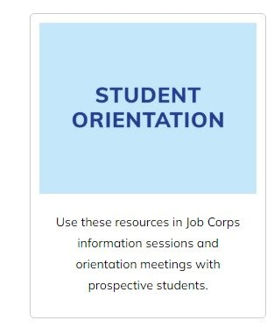

/// MATERIALS MARKETPLACE
www.jcmarketplace.com​
Notes:
We've covered a lot today, so I want to take a minute and explain where all of these resources live for you to access moving forward. This presentation, along with the new Student Orientation deck (and script talking points) and tips sheet live in the Student Orientation toolkit on the Materials Marketplace, along with a bunch of additional materials to help you in your outreach efforts.
If you're not familiar with the Materials Marketplace, every material on the Marketplace has been approved by the National Office of Job Corps and you should be using them frequently. You can order any of our orderable materials that are available for FREE; think of it as the Amazon of Job Corps, where you can order just about everything needed to successfully recruit and retain students. A few materials are listed as 'download only' where you can download them directly to your computer and use a center or local printer to print these materials.
To order a material, simply click on its image and you will be taken to a new page where you can add the material to your cart. Most materials are available in quantities of 25–100, but we can accommodate larger orders as well if you e-mail our team. We will get into that in the next slide. Fill your cart with as many materials as you would like, and then click on the shopping cart icon to check out.

Slide 21
/// QUESTIONS? CONTACT US
jobcorpsmaterials@mpf.com
615-259-4000
Thank you!
https://jcmarketplace.com/
Notes:
Well, I think we have covered everything, and this will conclude the training today. I know that was a lot of information to take in, so please feel free to ask any questions about the topics we covered today. And please remember this training will be available on the Materials Marketplace if you would like to review it again on your own time.
At this time, we’ll be dropping a feedback link into the chat box. We appreciate any and all feedback in regard to this presentation.
If you have any questions about this presentation, you can either call or e-mail us and we’d be happy to help you. Our phone number and e-mail address are on the screen.
Thank you so much for joining us today.

