Slide 1

Job Corps Recruiting 201: recruitment best practices
Notes:
Hi, everyone. Thank you for joining me for today’s webinar – Job Corps Recruiting 201: Recruitment Best Practices. My name is Sellars Huy, and I work for MP&F Strategic Communications.
We are the communications and marketing support contractor for Job Corps, which means we are responsible for creating national recruitment materials, coordinating Job Corps’ national advertising campaigns, handling text and e-mail campaigns to nurture prospective students through the recruitment process, and managing the program’s social media accounts on Facebook, YouTube, Instagram, X and LinkedIn.
But we also support Job Corps’ outreach and admission staff members like yourself. And that’s what today’s webinar is going to focus on. This webinar will last about 30 minutes, including some time for Q&A at the end of the webinar. At any point throughout the webinar, feel free to type questions in the chat box at the bottom of your screen. I’ll answer it either right away or at the end of the presentation.

Slide 2
Overview
Recruitment best practices
Marketing best practices
Notes:
Now for today's training. We will first cover key recruitment practices to keep in mind as you interact with a prospective student in Job Corps’ target age range.
From there, I'll introduce to you a few marketing techniques and important resources that you can use to market the Job Corps program to prospects.

Slide 3
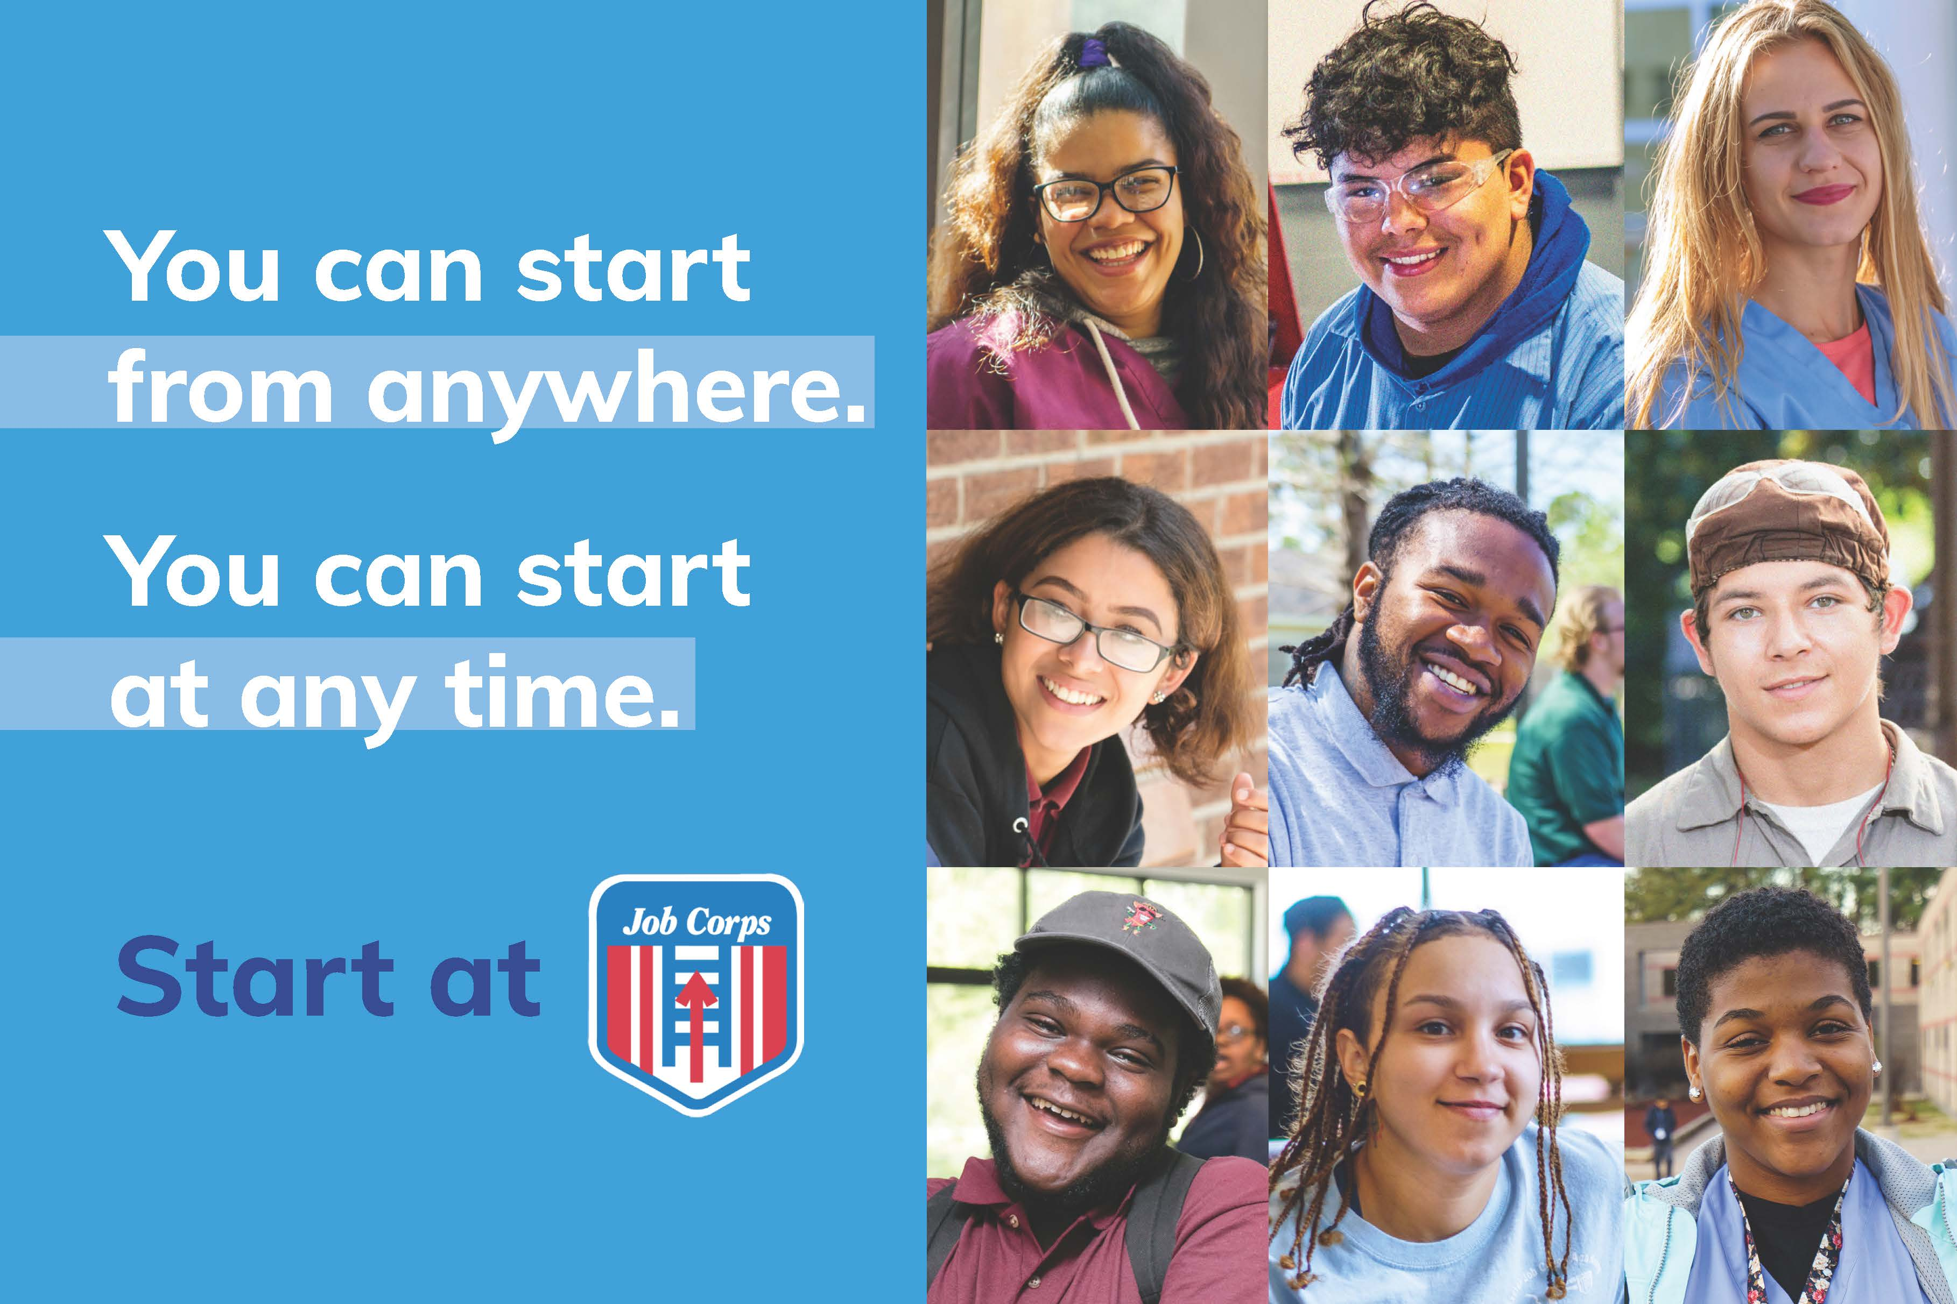

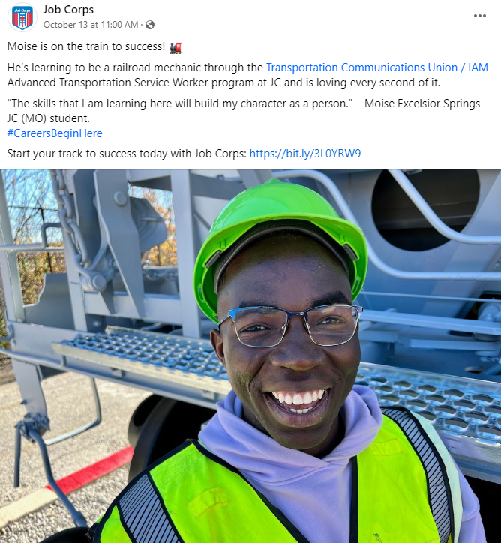
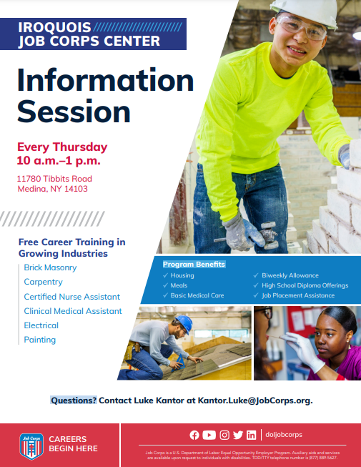
Recruitment Best Practices
Notes:
We'll kick off this presentation by sharing with you key recruitment best practices that we have received from many years of working closely with outreach and admissions and center staff like yourselves.
In order to keep your prospects in the recruitment pipeline, it’s very important to keep an open line of communication while providing them with their desired information through a variety of channels. There are multiple strategies available to OAs to be communicating with prospects.
On the screen, you can see just a few examples of different marketing techniques that admissions staff can be using to communicate with prospects. We have a variety of physical materials at your disposal as well as digital strategies that can help you promote Job Corps.

Slide 4
Recruitment Best Practices
1. Respond within 24 hours.
2. Employ a variety of outreach methods.
3. Remove barriers to student success.
4. Diagnose why prospects fall off.
5. Strive to make meaningful personal contact.
6. Adopt a sales mentality.
7. Strike while the iron is hot.
Notes:
When it comes to promoting Job Corps to this age group, you want to be timely, flexible and personable in all your outreach efforts.
In the next few slides, we will go through what have proven to be the seven best recruitment practices as outlined on the screen.

Slide 5



Respond Within 24 Hours
Notes:
Best practice number one is to make every effort possible to respond to prospects within 24 hours of their inquiring about Job Corps. The faster you respond, the better the chances of their becoming real applicants and then program participants. We live in a technology-driven world where people expect near-immediate responses. We especially see this expectation in the younger population.

Slide 6
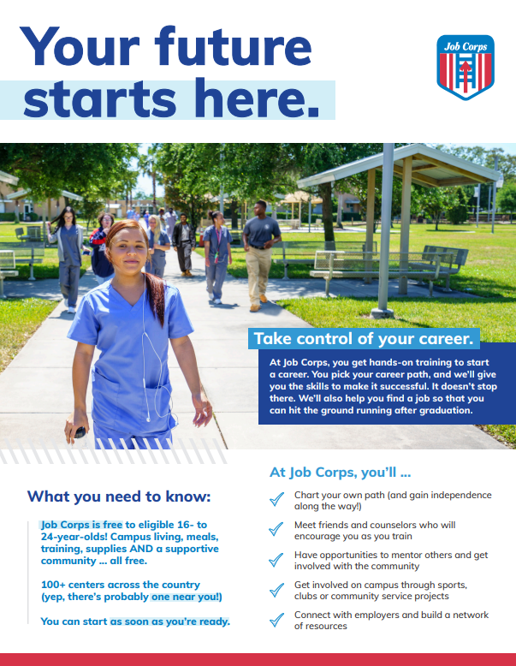
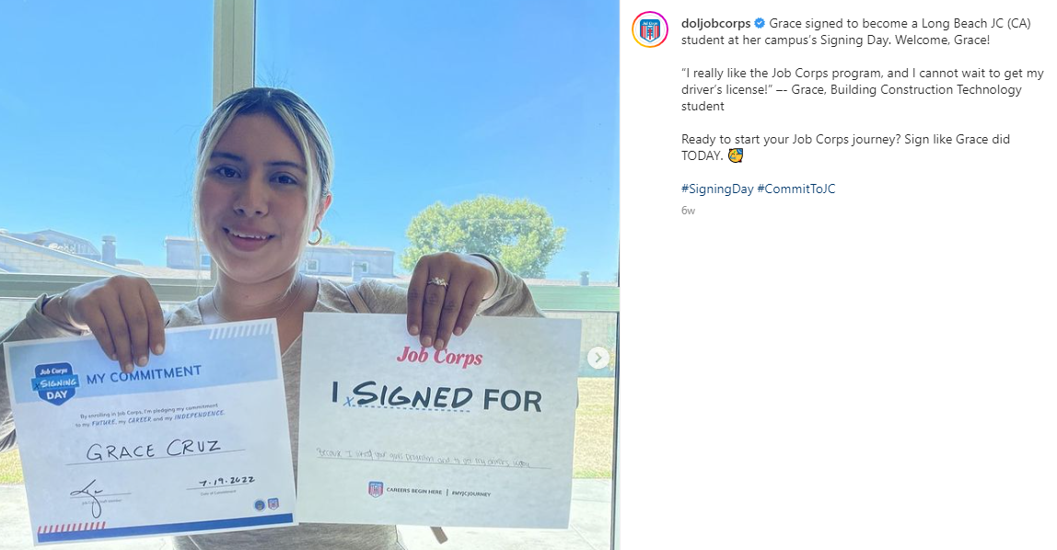
Employ a Variety of Outreach Methods
Notes:
The second tactic is to employ a variety of outreach methods. We continue to hear from Job Corps admissions counselors that they find the most success when they contact prospective students through several different mediums (examples are e-mail, phone call, text, social media, direct mail and door-to-door). Potential students are more likely to pay attention and engage with your recruitment efforts when they are communicated with via several different mediums.

Slide 7
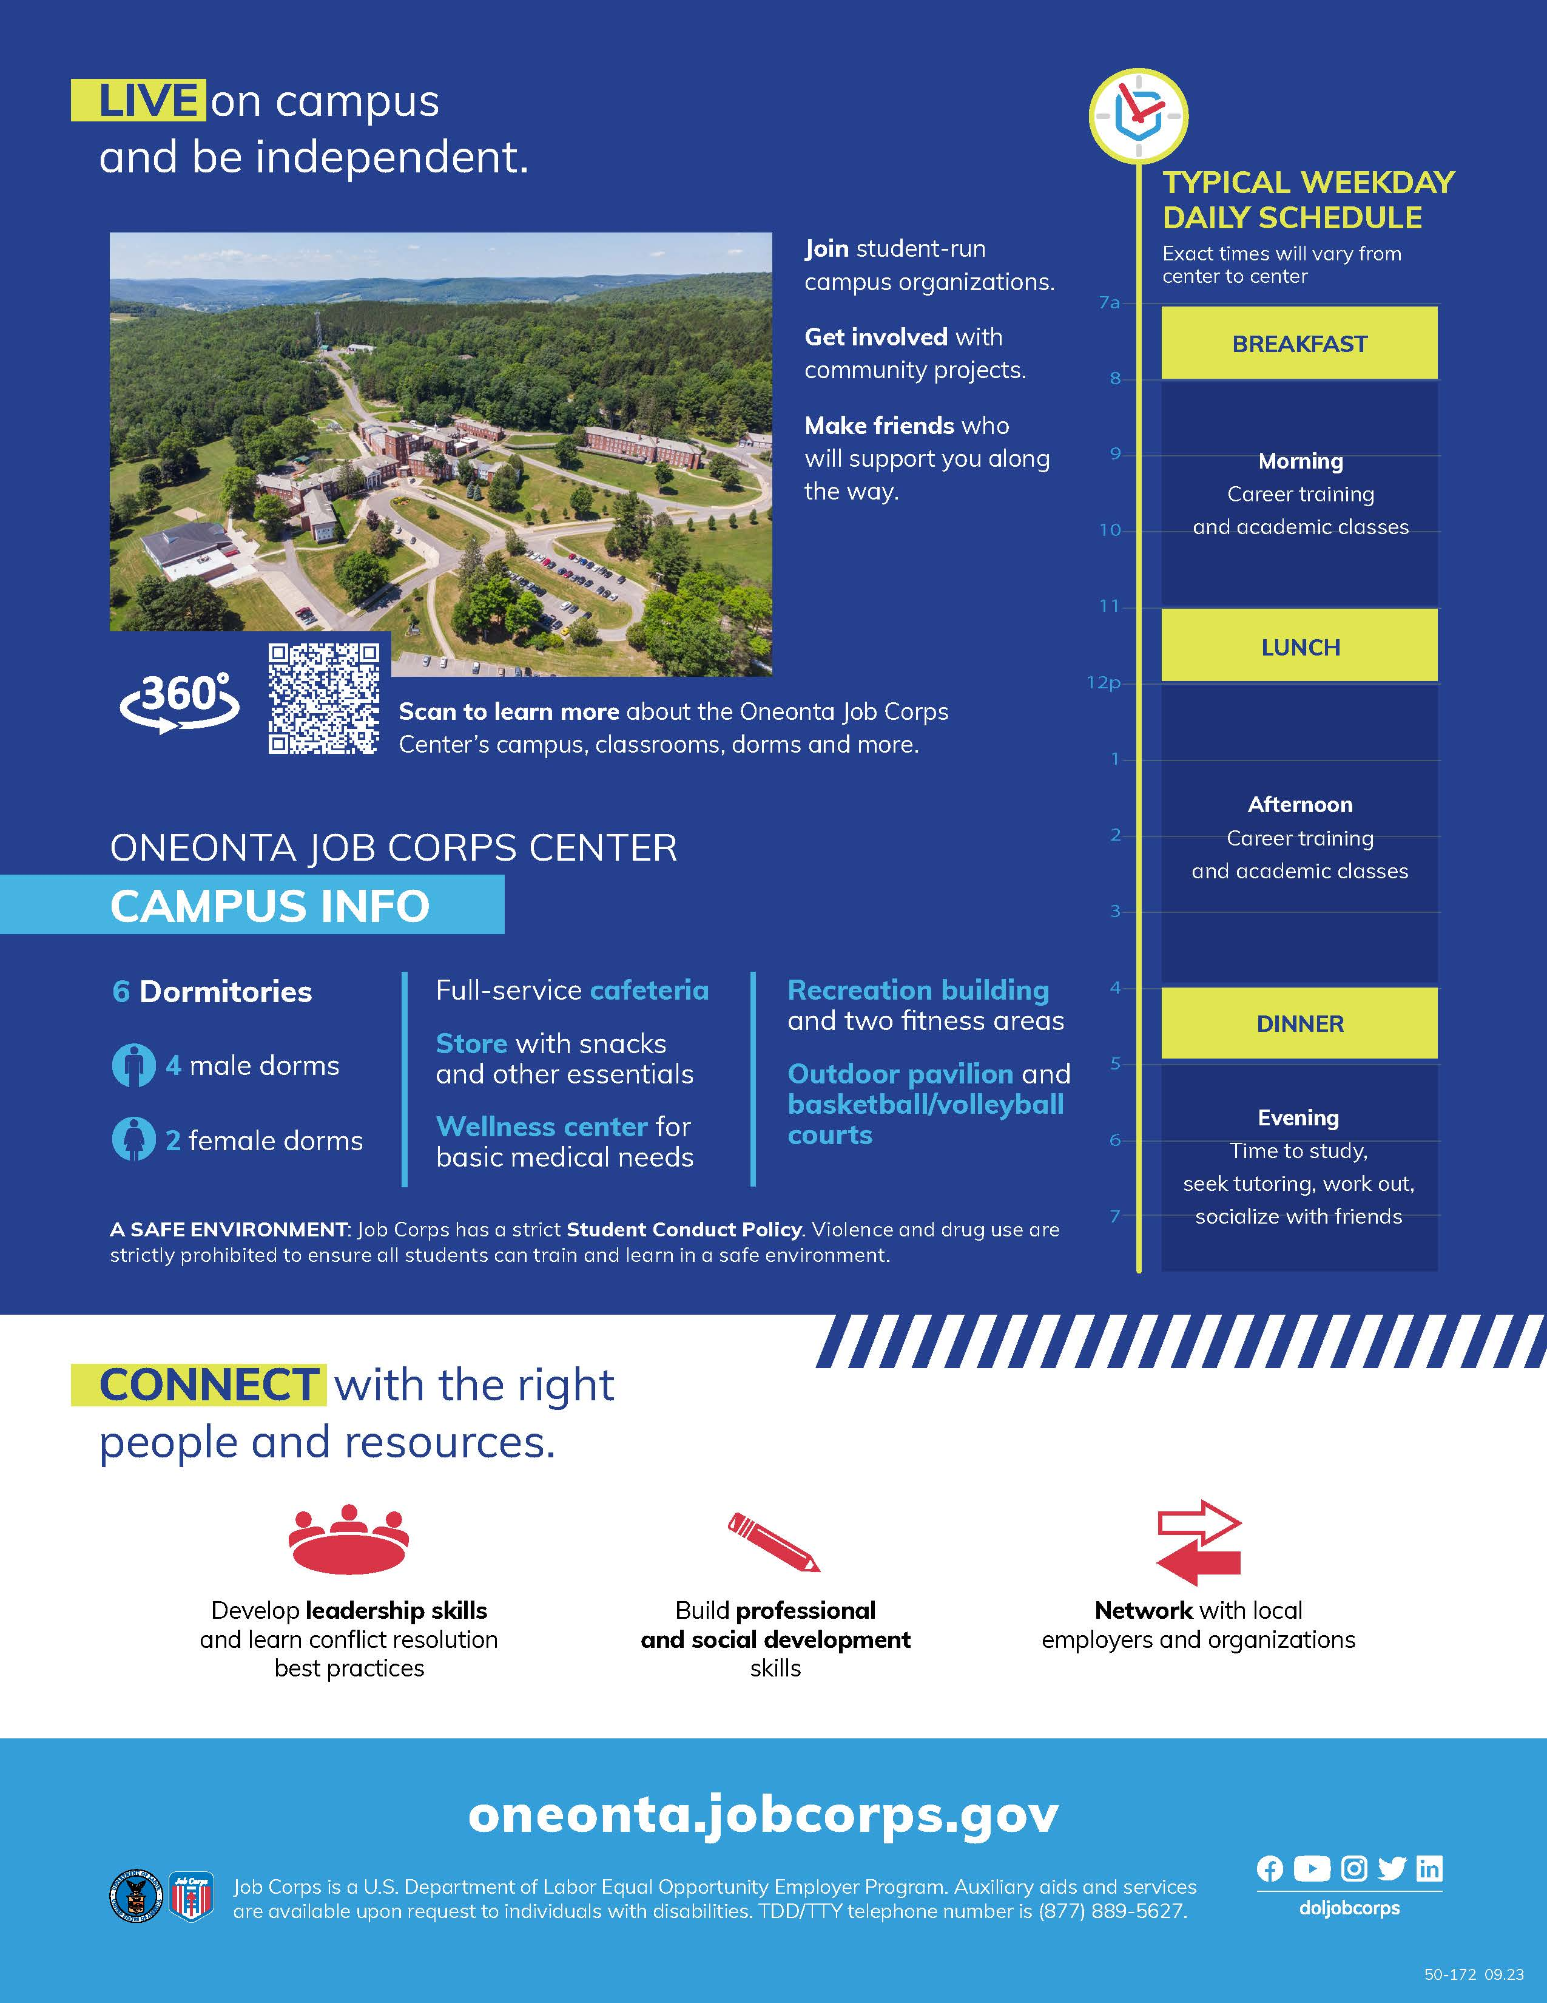
Remove Barriers to Student Success
Notes:
We also know it’s important to remove barriers to student success. During the recruitment and admissions process, speak with students to identify the specific barriers they might encounter on their way to becoming a successful Job Corps student. Tailor their experience to help them overcome those obstacles. For example, students may need assistance thinking through childcare, employment and financial support during the program, and more. If you can help eliminate some of the barriers on the front end, the more likely they will be to follow through. Help them understand that you are there to help them find a way to make it work.
The back of the Center Fliers are a great piece to show what Job Corps offers outside of education and career training. Our office is in the process of updating these and will have them available for download on the Materials Marketplace in the coming week so be sure to keep an eye out.

Slide 8


Diagnose Why Prospects Fall Off
Notes:
Number four: Diagnose why prospects fall off.
I know you’ve all dealt with a warm or strong lead going cold. That why it’s important (if possible) to determine what made a prospect fall out of the admission pipeline, especially if they were far along in the process. It might be a long shot, but try reaching out to prospects who have fallen off the radar and ask them why they chose not to attend Job Corps. Did they get a job? Were they afraid of leaving home? This type of information will only help inform your recruitment efforts moving forward.

Slide 9
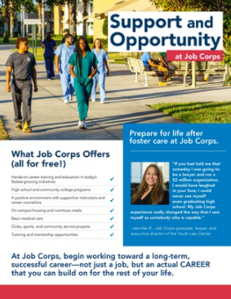
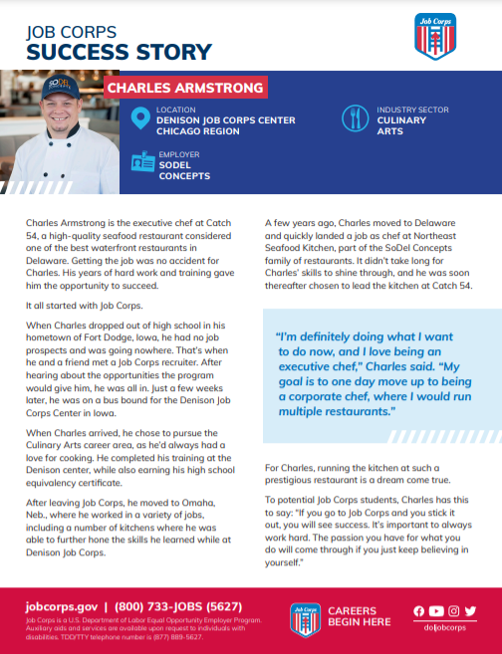
Strive To Make Meaningful Personal Contact
Notes:
Tactic number five is to strive to make meaningful personal contact through methods like e-mail and voicemail. Even though your main form of communication may be e-mail, that doesn’t mean you can’t be personable and relatable as you explain the Job Corps program. Help them understand what the program is, what it offers and its benefits, and what the program can do for them and their future as early in your conversations as possible. If you are using e-mail, include links to student success stories like the one on the screen so they can see for themselves that Job Corps works. If you are leaving a voicemail, offer to put them in touch with a current student or graduate.
We also have several specialized pieces that make up our Stakeholder Engagement Toolkit, such as the Foster Care flier on the right of your screen. The materials and strategies outlined in this toolkit can help you reach specific groups of prospective students. While you can use the general recruitment pieces for all prospects, it is also a good idea to use these pieces that were made specifically these groups to advance your outreach. We'll go more into that toolkit later in the presentation.

Slide 10

Adopt a Sales Mentality
Notes:
Number six: Try adopting a sales mentality. Many Job Corps outreach and admissions project directors have their admissions counselors go through customer service sales training, and they have found it to be incredibly helpful. Many who have done this say they are seeing higher conversion rates of prospects to applicants to students. Let them know you are not just some telemarketer. You are a customer service representative, and you want to tell them about a program that can change their life.

Slide 11

Strike While the Iron Is Hot
Notes:
And finally, strike while the iron is hot. Do whatever you can to get students on center as soon as you can. The longer they wait, the less likely it is for a prospect to become an arrival.

Slide 12
Frequently Asked Questions
Why are the rules at Job Corps so strict?
Why does the application process take so long?
Why should I enroll in Job Corps and not seek employment immediately?
Notes:
Another best practice to keep in mind when recruiting is to know the answer to a question before it gets asked. We have heard from the field that there are a few questions that continue to circulate and be of interest to prospects and the influencers in their life.
One thing prospects often ask is why the program is so strict. Remind them that staying focused is an essential part of succeeding in the program and that the more focused they are, the sooner they will graduate.
I am sure you all get asked why the application process takes so long at least once a day. Remind prospects that just like applying to college or for a job, things take time and we carefully consider if Job Corps is the right fit for every applicant.
Similarly, you might get asked why they should consider Job Corps instead of applying for a job where they can starting getting paid immediately. Emphasize that while a job right now might pay them a good wage, Job Corps can provide them with the training and skills that will serve as important building blocks to a successful, long-term career.

Slide 13
Marketing Best Practices
1. Refer a Friend
2. Recruitment Tour
3. Information Sessions
4. Community Outreach
5. Leverage Local Media
6. Leverage Social Media
7. Success Stories
Notes:
So how do we put these best practices into action? We will dive into that in the coming slides!
Based on years of research and feedback from outreach and admissions staff like you, we have compiled the most effective marketing and outreach strategies, as you can see on the screen. We will break each one of these down in the following slides. We’ll cover things such as why students and their personal experiences and stories are your strongest recruitment tool, why community outreach is critical in your recruitment efforts, and why you should use local media and social media to reach prospects and other stakeholder groups.

Slide 14
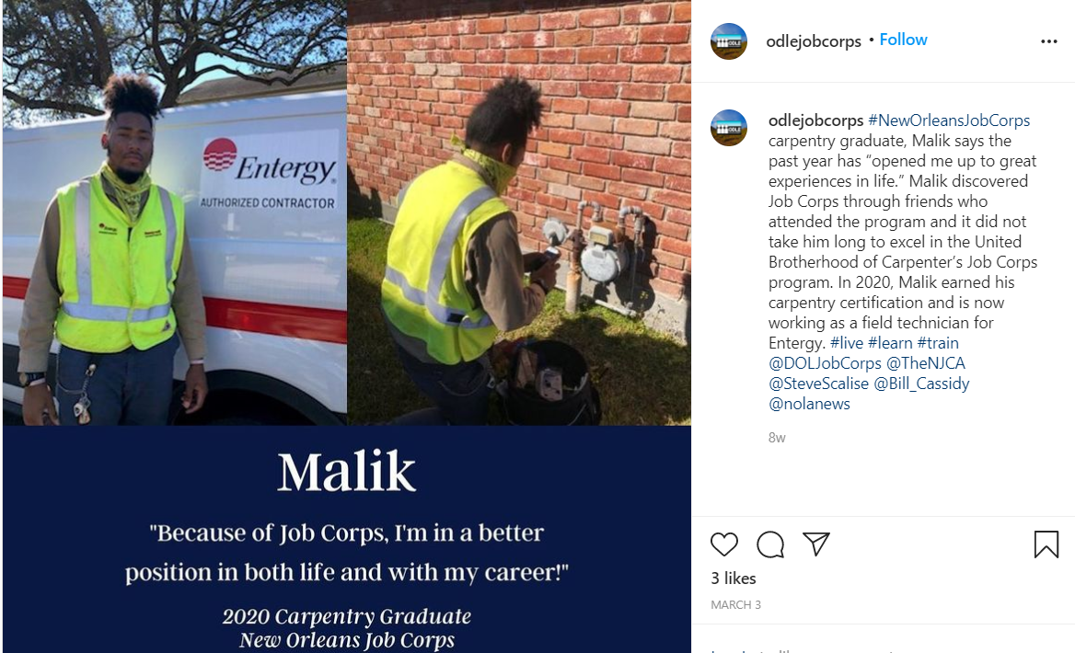
Refer a Friend
Do students know people who would be interested in the program?
Empower students to reach out to friends and family via e-mail, text and/or social media.
Notes:
So one of the first and easiest resources available to you to promote Job Corps is your STUDENTS. They are by far your strongest selling point. Through research and focus groups, we’ve found that potential students most want to see and hear from real Job Corps students who have participated in the program. It helps them put a face to Job Corps.
One of the easiest ways your current students can help with recruitment is if they share their experiences with friends and family members who they think might be interested in the program.
For example, you can see on the screen that we’ve got Malik, a Carpentry graduate from Job Corps. He discovered Job Corps through friends who attended and recommended the program. Now Malik himself is a walking testimonial for Job Corps.
Encourage students to either e-mail or text friends and family members, or maybe work with them to create a short video message where they share their own Job Corps experiences. They can then e-mail or text it to select friends, or they can share it on their personal social media pages.

Slide 15

Recruitment Tour
Engage your current students with the community and potential students.
Notes:
If your center hosts recruitment tours, that's great! If not it is a great way to get your students to promote the program to prospects.
The first step in the process is to identify a group of your most successful students, and if possible, it’s always a good idea to choose a diverse group of students for these types of events – both racially and ethnically, as well as a variety of career training areas so potential students can get a sense of the different options available to them at Job Corps. They need to be prepared to answer questions about why they chose to join Job Corps, how their experience has been and about what they are currently learning/doing in the program.
The next step is to identify a location for the event – some great ideas are local community centers, organizations, malls, shelters and public housing developments.
Once you have your location, it would be great to plan out what types of marketing materials you want to display and hand out at the event. For example, the recruitment brochure or flier, the eligibility flier, or some career training fliers. And be sure to have a way to capture contact information for everyone who stops by so you can follow up with them the next day and possibly invite them for a tour of the center.

Slide 16
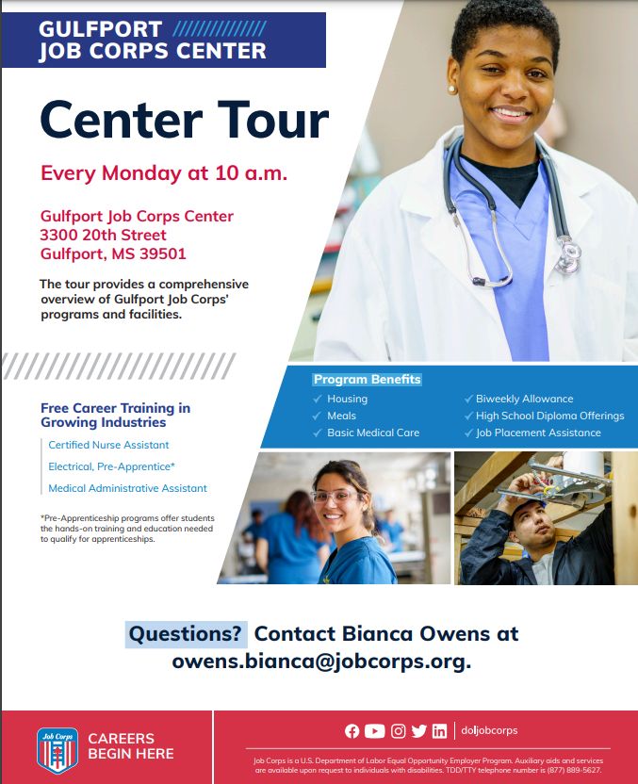
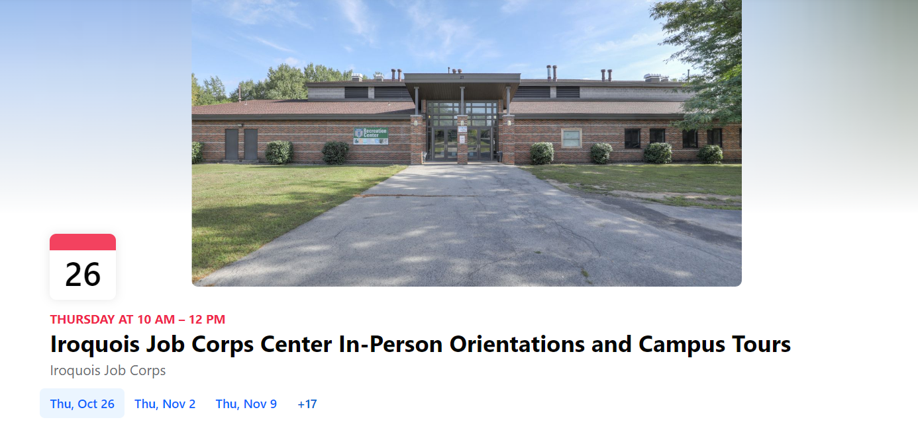
Information Sessions and Open Houses
Facebook Event
Information Session Flier
jobcorpsmaterials@mpf.com
Jcdigital@mpf.com
Notes:
So let's say you do host a recruitment tour. Another strategy you can implement during this tour would be to host an information session or invite folks back to your center for an open house.
Information sessions and open houses can be a very effective way to meet potential students, explain what Job Corps is and answer any questions they have about the program.
These information sessions offer a great opportunity to share a presentation, PowerPoint or videos with potential students.
Open houses are typically hosted at the center and allow potential students to see the space they'll be living and learning in. It's a great opportunity for potential students to connect with Job Corps staff and other students face to face.
If you already have a presentation compiled for these types of sessions, great. If you don’t, you may want to consider pulling one together that is essentially an overview of the program and what students can expect if they enroll. Be as transparent and thorough as you can with the students. The idea is to give them the most accurate portrayal of the program as possible.
If your center is hosting an information session or open house, feel free to share that with our Facebook team at jcdigital@mpf.com and they can post the details on the "event" tab of the National Job Corps Facebook page.
Another option is to create information session fliers that you can print, send via text or e‑mail to prospects and encourage them to learn more about the program. Many prospects may be looking for any reason to start planning ahead or looking for ways to start something new, so keep reaching out and inviting them to attend these sessions.
If you need help customizing an Information Session flier – whether it’s for a virtual session or an in-person session, you can e-mail MP&F at, jobcorpsmaterials@mpf.com, and we can help you.

Slide 17
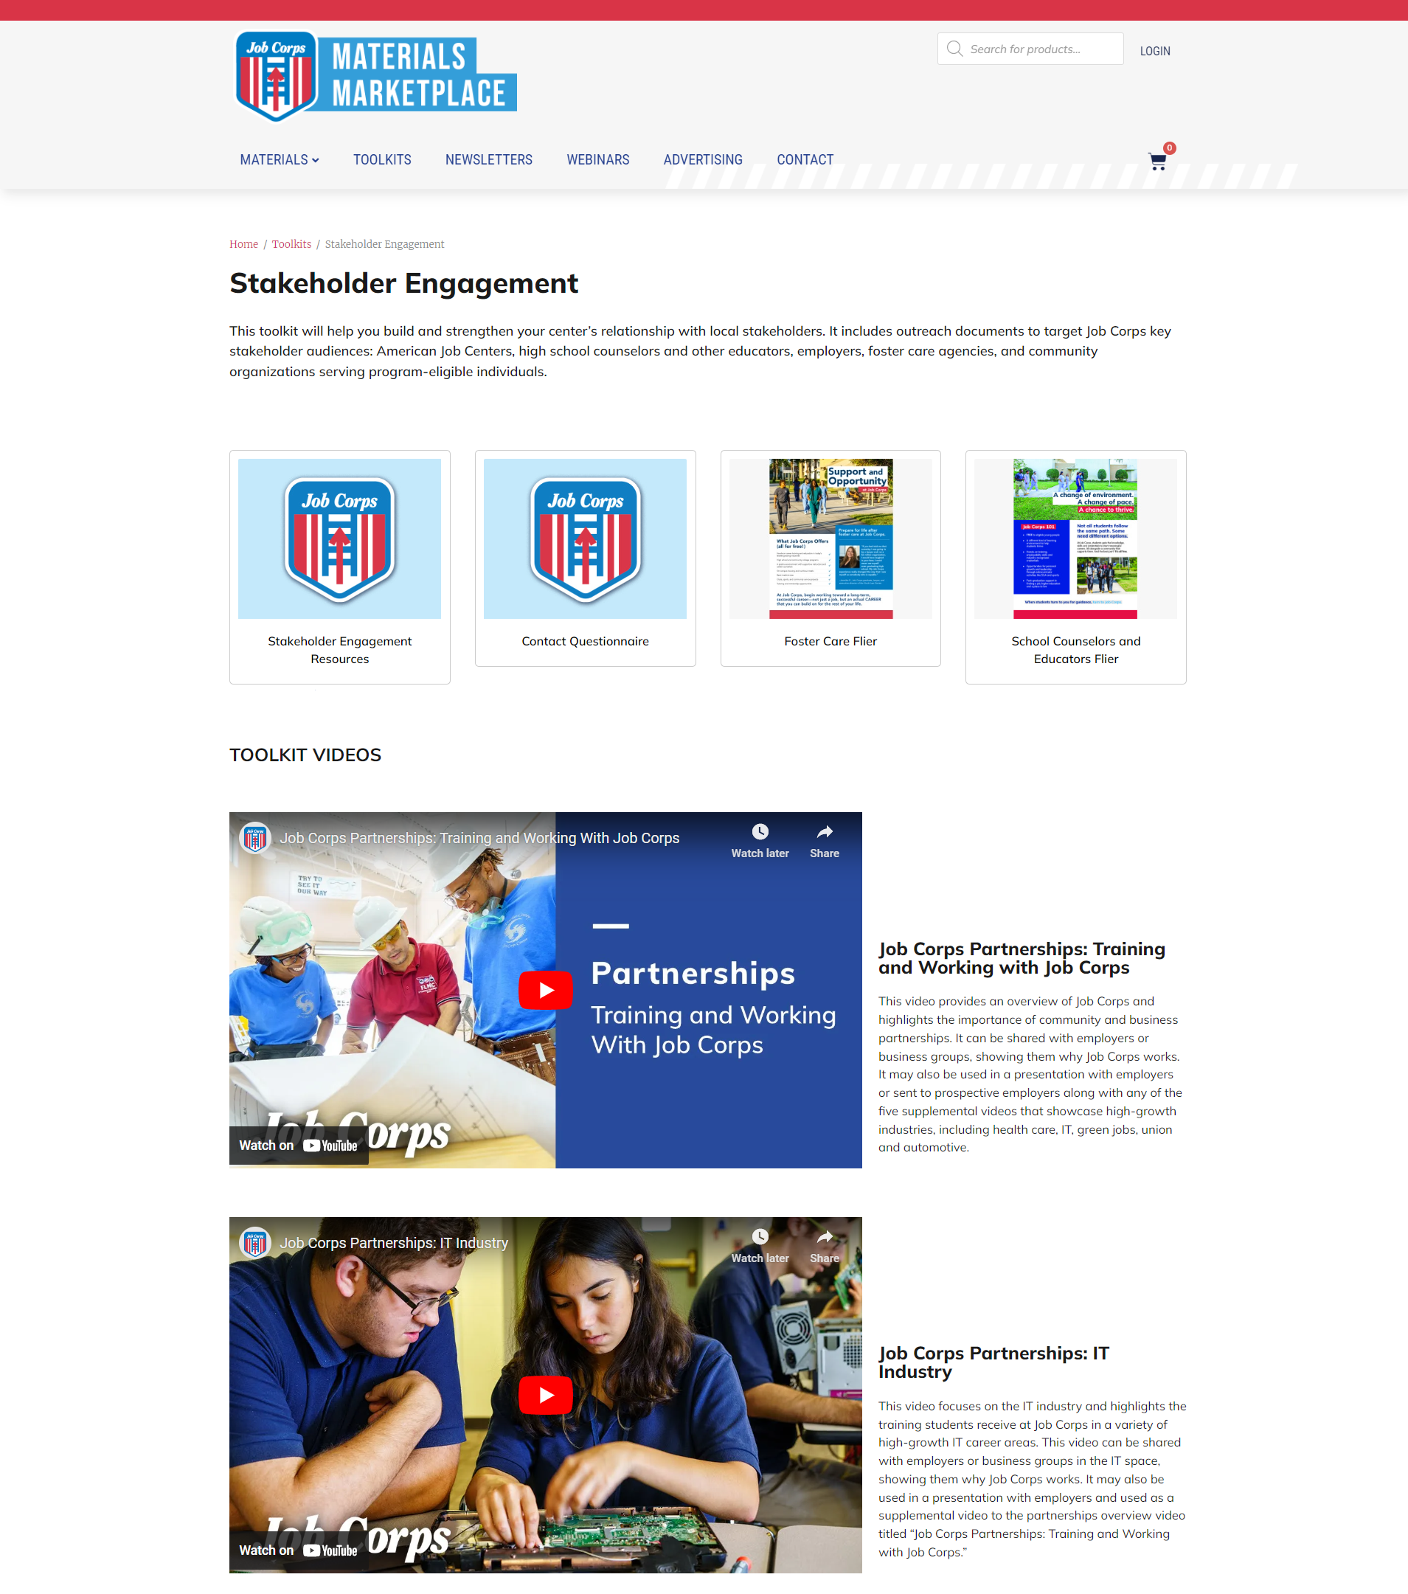
Stakeholder Toolkit
www.jcmarketplace.com
Notes:
I know I mentioned this stakeholder engagement toolkit earlier in the presentation, but let's take a closer look as to what's contained in this toolkit.
As you will see on the screen, we have created outreach templates to introduce the program and start the conversation around Job Corps with a variety of groups from employers to foster care agencies to school counselors and more.
The five key audiences are:
•American Job Centers (Career One-Stops)
•High school counselors and other educators
•Employers, Chambers of Commerce and business leaders
•Foster care agencies, social services and youth shelters
•Community organizations serving program-eligible individuals (Boys and Girls Clubs, community recreation centers, LGBTQIA+ organizations, and organizations for young people experiencing homelessness)
The materials include introductory e-mails and meeting talking points, as well as a landing page for stakeholders to access informational materials and sign up for more information. These toolkits are available on the Materials Marketplace under the toolkits section.
We also have a playlist of Stakeholder videos that you can share employers and businesses to show them the success that other groups have had by working with the program. We have a general video as well as specific videos for the health care, IT, green jobs, union and automotive industries. On this page is also where you will find the foster care and school counselor flier as well as a link to where you can submit your stakeholder and influencer contacts to include in the National Job Corps Stakeholders Database.

Slide 18
Leverage Social Media
Facebook Student-generated content Success Stories Third-party content Recruiting events
Instagram Student takeovers Student-generated content
Twitter Success Stories Quote graphics Student-generated content
YouTube Video testimonials and stories
LinkedIn Work experience Community partnerships
Notes:
There are lots of ways to leverage social media. So many that this topic has an entire training webinar dedicated to doing just this. For this reason, I won’t spend too much time today discussing Job Corps' social media strategy, but I do think it’s important to at least mention it.
Here on the screen, you can see how Job Corps presents content differently for each social media channel. What makes Job Corps’ organic social media presence so important, and such a great brand awareness and recruiting tool, is that it gives prospective students an inside look at real students, real centers and a real-life view of the program.
On Facebook, Job Corps shares student-generated content; graduate success stories; third-party content shares, such as positive news articles and blog posts; student and graduate quote graphics; community service; and graduation photos.
Instagram is also an incredibly important social media platform, especially considering its increasing popularity with younger audiences. On Instagram, Job Corps focuses on student takeovers, as well as student-generated, re-posted content. Student-generated content is a kind of grassroots, authentic content that plays incredibly well with potential students, and helps them get to know Job Corps and form personal connections with the page.
As X, formally known as Twitter continues to grow it's audience, the program is focused on sharing success stories, quote graphics and student-generated content. There is a lot of opportunity with this platform to reach not only prospective students, but also community influencers and employers.
The newest addition is LinkedIn, which just launched in the spring and already has more than 15,000 followers. This platform helps connect students with employers, jobs and networking opportunities. It also positions Job Corps as a thought leader in the skilled trades and workforce development. Content on this platform features partnerships with major employers and organizations, industry articles, blogs, and more.
Videos are one of the best tools out there when it comes to sharing an inside, behind-the-scenes look at Job Corps. On YouTube, we feature real students at Job Corps. With videos, and all content for that matter, we try to take a cue from students and what they’re into online. For example, the “Day in the Life”/blogger-style photos and videos are incredibly popular across social media, so we thought ‘why not apply this model to Job Corps?’

Slide 19
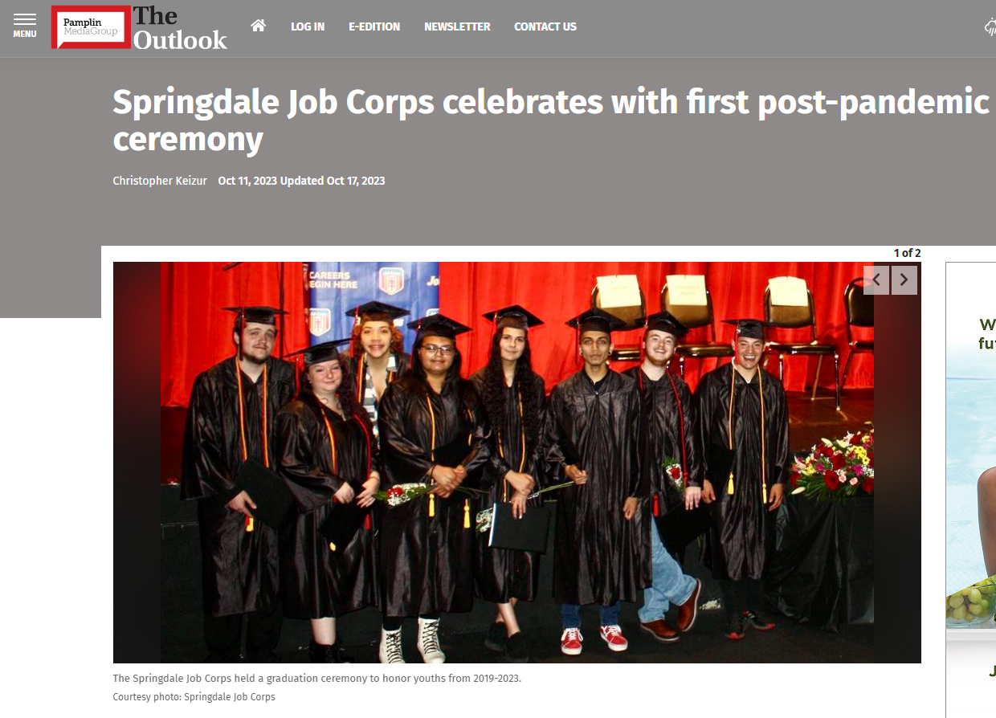
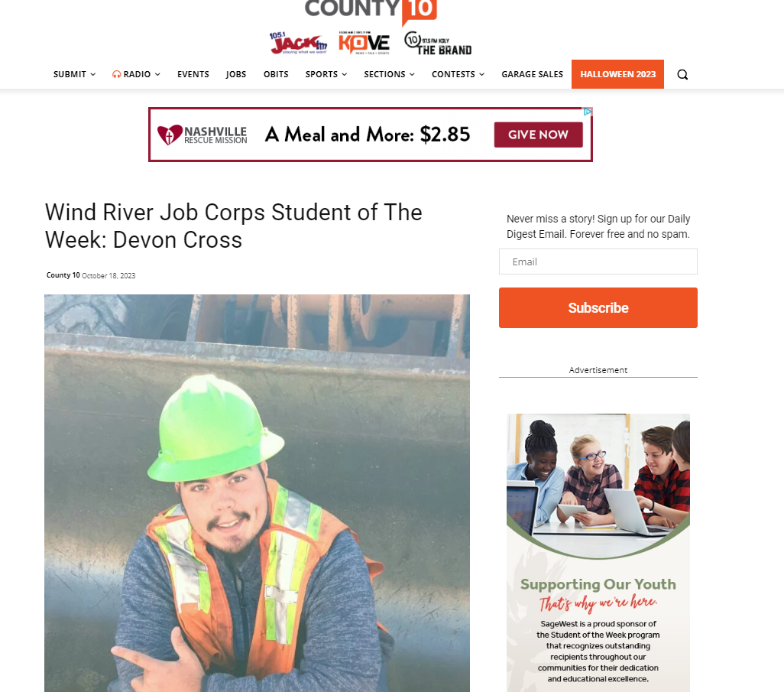
Leverage Local Media
Notes:
Another great way to reach prospective students and their influencers is by sharing information with the community through newspapers and TV and radio stations. Your local news outlets are powerful resources. On the screen, you will see a few examples of Job Corps centers making local news recently.
If you are having a open house or campus tour or even a graduation down the line, think about sending out a news release to your local media. If media can’t attend the event or it’s just not possible to bring outside visitors on campus, take the initiative to send them photos and descriptions after the event. You never know—they may include them in their publication or post them online.
Regardless of what topics you'd like your local media to cover, you will need to get both your Regional Office and DOL's Office of Public Affairs involved in this process so that they can help you oversee the protection and needs of the center and the students.
Our office offers two resources to help with your earned media efforts. The first is a media outreach toolkit that contains various promotional templates that you can use as you spread the word about Job Corps in your community. It includes a media outreach tip sheet, a recruitment media release and radio ad scripts. The second resource is a local media outreach training that takes you through the entire approval process while also sharing key tips to help you execute your own media strategy. Both of these resources can be found on the Materials Marketplace.

Slide 20
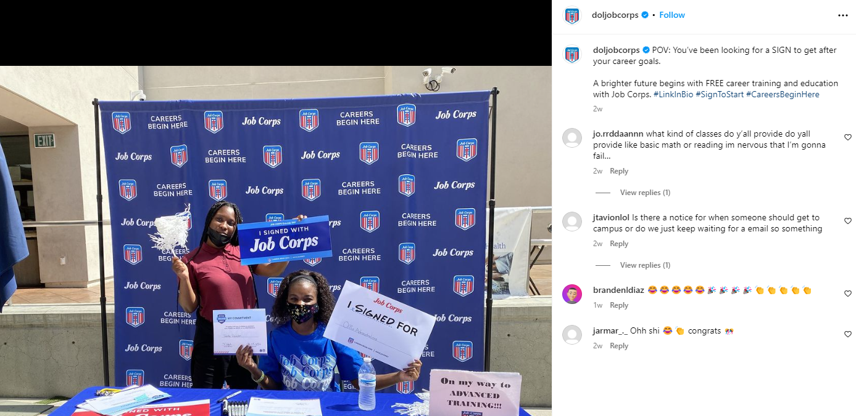
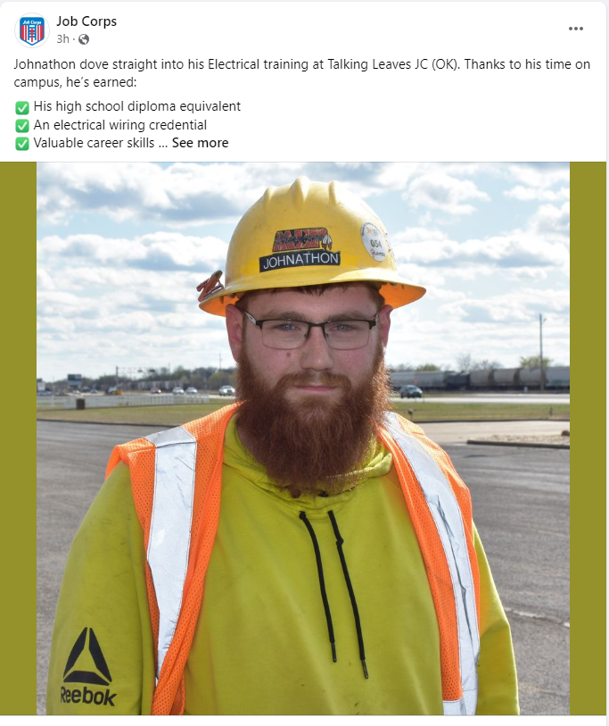
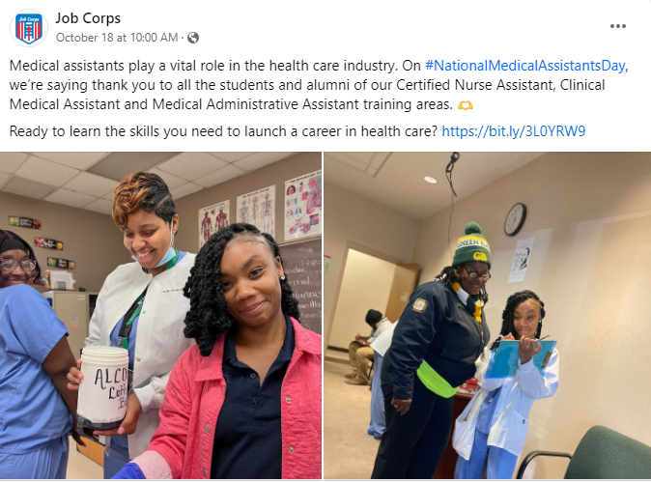
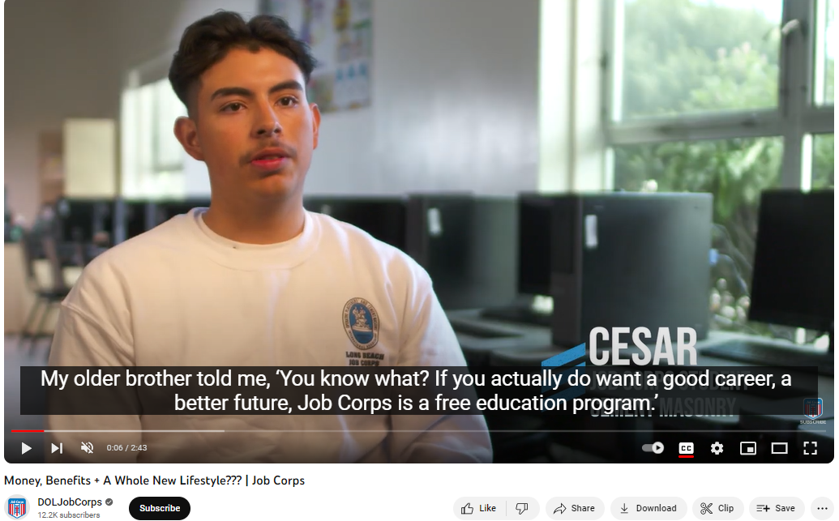
Leverage Social Media
jcdigital@mpf.com
Notes:
As I mentioned in the last slide, if you want to learn more about Job Corps’ social media strategies and how to submit content so your center or students can be featured on the platform, be sure to check out the webinar “Job Corps Digital Outreach Strategies.” It is offered several times a year, and you can register through the JCDC training schedule. You can also feel free to e-mail jcdigital@mpf.com as well, and our team will be happy to assist you and answer any questions you have. We've included the e-mail on the screen.
But honestly, the fastest and most efficient way for you to leverage Job Corps social media channels is to make sure you like and follow ALL the platforms, engage with the content - like posts, make comments on posts, and SHARE the content on your own social accounts.
On the screen, you will see a few of the top-performing social posts. They depict students volunteering, graduating, working in their chosen field and even just having a candid conversation about the program. As you can see, our followers love seeing real Job Corps students in action, so be sure to submit content from your center to jcdigital@mpf.com to be featured.

Slide 21
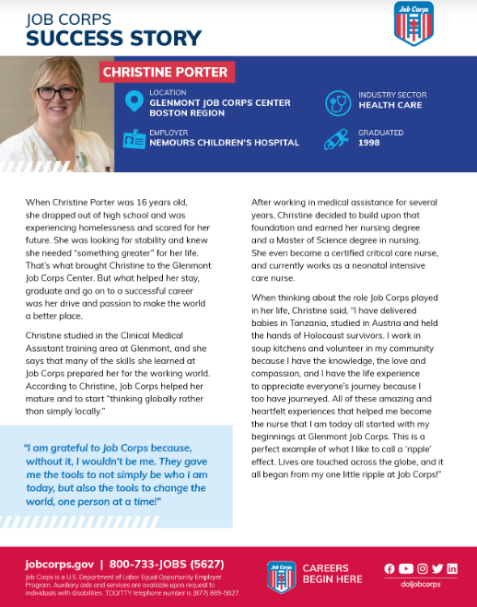
Success Stories
Jcsuccess.org
Username: doljobcorps
Password: CareersBeginHere
Notes:
Last but certainly not least, let’s talk about success stories. They provide a positive review of the program from the people who have actually gone through the experience. And for that reason, they’re more credible than you and I are. Job Corps uses them in many, if not all, of the marketing materials, because they enable a connection between two groups of people: successful Job Corps students and graduates, and prospective students and influencers.
Job Corps focuses so much on promoting success stories because the program’s target audience tells us to do so. When we conduct focus groups with prospective students, we ask them this question: Would you rather hear from famous people or influencers, or would you rather hear from the actual students and graduates? Prospective students overwhelmingly want to hear from real Job Corps students and graduates. Through these success stories, we make a connection … to help the reader start thinking—How am I like this person? Or do I know someone like this person?
That's why we encourage you all to use success stories in your outreach efforts. We have hundreds of stories available for download on JCSuccess.org so that you can find the perfect one to relate to the prospect you're working with by choosing a specific industry, gender or center. We will also be hosting a success story staff training next month to dive into the platform as well as best practices when it comes to success stories.

Slide 22

Contact Us
615-259-4000
jobcorpsmaterials@mpf.com
Thank you!
Notes:
Well, I think we have covered everything, and this will conclude the training today. I know that was a lot of information to take in, so please feel free to ask any questions about the topics we covered today. And please remember this training is available on the Materials Marketplace if you would like to review it again on your own time.
At this time, we’ll be dropping a survey link into the chat box. We appreciate any and all feedback in regard to this presentation.
If you have any questions about this presentation, you can either call or e-mail us and we’d be happy to help you. Our phone number and e-mail address are on the screen.
Thank you so much for joining me today.

