Slide 1






COMMUNITY OUTREACH TOOLKIT
STAFF TRAINING WEBINAR
Notes:
Hi, everyone. Thank you for joining me for today's training on our new community outreach toolkit. My name is XX, and I work for MP&F Strategic Communications.​
​
We are the communications support contractor for Job Corps, and are responsible for creating national recruitment materials, coordinating Job Corps’ national advertising campaigns, and managing the program’s social media accounts on Facebook, YouTube, Instagram, and LinkedIn. We also do many other things as well, but these are some of the main ways that we support the Job Corps National Office. ​
​
Before we begin, please add your name, center (or organization), and e-mail address into the chat box. This webinar will last about 45 minutes, including some time for Q&A at the end of the webinar. At any point throughout the webinar, feel free to type questions in the chat box at the bottom of your screen. Someone from MP&F will be monitoring the chat box and will respond to you or flag your question for discussion at the end. ​
​
OK, let’s jump in. ​

Slide 2

/// TODAY’S AGENDA
Community Outreach Toolkit Goals ​
Types of Outreach Events ​
Materials and Best Practices ​
Materials Marketplace/ Additional Resources
Notes:
First, here’s an overview of what we’ll discuss today.
Now many of you may already host employer-focused events like career fairs on a regular basis, which is great. You are already ahead of the game. ​
​
But even if you already do or don't host these types of events on your campuses, I think the toolkits we will be discussing today will be really helpful for everyone, as they contain a lot of helpful resources that will help you plan and execute successful outreach events. ​
​
So today's webinar will go into detail about the Community Outreach Toolkit and its importance in executing events for different audiences. ​
​
I'll break down the types of events your center can hold, along with the goals of each event, and we'll look at the event materials available in the toolkit and review best practices on how to use them. ​
​
Finally, we'll dive into where you can find these materials and additional materials for employer and workforce audiences to aid you in your events.​
​
We'll be covering a lot of information today, but don't worry. This training will be available on the Materials Marketplace, and we will be sending you a follow-up e-mail that includes a link to where you can find the training and the toolkit materials. ​

Slide 3
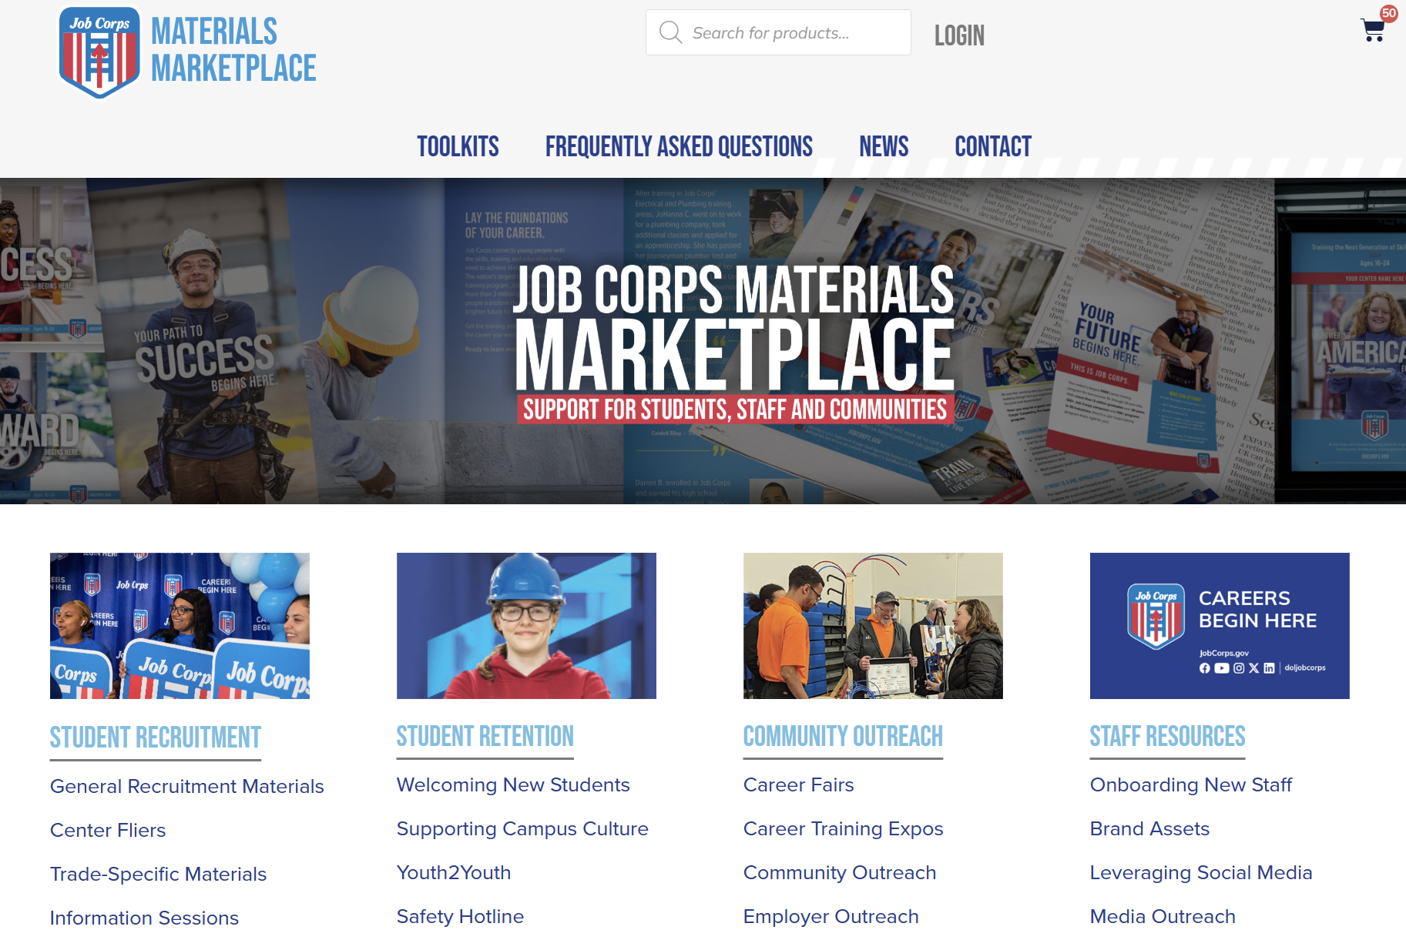
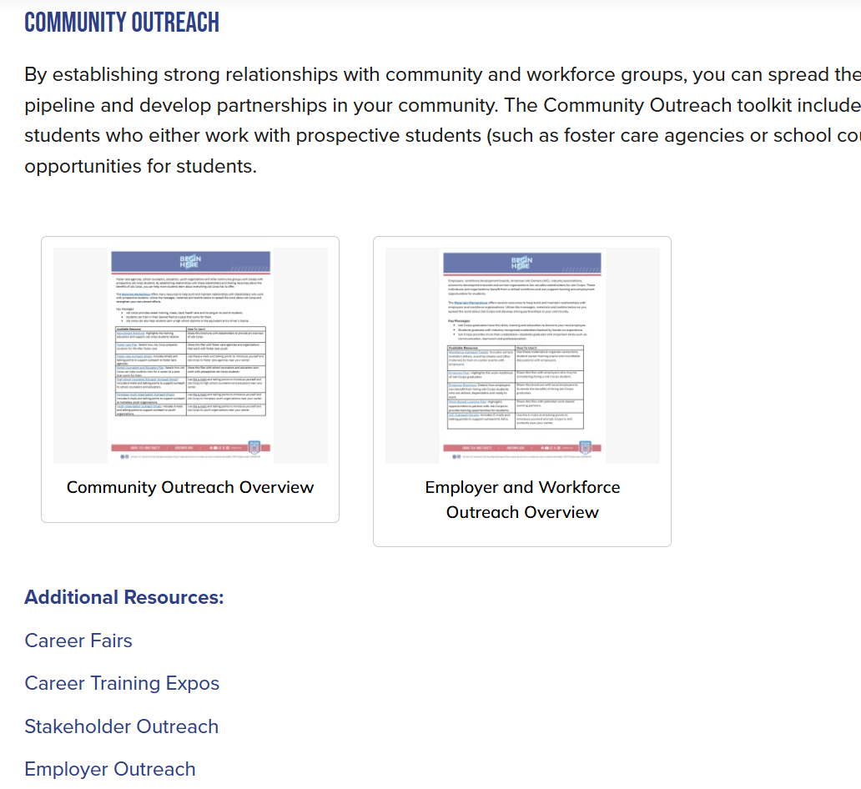
/// COMMUNITY OUTREACH TOOLKIT
Notes:
Let’s start with our “why” today. Why is community outreach important? By establishing strong relationships with community and workforce groups, you can spread the word about Job Corps, create a stronger recruitment pipeline and develop partnerships in your community.
The Community Outreach toolkit includes materials to help build and maintain relationships with organizations that either work with prospective students (such as foster care agencies or school counselors) or may support training and employment opportunities for students.
​
A great way to connect with new employer and community partners is to bring these organizations to your campus, so they can see firsthand all the great opportunities the program provides for students and graduates. ​
​
The toolkit contains many helpful resources such as event planning tips and guidelines, templates for invitations, programs and media advisories, and much more. ​
​
The first and most important step for hosting any event is to establish a clear goal that is based on the specific needs of your center and students.​
​
So – what I mean by that is – first you need to determine what type of outreach event would benefit your center the most. Some questions to ask yourself could be: ​
Do you have a large group of students ready to graduate and in immediate need of entry-level jobs?​
Do you need to build relationships with local employers and secure more work-based learning partnerships?​
Do you need guidance from local employers on training curriculum and/or industry trends?​
Do you need to build stronger recruitment pipelines within your local community?
​
The answers to these questions will help you determine which type of event your center should host to best meet the needs of students and community stakeholders. We will discuss the three different types of events your center can hold in the next slide. ​

Slide 4
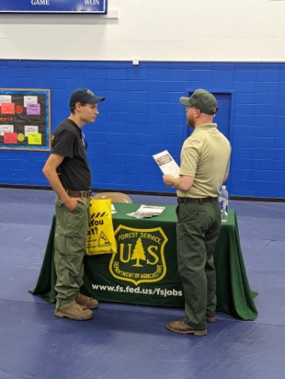
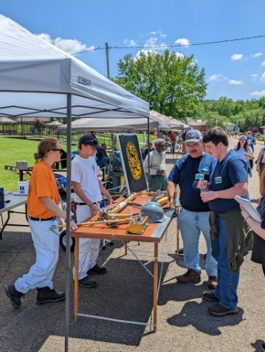
/// TYPES OF EVENTS
Student Career Training Expo ​
Career Fair ​
Employer Roundtable ​
Notes:
As I mentioned before, the toolkit has materials for three event types for your center. Each event has its own materials and audience-specific resources to help reach your individual center's employer-focused goals. ​
​
The first type of event is a Student Career Training Expo. The goal of this event is to highlight/showcase your center's different hands-on training programs by inviting local employers and community leaders to see your students in action. This will help build and foster relationships with the workforce development community members and identify opportunities for new work-based learning partnerships. The Student Expo is ideal for centers who are looking to reengage with local employers and introduce new employers and workforce entities to the program. By setting up booths for each career training area that are student-led (with support from instructors), your center has a great opportunity to show potential partners the types of skills students are learning and how their training is preparing them for the workforce. It also gives employers the chance to ask questions and engage with students one-on-one. A key component to this type of event is also the coordination of tours of the training classrooms. In addition to the student-led training booths, if your center is able to coordinate the logistics of taking the attendees to the training classrooms where they can see students in action and see the type of equipment they are training on, that is highly recommended as well. The more engaging and interactive the event, the better. ​
​
The second type of event is hosting an Employer Career Fair. This type of event may be the one that your center is the most familiar with, as it strives to connect soon-to-be Job Corps graduates with employers looking to hire and fill open positions. A career fair is ideal for centers who have a large or fairly large population of students who are graduating soon. In this type of event, you are inviting employers to come and set up booths on campus – probably in the gym or other large area on campus that can hold a lot of people. The employers are there to sell their companies to potential employees – providing them with information about the types of jobs they are hiring for, job expectations, job benefits, how to apply for open positions, etc. This event is also a great opportunity to set up for interviews where employers can interview students on the spot. The goal of course is to connect as many soon-to-be graduates with future employers as possible – so make sure they are ready – dressed for success, resumes printed and proofed, rehearsed answers for interview questions, etc. ​
​
The third event is an Employer Roundtable. The ultimate goal of this event is to gather feedback from employers on their hiring needs and expectations, their interest in potential partnerships, and their thoughts on your centers training curricula and equipment. The roundtable event is a little different in the other two events in that it is more of a facilitated discussion than an expo or fair. This event is more like a networking breakfast or luncheon. You are inviting audiences like employers, workforce councils, community organizations and leaders, elected officials, etc., to join you and your center team for a morning or afternoon discussion about workforce-related topics and how Job Corps can help address local workforce needs. This event (and the other two events) will most likely have an official program with guest speakers. Then after the official program, each table – which we recommend are grouped by industry -- will be prompted to have meaningful conversations, and each table will have a facilitator and prompt cards to keep the conversation going. ​
​
OK – so those are the three events the toolkit covers. Next, we are going to dive into the materials.

Slide 5
/// AVAILABLE MATERIALS
Event Planning Tips and Timeline ​​
Program Speakers' Tip Sheet ​​
Invitation ​​
Invitation Letter ​​
Program ​​
Save the Date​​
Student Resume Template ​​
Employer Roundtable Discussion Prompts ​​
Pre-Event Media Advisory Template ​​
Post-Event Media Release Template ​​
Post-Event Survey ​
Notes:
Here is a comprehensive list of all the materials that are available to you in the Community Outreach Toolkit. We'll be explaining these materials more on the next slides and discussing best practices and for each resource. ​
​
Each of these resources has been tailored to the three specific events we just went over. And, many of them can be customized to meet your center's event needs. For customization of the PDF materials, please e-mail jobcorpsmaterials@mpf.com with enough time before your event to coordinate – ideally eight to 10 weeks before your scheduled event. We need enough time to customize the materials, and you will want to send out invitations six weeks or so before your event to get on people's calendars. ​

Slide 6
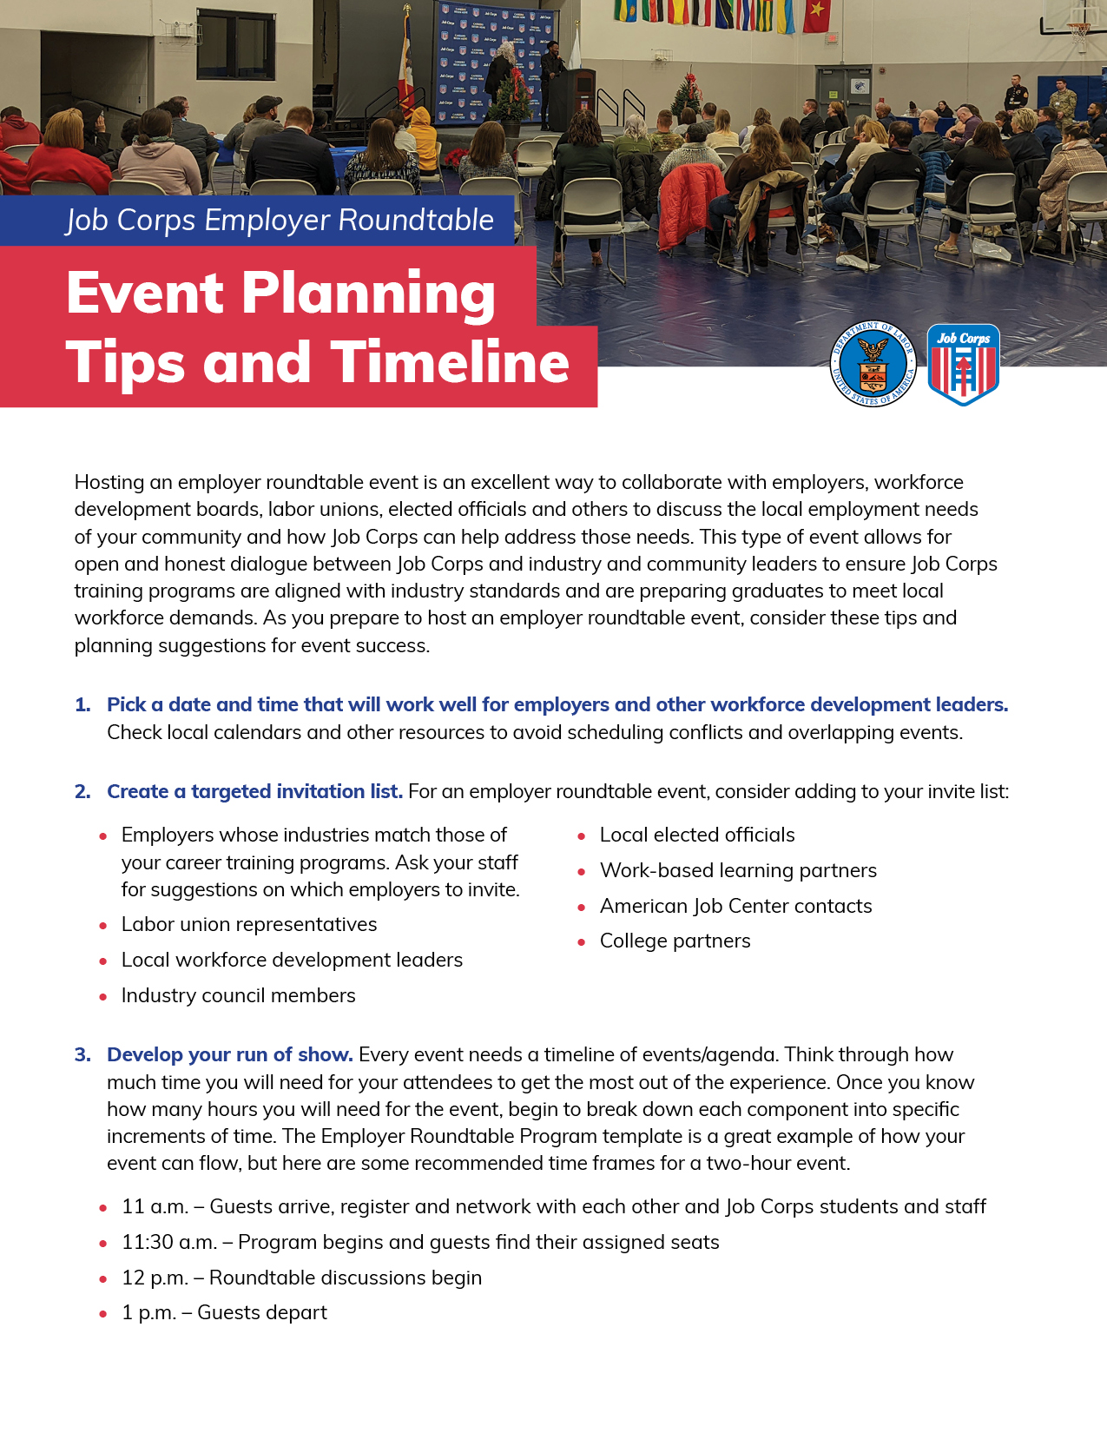
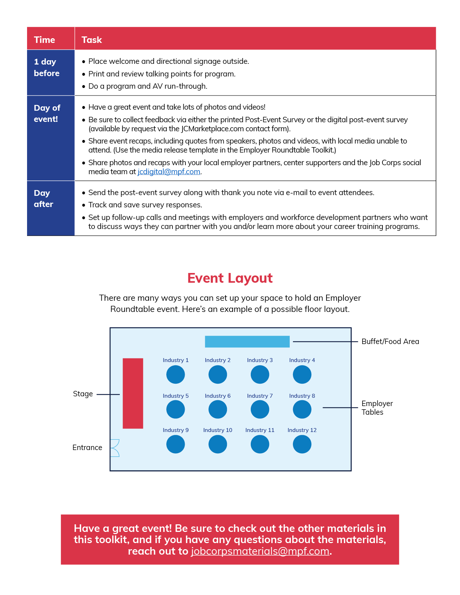
/// EVENT PLANNING TIPS & TIMELINE
Notes:
The first material is an event planning tips and timeline document to help you in setting up and running these events on your campus. ​
​
Hosting an event on campus involves a lot of preparation. For each event, we have compiled a list of tips and timelines for a successful event. ​
A few of our key tips include: ​
Picking a date and time that works well for your center, employers and students. ​
Creating a targeted invitation list. ​
Developing a run of show. ​
Generating excitement and preparing students ahead of time. ​
​
Along with our tips, the sheet lists out a very detailed event timeline that lists everything that needs to get done prior to the event, the day of the event and even the day after the event. Along with the timeline, we have also included an event layout suggestion for each of the three events. ​
​

Slide 7

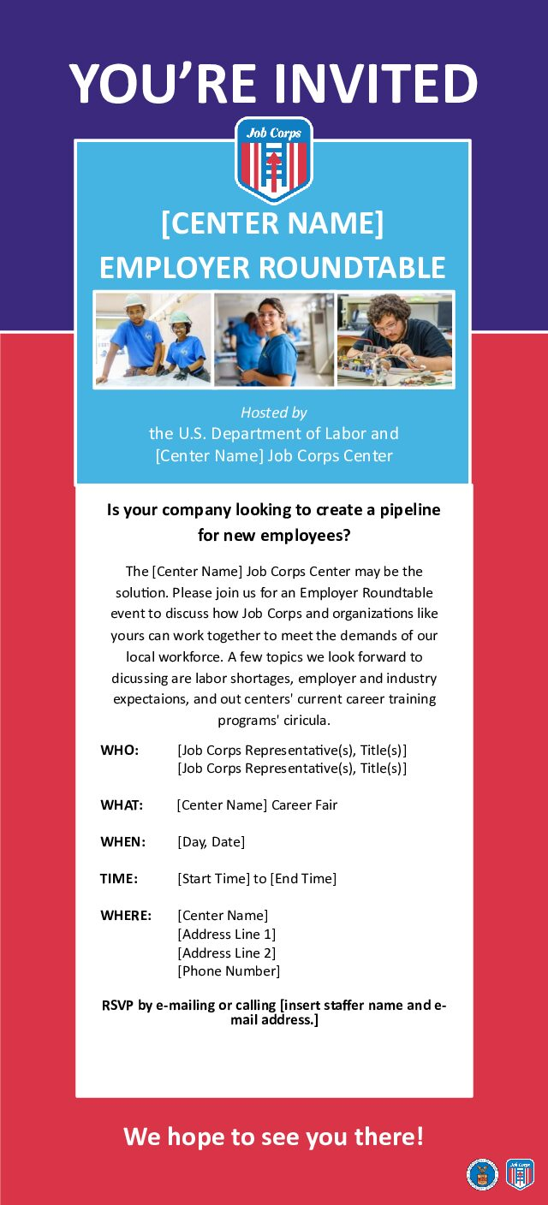

/// SAVE THE DATE & INVITES
Notes:
OK, so now you know what type of event you want to host and you have read the tips and planning guide to make sure you are set up for success. Now, it's time to get the event on your list of attendees' calendars! ​
​
This next material is a Save the Date and ensures that your event gets on your guests' radar early, reducing the likelihood of their committing to other engagements on the same date.​
​
Sending a Save the Date is important for any event as it serves as an early notification for the formal invitation. The Save the Date notifies guests about an upcoming event and allows them to plan their schedules, make travel arrangements, and/or avoid scheduling conflicts. ​
​
To have this material customized with your event information, you can e-mail our team at MP&F for customization at Jobcorpsmaterials@mpf.com.​
​
​So, if you send out the Save the Date about six weeks before your event, you will want to follow with an actual invitation about four weeks before the event. ​
​
Sending invitations either digitally or via snail mail is essential for your event and can impact the success and overall experience of the occasion. By sending out invitations, you can manage and gauge the interest and availability of your attendees. An invitation includes essential information such as date, location and purpose of your event to spark the interest of your guests. It also includes a way for guests to RSVP – so make sure to include that information as well. ​
​
E-mail jobcorpsmaterials@mpf.com to customize your invitation. ​
​
And finally, each toolkit also has more formal invitation letter. This letter is more for the potential partners and organizations that may not know much about Job Corps, and you are wanting to provide them with more of a formal introduction. This letter is totally optional and just available if you think it makes sense to send to any or all of your potential guests. ​
​
This letter is a document that you can edit on your own and customize to your needs – you don't need MP&F's help with this. ​
​

Slide 8
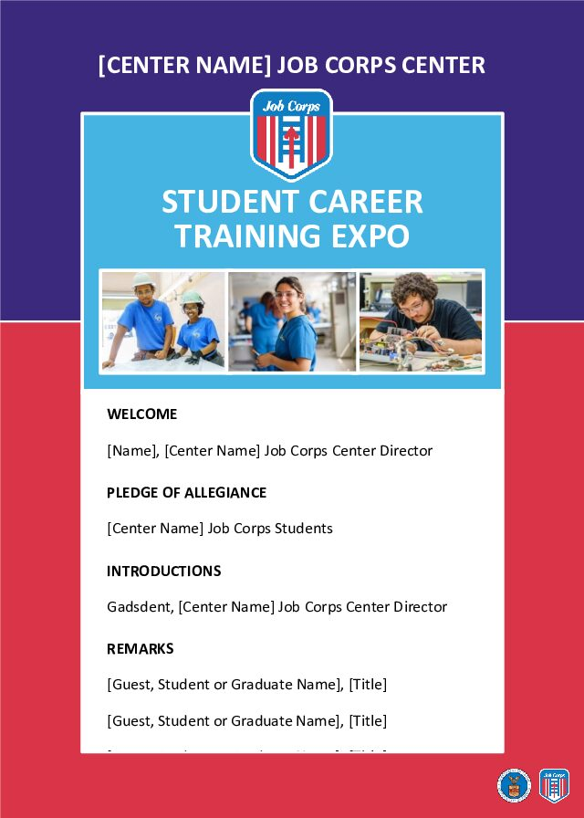
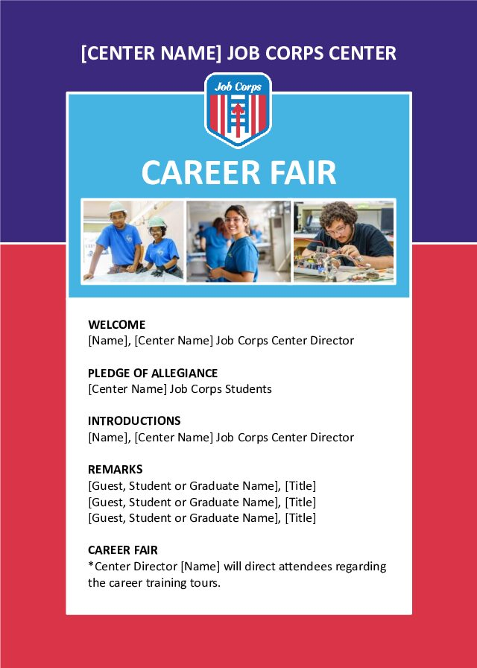
/// PROGRAM TEMPLATES
Notes:
As I mentioned, your event will most likely include a program of some sort with remarks by the center director, a featured employer, a Job Corps student or graduate, or even a DOL representative. ​
Every event needs a good program so attendees know what to expect and how to manage their time at the event. ​
​
The templated program outlines a standard run of show, including welcome remarks, the pledge of allegiance, speaker introductions, speaker remarks and the timeline for the main event – whether it's the expo, career fair or roundtable. The back of the program has a message about Job Corps and encourages attendees to work/partner with Job Corps in the future. ​
​
This program or outline should be used to make sure the event runs smoothly and that there is an understanding on what will take place during the event. E-mail our team for customization. ​

Slide 9
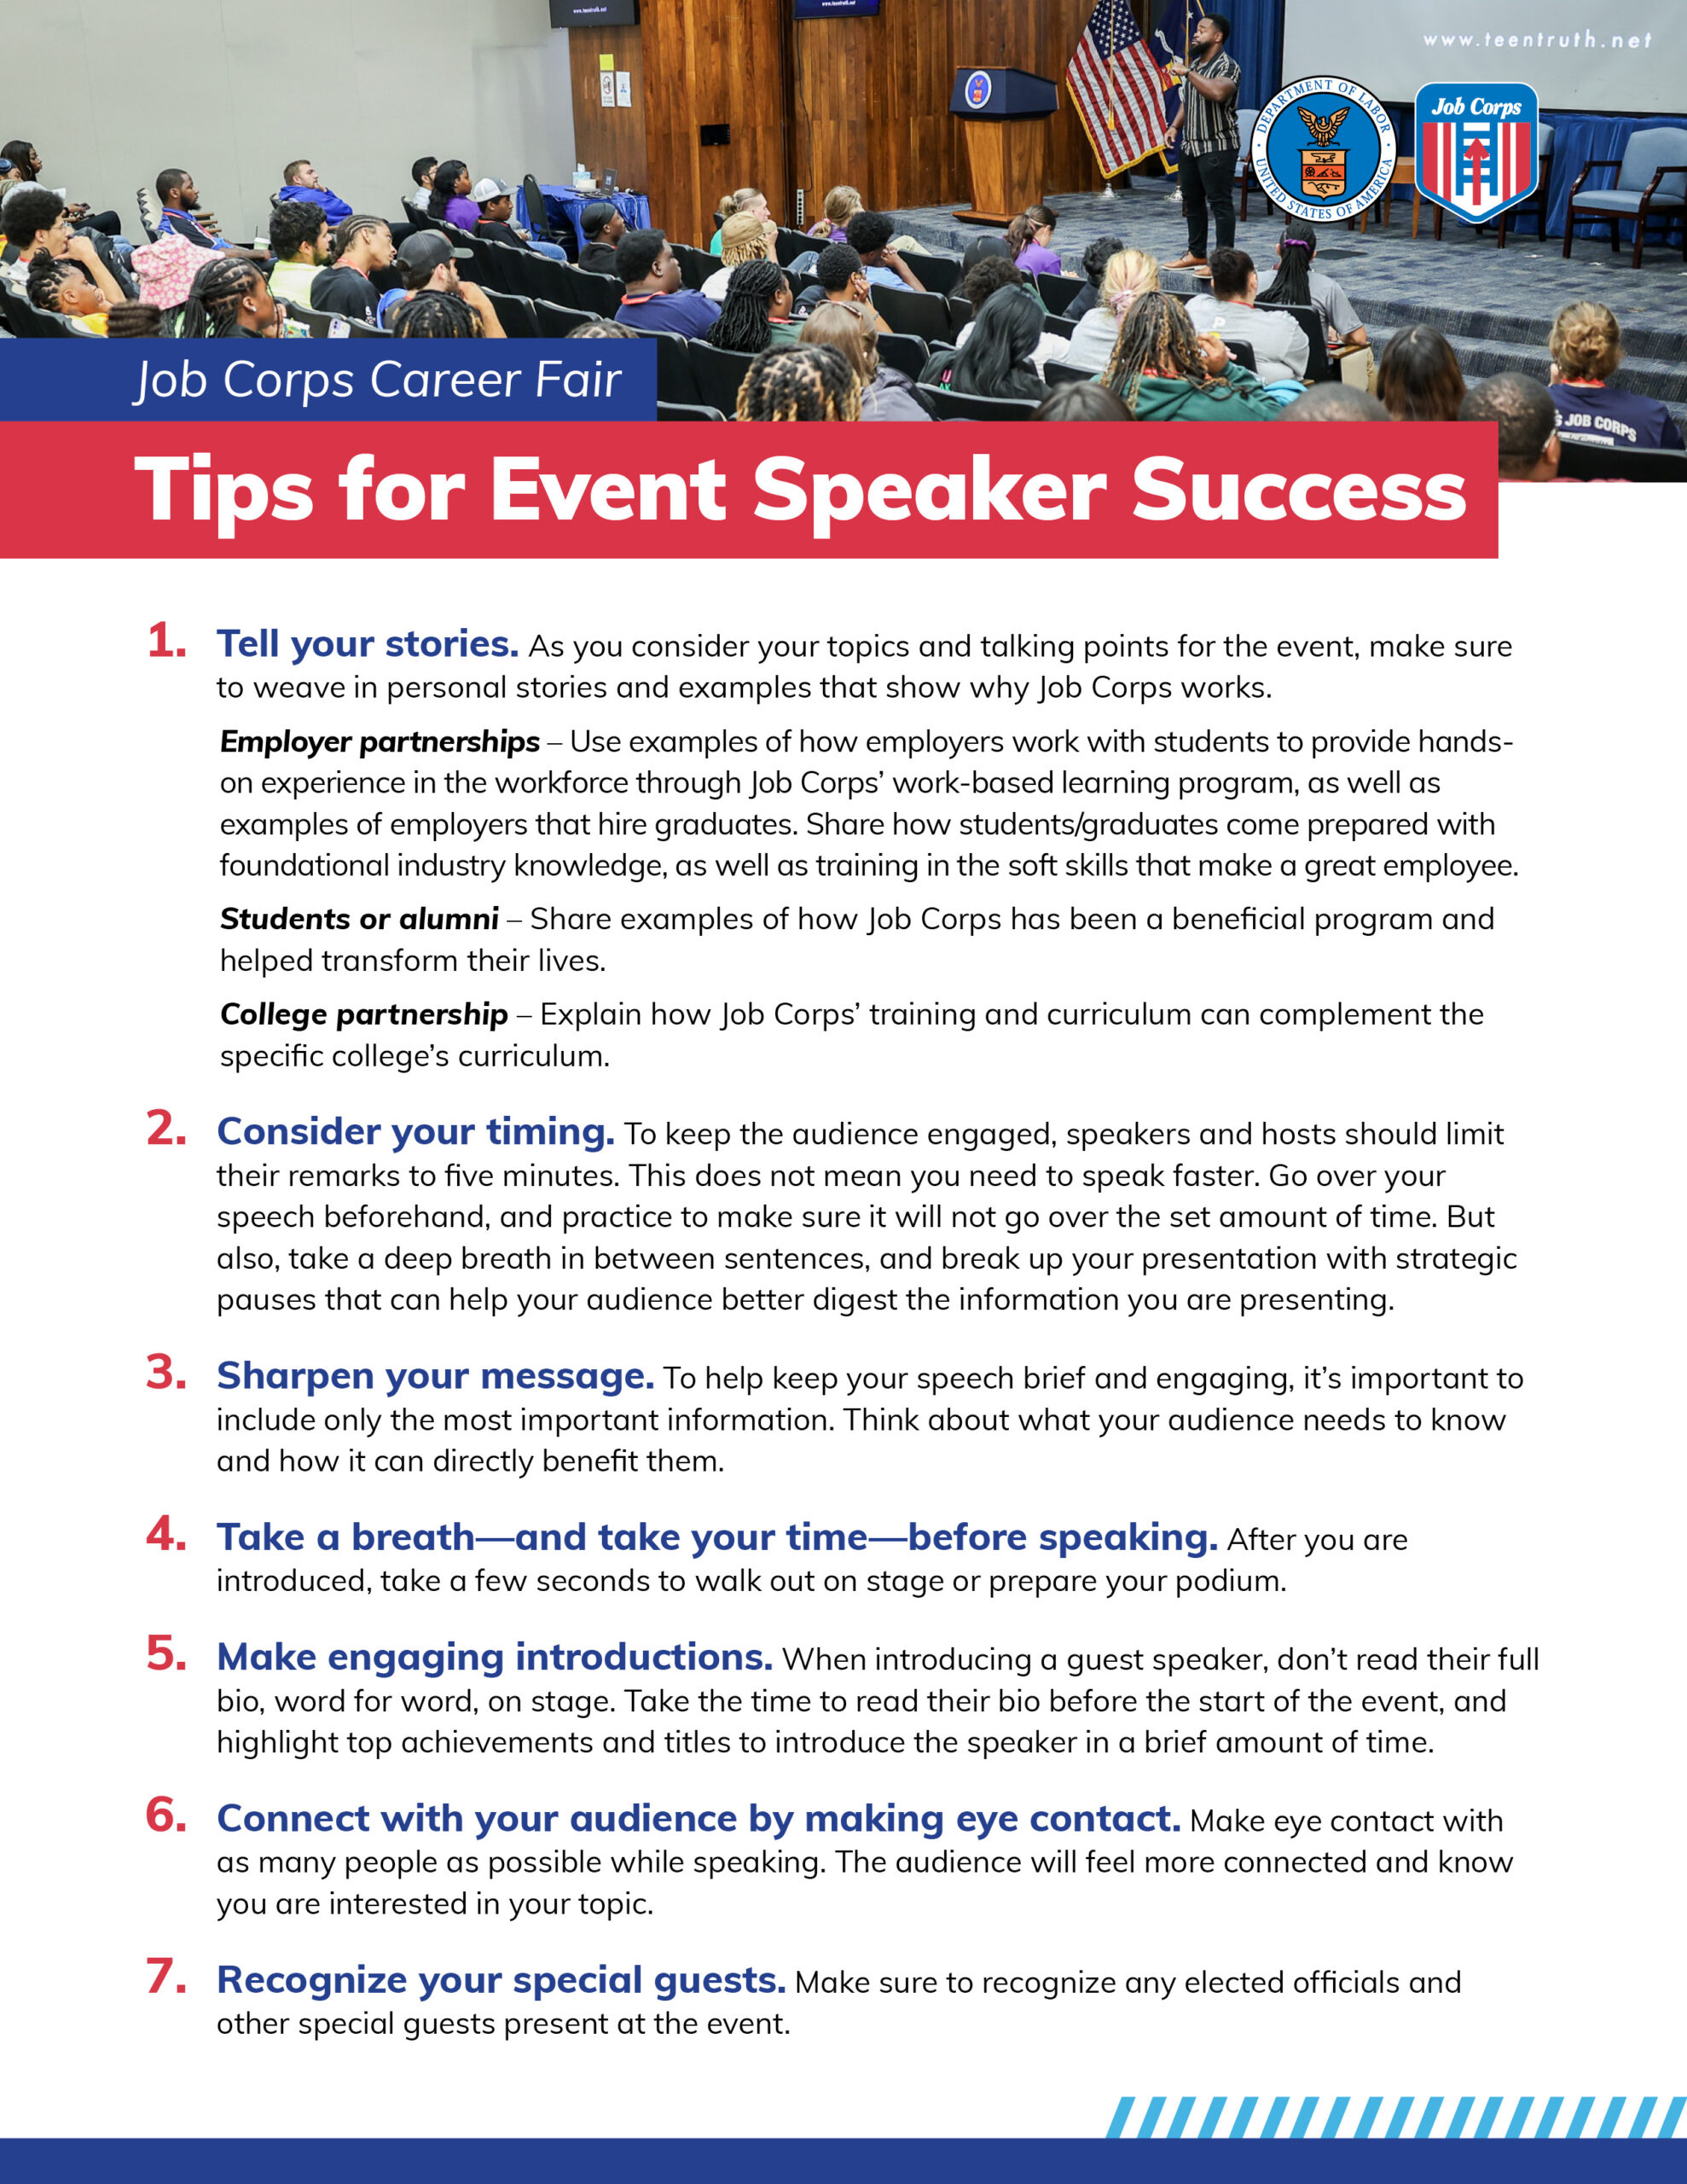
/// PROGRAM SPEAKER TIPS
Notes:
No matter who the identified speakers are for your event, the next material is a program speakers' tip sheet to aid you in making sure your speakers feel calm and confident. ​
​
This one-pager lists out our top seven public speaking tips to make sure it's a success.​

Slide 10

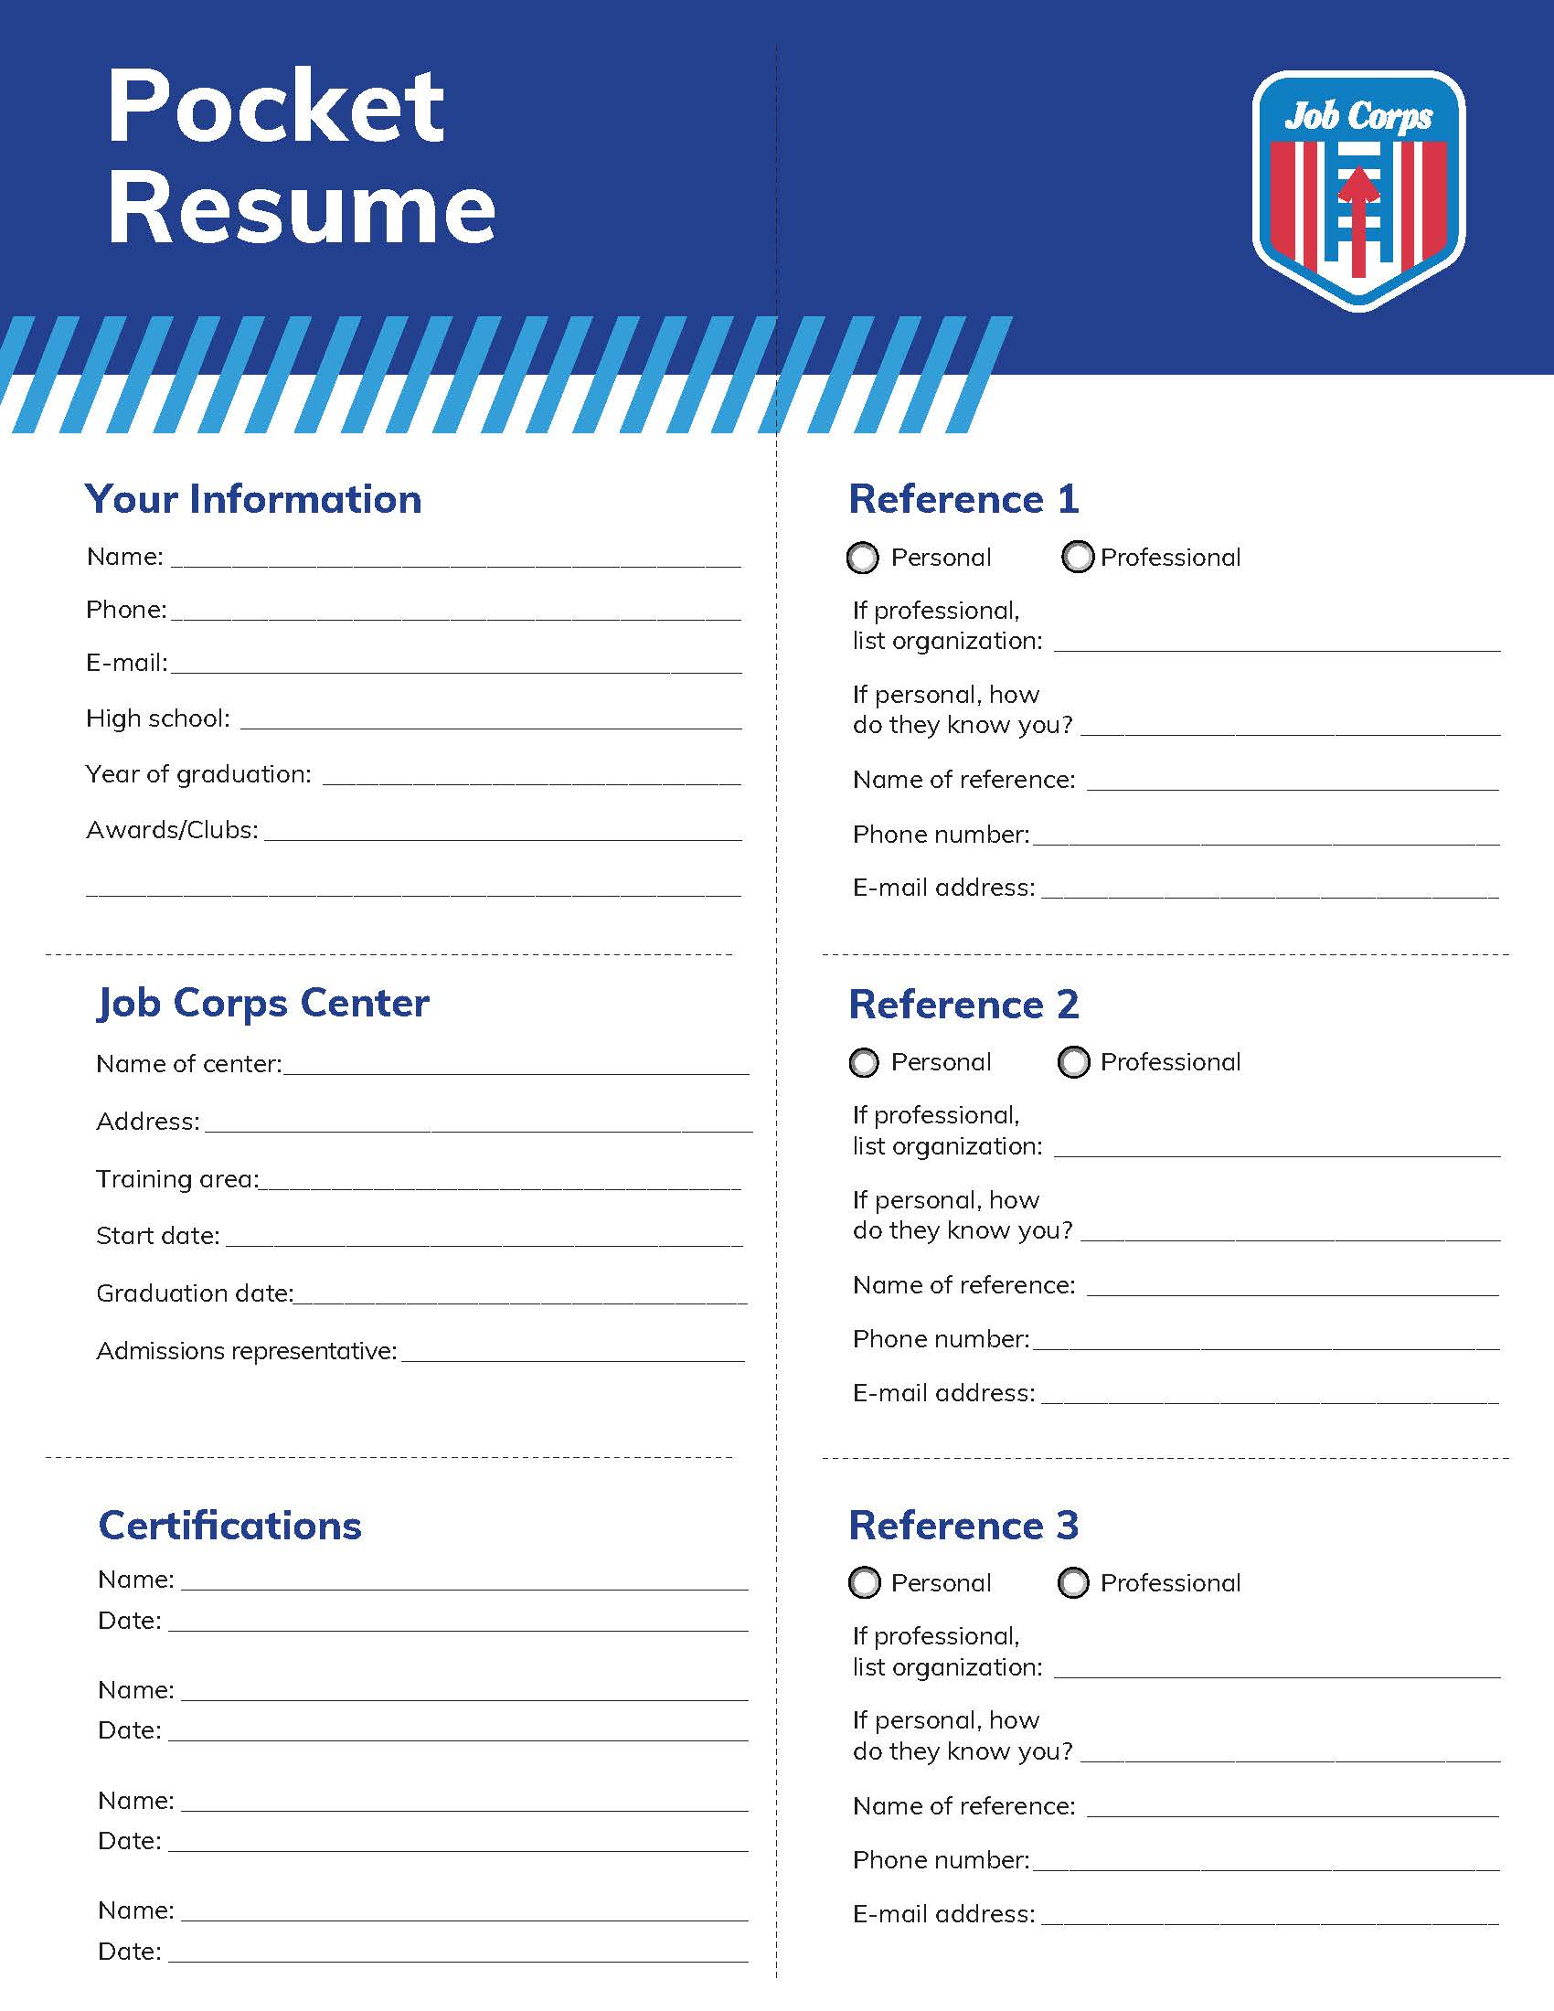
/// POCKET RESUME FOR STUDENTS
Notes:
This next material is great for career fairs and is something you should provide participating students with ahead of time.
This resume template provides students with a structured format on what information to include and how to present it effectively. It ensures the document looks organized, visually appealing and easy to read, making a positive first impression on potential employers. Students can download the template directly to their computer and edit the template.

Slide 11
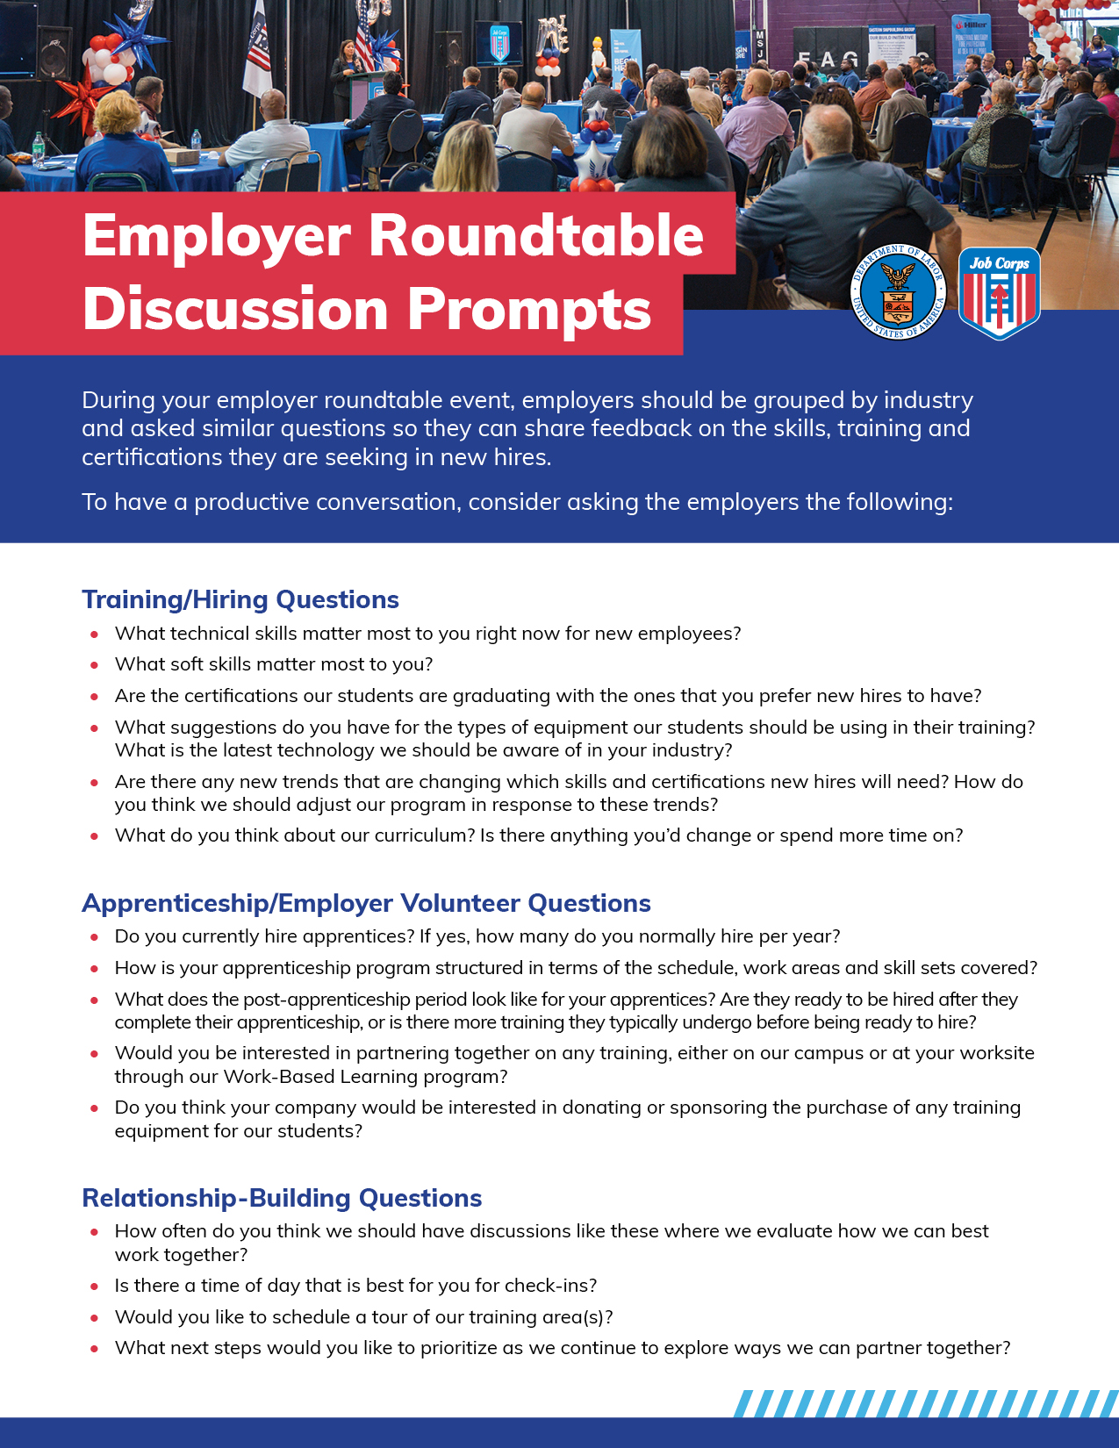
/// EMPLOYER ROUNDTABLE
Notes:
The next material is a document that is for the employer roundtable discussion event. I mentioned this earlier when I was talking about this event. This document contains several prompts that will help with conversation flow and building relationships.
The prompts spark productive conversation with employers and industry leaders.
Some prompts include:
What technical skills matter most to you right now for new employees?
Do you currently hire apprentices? If yes, how many do you normally hire per year?
What next steps would you like to prioritize first as we continue to explore ways we can partner together?

Slide 12
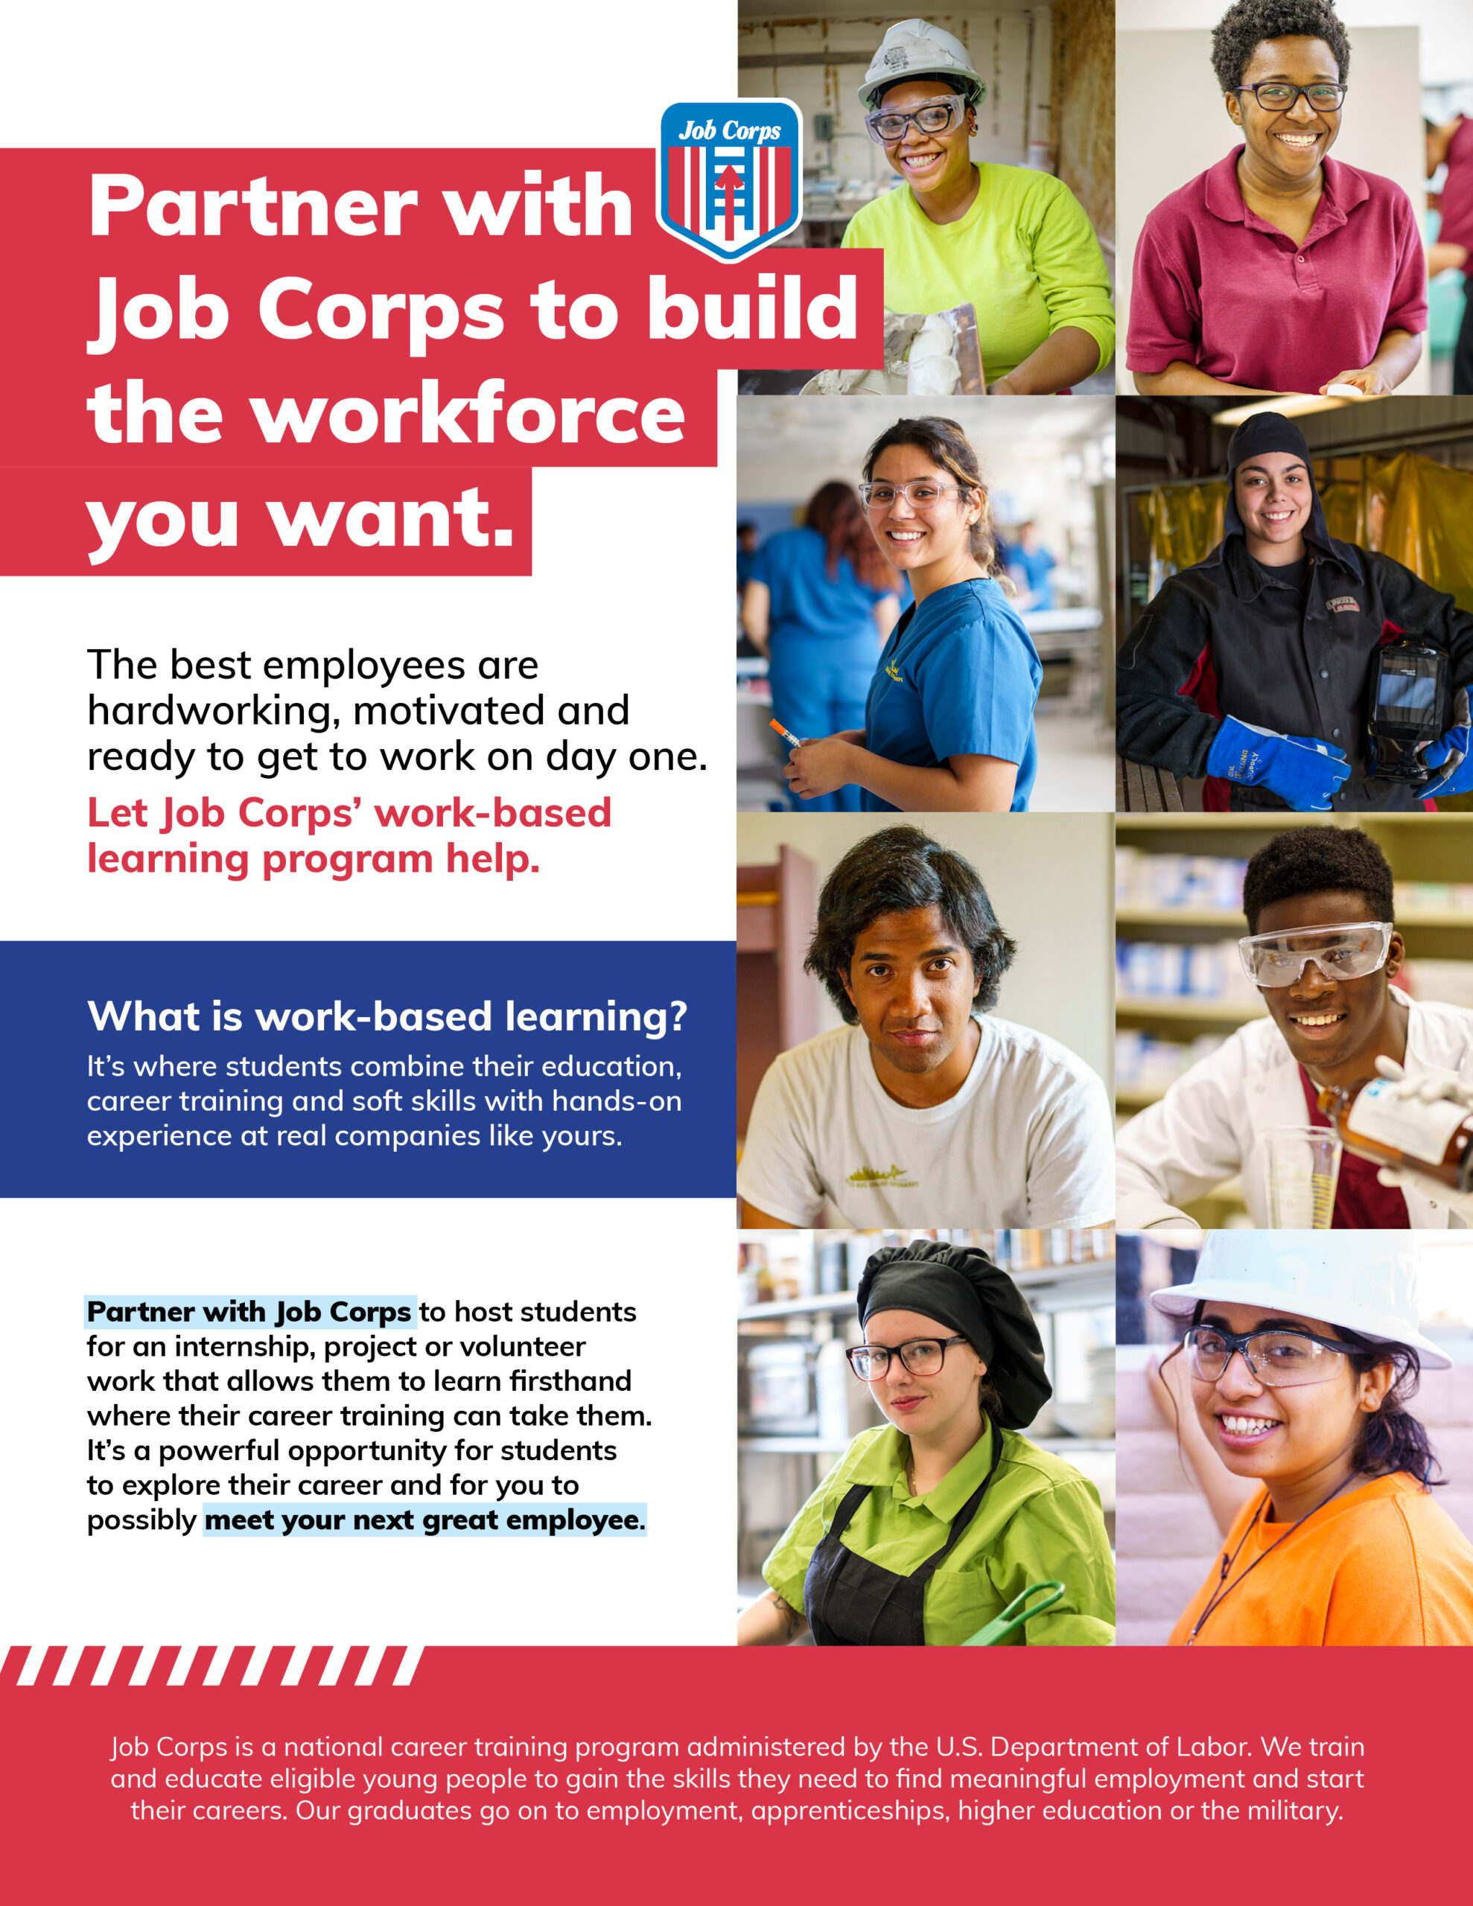
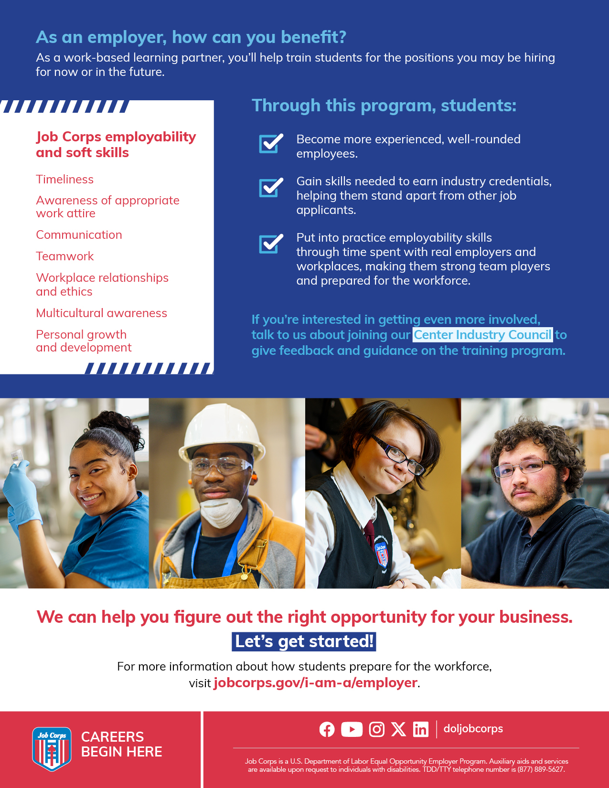
/// WORK-BASED LEARNING FLIER
Notes:
I also want to mention a few materials we have that can assist with employer outreach, whether at an event or other methods.
The work-based learning flier is a great material to inform employers about Job Corps successful partnerships and centers' work-based learning programs. The flier lists out what work-based learning is and how to set students up for success with hands-on experience in their career field.
It also informs employers how they can get involved with Job Corps and the benefits a partnership can bring, not only to the them, but to the students as well. It is suggested to share this flier with local businesses in the area and would be a great resource to hand out if your center plans on hosting a Student Career Training Expo.

Slide 13
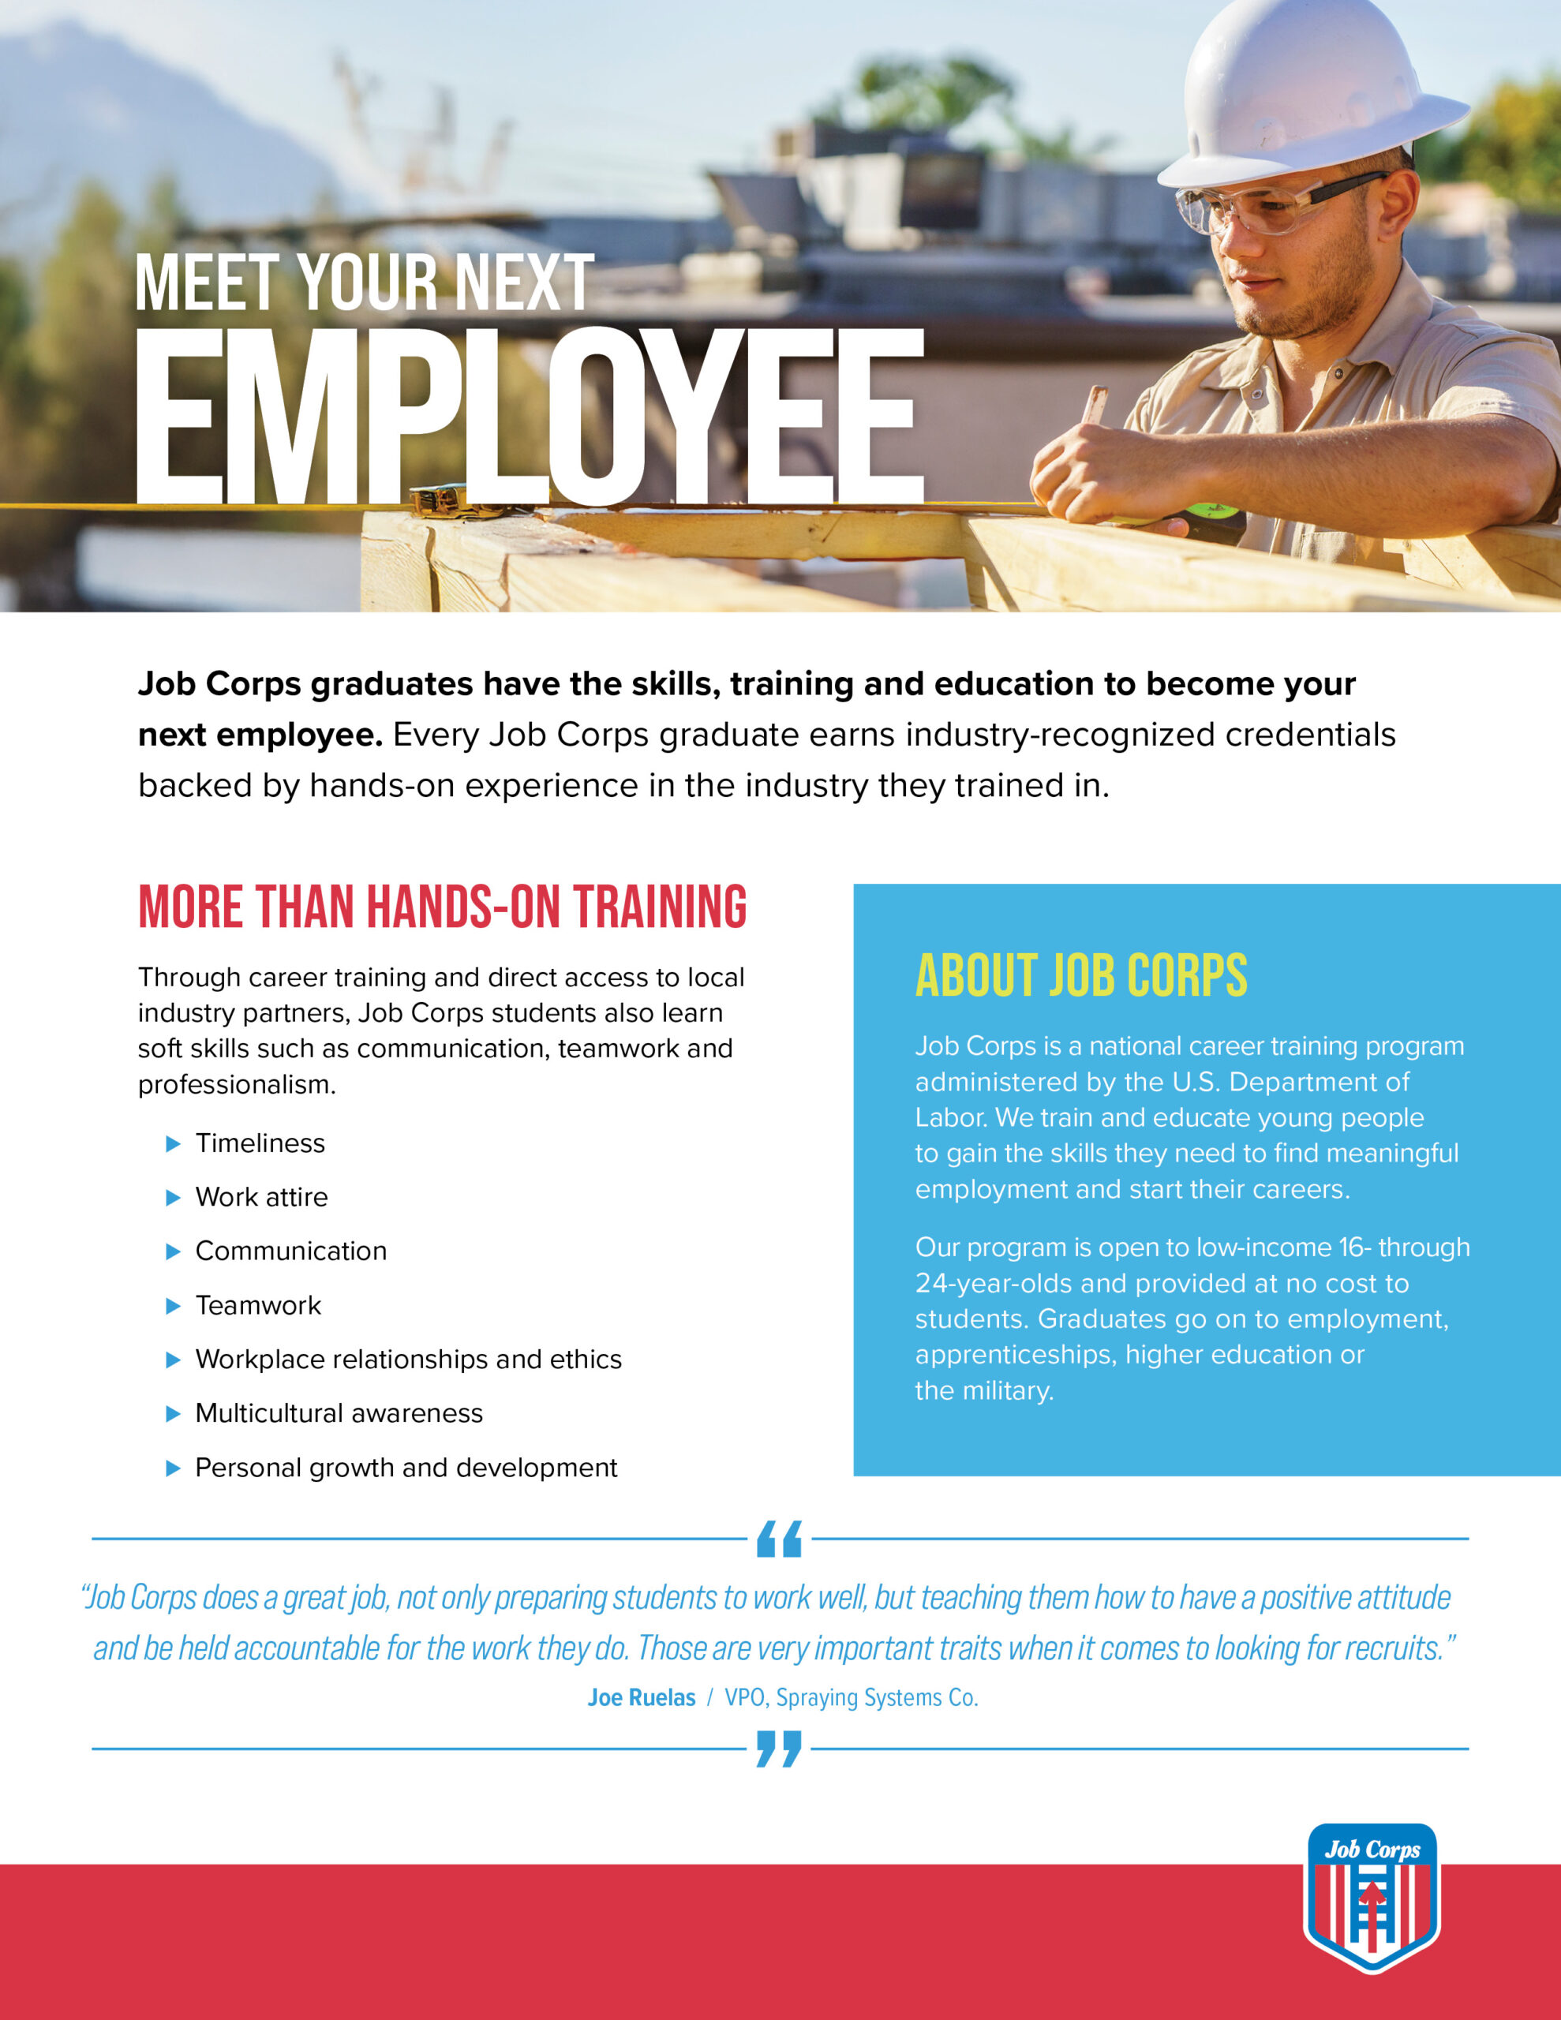

/// EMPLOYER FLIER & BROCHURE
Notes:
The Job Corps Employer Brochure and Flier should be shared with employers who may be considering hiring a Job Corps student. These materials should be shared with local employers, community leaders and government officials.
The brochure details how employers can benefit from hiring Job Corps students who are dependable, work-ready, cost-efficient employees, and it includes testimonials from company leaders who have hired Job Corps students. Employers will read how Job Corps can provide scalable and local talent, a streamlined recruiting process, and experienced recruits. These materials also offer an overview of the program, including training areas and center locations.
Definitely make sure you have one or both of these materials on hand at your next event that includes employers.

Slide 14
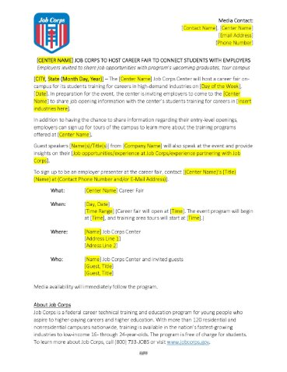
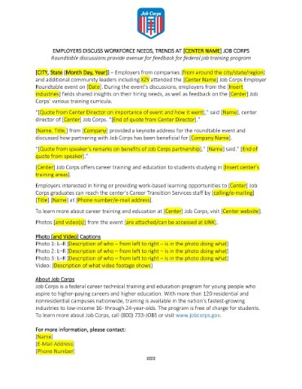
/// MEDIA TEMPLATES
Notes:
The next two materials are for media outreach. If you think your event would benefit from having media attend and you have permission to have media on your center from your Regional Office and Office of Public Affairs, these documents will be very helpful.
The first is the pre-event media advisory that will help bring awareness to your event. MP&F has filled in a lot of the basic information that goes into an advisory, and all the highlighted parts are what needs to be customized based on your event.
A pre-event media advisory plays a crucial role in maximizing media coverage and generating interest and excitement about your upcoming event. It is a valuable tool in the overall event marketing and communication strategy, ensuring that your event gains the attention and coverage it deserves. Most media advisories are sent out two to four weeks in advance of the event to make sure the event gets on your local media outlets' radar.
Following the media advisory – you will want to send out a post-event news release that gives highlights of the event and who attended. Many news outlets will run a short blurb or story about the event if you send it along with great photos and maybe even video from the event.
This is the post-event media release template that will help media outlets understand the key takeaways from the event. This is a great way to share the event's success with a broader audience and reinforce a positive perception of Job Corps in your community.

Slide 15
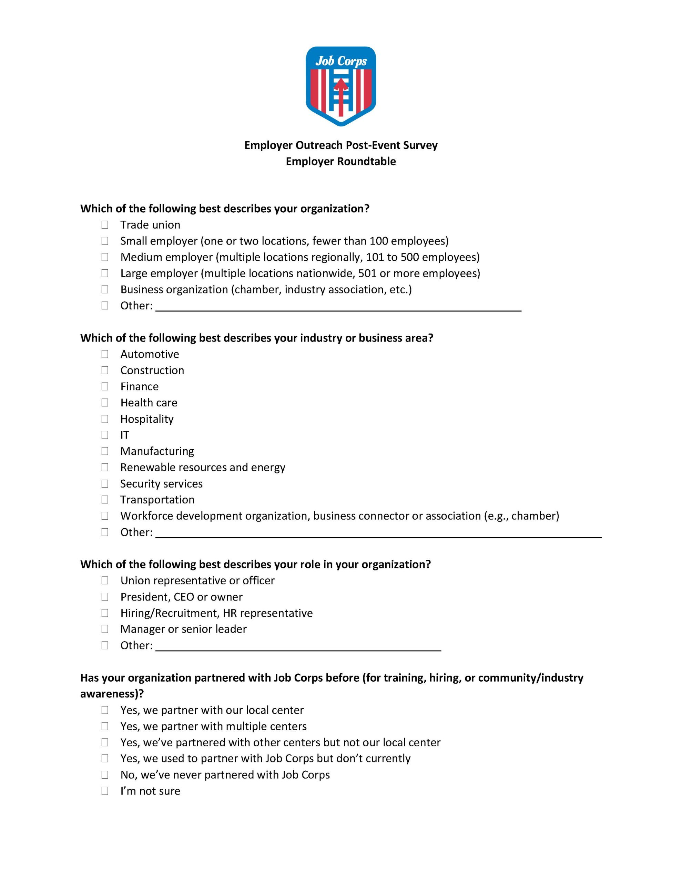
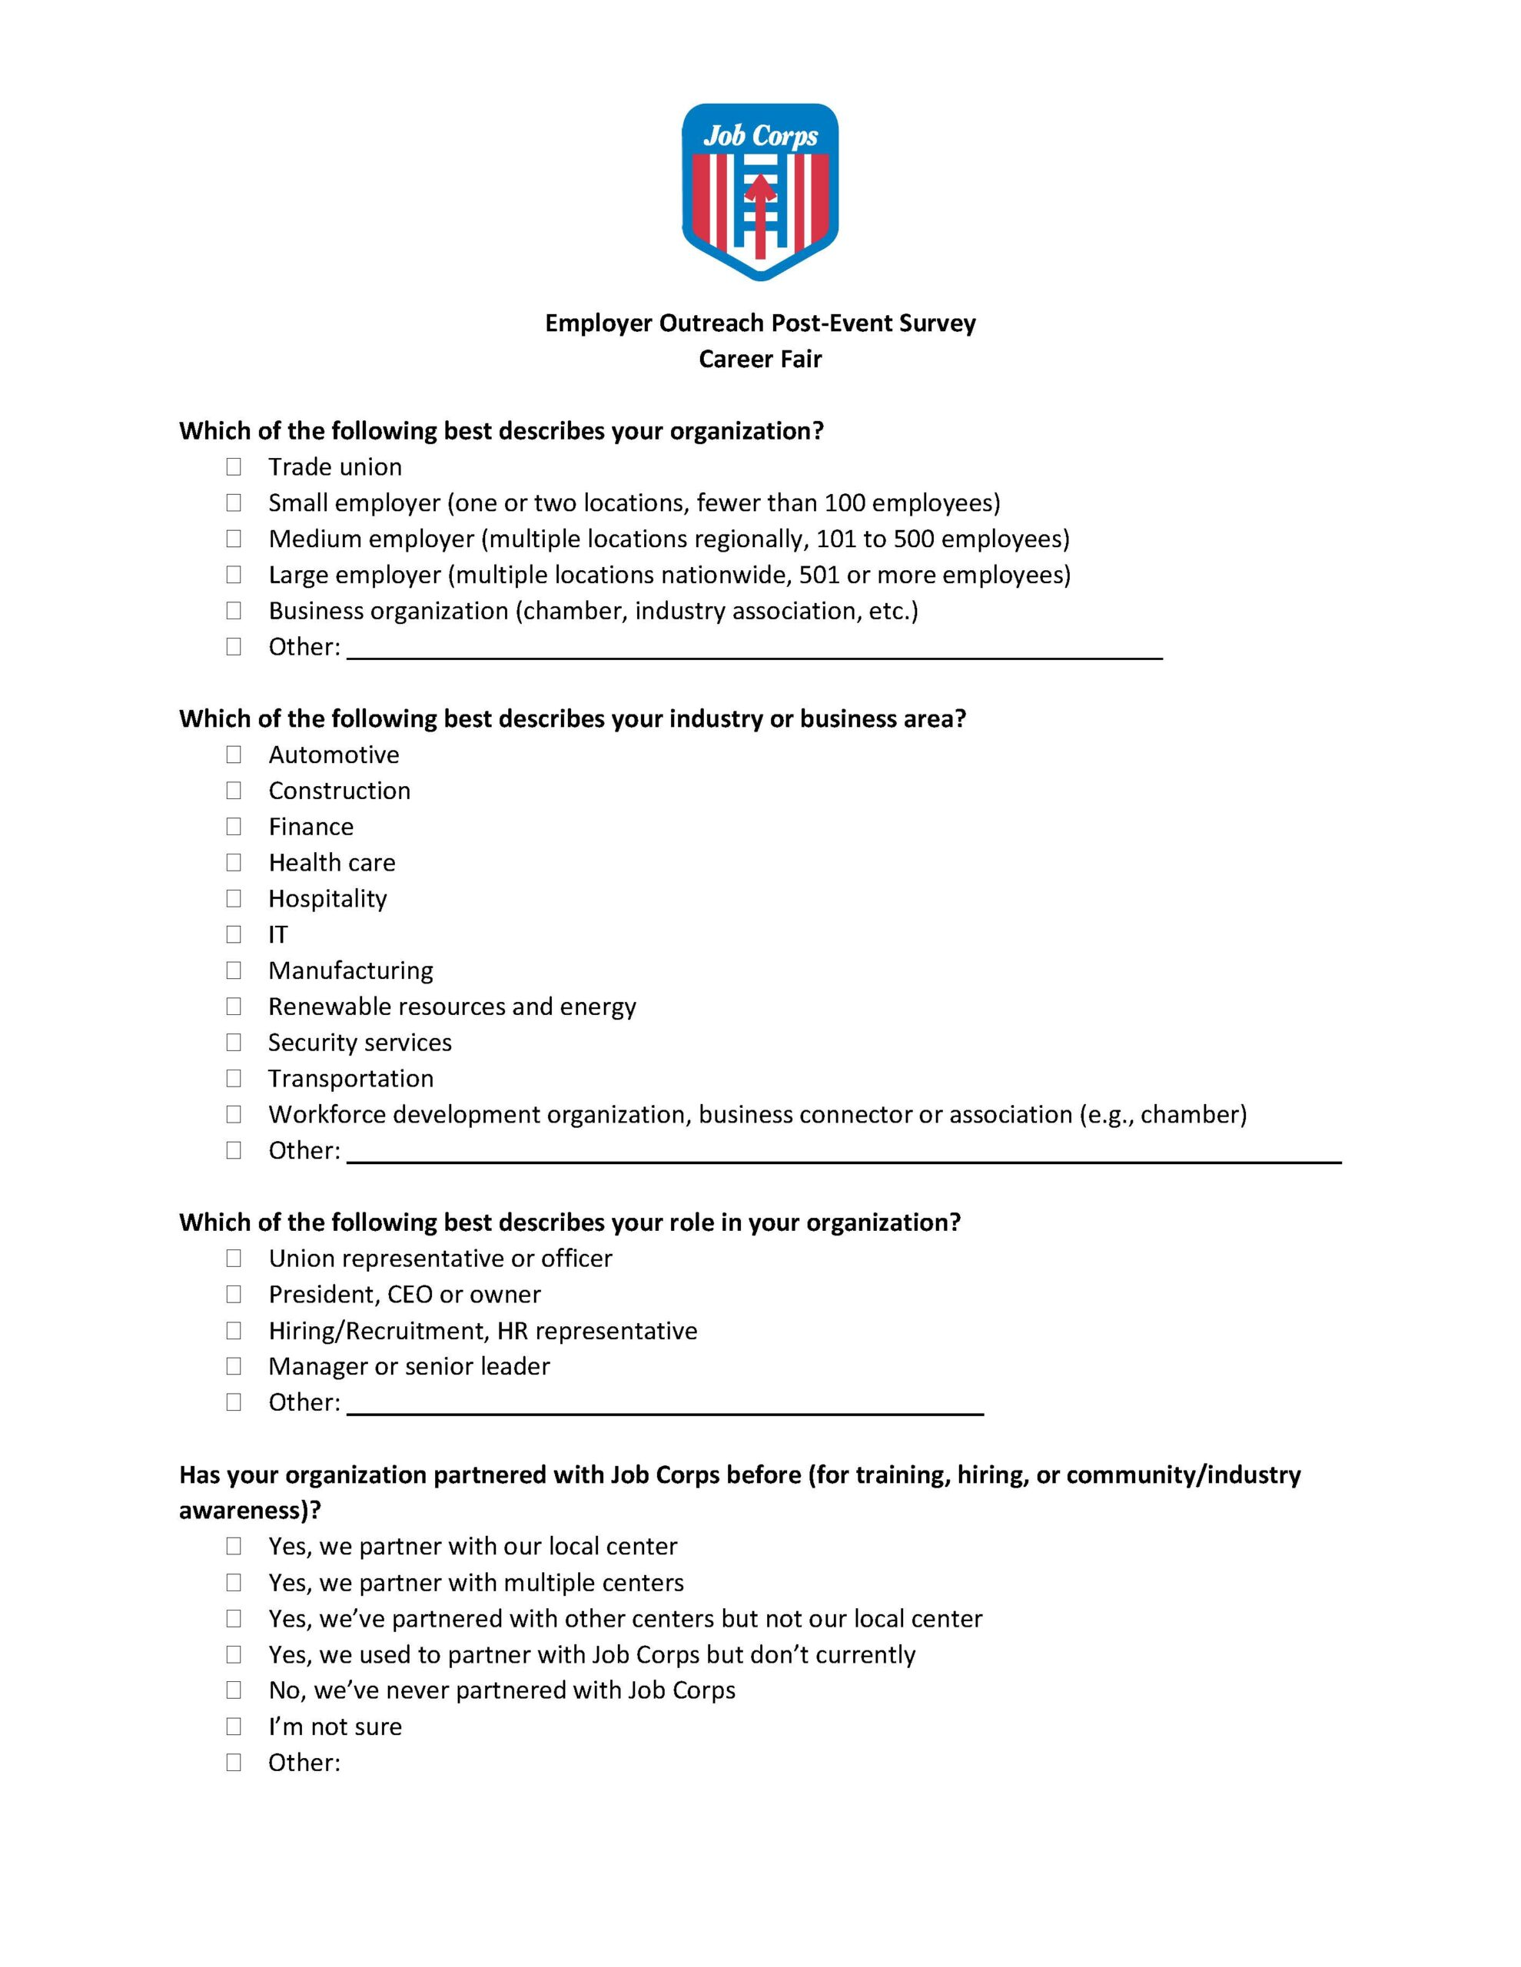
/// POST-EVENT SURVEY
Notes:
Our last material in the Community Outreach Toolkit are the post-event surveys.
This survey allows your center to gather valuable attendee feedback, evaluating event success and identifying areas for improvement. This should be sent to all attendees (you should have all of their contact information from the invitation list).
The survey is a recommended list of questions to ask those who attended your event. You can distribute it whichever way is easiest for you, whether that’s sending via or email or creating an online form that participants can fill out.

Slide 16
/// MATERIALS MARKETPLACE
Notes:
Now we touched on this a little at the beginning of the presentation, but I want to make sure you are all aware that this toolkit lives on the Materials Marketplace, along with a bunch of additional materials to help you in your outreach efforts.
Every material on the Marketplace has been approved by the National Office of Job Corps, and you should be using them frequently. You can order any of our orderable materials that are available for FREE; think of it as the Amazon of Job Corps, where you can order just about everything needed to successfully recruit and retain students.
Some materials are listed as “download only” where you can download them directly to your computer and use a center or local printer to print these materials.
To order a material, simply click on its image and you will be taken to a new page where you can add the material to your cart.

Slide 17
QUESTIONS?
615-259-4000​
jobcorpsmaterials@mpf.com
Notes:
Well, I think we have covered everything, and this will conclude the training today. I know that was a lot of information to take in, so please feel free to ask any questions about the topics we covered today. And please remember this training is available on the Materials Marketplace if you would like to review it again on your own time. ​
​
At this time, we’ll be dropping a feedback link into the chat box. We appreciate any and all feedback in regard to this presentation. ​
​
If you have any questions about this presentation, you can either call or e-mail us and we’d be happy to help you. Our phone number and e-mail address are on the screen.​
​
Thank you so much for joining us today.​
​
​

