Slide 1
Student Welcome and Retention Toolkit
Notes:
Hi, everyone. Thank you for joining me for today's training on our new student welcome and retention toolkit. My name is XX, and I work for MP&F Strategic Communications.
We are the communications support contractor for Job Corps, and are responsible for creating national recruitment materials, coordinating Job Corps’ national advertising campaigns, and managing the program’s social media accounts on Facebook, YouTube, Instagram, LinkedIn and now Twitter or "X." We also do many other things as well, but these are some of the main ways that we support the Job Corps National Office.
Before we begin, please add your name, center (or organization), and e-mail address into the chat box. This webinar will last about 45 minutes, including some time for Q&A at the end of the webinar. At any point throughout the webinar, feel free to type questions in the chat box at the bottom of your screen. Someone from MP&F will be monitoring the chat box and will respond to you or flag your question for discussion at the end.
Before we jump in here, let me give you a bit of context as to what we're going to discuss today.

Slide 2
/// Agenda
Toolkit Overview
Materials and Best Practices
Materials Marketplace
Notes:
We are excited to announce that the Student Welcome and Retention Toolkit is available now on the Job Corps Materials Marketplace!
But before you start utilizing the items in this toolkit, it's important to understand the reason why this resource was created in the first. We'll first spend a bit of time going into detail about the purpose of this new toolkit and its importance in welcoming and retaining students at Job Corps and then we'll talk through the materials of the toolkit and some best practices on when to utilize each material. Finally, we'll show you where you can find these materials and more.
We'll be covering a lot of information today, but don't worry. This training will be available on the Materials Marketplace, and we will be sending you a follow-up e-mail that includes a link to where you can find the training and the toolkit materials.
Let's dive in!

Slide 3
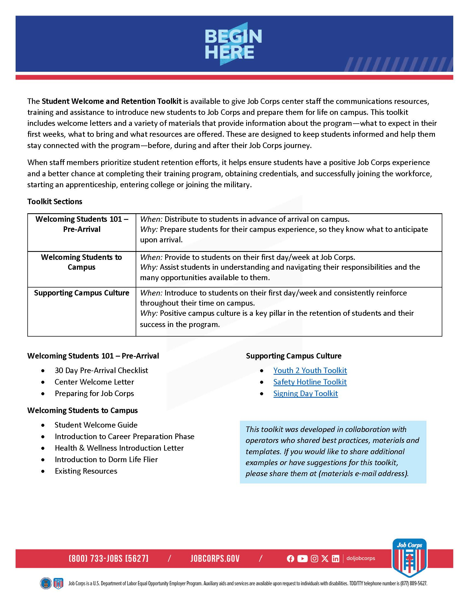
/// Student Welcome and Retention Toolkit Overview
Notes:
Being accepted into Job Corps is an exciting time in every student’s life. Giving them the information they need to feel ready—what to expect in their first few weeks, what to bring and what resources are available to them—is crucial for student retention.
But before we can even touch on student retention, we need to touch on the importance of consistent messaging with both prospects AND arriving students. Since Admissions staff serve as the initial introduction to the Job Corps program, it’s crucial they have the correct tools available to them, so their messages align with what students are hearing from advertising, social media, online and other official Job Corps channels. When staff understand how to talk about Job Corps, orientation sessions are more effective for recruiting new students. When students feel welcomed and prepared for Job Corps, we boost retention and guide more students to graduation.
Ensuring your students feel prepared and welcomed when they arrive on campus is a critical part of student retention. Students who have a positive first impression of the program are more likely to have a positive Job Corps experience overall. That means a better chance at completing their training program, obtaining credentials, and successfully joining the workforce, starting an apprenticeship, entering college or joining the military. That’s exactly why they came to Job Corps, and it should always be the priority of Job Corps staff to set your students up to succeed from the start.
The purpose of the new Student Welcome and Retention Toolkit is to give Job Corps center staff (that’s you!) the communications resources, training and assistance to introduce new students to Job Corps and prepare them for life on campus. The overview flier you see on the screen here emphasizes the purpose of this toolkit – to welcome students to campus and support retention efforts – and lists out the different sections of the toolkit, along with the materials available for each section.
This toolkit is split up into three sections:
Welcoming Students 101 – Pre-Arrival
Welcoming Students to Campus
Supporting Campus Culture
We'll spend some time going over each section so that you understand when to utilize certain resources with your students.
So let's start with the basics of welcoming new students to your center.

Slide 4
/// Welcoming Students 101 – Pre-Arrival
WHEN: Distribute to students before arriving on campus
WHY: Prepare students for their campus experience, so they know what to expect before arrival.
Notes:
With successful student retention first comes a first good impression. We want to set students up for success with a warm welcome.
The Welcoming Students 101 – Pre-Arrival section of the toolkit hosts materials that should be used before students arrive at your Job Corps center. It utilizes three specific materials to prepare them for their campus experience, so they know what to expect.
These three materials are the:
Welcome Day Pre-Arrival Checklist
Center Welcome Letter
Preparing for Job Corps
Over the next (3) slides, we will go into more depth over what the materials are and best practices.

Slide 5
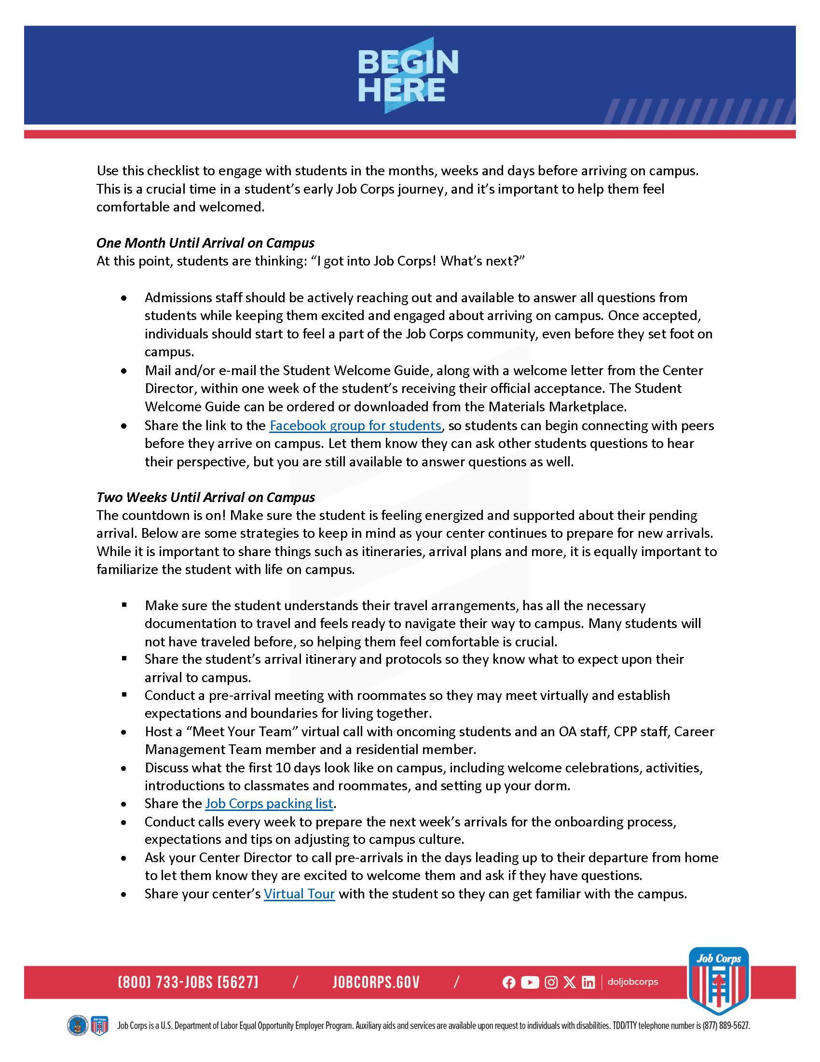
/// 30 Day Pre-Arrival Checklist
Notes:
The first material for this section is a 30 day pre-arrival checklist. Think of this material as your guide for welcoming students to your center.
Reference this checklist for tips on how to engage with students in the months, weeks and days before arriving on campus. This is a crucial time in a student’s early Job Corps journey, and it’s important to help them feel comfortable and welcomed.
Engaging students before arrival is crucial. Early engagement ensures students feel prepared and welcomed, fostering a smooth transition and positive start.
Essentially, this document breaks down the actions that Job Corps staff should take before a new student arrives to campus. The breakdown begins at one month before arrival, (hence, the "30 day pre-arrival checklist" name) then narrows the required actions needed 2 weeks (closer to) to the arrival date.
Over the course of those 30 days, you're touching on different topics that students will need to know before arriving on campus like, travel arrangements, packing dos and don’ts, how they can connect with other peers, and of course answering any and all questions they may have about life at Job Corps.

Slide 6
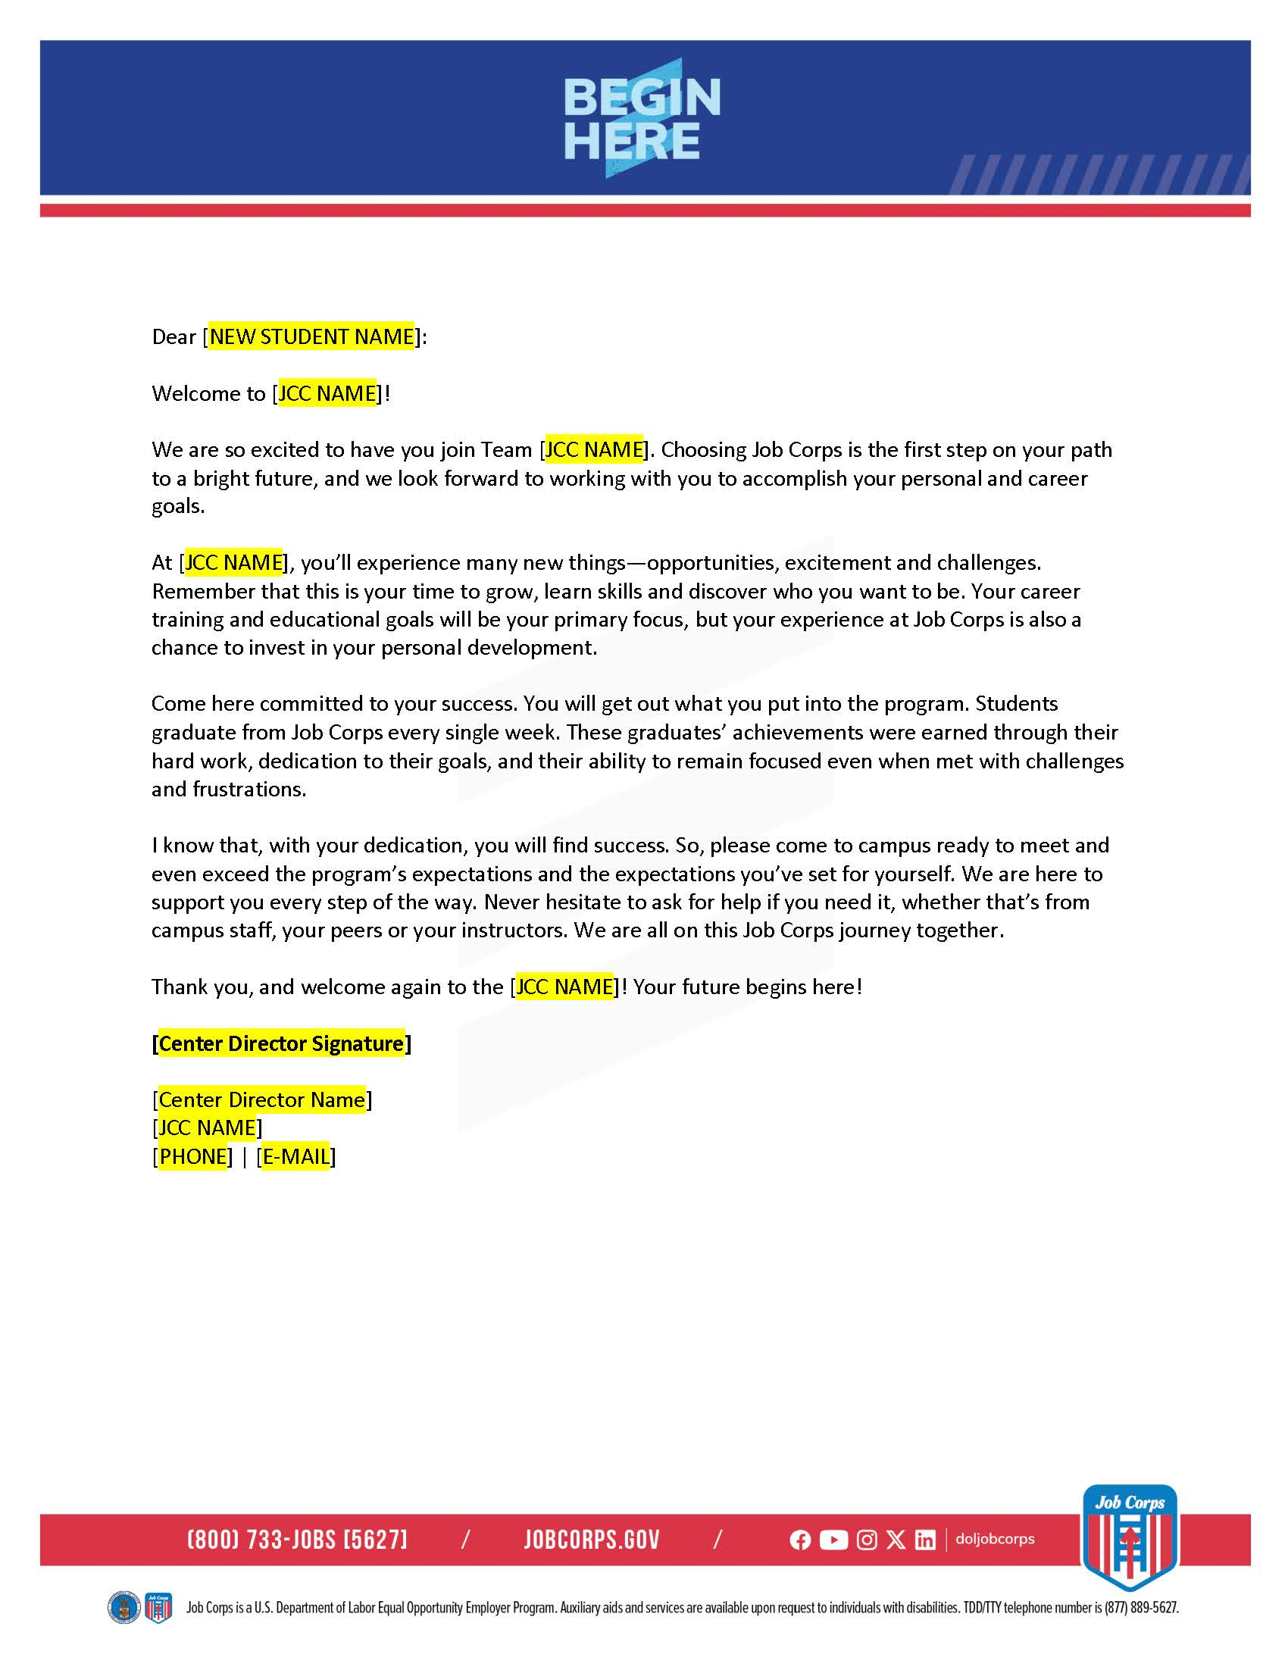
/// Center Welcome Letter
Notes:
This next piece is this section is a welcome letter from your center’s director to send to newly accepted students. This letter sets a positive, motivating tone and reinforces commitment and readiness for Job Corps.
The highlighted parts are sections that you will need to customize to make it specific to your center. This is a document that you can edit on your own – you don't need MP&F's help with this.

Slide 7
/// Preparing for Job Corps
Notes:
I know I referenced a packing dos and don'ts on a previous slide and we've created a material that you can share with students that outlines what they can and can't bring to Job Corps. This piece shares what are and are not allowed, and what Job Corps already provides for them. It also includes some travel tips.
Make sure to share this piece with students as they are preparing to come to campus. It will help them when they’re packing and help keep your campus safe by reminding them what items are prohibited.

Slide 8
/// Welcoming Students to Campus
WHEN: Provide these resources to students during their first day/week at Job Corps
WHY: Assist students in navigating and understanding their responsibilities and and the many opportunities available to them.
Notes:
Once students have made it to campus, we want to make them feel welcomed! The second phase in the Student Welcome and Retention Toolkit is here to help you do just that.
The materials housed in this section should be given to students during their first days at Job Corps, to help them understand and navigate their new responsibilities and the exciting opportunities available to them. These materials will also help them understand what kind of support is available to them and who they can go to if they need help.
Within this phase, we have many materials available for you all, such as:
Student Welcome Guide
Introduction to Career Preparation Phase
Introduction to Dorm Life
We will talk through these more in-depth in the next few slides.

Slide 9
/// Student Welcome Guide
Notes:
This piece may sound familiar, but look different to a few folks here that have been with Job Corps for some time. We recently redesigned the student welcome guide as a part of creating this larger Student Welcome and Retention toolkit and added some new features and topics to this resource.
The student welcome guide is designed to walk new students through the key information they need to know as they begin life at Job Corps.
This 15- page document arms students with information about Job Corps so that they feel encouraged and prepared to succeed on campus.
The guide talks through program expectations, training and learning opportunities, and campus life. It also outlines the Career Preparation Phase, or CPP, so they understand how their first few months at Job Corps will be spent. We'll discuss CPP a bit more on the next slide.
While the guide outlines Job Corps’ rules and policies and talks about the Safety Hotline and Youth2Youth resources, you should plan to re-emphasize these topics with students as well. We'll get to this piece a little later in this presentation.
Lastly, the guide includes some fun activities like a scavenger hunt to help students get connected and acquainted with their campus.
Everything in this guide will help the students feel well prepared and equipped for life at Job Corps.

Slide 10
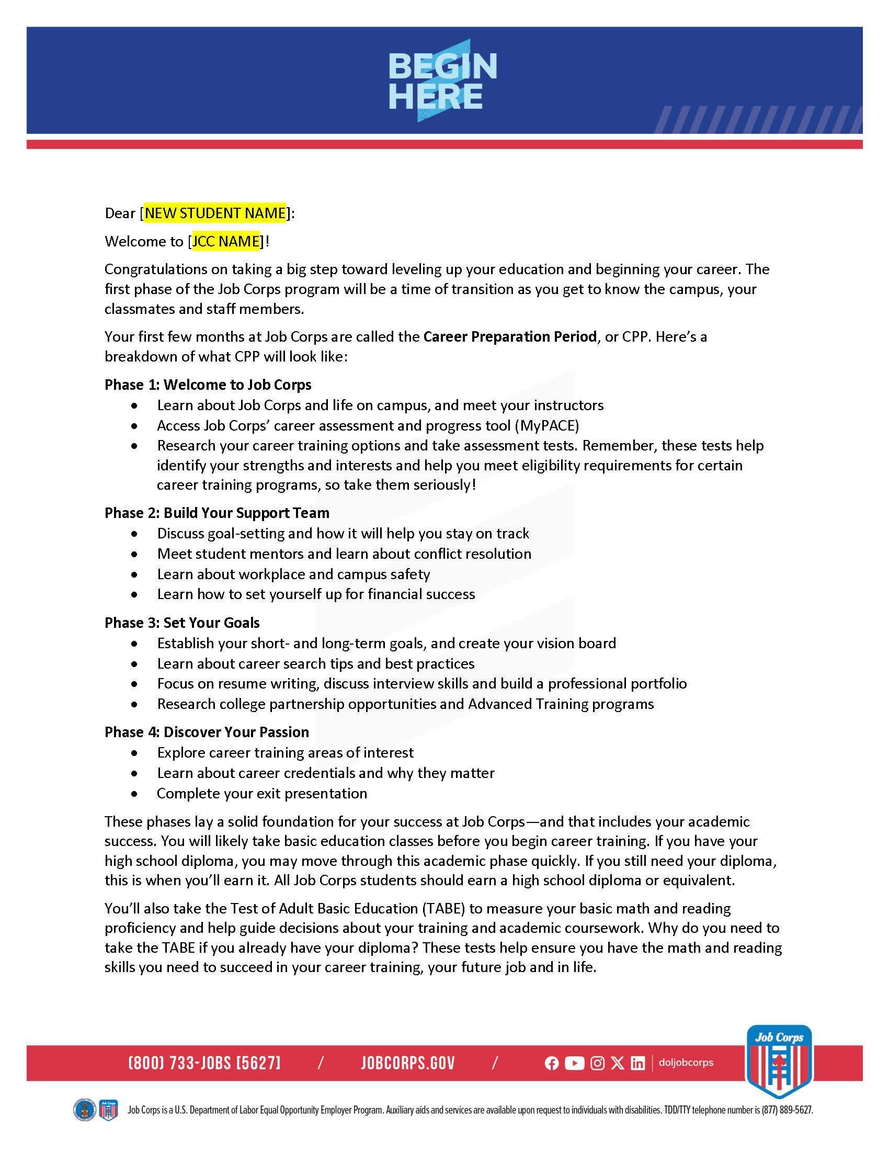
/// Introduction to Career Preparation Phase
Notes:
In addition to the pre-arrival welcome letter from the center director, this section also contains a welcome letter that should come from your center director. You should share this letter with new students during their first week at Job Corps.
This letter is important because it introduces the topic of the Career Preparation Period (CPP). The letter breaks down the entire CPP process and sheds light on what students will learn during their first few months in the program. Deliver this letter to your students, but plan to go over it with them as well to make sure they understand.
It goes over the four phases of CPP:
Welcome to Job Corps -- getting settled on campus, taking assessment tests, setting up a MyPACE account and research training options
Building a Support Team -- meet with other students and staff, learn about campus and workplace safety
Goal Setting -- create short and long term goals, set up a professional portfolio, put a plan together for the future (career, AT, military, etc).
Discover Your Passion – explore trainings areas of interest, learn about career credentials
As you know, the first few months are a crucial time for retention, and making sure new students know what to expect – as well as what’s expected of them – is a major factor in that.
To reiterate, the highlighted parts are sections that you will need to customize to make it specific to your center. This is a document that you can edit on your own – you don't need MP&F's help with this

Slide 11
/// Introduction to Dorm Life
Notes:
The Introduction to Dorm Life flier, provides guidelines for the new students about how to live in the dorms.
It sets expectations upon arrival and sets a standard for living, emphasizing respect and responsibility as key factors in building a positive campus community.
Following these guidelines helps create a supportive and respectful dormitory community, enhancing the overall Job Corps experience and community spirit.
In addition to providing students with this flier, make sure to go over any information or rules they need to know about life on your campus.

Slide 12
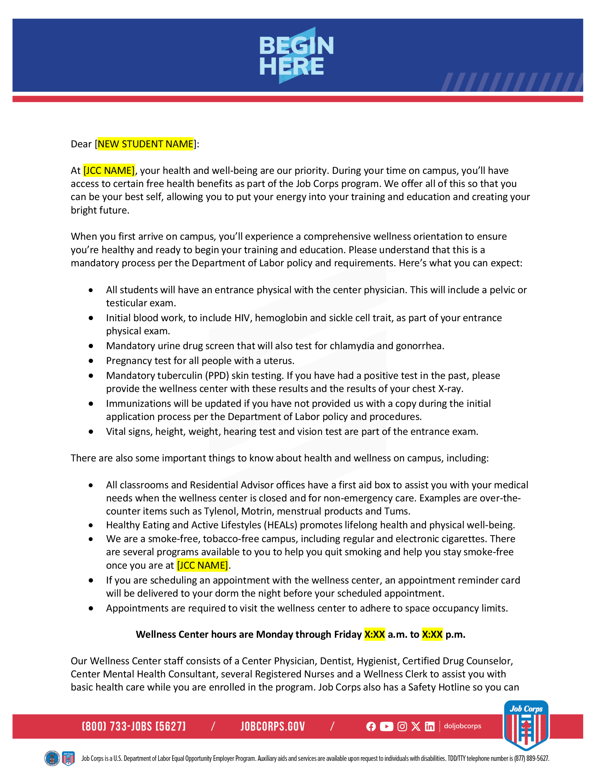
/// Health & Wellness Introduction Letter
Notes:
This is our Health & Wellness Introduction Letter.
We encourage you to utilize this letter to inform students of the comprehensive health and wellness services, including free health benefits, mandatory wellness orientation, and various health exams and screenings, to ensure they are healthy, focused, and ready to excel in their training and education.

Slide 13
/// Supporting Campus Culture
WHEN: Introduce to students on their first day/week to and consistently reinforce throughout their time on campus.
WHY: Positive campus culture is a key pillar in the retention of students and their success in the program.
Notes:
The final phase of the Student Welcome and Retention Toolkit is supporting culture on campus!
Creating an intentional, positive campus culture is absolutely critical to student retention and success. One part of this is introducing resources to students early and emphasizing them often throughout their time at Job Corps.
The toolkit materials within this phase include three pre-existing toolkits:
Youth 2 Youth Toolkit
Safety Hotline Toolkit
Signing Day Toolkit
Although these are not new initiatives, they encourage a supportive environment, enhancing the overall Job Corps experience and therefore student retention.
These toolkits already live on the jcmarketplace.com, as we will show and discuss in the next coming slides.

Slide 14
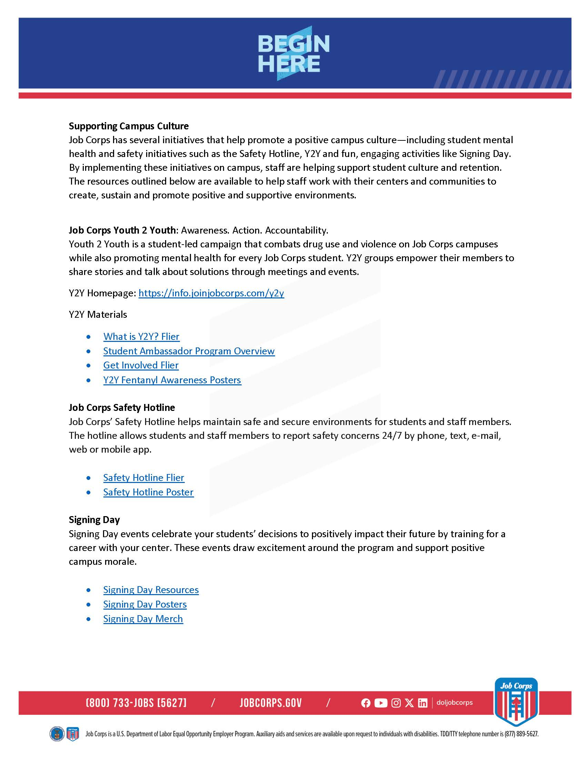
/// Supporting Campus Culture Overview
Notes:
As mentioned already, there are an array of existing materials on the jcmarketplace.com website to reference and use.
This specific document present here essentially summarizes all the materials and ways to foster a positive culture on campuses. These resources and toolkits are meant to help staff work with their centers and communities to create, sustain and promote positive and supportive environments.
Overall, though, in this phase, we'll focus on how Job Corps initiatives support a positive campus culture and enhance student retention.

Slide 15
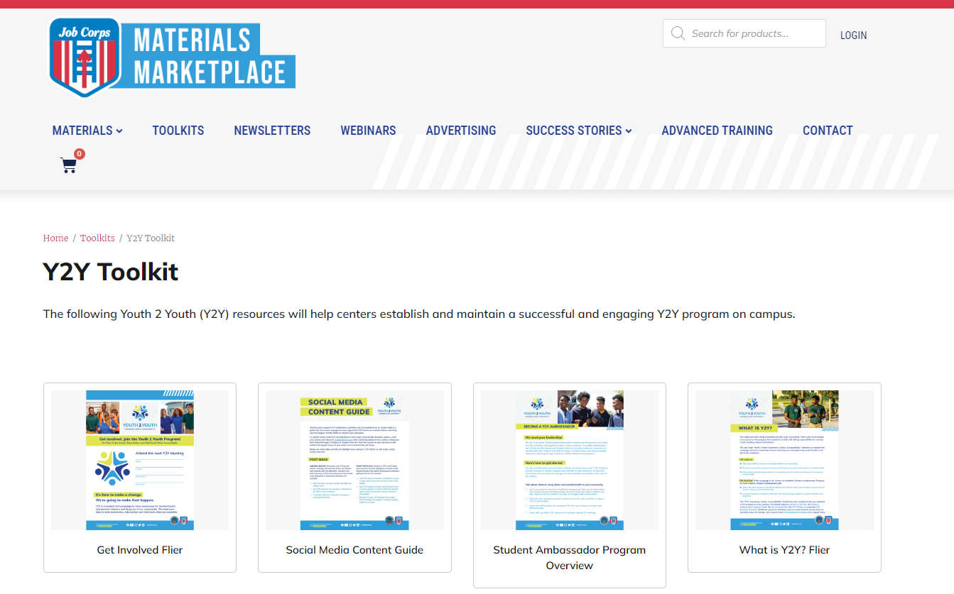
/// Youth 2 Youth Toolkit
Notes:
First set of materials in this phase are the Youth 2 Youth (Y2Y) pieces. The safety and well-being of students are Job Corps’ top priority. That’s why every person in the program, from students to staff, are tasked with taking responsibility for creating a safe, healthy campus environment.
Youth 2 Youth (Y2Y) is a student-led campaign that addresses drug use and violence while promoting mental health. Y2Y empowers students to share stories and find solutions through meetings and events. Feeling connected to peers and like they’re part of a community is a huge part of making students feel like they belong.
The first step of this campaign is for centers to establish a Student Ambassador Program on each campus. Student ambassadors will work with other students and with assistance from staff to create conversations around issues of violence, drug use and mental health. As you share information about your campus life, make sure to highlight Y2Y and how new students can get involved with this initiative from the start by becoming a student ambassador.
Key resources include fliers, ambassador programs, and awareness posters and can all be found at jcmarketplace.com

Slide 16
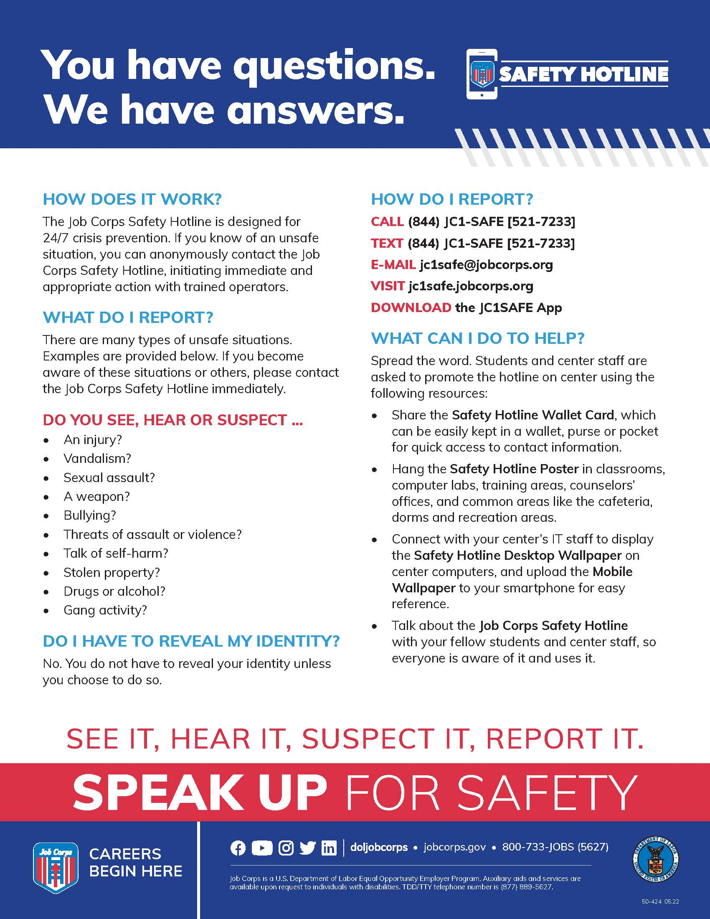
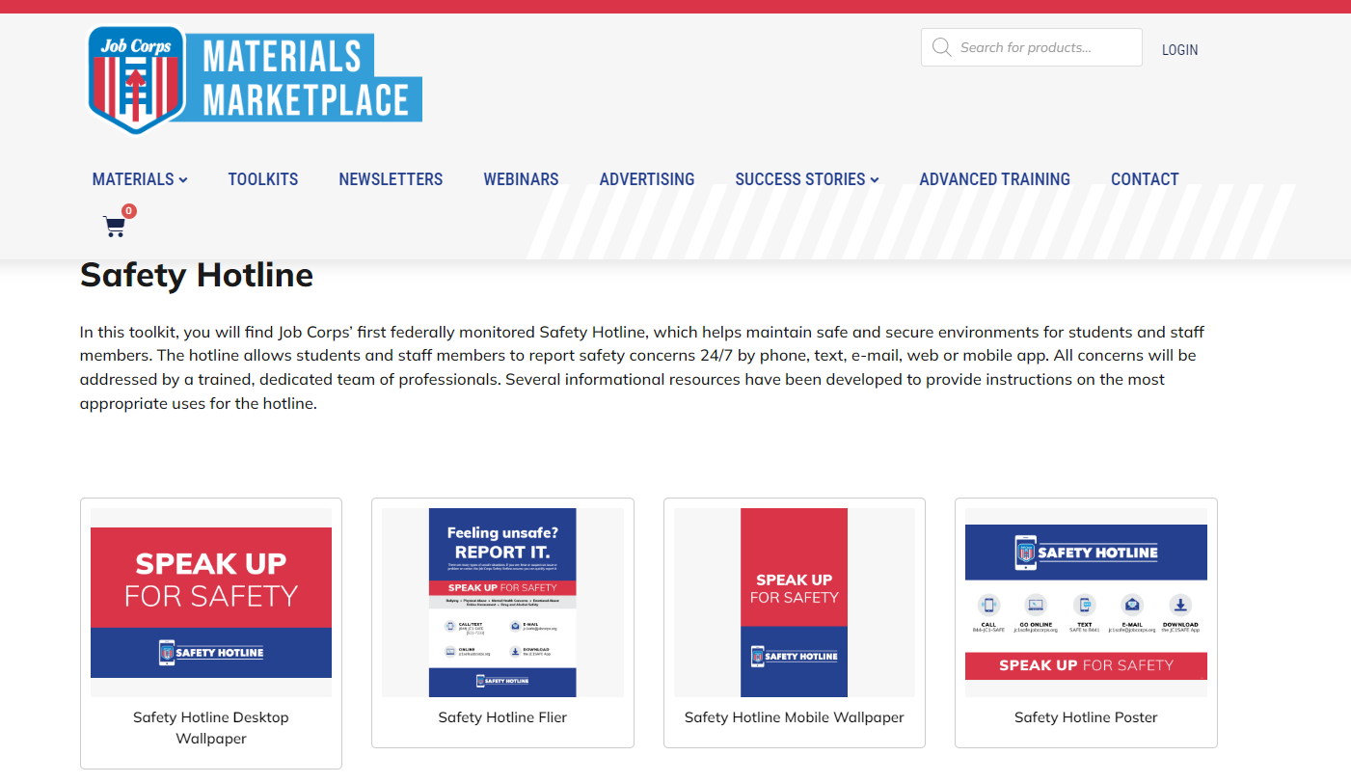
/// Safety Hotline Toolkit
Notes:
The next set of materials to help foster a culture of safety is the safety hotline toolkit. Job Corps’ first federally monitored Safety Hotline, helps maintain safe and secure environments for students and staff members. The hotline allows students and staff members to report safety concerns 24/7 by phone, text, e-mail, web or mobile app. All concerns will be addressed by a trained, dedicated team of professionals.
Resources for this toolkit include a flier, wallet card, and poster that can be found on the Materials Marketplace. Make sure to display these resources around your center at all times and give new students the wallet card and/or flier.

Slide 17
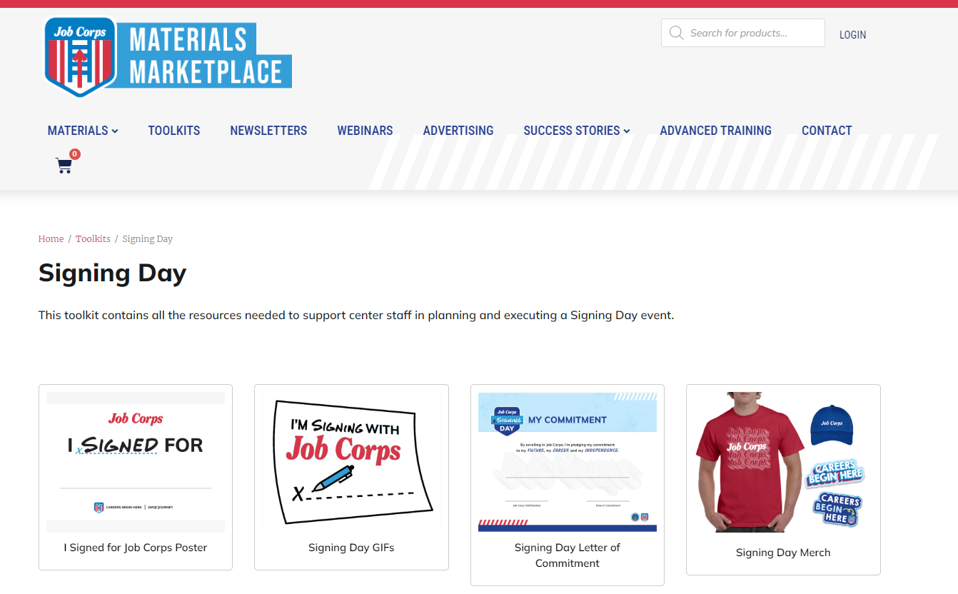
/// Signing Day Toolkit
Notes:
Signing Day celebrates students’ commitment to their future careers, boosting campus morale. Resources include posters and merchandise.
These events create a positive impact by generating excitement and positivity, whether it’s a student’s first day or they’re renewing their commitment to their future. Holding a Signing Day event for current students can be a great retention tool, reminding them of their "why" behind joining Job Corps in the first place.
Resources available on the marketplace include things like a letter of commitment and posters to help you throw a Signing Day event on your campus.
These materials highlight the importance of celebrating every milestone to foster a supportive and motivating environment.

Slide 18
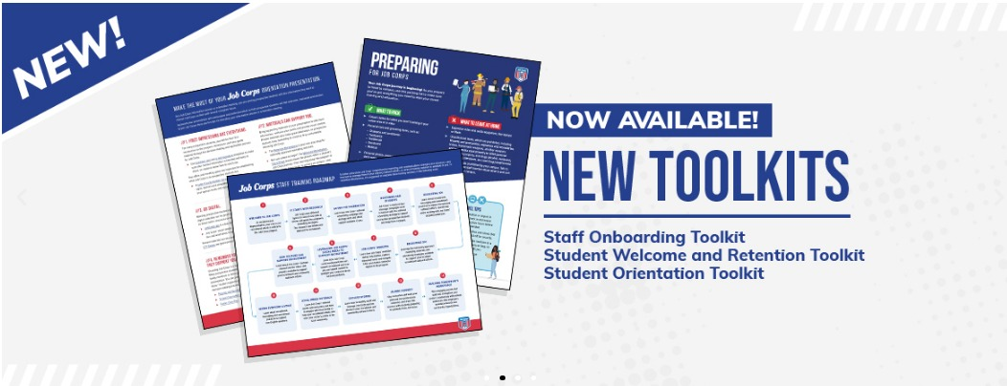
/// Materials Marketplace and Additional Resources
www.jcmarketplace.com
Notes:
Now we touched on this a little at the beginning of the presentation, but I want to make sure you are all aware that the Student Welcome and Retention toolkit lives on the Materials Marketplace, along with a bunch of additional materials to help you in your outreach efforts.
Every material on the Marketplace has been approved by the National Office of Job Corps, and you should be using them frequently. You can order any of our materials that are available for FREE; think of it as the Amazon of Job Corps, where you can order just about everything needed to successfully recruit and retain students. A few materials are listed as 'download only' where you can download them directly to your computer and use a center or local printer to print these materials.
To order a material, simply click on its image and you will be taken to a new page where you can add the material to your cart. Most materials are available in quantities of 25–100, but we can accommodate larger orders as well if you e-mail our team. We will get into that in the next slide. Fill your cart with as many materials as you would like, and then click on the shopping cart icon to check out.

Slide 19
/// CONTACT US
615-259-4000
jobcorpsmaterials@mpf.com
Thank you!
Notes:
So—that’s Job Corps new Student Welcome and Retention Toolkit. I hope you have found this webinar informative and helpful and that you understand the importance of your role in supporting student retention efforts. This toolkit is here to help you, and it’s available now.
Always feel free to call MP&F at the number you see on the screen—(615) 259-4000—and we will make sure you are put in touch with the right person.
If you have any additional questions about any of the resources or need additional support, please reach out to our materials team at jobcorpsmaterials@mpf.com.
We covered a lot of information today, but we will be posting a recording of this training along with all of the other trainings we give on the Materials Marketplace under 'Webinars.' We will also be sending everyone a follow-up e-mail this week that will include the recording along with the resources mentioned in this webinar.
Thank you so much for your time!

