Slide 1
Advanced Training Website
Notes:
Hi, everyone.
Thank you so much for joining us today.
My name is Schuyler Pringle. I work for MP&F Strategic Communications, the communications and marketing support contractor for Job Corps.
Today’s webinar is going to focus on the new advanced training website that debuted last week.
I want to show you all the new features of this website so that you in turn can understand how to integrate this resource into ongoing support effort for students
This webinar will last about 30 minutes, including some time for a Q&A session at the end of the presentation.
At any point, please also feel free to type questions in the chat, and we’ll answer as we go if possible or at the end of the webinar.
So, with that, let’s get started.

Slide 2
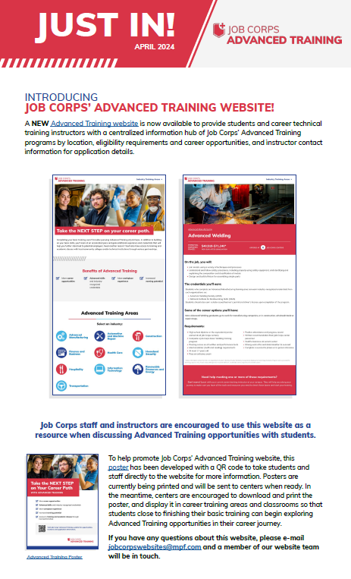
/// Just In
Notes:
Hopefully you all received this Just In last week that announced this new website. Like this Just In mentions...
The Advanced Training website was created to provide students and career technical training instructors with a centralized information hub of Job Corps’ Advanced Training programs by location, eligibility requirements and career opportunities and instructor contact information for application details.
Job Corps staff and instructors are encouraged to use this website as a resource when discussing Advanced Training opportunities with students.
We're in the process of printing and shipping the Advanced Training poster featured in this Just In to all centers. More to come on this in the coming slides.
A couple of things that this Just In didn't mention...
This website just reflects on-center AT offerings. We will be adding OTP AT offerings as a phase two to this website.
This is a living, ever-evolving website. Meaning we have the ability to change content as frequently as we like. I'll show you more of what I mean when I take you all through the website itself.

Slide 3
/// Website
jcadvancedtraining.com

Slide 4
/// Poster
Notes:
To help promote Job Corps’ Advanced Training website, this poster has been developed with a QR code to take students and staff directly to the website for more information. Posters are currently being printed and will be sent to centers when ready. In the meantime, centers are encouraged to download and print the poster, and display it in career training areas and classrooms so that students close to finishing their basic training can begin exploring Advanced Training opportunities in their career journey.

Slide 5
Questions?
615-259-4000
jobcorpswebsites@mpf.com
Thank you!
Notes:
Well, I think we have covered everything, and this will conclude the training today. I know that was a lot of information to take in, so please feel free to ask any questions about the topics we covered today. And please remember this training and will be posted to the Materials Marketplace as a recording in case you'd like to reference this information in the future. At this time, we’ll be dropping a survey link into the chat box. We appreciate any and all feedback in regard to this presentation.
If you have any questions about this presentation, you can either call or e-mail us and we’d be happy to help you. Our phone number and e-mail address are on the screen.
Thank you so much for joining me today.

