Slide 1
JOB CORPS
Workforce Outreach Toolkit
Notes:
Hi, everyone. Thank you for joining me for today's training on our new workforce outreach toolkit. My name is Jessica Darden, and I work for MP&F Strategic Communications.
We are the communications support contractor for Job Corps, and are responsible for creating national recruitment materials, coordinating Job Corps’ national advertising campaigns, and managing the program’s social media accounts on Facebook, YouTube, Instagram, and now Twitter or "X." We also do many other things as well, but these are some of the main ways that we support the Job Corps National Office.
Before we begin, please add your name, center (or organization), and e-mail address into the chat box. This webinar will last about 45 minutes, including some time for Q&A at the end of the webinar. At any point throughout the webinar, feel free to type questions in the chat box at the bottom of your screen. Someone from MP&F will be monitoring the chat box and will respond to you or flag your question for discussion at the end.
OK, let’s jump in.

Slide 2
Overview
PIN 22-19 and PIN 23-05 Highlights
Workforce Outreach Toolkit Goals
3. Types of Outreach Events
4. Materials and Best Practices
5. Materials Marketplace/ Additional Resources
Notes:
Hopefully everyone participating today has had a chance to review the Job Corps Program Instruction Notice 22-19, also known as "Promoting and Advancing Job Corps Centers as Infrastructure Academies." There is a lot of very helpful information in the PIN, and it highlights the need for and the benefits of Job Corps Centers partnering with employers to establish our program as a talent pipeline that will help employers fill the wave of jobs created by recent historic investments in our nation’s infrastructure. And as I'm sure you all noticed – another PIN was very recently issued, Program Instruction Notice No. 23-05, “Local Workforce Outreach Events and Toolkits.” This notice complements PIN No. 22-19 in that it maps out and provides tools to support centers with workforce outreach at the local level. PIN No. 23-05 includes a call to action that requires all Job Corps centers each to host two workforce outreach events by the end of fiscal year 2024. These events should support each center's strategic action plan to help establish a local partnership network. The workforce outreach toolkit that we are discussing today has been created to aid your center in planning engaging events with these various audiences.
Now many of you may already host employer-focused events like career fairs on a regular basis, which is great. You are already ahead of the game.
But even if you already do or don't host these types of events on your campuses, I think the toolkits we will be discussing today will be really helpful for everyone as they contain a lot of helpful resources that will help you plan and execute successful outreach events.
So today's webinar will go into detail about the new Workforce Outreach Toolkit and its importance in executing events for different audiences.
I'll break down the types of events your center can hold, along with the goals of each event, and we'll look at the event materials available in the toolkit and review best practices on how to use them.
Finally we'll dive into where you can find these materials and additional materials for employer and workforce audiences to aid you in your events.
We'll be covering a lot of information today, but don't worry. This training will be available on the Materials Marketplace, and we will be sending you a follow-up e-mail today or tomorrow that includes a link to where you can find the training and the toolkit materials.

Slide 3
Workforce Outreach Toolkit
jcmarketplace.com
Notes:
Employer and workforce outreach is a important focus for the program now that Job Corps centers have completed their Infrastructure Academy asset maps and action plans and are now focused on implementing these plans and building connections with potential partners.
A great way to connect with new employer and community partners is to bring these organizations to your campus so they can see firsthand all the great opportunities the program provides for students and graduates.
The new Workforce Outreach Toolkit is available to help centers make these connections and plan engaging events with audiences such as employers, workforce boards and community organizations.
The toolkit (which is really three different toolkits) contains many helpful resources such as event planning tips and guidelines, templates for invitations, programs and media advisories, and much more that we will discuss later in the presentation.
The toolkit is designed to walk you through hosting a successful event step by step.
The first and most important step is to establish a clear goal that is based on the specific needs of your center and students.
So – what I mean by that is – first you need to determine what type of workforce outreach event would benefit your center the most at any given moment in time. Some questions to ask yourself could be:
Do you have a large group of students ready to graduate and in immediate need of entry-level jobs?
Do you need to build relationships with local employers (specifically infrastructure-related employers) and secure more work-based learning partnerships?
Do you need guidance from local employers on training curriculum and/or industry trends?
The answers to these questions will help you determine which type of event your center should host to best meet the needs of students and employers. We will discuss the three different types of events your center can hold in the next slide.

Slide 4
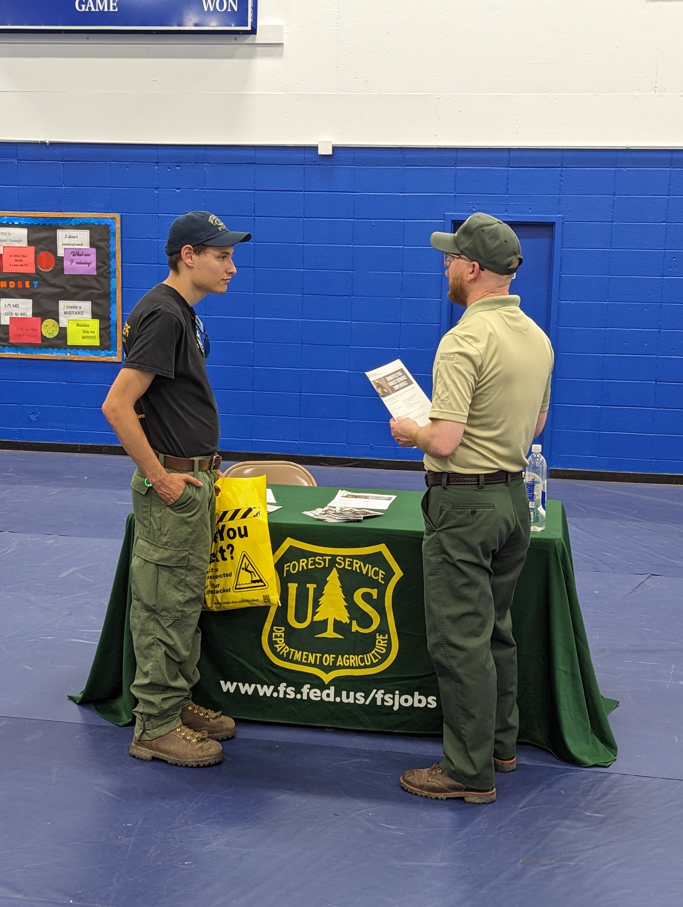
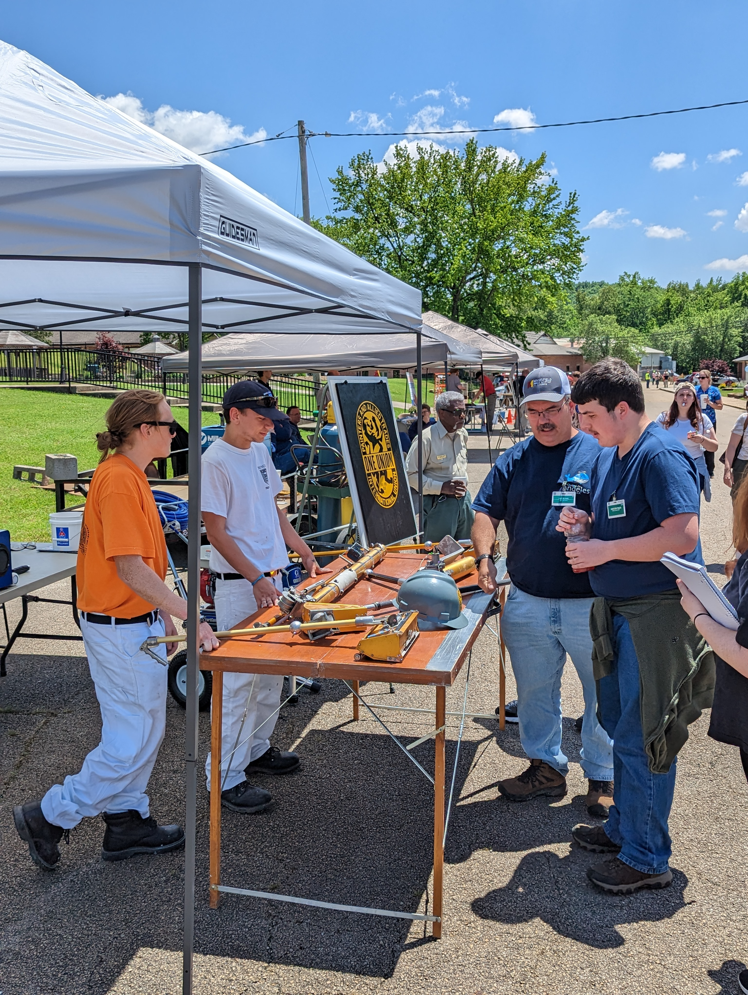
Types of Events
Student Career Training Expo
Career Fair
Employer Roundtable
Notes:
As I mentioned before, the toolkit has materials for three event types for your center. If it works for you, we suggest each center host at least two of the three events every year to meet the requirement outlined in PIN 22-19. Each event has its own materials and audience-specific resources to help reach your individual center's employer-focused goals.
The first type of event is a Student Career Training Expo. The goal of this event is to highlight/showcase your center's different hands-on training programs by inviting local employers and community leaders to see your students in action. This will help build and foster relationships with the workforce development community members and identify opportunities for new work-based learning partnerships. The Student Expo is ideal for centers who are looking to reengage with local employers and introduce new employers and workforce entities to the program. By setting up booths for each career training area that are student-led (with support from instructors), your center has a great opportunity to show potential partners the types of skills students are learning and how their training is preparing them for the workforce. It also gives employers the chance to ask questions and engage with students one-on-one. A key component to this type of event is also the coordination of tours of the training classrooms. In addition to the student-led training booths, if your center is able to coordinate the logistics of taking the attendees to the training classrooms where they can see students in action and see the type of equipment they are training on, that is highly recommended as well. The more engaging and interactive the event, the better.
The second type of event is hosting an Employer Career Fair. This type of event may be the one that your center is the most familiar with as it strives to connect soon-to-be Job Corps graduates with employers looking to hire and fill open positions. A career fair is ideal for centers who have a large or fairly large population of students who are graduating soon. In this type of event, you are inviting employers to come and set up booths on campus – probably in the gym or other large area on campus that can hold a lot of people. The employers are there to sell their companies to potential employees – providing them with information about the types of jobs they are hiring for, job expectations, job benefits, how to apply for open positions, etc. This event is also a great opportunity to set up for interviews where employers can interview students on the spot. The goal of course is to connect as many soon-to-be graduates with future employers as possible – so make sure they are ready – dressed for success, resumes printed and proofed, rehearsed answers for interview questions, etc.
The third event is an Employer Roundtable. The ultimate goal of this event is to gather feedback from employers on their hiring needs and expectations, their interest in potential partnerships, and their thoughts on your centers training curricula and equipment. The roundtable event is a little different in the other two events in that it is more of a facilitated discussion than an expo or fair. This event is more like a networking breakfast or luncheon. You are inviting audiences like employers, workforce councils, community organizations and leaders, elected officials, etc., to join you and your center team for a morning or afternoon discussion about workforce-related topics and how Job Corps can help address local workforce needs. This event (and the other two events) will most likely have an official program with guest speakers. Then after the official program, each table – which we recommend are grouped by industry -- will be prompted to have meaningful conversations, and each table will have a facilitator and prompt cards to keep the conversation going.
OK – so those are the three events the toolkit covers. Next we are going to dive into the materials that can be used to gain traction for each of these events, and I'm sure I will talk more about the formats of these events as we get into the different materials and resources and what they are for.

Slide 5
Workforce Outreach Materials
Event Planning Tips and Timeline
Program Speakers' Tip Sheet
Invitation
Invitation Letter
Program
Save the Date
Student Resume Template
Employer Roundtable Discussion Prompts
Pre-Event Media Advisory Template
Post-Event Media Release Template
Post-Event Survey
jobcorpsmaterials@mpf.com
Notes:
Here is a comprehensive list of all the materials that will be available to you in the Workforce Outreach Toolkit. We'll be explaining these materials more on the next slides and discussing best practices and for each resource.
Each of these resources has been tailored to the three specific events we just went over. And, many of them can be customized to meet your center's event needs. For customization of the PDF materials, please e-mail jobcorpsmaterials@mpf.com with enough time before your event to coordinate – ideally eight to 10 weeks before your scheduled event. We need enough time to customize the materials, and you will want to send out invitations six weeks or so before your event to get on people's calendars.

Slide 6
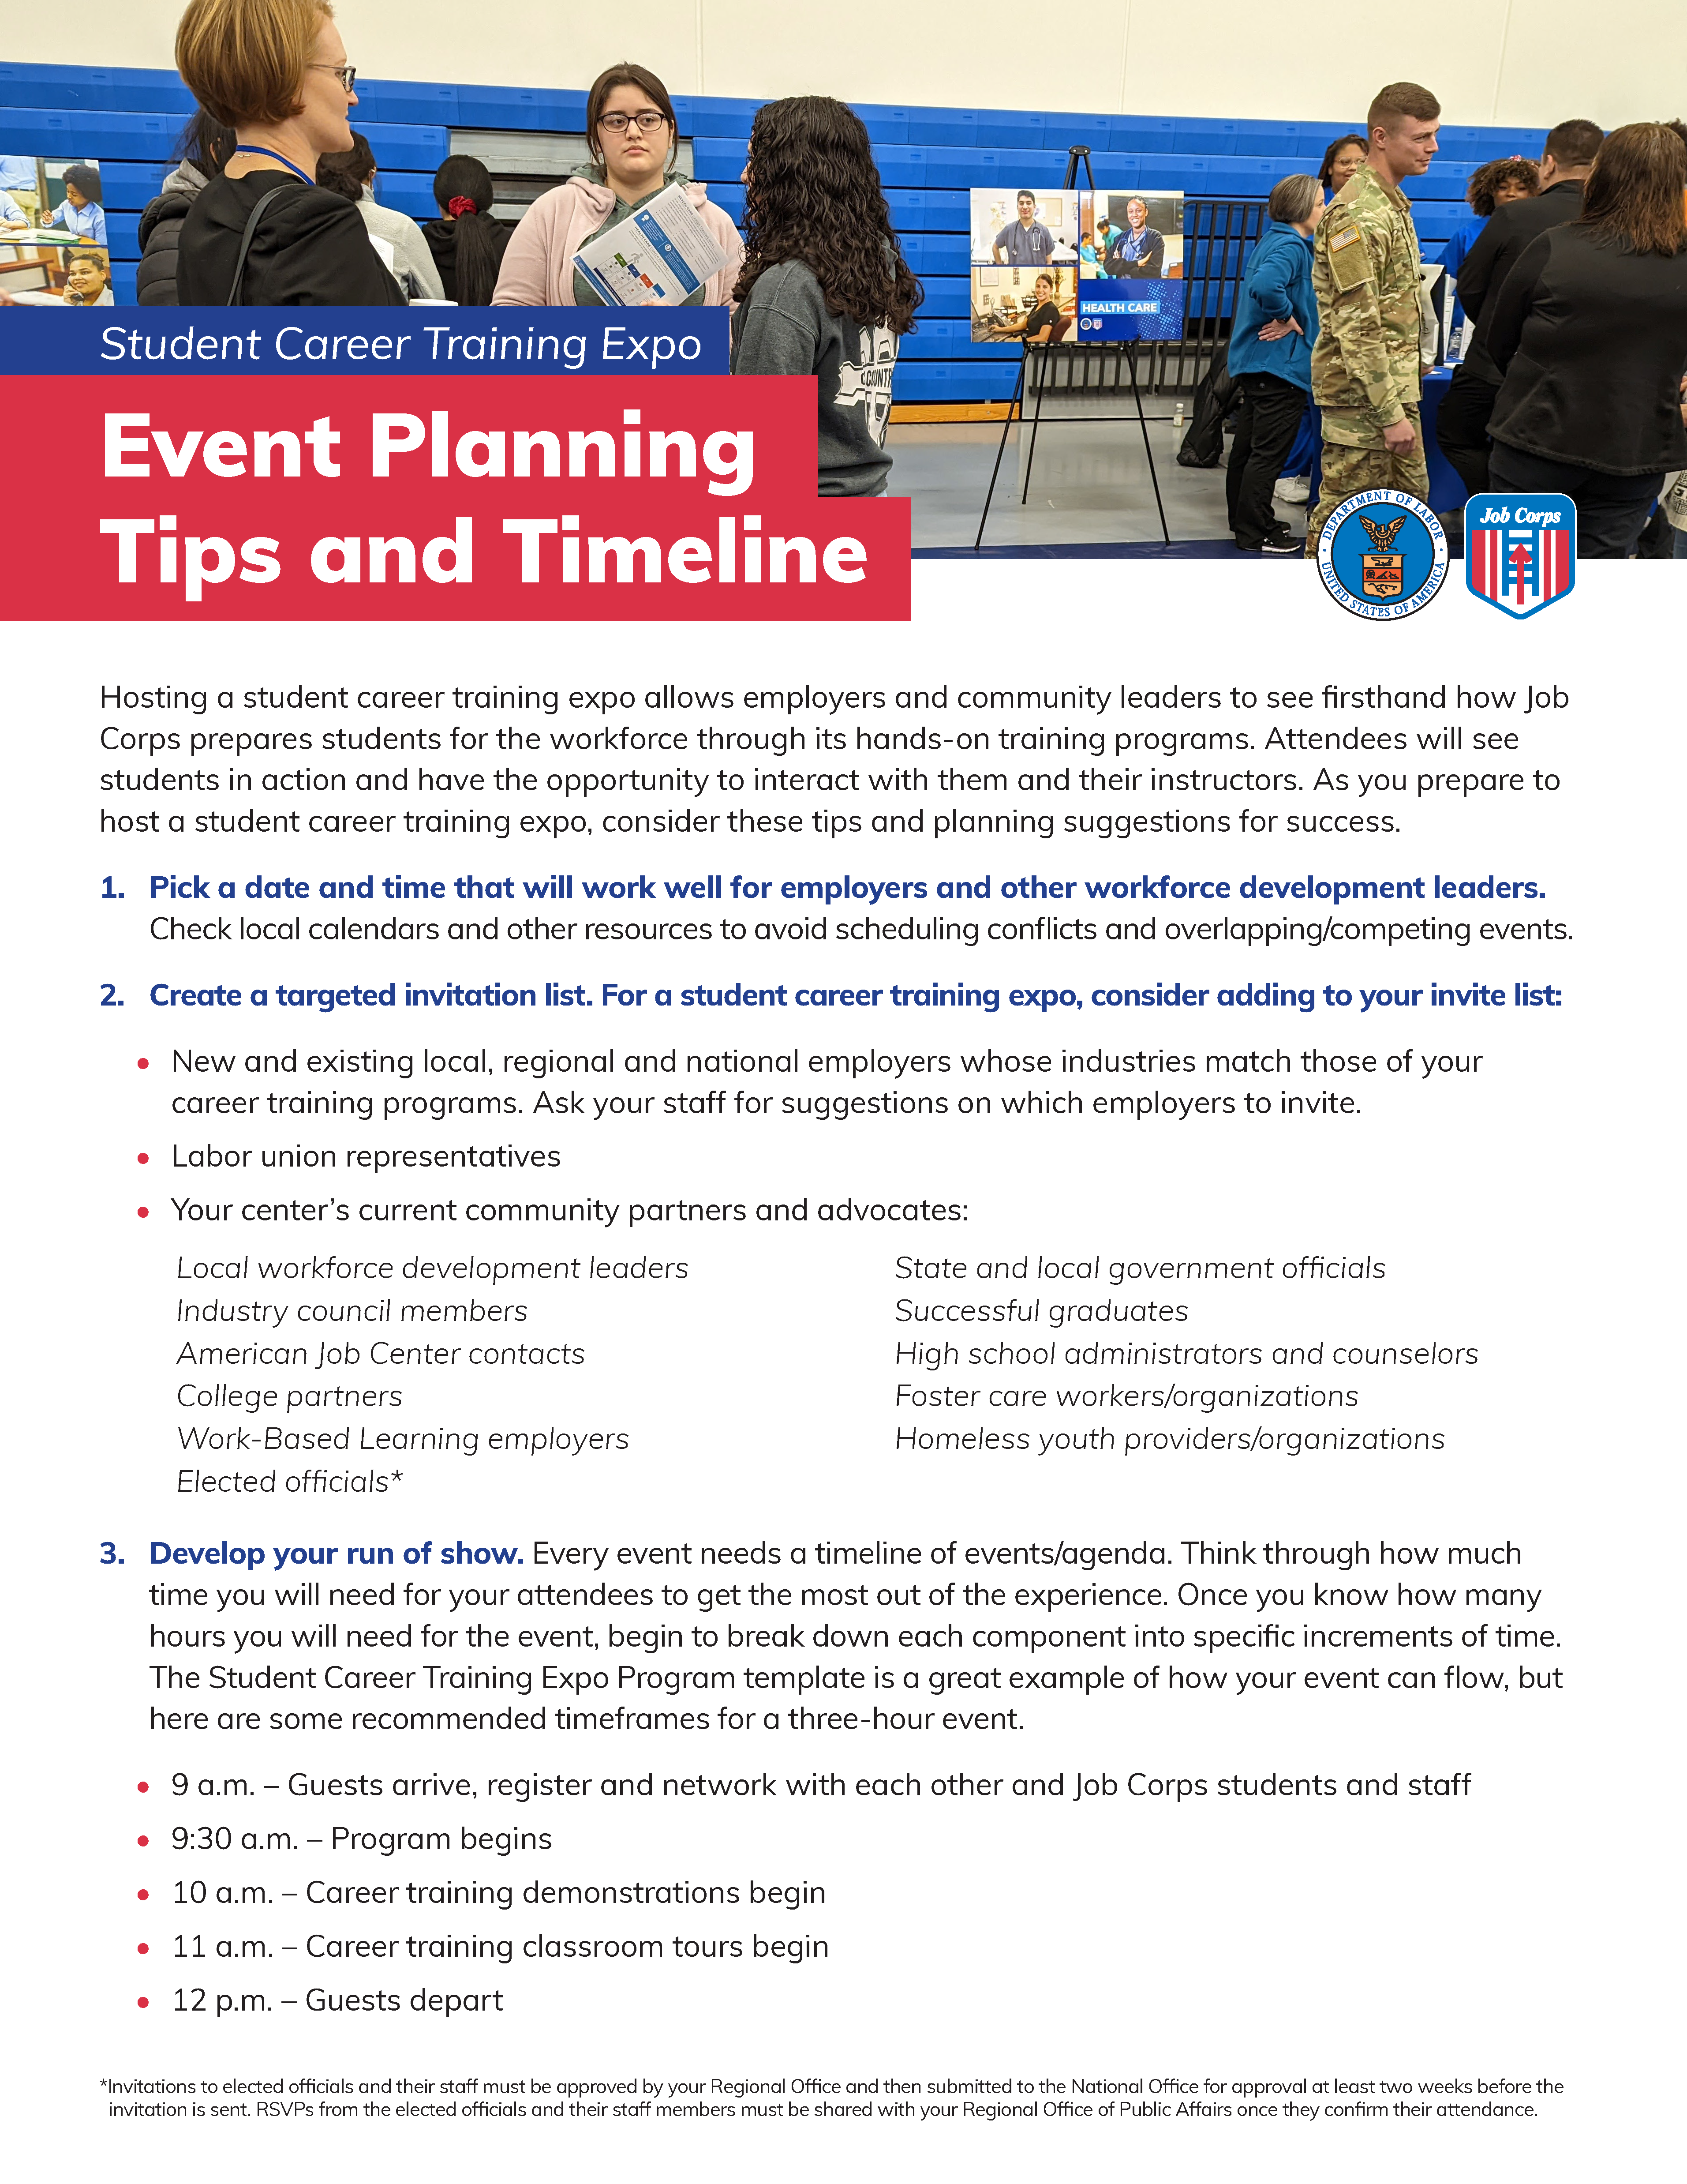
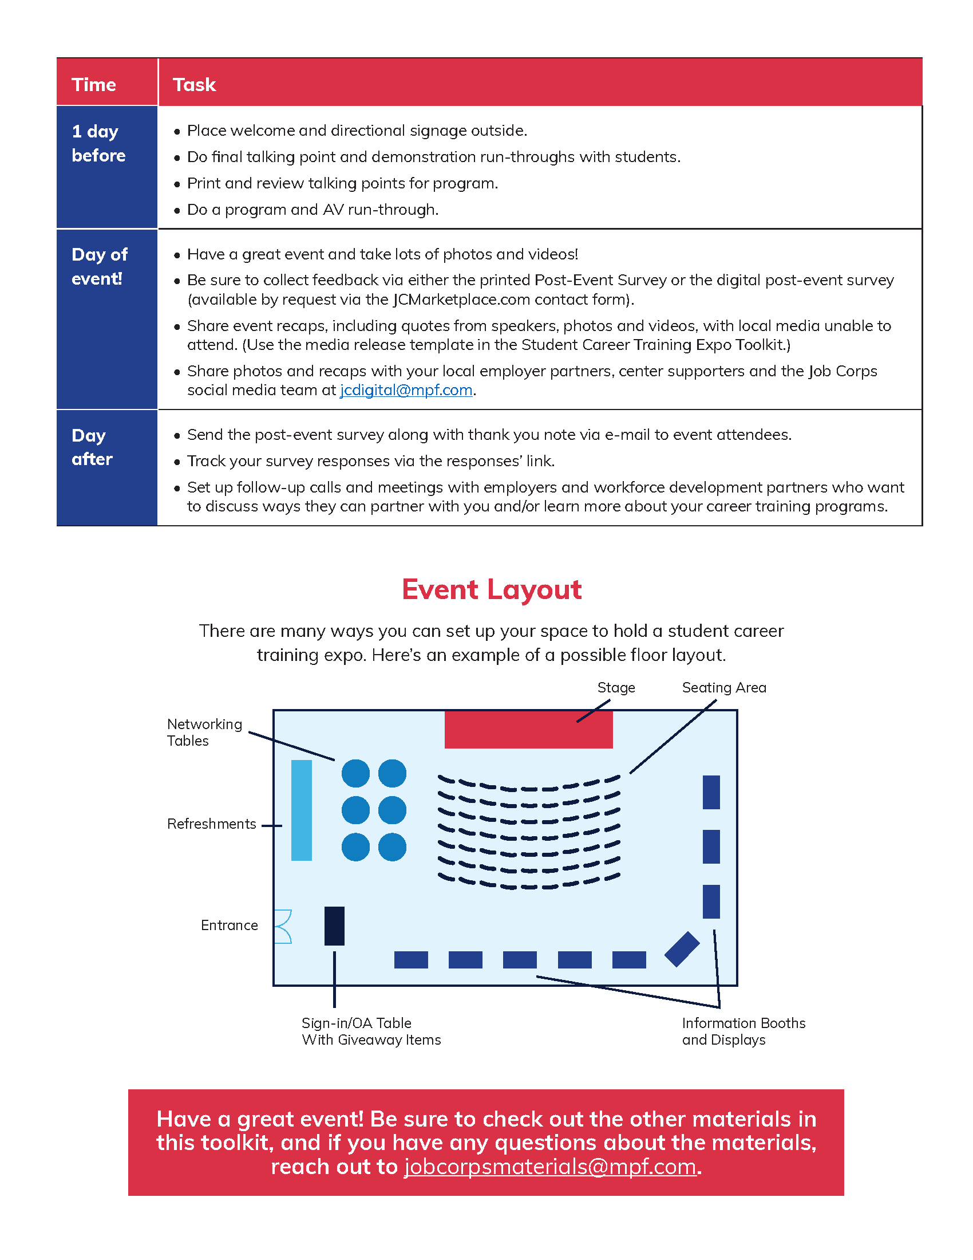
Event Planning Tips and Timeline
Notes:
The first material is an event planning tips and timeline document to help you in setting up and running these events on your campus.
Hosting an event on campus involves a lot of preparation. For each event, we have compiled a list of tips and timelines for a successful event.
A few of our key tips include:
Picking a date and time that works well for your center, employers and students.
Creating a targeted invitation list.
Developing a run of show.
Generating excitement and preparing students ahead of time.
Along with our tips, the sheet lists out a very detailed event timeline that lists everything that needs to get done prior to the event, the day of the event and even the day after the event. Along with the timeline, we have also included an event layout suggestion for each of the three events.

Slide 7
Save the Date
Notes:
OK, so now you know what type of event you want to host and you have read the tips and planning guide to make sure you are set up for success. Now it's time to get the event on your list of attendees' calendars!
This next material is a Save the Date and ensures that your event gets on your guests' radar early, reducing the likelihood of their committing to other engagements on the same date.
Sending a Save the Date is important for any event as it serves as an early notification for the formal invitation. The Save the Date notifies guests about an upcoming event and allows them to plan their schedules, make travel arrangements, and/or avoid scheduling conflicts.
To have this material customized with your event information, you can e-mail our team at MP&F for customization at Jobcorpsmaterials@mpf.com.

Slide 8
Invitation
Notes:
So if you send out the Save the Date about six weeks before your event, you will want to follow with a more formal invitation about four weeks before the event.
Sending invitations either digitally or via snail mail is essential for your event and can impact the success and overall experience of the occasion. By sending out invitations, you can manage and gauge the interest and availability of your attendees. An invitation includes essential information such as date, location and purpose of your event to spark the interest of your guests. It also includes a way for guests to RSVP – so make sure to include that information as well.
E-mail jobcorpsmaterials@mpf.com to customize your invitation.

Slide 9
Invitation Letter
Notes:
In addition to the Save the Date and Invitation, each toolkit also has more formal invitation letter. This letter is more for the potential partners and organizations that may not know much about Job Corps, and you are wanting to provide them with more of a formal introduction before sending them a Save the Date or Invitation. This letter is totally optional and just available if you think it makes sense to send to any or all of your potential guests.
The highlighted parts are sections that you will need to customize to make it specific to your center. This is a document that you can edit on your own – you don't need MP&F's help with this.

Slide 10
Program Speakers' Tip Sheet
Notes:
As I mentioned, your event will most likely include a program of some sort with remarks by the center director, a featured employer, a Job Corps student or graduate, or even a DOL representative.
No matter who the identified speakers are for your event, the next material is a program speakers' tip sheet to aid you in making sure your speakers feel calm and confident.
This one-pager lists out our top seven public speaking tips to make sure it's a success.

Slide 11
Program
Notes:
Every event needs a good program so attendees know what to expect and how to manage their time at the event.
The templated program outlines a standard run of show, including welcome remarks, the pledge of allegiance, speaker introductions, speaker remarks and the timeline for the main event – whether it's the expo, career fair or roundtable. The back of the program has a message about Job Corps and encourages attendees to work/partner with Job Corps in the future.
This program or outline should be used to make sure the event runs smoothly and that there is an understanding on what will take place during the event. E-mail our team for customization.

Slide 12
Student Resume Template
Notes:
So this is actually a material that already exists and has been on the Materials Marketplace for a while. But since the purpose of the career fair is for students and/or graduates to get hired, we wanted to include this pocket resume template in the career fair toolkit so students can use it to give to employers at the event.
This resume template provides students with a structured format on what information to include and how to present it effectively. It ensures the document looks organized, visually appealing and easy to read, making a positive first impression on potential employers. Students can download the template directly to their computer and edit the template.

Slide 13
Employer Roundtable Discussion Prompts
Notes:
The next material is a document that is for the employer roundtable discussion event. I mentioned this earlier when I was talking about this event. This document contains several prompts that will help with conversation flow and building relationships.
The prompts spark productive conversation with employers and industry leaders.
Some prompts include:
What technical skills matter most to you right now for new employees?
Do you currently hire apprentices? If yes, how many do you normally hire per year?
What next steps would you like to prioritize first as we continue to explore ways we can partner together?

Slide 14
Pre-Event Media Advisory Template
Notes:
The next two materials are for media outreach. If you think your event would benefit from having media attend and you have permission to have media on your center from your Regional Office and Office of Public Affairs, these documents will be very helpful.
The first is the pre-event media advisory that will help bring awareness to your event. MP&F has filled in a lot of the basic information that goes into an advisory, and all the highlighted parts are what needs to be customized based on your event.
A pre-event media advisory plays a crucial role in maximizing media coverage and generating interest and excitement about your upcoming event. It is a valuable tool in the overall event marketing and communication strategy, ensuring that your event gains the attention and coverage it deserves. Most media advisories are sent out two to four weeks in advance of the event to make sure the event gets on your local media outlets' radar.
Some of you may have great relationships with your local media and know exactly who to send a media advisory to. If you need help with this, MP&F can help you build out a media list and also distribute the advisory for you if need be. Just e-mail us again at jobcorpsmaterials@mpf.com.

Slide 15
Post-Event Media Release Template
Notes:
Following the media advisory – you will want to send out a post-event news release that gives highlights of the event and who attended. Many news outlets will run a short blurb or story about the event if you send it along with great photos and maybe even video from the event.
This is the post-event media release template that will help media outlets understand the key takeaways from the event. This is a great way to share the event's success with a broader audience and reinforce a positive perception of Job Corps in your community.
Again, if you need help writing the release and distributing it to media, you can let MP&F know and we are more than happy to provide as much or as little assistance as you need.

Slide 16
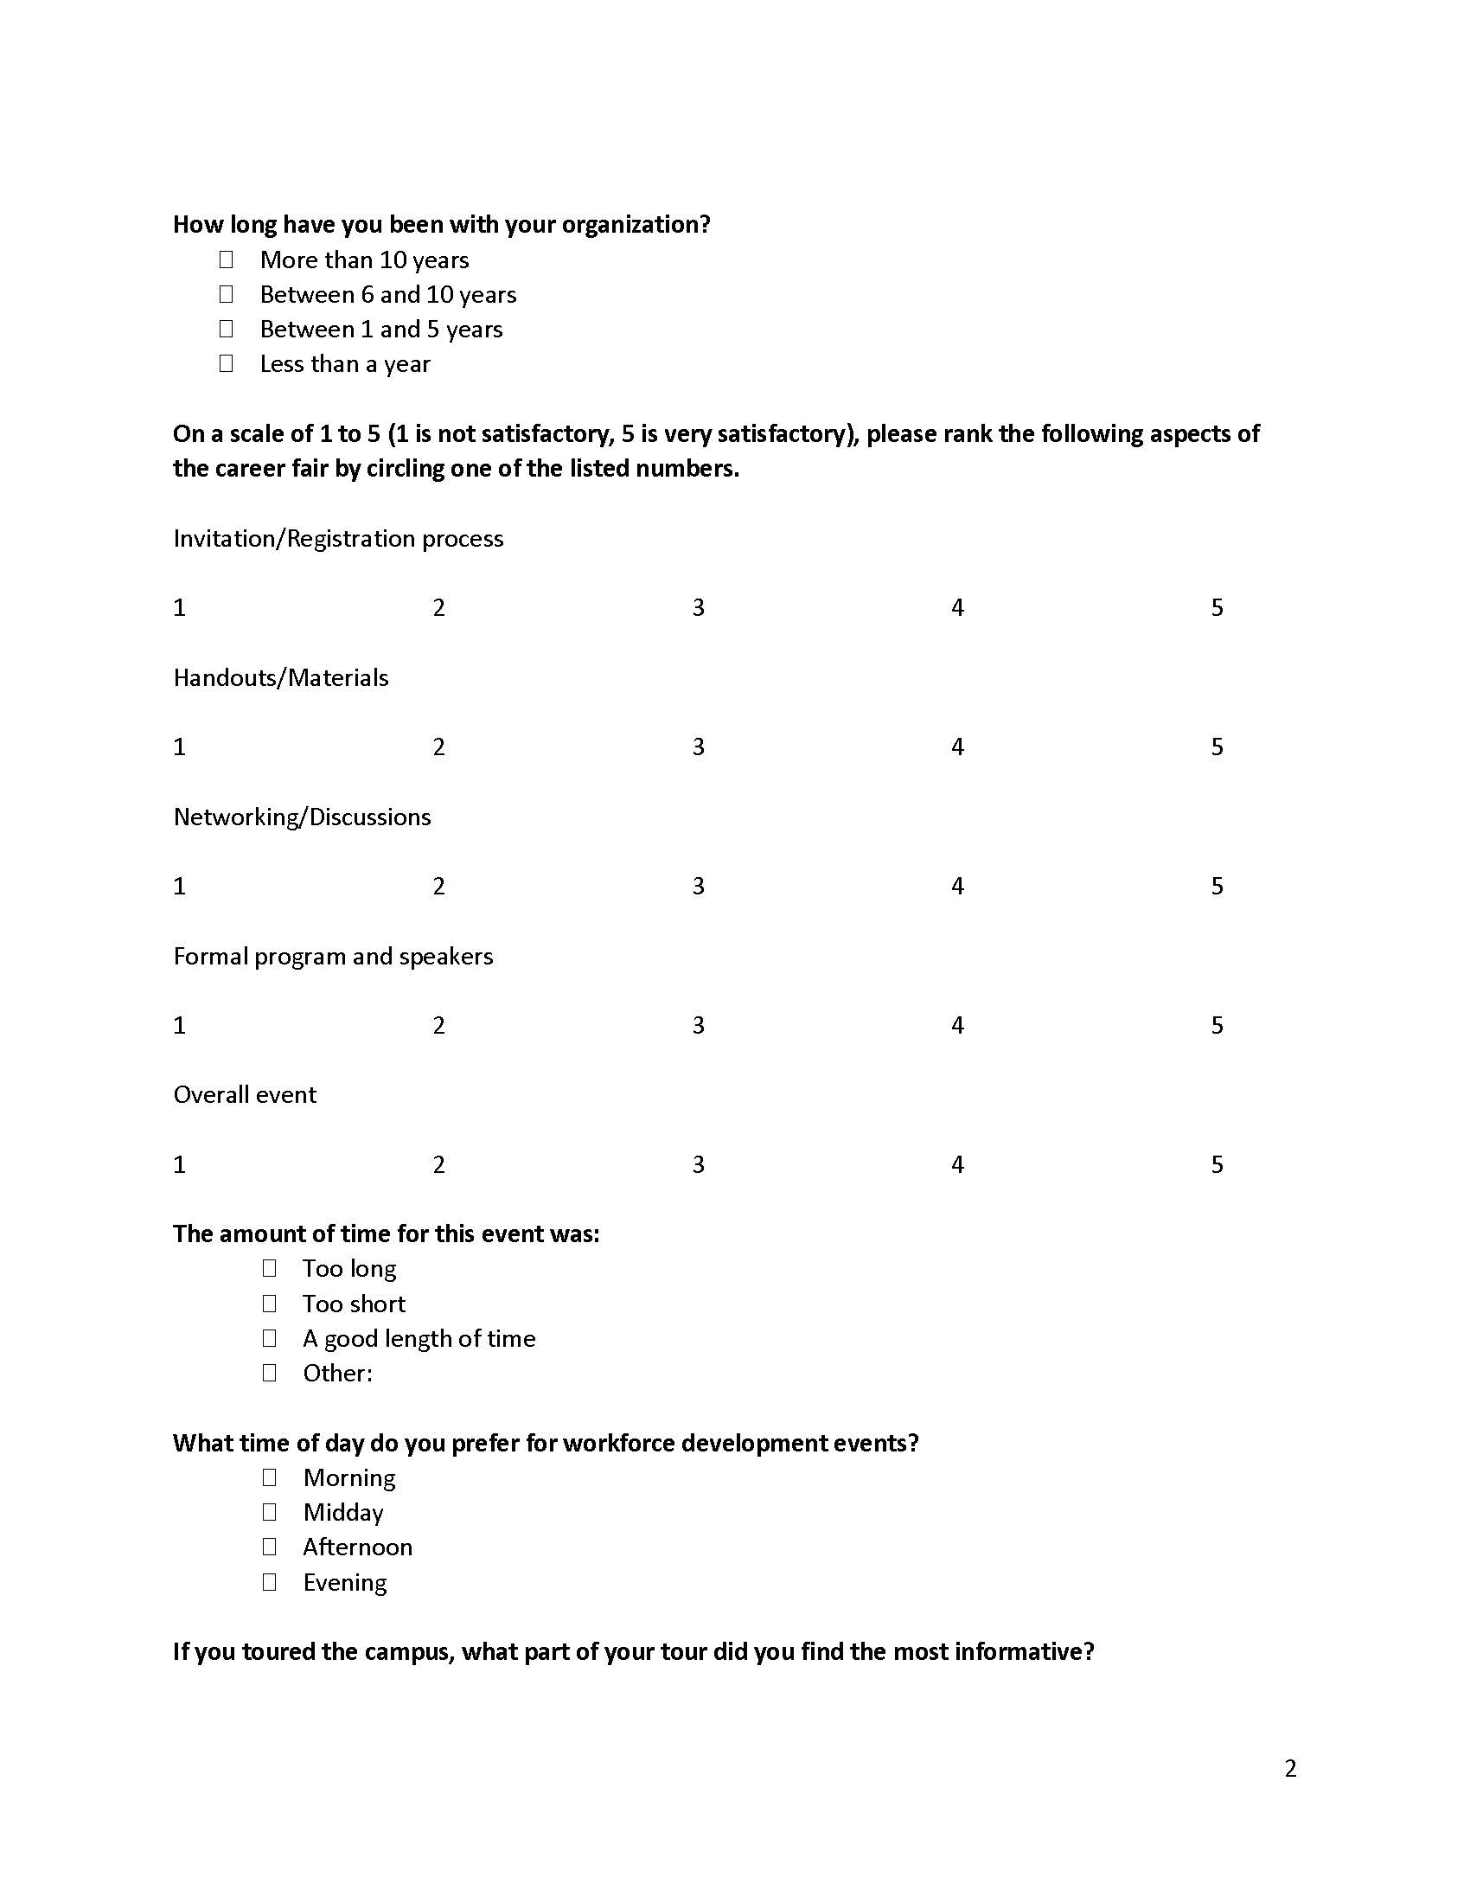
Post-Event Survey
Notes:
Our last material in the Workforce Outreach Toolkit is the post-event survey.
This survey allows your center to gather valuable attendee feedback, evaluating event success and identifying areas for improvement. This should be sent to all attendees (you should have all of their contact information from the invitation list).
The survey is a recommended list of questions to ask those who attended your event. You can distribute it in a couple different ways. You can put the questions in SurveyMonkey and send the link out to everyone, or you can copy and paste the questions into an e-mail and distribute it that way. Whatever works best for your center.

Slide 17
Materials Marketplace
www.jcmarketplace.com
Notes:
Now we touched on this a little at the beginning of the presentation, but I want to make sure you are all aware that this toolkit lives on the Materials Marketplace, along with a bunch of additional materials to help you in your outreach efforts.
Every material on the Marketplace has been approved by the National Office of Job Corps and you should be using them frequently. You can order any of our orderable materials that are available for FREE; think of it as the Amazon of Job Corps, where you can order just about everything needed to successfully recruit and retain students. A few materials are listed as 'download only' where you can download them directly to your computer and use a center or local printer to print these materials.
To order a material, simply click on its image and you will be taken to a new page where you can add the material to your cart. Most materials are available in quantities of 25–100, but we can accommodate larger orders as well if you e-mail our team. We will get into that in the next slide. Fill your cart with as many materials as you would like, and then click on the shopping cart icon to check out.

Slide 18
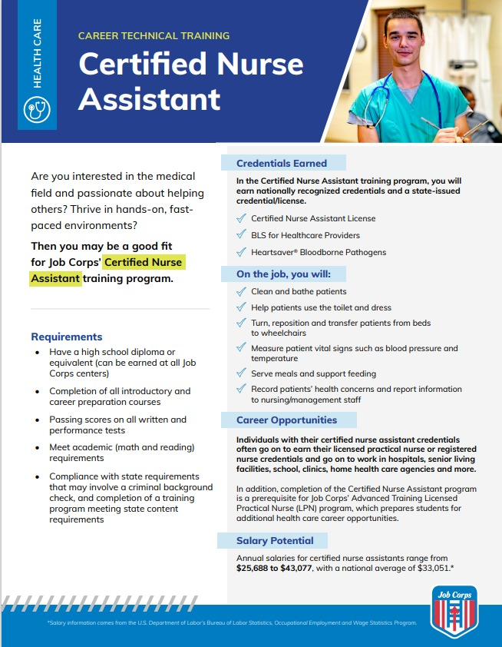
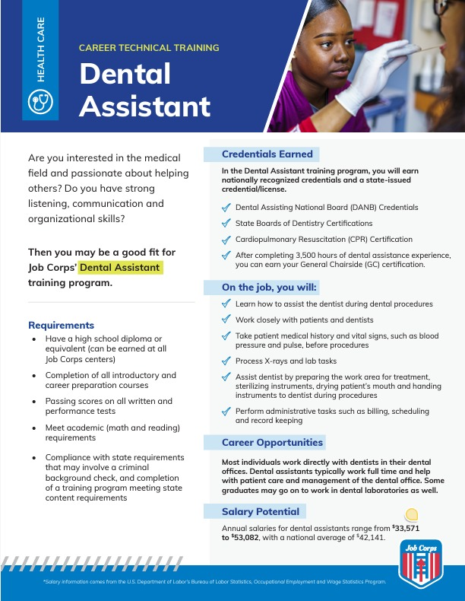
E-Mailing jobcorpsmaterials@mpf.com
Pieces available for customization on the Materials Marketplace
Bulk orders
Tracking missing orders
Notes:
As we mentioned before, a few of the materials in the toolkit will need our assistance with customization.
On the screen, you will see two of our new career technical training area fliers. We have created these for each training program, and they will be available on the Materials Marketplace soon, pending National Office approval. If there are any training programs specific to your center that you'd like to highlight that are not available on the new training area fliers, please reach out to our team at jobcorpsmaterials@mpf.com.

Slide 19
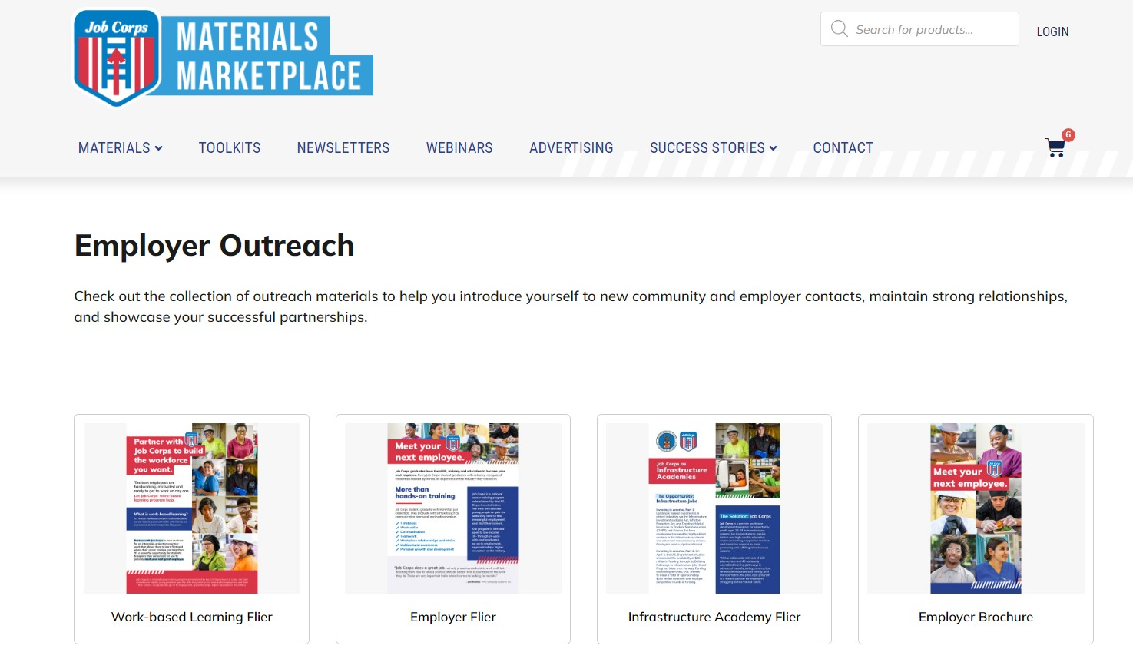
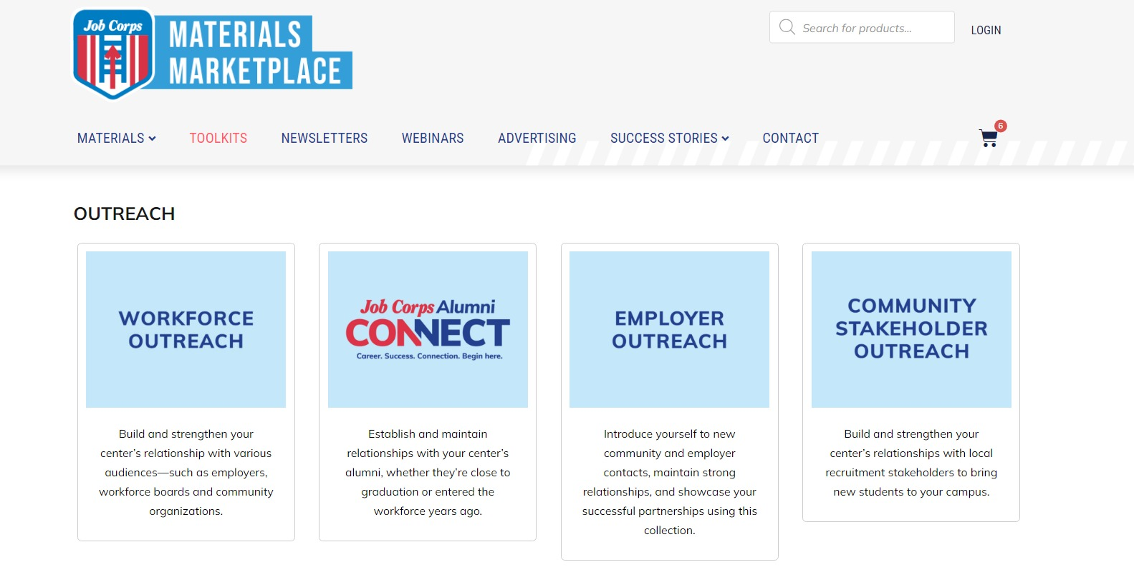
Additional Outreach Materials
Employer Outreach Toolkit
Work-Based Learning Flier
Employer Flier
Infrastructure Academy Flier
Employer Brochure
Notes:
In additional to the Workforce Outreach Toolkit, we highly recommend familiarizing yourself with our Employer Outreach Toolkit/resources. The pieces listed on the screen are the materials available in the toolkit, and we'll dive into when and how to use each material in the next few slides.
These are great materials to hand out to employers at your Workforce Outreach events, and they can aid you in showcasing Job Corps' successful partnerships and commitment to getting students workforce-ready.

Slide 20
Work-Based Learning Flier
Notes:
The work-based learning flier is a great material to inform employers about Job Corps successful partnerships and centers' work-based learning programs. The flier lists out what work-based learning is and how to set students up for success with hands-on experience in their career field.
It also informs employers how they can get involved with Job Corps and the benefits a partnership can bring, not only to the them, but to the students as well. It is suggested to share this flier with local businesses in the area and would be a great resource to hand out if your center plans on hosting a Student Career Training Expo.

Slide 21
Employer Flier / Employer Brochure
Notes:
The Job Corps Employer Brochure and Flier should be shared with employers who may be considering hiring a Job Corps student. These materials should be shared with local employers, community leaders and government officials. The brochure details how employers can benefit from hiring Job Corps students who are dependable, work-ready, cost-efficient employees, and it includes testimonials from company leaders who have hired Job Corps students. Employers will read how Job Corps can provide scalable and local talent, a streamlined recruiting process, and experienced recruits. These materials also offer an overview of the program, including training areas and center locations.
This brochure should be shared far and wide at your outreach events, but definitely make sure you are handing these out if your center chooses to host a career fair.

Slide 22
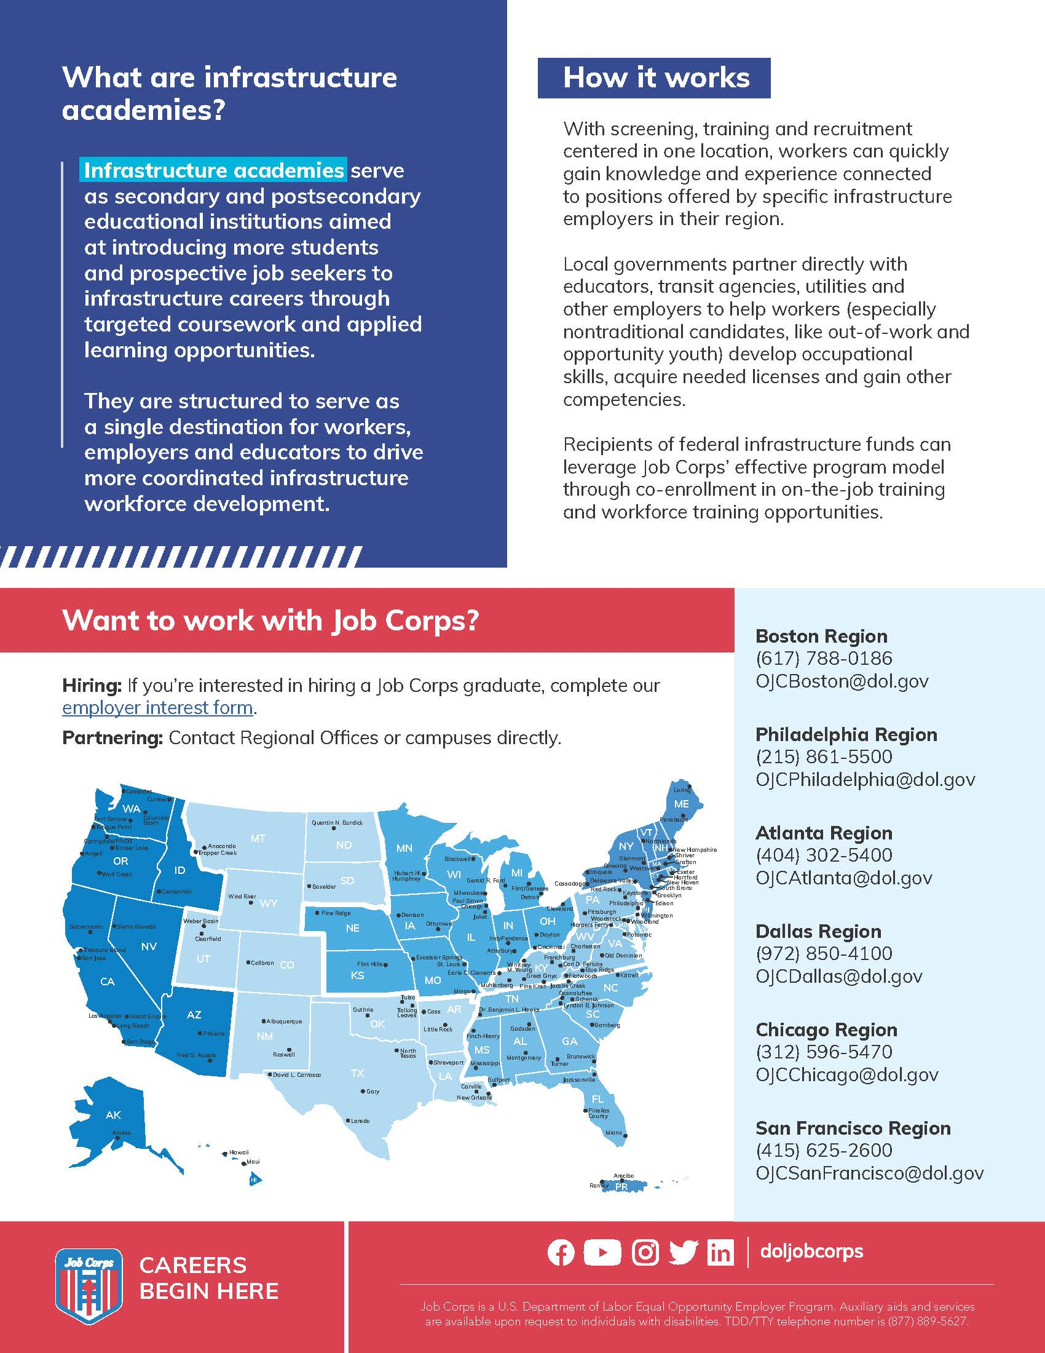
Infrastructure Academy Flier
Notes:
There is also a one-pager/flier that speaks about Job Corps as Infrastructure Academies. This flier can be shared with workforce partners who could benefit from connecting Job Corps with employers looking to hire advanced manufacturing, construction, renewable resources and energy, transportation, and other infrastructure-related Job Corps graduates. Encourage them to learn more about how Job Corps grads can benefit their organization and complete the Employer Interest Form that can be found at JobCorps.org under the 'I am an Employer' section.

Slide 23
Questions?
jobcorpsmaterials@mpf.com
615-259-4000
Thank you!
Notes:
Well, I think we have covered everything, and this will conclude the training today. I know that was a lot of information to take in, so please feel free to ask any questions about the topics we covered today. And please remember this training is available on the Materials Marketplace if you would like to review it again on your own time.
At this time, we’ll be dropping a feedback link into the chat box. We appreciate any and all feedback in regard to this presentation.
If you have any questions about this presentation, you can either call or e-mail us and we’d be happy to help you. Our phone number and e-mail address are on the screen.
Thank you so much for joining us today.

