Slide 1
Introducing
Job Corps Alumni Connect
Notes:
Hi, everyone.
Thank you so much for joining us today.
My name is XX, and I’m joined by my colleague XX. We work for MP&F Strategic Communications, the communications and marketing support contractor for Job Corps.
Today’s webinar is going to focus on Job Corps Alumni Connect.
Job Corps’ Alumni Connect network—launched in May—aims to help graduates stay connected to friends and mentors they met on campus and build their network with other alumni across the country.
And today, I’m going to cover the ways Job Corps is building the network and communicating with alumni at the national level and—even more importantly—how you locally can bring alumni into the network and showcase alumni to prospects, current students, employers and other stakeholders in your area to drive recruitment, retention and positive awareness for the program.
This webinar will last about 30 minutes, including some time for a Q&A session at the end of the presentation.
To keep you on your toes, I’m also going to throw out a few icebreaker questions throughout the presentation about alumni connection. So, be ready to put your answers in the chat box!
At any point, please also feel free to type questions in the chat, and we’ll answer as we go if possible or at the end of the webinar.
So, with that, let’s get started.

Slide 2
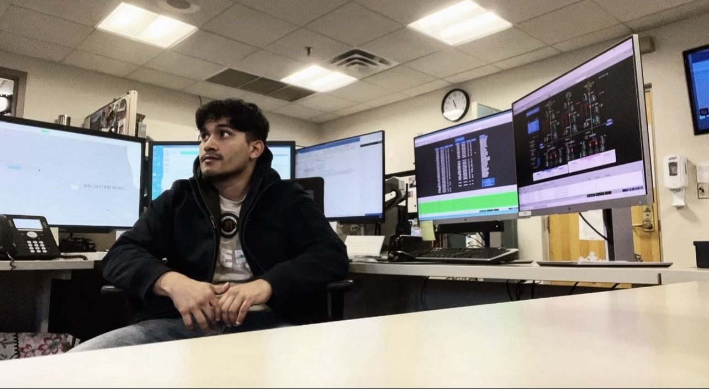
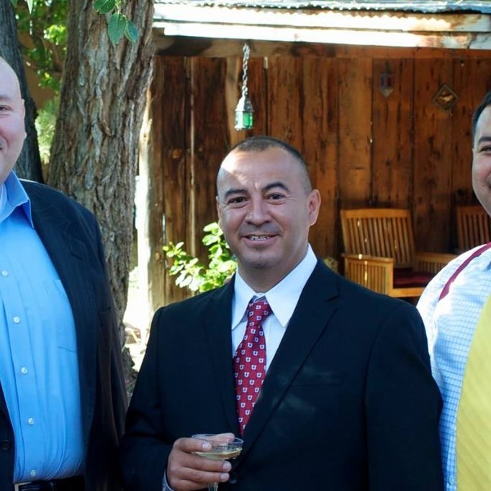
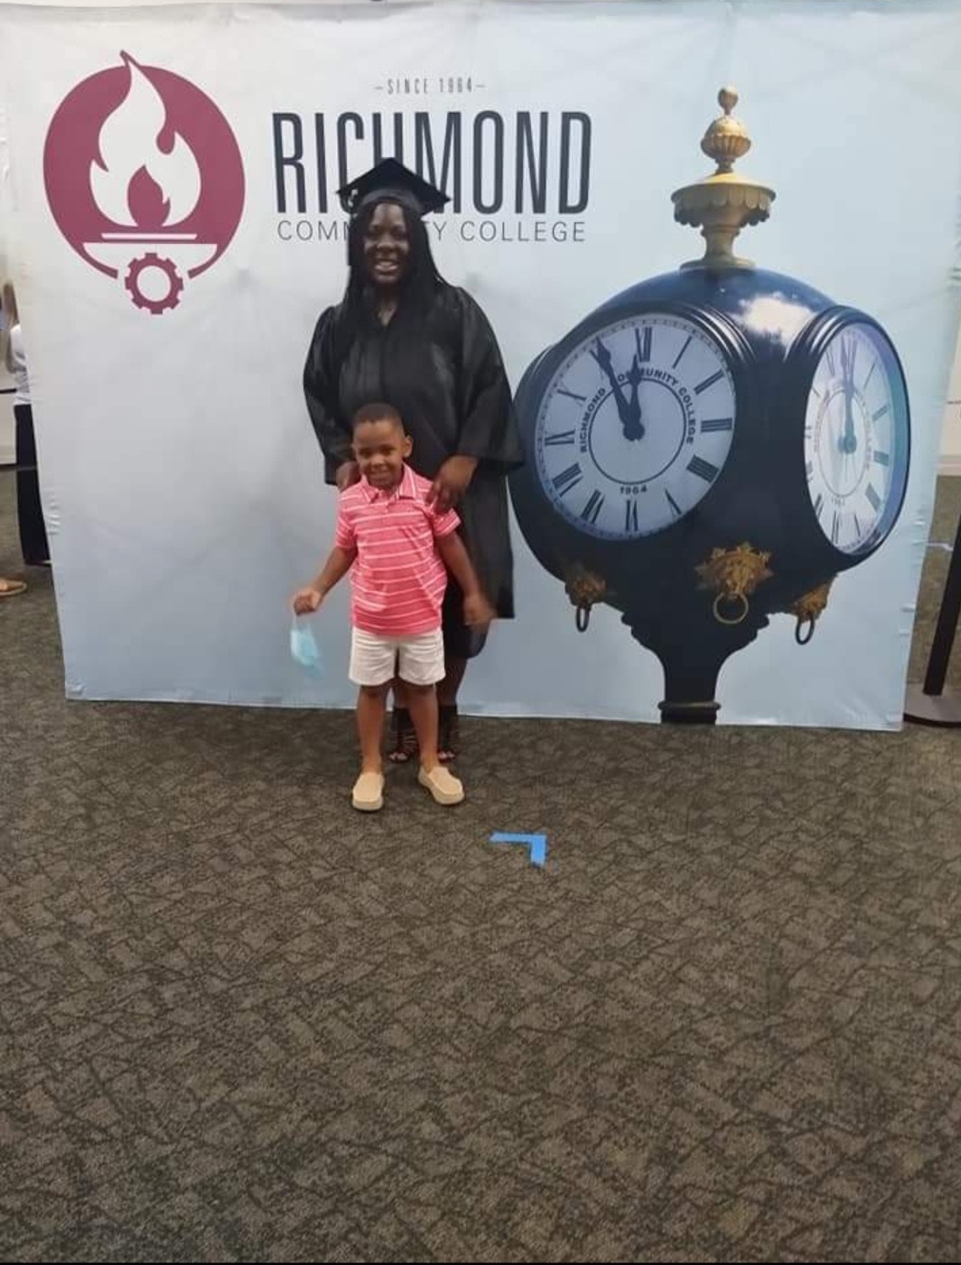
“The support I received at Job Corps inspired me to provide the same support in my community.” – Frank
“I think Job Corps was the first step [for me] to really bloom [into] the type of man that I am now.” – Kevin
“I remember the feeling of getting my GED. I felt like I accomplished something and I did something with myself. Everyone back home was proud of me.”
– Shaneequah
Notes:
Take a look at the alumni quotes on this slide. Job Corps alumni are the strongest voices for the program.
They are examples of the success that can be achieved through Job Corps and the connections that are created and can last a lifetime.
Their experiences and the pride they have in graduating from Job Corps serve as sources of inspiration for both prospects and students on your campuses right now.
They are also promising examples for communities and employers to see that there are inspired, passionate professionals graduating from Job Corps every day.
It doesn’t matter if we’re talking to potential students about how they found Job Corps or parents about why they are choosing Job Corps for their child or even community stakeholders about why they partner with Job Corps—an alum and their story always seem to come up as a reason for why they’ve gotten connected to Job Corps.

Slide 3
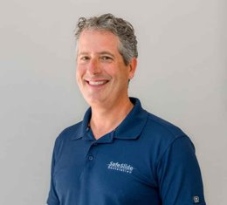
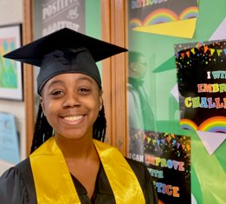
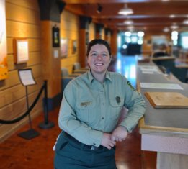
Notes:
Similar to your responses about your pride for your alma mater, Job Corps students feel and experience the same sense of pride when they complete their training.
As we’ve learned through years of research and testing, Job Corps alumni’s visible success is the program’s most effective referral source of prospects and supports student retention.
That’s why we created Job Corps Alumni Connect—to build alumni’s sense of pride, strengthen their professional connections and lifelong connection to Job Corps, and harness the power of their voices for the program.
Through the national network, alumni are connected to:
The friends and mentors they met at Job Corps
The latest Job Corps news and happenings
The vast network of Job Corps alumni across the country
Opportunities to share their story and inspire future JC alums
The first step is to get them here!
Alumni connection can begin the moment they graduate. That’s why it’s critical to build these relationships early.
This is why we are excited to share that we currently have 182 alumni signed up for the network and are ready to build Job Corps connections again.

Slide 4
This Is Alumni Connect
https://info.joinjobcorps.com/alumni-connect
Notes:
So, how do we do that?
Here on the screen, you see the Job Corps Alumni Connect landing page, found at info.joinjobcorps.com/alumni-connect.
Through national and center-level efforts that I’ll cover as we continue the presentation today, Job Corps alumni visit the site to learn more about what the network entails and sign up to join the network.
Alums are prompted to fill out a basic, easy-to-use form with:
Name (first and last),
Name while at Job Corps, if different (ex. Maiden name),
E-mail,
Job Corps center they graduated from,
Graduation year,
Industry,
Training area not in the list above,
City, and
State.
By filling out the form and signing up, alumni join and help build the database of Job Corps alumni.
As members of Alumni Connect, they are brought into the network for national communications and updates, broad alumni connection, and opportunities to be ambassadors for the program.
We are also working on an Alumni Connect section on the JobCorps.gov website. Stay tuned for more details to come.

Slide 5
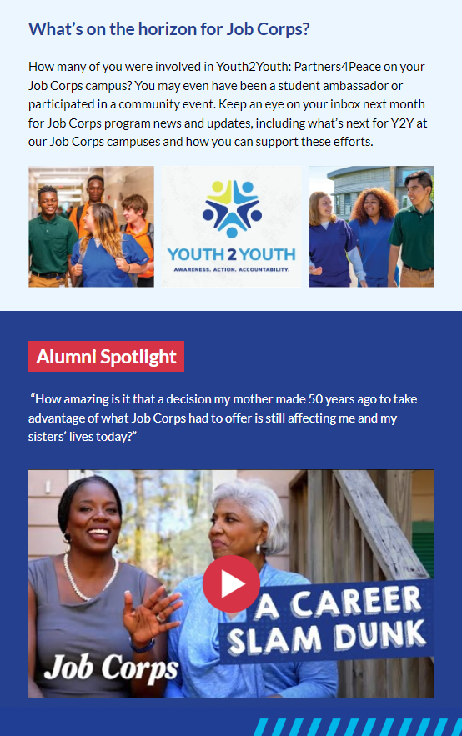
National Connections and Communication
Notes:
At the national level, we bring people in through social media engagement on Job Corps’ pages, the private Facebook group for alumni, graduate success story leads and other center-level efforts that you drive.
Once in the Alumni Connect network, alumni receive Job Corps’ monthly e-mail newsletter featuring Job Corps happenings, success stories and what’s on the horizon for the program. These newsletters mimic those you may receive from your alma mater and generate pride and connection among the Job Corps alumni network. You can see a recent one on the slide. The June newsletter performed well, proving alumni are receiving the content. It has a 66.2% open rate and a 2.11% click rate.
These are great stats for the first monthly e-mail newsletter. Our average 2023 stakeholder newsletters are around 18.45% open rate and 6.975% click rate. We are thrilled the newsletter is performing well with alumni.
Each newsletter also is published on the Job Corps Materials Marketplace at jcmarketplace.com/newsletters for you to view at any time. We’ll also periodically remind you about these through regional calls and communications.
Alumni feedback is important for us to continue to improve and evolve this program and these communications. So, now that the first groups of alumni have been in the network for a few months—we are conducting a new member survey. This is automatically sent to alumni three months after they have signed up for Alumni Connect. In addition, we are developing an annual survey to receive feedback from the entirety of the Alumni Connect network and plan to distribute that later this year.

Slide 6
Job Corps Social Media
@doljobcorps
and the Job Corps Alumni Connect
private Facebook group
Notes:
We also highlight the network on social media to build awareness and feature the individual and collective strength of Job Corps alumni.
Social media is key to connection with JC alums. In fact, Facebook was home to the original form of this Job Corps alumni network with the Job Corps Grads private Facebook group launched in 2018.
There are around 3,800 members in that group today.
We’ve grown the group by running post-engagement ads encouraging alums to join, sharing the group with alumni we interview for success stories and driving sign-ups in social media content.
This group connects Job Corps alums to each other, expands their network and helps us identify success stories. Much of the conversation is alumni-driven and allows them to interact with other alumni across the country and share their Job Corps memories, pride and experiences.
When creating Job Corps Alumni Connect, we posted a short survey for the Facebook group to ensure we were communicating with Job Corps alumni in the way they want to be communicated with. The survey results showed us things like where their Job Corps pride comes from and, perhaps most importantly, that they want to be called Job Corps alumni, not grads. Hence the name!
In essence, the Facebook Grads group was the perfect focus group to help us set the foundation for an official Job Corps alumni organization.
And social media more broadly is a great place for Job Corps to showcase alumni’s powerful voices and stories and keep them in the loop of what’s going on at their centers.
Job Corps Alumni Connect will have a strong ongoing presence on all Job Corps social channels—Instagram, Facebook, YouTube, Twitter and LinkedIn—as all of us steadily build the network.
We will continue to feature alumni success stories and now draw awareness to the new network through social media posts and post-engagement ads.
Please encourage your center alumni to connect with Job Corps on social media and to join the Job Corps Alumni Connect private Facebook group as additional networking connections.

Slide 7
Your Outreach Toolkit
Notes:
I’ve talked about Alumni Connect growth and connection driven by national communications, but here’s where you come in.
We’ve developed the Alumni Connect toolkit for you that contains materials and resources to help you build the alumni pipeline to and from your center.
Alumni Connect members will be valuable for you and other staff to recruit new students to Job Corps, to show the collective strength of Job Corps to employers and our communities, and foster pride in being a Job Corps alum.
The pieces and materials in the Job Corps Alumni Connect toolkit are designed to help your center spread awareness of the network and assist in these outreach efforts to Job Corps alums.
The toolkit includes:
An alumni letter/e-mail for you to share with new alumni after they graduate to congratulate them and invite them to join Alumni Connect.
A Job Corps Alumni Connect flier to share in one-on-one conversations, whether those are on campus with students about to graduate or out in the community with local alums or even employer partners.
A poster to showcase on campus or on community stakeholder organization sites.
An event guide with event ideas to engage alumni on your campus.
A postcard that promotes the benefits of the Alumni Connect network and resources available through the program.
These materials provide you with resources to help alumni build their networks and stay involved with your center even after they’ve graduated.
All materials include the link or QR code to the Job Corps Alumni Connect landing page I showed you earlier so alumni can learn more and sign up.

Slide 8
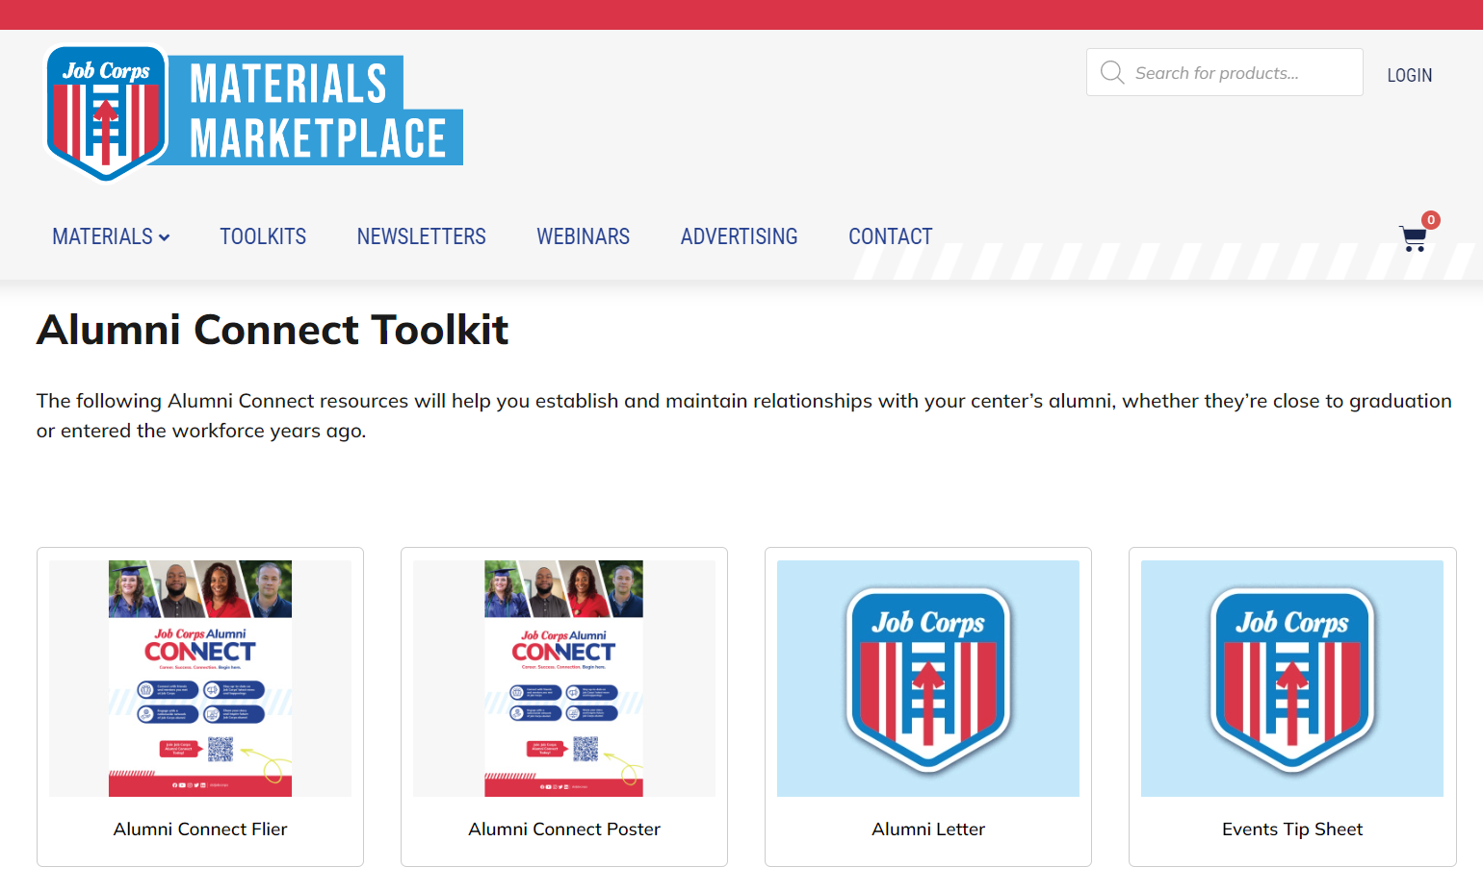
Find this in the Toolkits section of jcmarketplace.com!
Notes:
The toolkit is on the Job Corps Materials Marketplace at jcmarketplace.com/alumni-connect-toolkit (or found in the Toolkit section of the Marketplace) with all materials accessible to you to view and download at any time!
As you explore the toolkit and use materials, please be sure to let us know what is working, what isn’t working and what is most helpful in the field. E-mail us at jcalumni@mpf.com.
This is a new program. It’s for you and for every student you’ve brought through Job Corps and put on the path to a career.
I know the ways to communicate with students and alumni are ever-changing, and we want to make sure you have what you need.

Slide 9
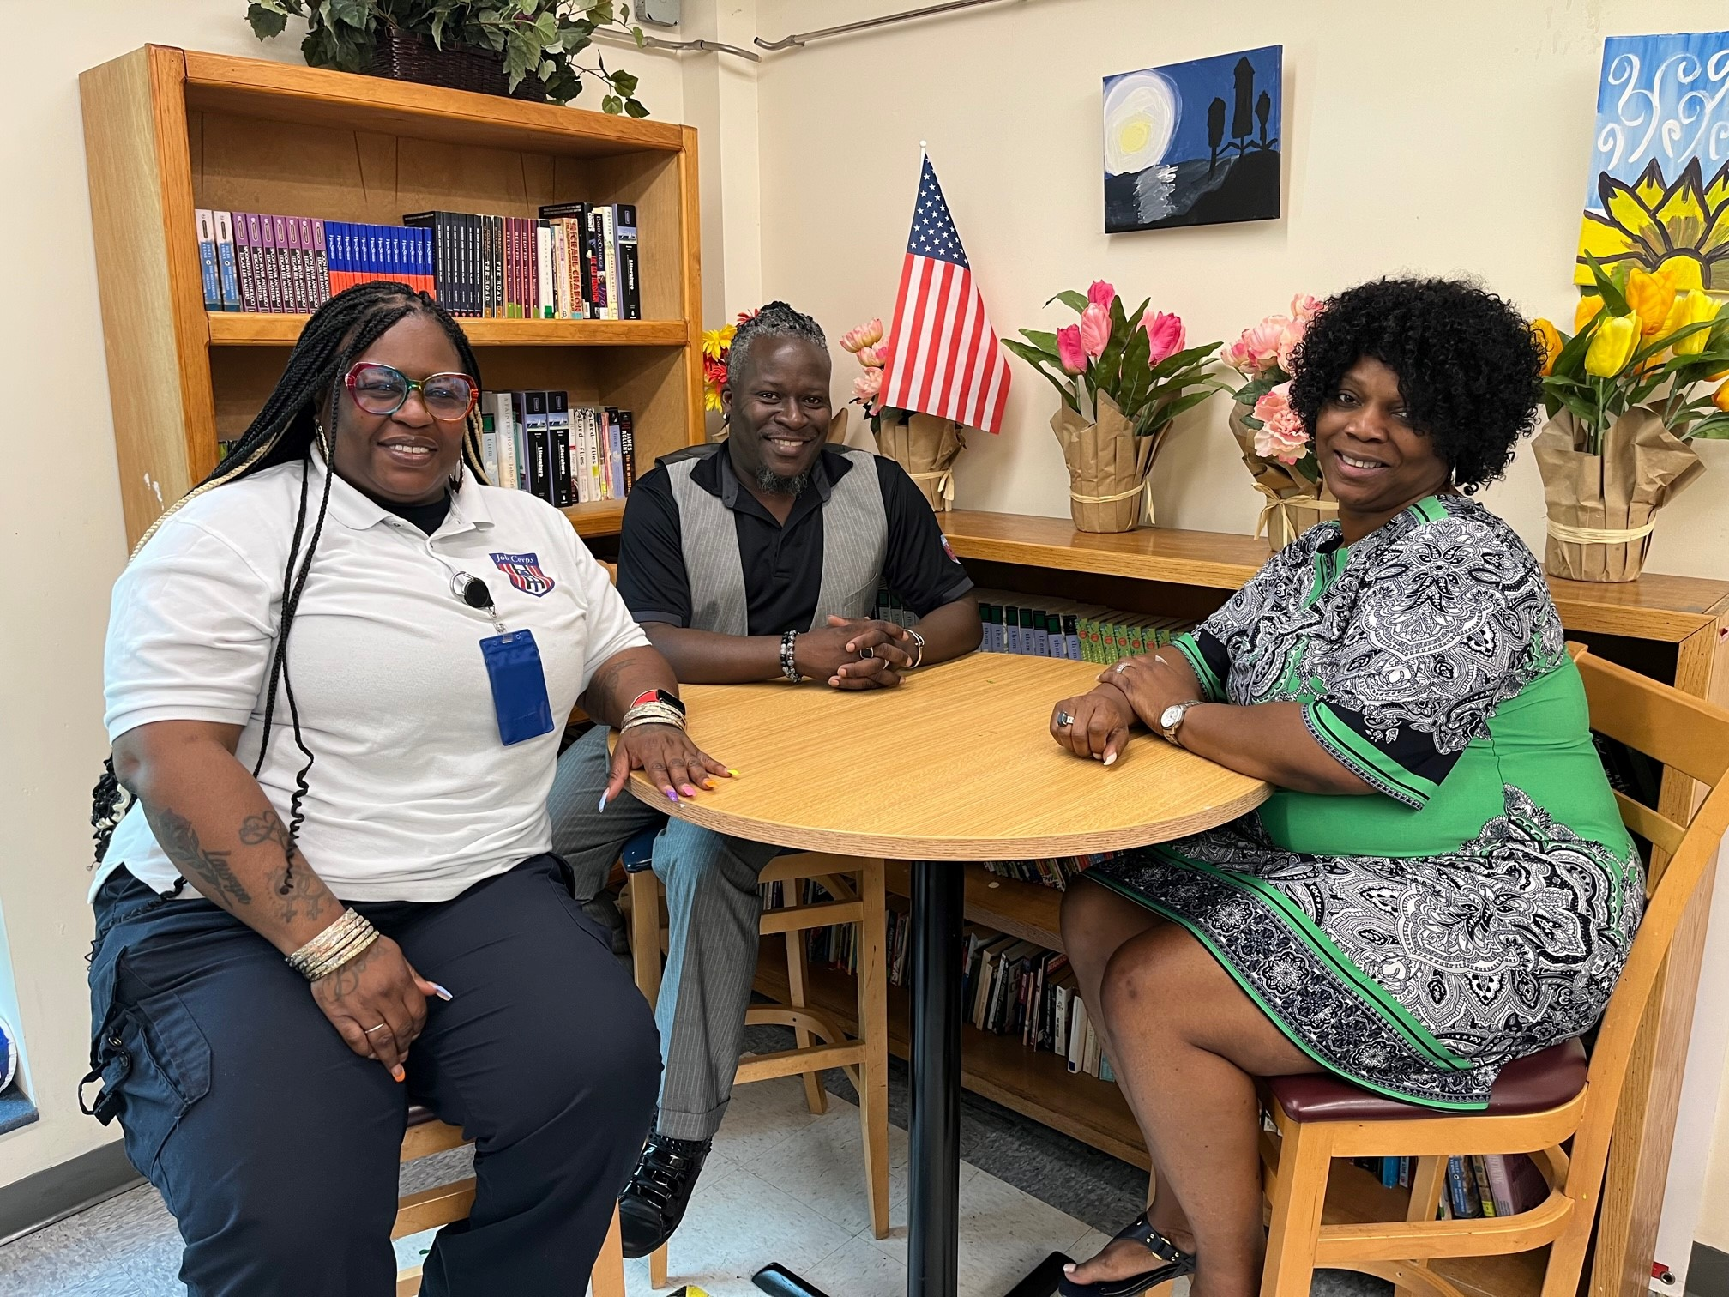
Alumni Events
Homecoming/alumni campus visits
Mentor/mentee program
Alumni guest speaker
Networking
Reception
Notes:
I’ve said it before, and I’ll say it again. Job Corps alumni are the best advocates for the program, and they can help prospects and current students see the long-term values.
Inviting alumni back to campus for events and mentoring opportunities will spotlight their achievements and reconnect them with the program in new ways. Your event could even be highlighted in the Alumni Connect newsletter.
Examples of alumni events include:
Homecoming/alumni campus visits: An alumni homecoming can be one of the most exciting post-graduation events. It’s a great way to get alumni together to catch up and celebrate their triumphs and achievements.
Mentor/mentee program: These events can happen a few times a year and are great ways to connect a Job Corps alum with a current student completing their training in the same training area. They can share tips and best practices for completing their courses and be a connection for them in the future.
Alumni guest speaker: Invite alumni who are willing to share their story with others for a speaking event on campus. This will spread Job Corps pride and inspiration to current students.
Networking: Host a networking event or community open house with Job Corps alumni to introduce them to other working professionals in their industry, connect with current Job Corps students, and support employer/professional partnerships.
Reception: Over light refreshments, alumni and associates can reminisce about their favorite Job Corps memories and just enjoy each other’s company!
The possibilities for involving and engaging with Job Corps alumni are endless.
As we mentioned earlier, start nurturing your relationships with them early and often.
Job Corps alumni are the best voices of the program, and the most powerful advocates to help spread the message and potential of the program to current and prospective students, as well as employers and other community stakeholders!

Slide 10
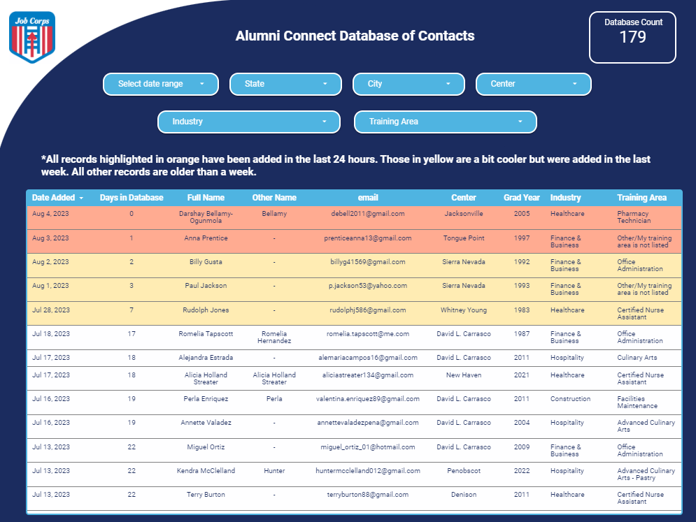
Alumni Connect Database
Notes:
Job Corps has created an easily accessible database with contact information for Job Corps alumni so that you and other designated center staff can continue to establish and maintain professional relationships with your center’s alumni.
I mentioned this earlier. As of today, there are 182 people registered in the Alumni Connect database. This number can be found in the top right corner of the database and will automatically update.
You can see in the example here that this database provides you with the full name, e-mail, training area and graduation year for your center’s alumni.
After this training, we will send a follow-up e-mail with links to the database and step-by-step instructions on how to create an account to view the database.
Please check out the database and access it regularly for opportunities to connect with these alumni. The database updates regularly to provide you with a continuous stream of alumni to reconnect with.
When alumni sign up for Alumni Connect, it opens doors to speaking, mentorship and more opportunities for them to connect with our students, further strengthening the importance of the network.

Slide 11
Questions?
jcalumni@mpf.com
(615) 259-4000
Thank you for joining us today!
Notes:
Thank you for all your great answers and your participation today.
This will conclude the training.
I know that there was a lot of information to take in. So, I’ll open it up now for any questions about the topics we covered or to share any successes you’ve had so far reconnecting with alumni and engaging them in center events or mentorship. Please put those in the chat box, and we’ll respond to them.
[Take questions.]
Thanks again. Please remember this training will be available on the Materials Marketplace if you would like to review it again.
Now, we’ll be dropping a feedback link into the chat box.
We appreciate any and all feedback to this presentation.
If you have any questions later, you can either call or e-mail us and we’d be happy to help you. Our contact information is listed on the screen.
Thank you so much for joining us today!

