Slide 1
Recruiting 101: Using Recruitment Materials
Notes:
Hi, everyone. Thank you for joining me for today’s webinar – Job Corps Recruiting 101: Using Recruitment Materials. My name is Amanda Amorese, and I work for MP&F Strategic Communications.
We are the communications and marketing support contractor for Job Corps, which means we are responsible for creating national recruitment materials, coordinating Job Corps’ national advertising campaigns, handling text and e-mail campaigns to nurture prospective students through the recruitment process, and managing the program’s social media accounts on Facebook, YouTube, Instagram, X and LinkedIn.
But we also support Job Corps’ outreach and admission counselors like you. And that’s what today’s webinar is going to focus on. This webinar will last about 30 minutes, including some time for Q&A at the end. At any point throughout the webinar, feel free to type questions in the chat box at the bottom of your screen. I’ll answer it either right away or at the end of the presentation.

Slide 2
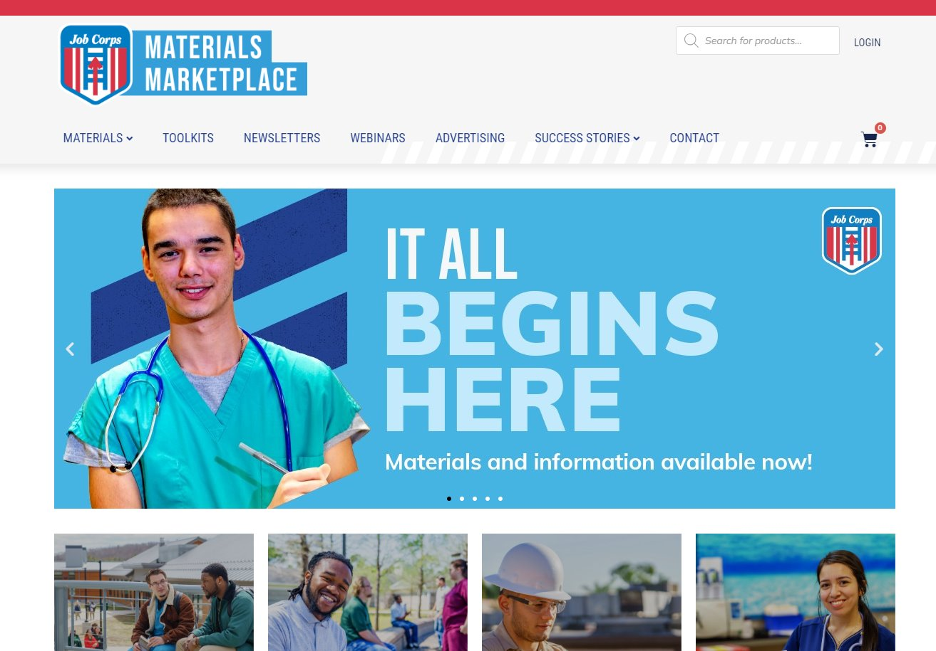
/// OVERVIEW
jcmarketplace.com.
Notes:
While I am sure many of you are familiar with the Materials Marketplace, I want to go over what it is for those of you who are newer to the program.
Every material on the Marketplace has been approved by the National Office of Job Corps. These are the marketing materials you should be using in your outreach efforts.
You can find and order all of the materials we will discuss today on the Job Corps Materials Marketplace at jcmarketplace.com. Think of it as the Amazon of Job Corps where you can order just about everything needed to successfully recruit and retain students.
There is everything from center fliers, translated materials, videos and e-mail templates to posters and banners and so much more.

Slide 3
/// Question
How often do you use materials from the Job Corps Materials Marketplace in your outreach?
Daily
On an as need basis
I mostly use my own materials
I never use the Materials Marketplace

Slide 4
/// Question
How much does it cost to order a material from the Materials Marketplace?
A) Free
B) $5
C) $10
D) $20
Notes:
Let's do another question. What do you think the average cost to order a material is from the marketplace?
If you guessed Free, you are correct! That is right, the materials available for order from the Materials Marketplace are all FREE! The Job Corps National Office covers the cost of producing, printing and shipping the free materials to you.

Slide 5
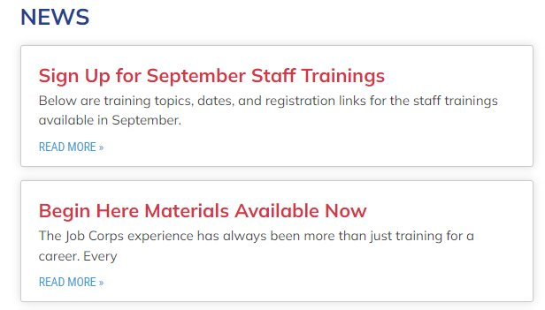
/// How to Use the Materials Marketplace
jcmarketplace.com
jobcorpsmaterials@mpf.com
Notes:
Now, let's get into the training. Today we are going to discuss our most popular materials and how and when these should be used.
These materials can be shared directly with prospects or even with parents, grandparents and potential employers of Job Corps grads.
On the screen, you will see the front page of the Materials Marketplace.
At the top of the page, you will see a revolving banner that displays the most recent need-to-knows on the Marketplace. Here we display new toolkits that are available, new ad campaigns and so much more. This should be your first stop when on the Materials Marketplace!
Below the banner, you will see boxes for Recruitment Materials, On-Center Materials, Industry Specific Materials and Stakeholder Outreach materials. Feel free to click directly on those boxes and it will take you to those materials available. Additionally there is a section marked 'Materials Spotlight' where we will display our newest materials avalaible to you.
Lastly, when you scroll down you will see the news section, where you can find even more new information. Here we share new and improved campaigns, the latest PIN updates, AND links to sign up for staff trainings like this one. In this section, you will find updates about what is going on in the Job Corps program.
You may or not be familiar with this website, but we encourage you to frequently visit this site for all your materials needs and to see what new materials may be available to use in your outreach efforts. If you have any questions about where you can find a material, please feel free to e-mail us at jobcorpsmaterials@mpf.com.

Slide 6
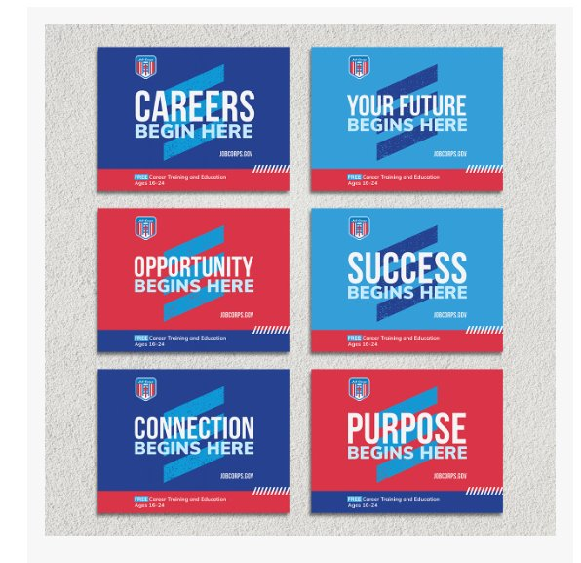
/// Costs Associated with the Materials Marketplace
Notes:
On the lefthand side of your screen, you will see the Recruitment Flier as an example of a piece that is available for both ordering and download for free.
I did want to note that there are a few items that your center will be responsible for covering the cost of.
On the right, you will see our new Yard Signs as an example of a piece that your center would be responsible for paying for. If you would like to use MP&F's preferred vendor to print and purchase theses materials, we will go into more detail on that later on in this presentation.
You will also see on the marketplace that there are some items that are download only. You are welcome to download those and print them at your office or take them to a local vendor to have them professionally printed.

Slide 7
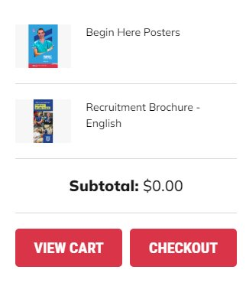
/// Ordering from the Materials Marketplace
Notes:
Let’s briefly talk through the ordering process.
To order a material, simply click on its image and you will be taken to a new page where you can add the material to your cart. Most materials are available in quantities of 25–200, but we can accommodate larger orders as well. We will get into that in the next slide. Fill your cart with as many materials as you would like, and then click on the shopping cart icon to check out.
From there, you will be taken to your online shopping basket. Make sure that you have everything you want, and then continue to checkout. You can check out as a guest, but you also have the option to create an account and save these materials for future orders. To create an account, click on the “register” button.
Next, you will need to fill out some basic information, like your name, center and address, and then your order will be on its way. We suggest you try to give yourself some breathing room of about three weeks when ordering if you have an event coming up in case there are any shipping delays.

Slide 8
/// Question
Does the MP&F team coordinate customized pieces for center?
​
Yes ​
No
Notes:
For our next question, I wanted to see if you all are aware of our custom order process. Do you think MP&F can design and coordinate custom orders?
The answer is yes!

Slide 9
/// Contact Us
Personalized event fliers ​
Pieces available for customization on the Materials Marketplace ​
Bulk orders ​
Tracking missing orders
jobcorpsmaterials@mpf.com
Notes:
If you find that the materials on the Materials Marketplace do not fit your current recruitment and outreach needs, please feel free to reach us at jobcorpsmaterials@mpf.com.
On the screen, you will see two customized pieces we recently created. On the left is a business card, and on the right is a bookmark.
You can also reach us if you need to place a bulk order of a few hundred pieces as the Marketplace does not allow you to place the order yourself.
We know QR codes are popular right now and many of you are requesting to include them on various materials. We hear you. And we think this is a great addition, but to the right materials. We want to be cautious of how we offer QR codes, where we place them and where they link to. For example, putting a QR code on an info session flier that already has a virtual meeting link can be confusing for prospects.
All this to say, we see the opportunity and are discussing with the National Office the best strategy to implement QR codes for Job Corps. In the meantime, if you would like to add a QR code to a material, please email us and we will discuss the best course of action with you.

Slide 10
/// Materials for Easy Handout
Notes:
So now that you know how to order and find materials, lets discuss the types of materials at your disposal.
I’m first going to talk about the recruitment postcard and doorhanger. We like to think of these as the perfect “leave behind” pieces in the sense that you could drop these off in a prospective student’s mailbox or leave on their door. Both of these pieces give a brief yet informative overview and describe the types of things that students could achieve while in the program.
Ideally, these pieces should prompt a prospective student to contact his or her local admissions counselor for more information. These are designed to be used very early on in your interactions with potential students.
You’ll notice that there is a spot on the back of both of these pieces to leave your personal information. It’s important to include your information so you are making a personal connection. Make sure to leave all your necessary contact information so that prospects can reach out to you.
Keeping that in mind, you could take a few of these materials with you on recruitment tours and fill them out ahead of time so that you could easily pass them out to students you meet at the event. The postcard especially is a great material to send as a follow-up after a one-on-one meeting or phone call with a prospect.

Slide 11
/// Materials for Warmer Leads
Notes:
Although the recruitment brochure is our most popular piece, we have recruitment information available for all types of leads. On the screen, you can see a few key materials that are consistently used in recruitment efforts. Each has a different amount of information for each piece.
Let’s first talk about the recruitment flier. This piece is an easily digestible, condensed introduction to Job Corps. It is easy to pass out at events or send as an attachment via e-mail. It is available to order or download, and it can be used as a standalone piece or combined with other materials. It comes in various languages as well and a QR code that will direct people to the jobcorps.gov site. This material is also translated in 20 different languages.
Now let's talk about the recruitment brochure. It provides general information and highlights training, education and student support. You should give this material to a potential student or student influencer who you have already spoken to about Job Corps, or someone who has seen the recruitment flier already.
The recruitment brochure is also available in Spanish, and there’s a version that you can download on the Materials Marketplace. You are encouraged to keep your offices fully stocked with this brochure. It should be your “go-to” piece.

Slide 12
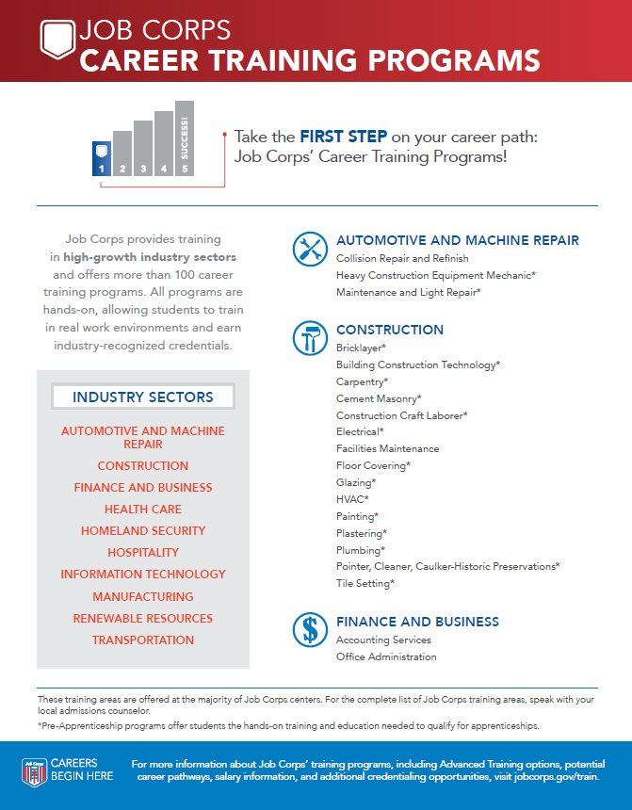
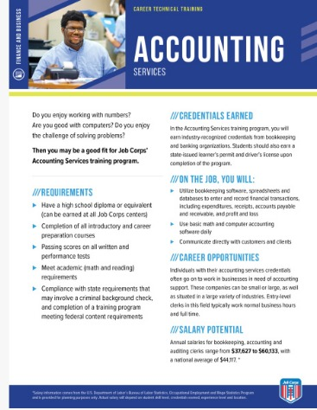
/// Career Training Program Fliers and Industry Materials
Notes:
Now we can talk about some popular pieces that have more specific information about certain elements of the program. These are materials that you should share with warmer students.
The Career Training Programs Flier on the left lists all the career training programs by industry. This is a great piece to share with students so that they can get a big-picture overview of Job Corps’ career training options.
The Career Technical Training or CTT sheets on the right are another great resources to share with prospective students. We have created a CTT sheet for every Job Corps training area that provides detailed information about training requirements, skills gained, credentials earned, career opportunities and potential earnings to help students make informed decisions about their career and educational pathways. These CTT sheets are available for order or download.

Slide 13
/// Center Fliers
Notes:
There’s a center-specific flier on the Marketplace for every Job Corps center across the country. These are great pieces to combine with other, more general recruitment materials, like the recruitment flier or brochure. Use the general piece to introduce Job Corps, and the center flier to fill in details about life at your center. The fliers provide comprehensive, yet easily digestible descriptions of each center, including location information, training areas, campus information and a typical weekday daily schedule.
On the screen you will see an example of a typical Job Corps center flier and a CCC flier. CCC materials have their own distinct look and color scheme, so be sure to check those out.

Slide 14
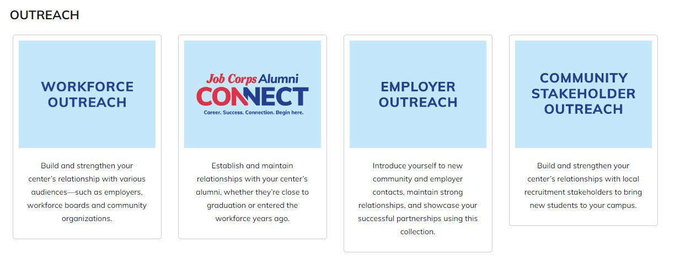
/// Toolkits
Notes:
At the top of the website, the Marketplace has a section specifically dedicated to the toolkits that have been created for center staff.
Job Corps offers access to toolkits on various Job Corps topics, from recruitment to media outreach and beyond. Each toolkit contains resources including tip sheets, templates and more to support your outreach and recruitment efforts.

Slide 15
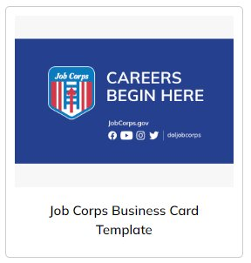
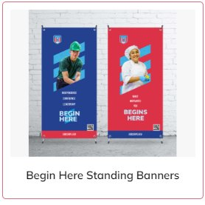
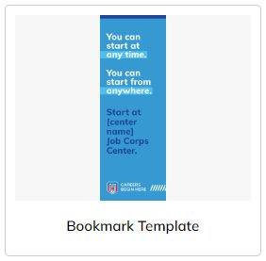
/// Custom Orders
Digital Flier​
Yard Signs​
Car Magnets​
Hanging Banners​
Standing Banners​
Business cards ​
Bookmarks ​
And more!
Notes:
As I mentioned before, MP&F can work with you to customize materials. A suite of event and outreach materials have been developed for centers to customize to make them center-specific. These items can be used on- and off-campus and feature an updated look. You can see examples of what the yard signs, car magnets and banners look like on the Marketplace.
There is no cost for MP&F to help you design these materials, but centers will be responsible for the costs associated with these pieces.
We have recently created a pop-up shop with our preferred vendor if you would like to order from them. You can find all that information located in the product description.

Slide 16
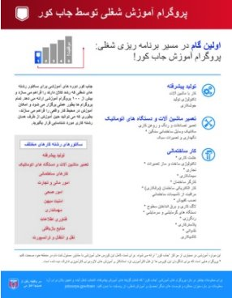
/// Translated Materials
Notes:
We have translated materials for a wide range of audiences, including potential students, parents and organizations. We have not only Spanish materials, but French, Somali, Russian, Dari, Pashto, Vietnamese and more. We are always working on translating more materials and expanding the languages we provide. On the screen, you will see a Dari Career Training Programs flier, a Pashto recruitment flier and French enrollment card.
If there is a language that is commonly spoken in your area and you are interested in having a piece translated, please email us.

Slide 17
/// Seasonal Materials
Notes:
We also have a few seasonal materials on the Marketplace that are great recruitment resources for changes in season, especially as you ramp up recruitment to kick off this year. The seasonal postcards on the Marketplace provide an overview of Job Corps and encourage students to start on the right foot by considering the options available to them at Job Corps.
Personally, I recommend sharing these postcard as a series. You can first share the Spring postcard, which is to the left of your screen. The message on this postcard encourages prospects to start thinking about their future career and education goals.
The summer seasonal postcard, which is to the right of your screen, serves as a reminder to potential students about how Job Corps can help them take the next step toward a successful future and long-term career.
And then the last postcard in the series is what we've deemed the "back to school" postcard. It encourages students to start a new school year off on the right foot by considering the options available to them through enrolling in a free career training program.

Slide 18
/// Editable Materials
Notes:
Lastly I want to touch on our editable materials. These are materials that you can download directly to your desktop and personalize or make center-specific.
You can find this material by searching 'Editable Information Session Flier' on the Materials Marketplace. This material is editable and is a great tool if you have an upcoming event on center you want to promote. Just click the 'Download Now' button and a file with all the variations of this flier will pop up on your computer. From there, you can edit it just like a normal word document. We also have a CCC-Specific one as well.
If you are having difficulty editing this flier, please reach out to our team and we’d be happy to assist.

Slide 19
Questions?
615-259-4000
jobcorpsmaterials@mpf.com
Thank you!
Notes:
Well, I think we have covered everything, and this will conclude the training today. I know that was a lot of information to take in, so please feel free to ask any questions about the topics we covered today. And please remember this training and Recruiting 201 are available on the Materials Marketplace if you would like to review them again on your own time. At this time, we’ll be dropping a survey link into the chat box. We appreciate any and all feedback in regard to this presentation.
We hope you will be able to join us for Recruiting 201: Recruitment Best Practices next week. We will be discussing the best tactics on how to use the materials you learned about today.
If you have any questions about this presentation, you can either call or e-mail us and we’d be happy to help you. Our phone number and e-mail address are on the screen.
Thank you so much for joining me today.

