Slide 1

Success Stories:
They Come From You
Notes:
Thanks for joining today’s webinar. My name is Mason Wright, and I work for MP&F, the marketing and communications support contractor for Job Corps.
We are responsible for creating national recruitment materials, coordinating Job Corps’ national advertising campaigns, and managing the program’s social media accounts on Facebook, YouTube, Instagram, Twitter or 'X' and LinkedIn. We also do many other things as well, but these are some of the main efforts we coordinate.
Part of what we do every day is share the incredible stories of Job Corps students and alumni, and the successes they find through this program. I’m talking with you today about how these success stories are generated and used in promoting Job Corps to prospects, their influencers and other members of your communities … and how you’re a key part of this process.

Slide 2
Overview
What makes a great success story
How to capture success stories
How success stories can be used
How to use and access JCSuccess.org
You will be able to find this presentation under the “Webinars” section at JCMarketplace.com.
Notes:
Here’s a quick overview of what we’ll discuss today.
First, we will talk about the key components of a great success story. Then, we’ll dive into why they’re so important to the program, how to capture success stories, and the many ways they can be used internally and externally for Job Corps. Lastly, we'll talk about the Job Corps Success website.
For anyone just joining us, a quick reminder to please add your name, center (or organization), and e-mail address into the chat box.
After this webinar, we will e-mail each of you with a survey and link to this presentation. This presentation is being recorded, and the PowerPoint will also be available on the Job Corps Materials Marketplace under “Training,” so you can download or watch it for future reference at any time.

Slide 3
What is a success story?
A personal account of how Job Corps helped a student, alumni, employer
Good news
A personal story/snapshot that shows that Job Corps works
Notes:
What is a success story? Simply, it’s a student or alum who benefited from the program and is willing to share that experience with others. Those personal stories show that Job Corps does what it was designed to do. It’s a snapshot of someone’s journey meant to inspire the next prospect, the next student and the next success story … It’s about people.
That’s not to say that things can’t be success stories. For example:
A work-based learning project that helped a specific audience
Community service where students were able to use the skills they’ve gained in Job Corps
A special event, like an open house or graduation ceremony
Those are successes too, and you should capture, document and share them with others. And if you have a great photo or two, send them to us for Job Corps’ social media!

Slide 4
Important Success Story Indicators
Successful alumni
Good wage or higher education
Job training match
Overcoming challenges
The friend test
Notes:
You may be wondering how to know if have a good Job Corps success story. In many cases, it can jump off the page to you.
But on the slide, I’ve listed some common indicators.
For the most part, think alumni. These stories have such a significant impact because they’ll demonstrate a path in life that Job Corps helped set them on. It’s easier to measure the success of Job Corps through the eyes of an alum who’s now earning a paycheck or has moved on to higher education or the military. This is especially relevant for alumni two-plus years out of the program who have had a little more time to advance in their career but still remember a lot about their Job Corps experience.
Also, does the story pass the friend test? In other words, would this success story be interesting or inspirational to your best friend if you were to tell them about it?
While we’re often talking about alumni, I don’t want you to walk away from this webinar thinking we don’t also want to hear about students who are recently enrolled or are partway through their training—if they have motivating or inspiring experiences or testimonials to share. This type of content plus a photo is perfect for Job Corps’ social media pages.

Slide 5
Why are Success Stories important?
Successful alumni: your best, most powerful, most impactful communications tool
Job Corps’ target audience told us this is who they want to hear from
Success stories help the reader connect personally
Notes:
Success stories are important for many reasons.
How many of you shop on Amazon, fast-forward through the product description, and go right to the reviews at the bottom? … Looking to connect with people who have actually bought the product before you do.
That’s what success stories are. They’re a positive review of the program from the people who have actually gone through the experience. They’re our most credible form of communication.
Therefore, Job Corps uses them in many, if not all, of the marketing materials, because:
We’re trying to enable a conversation or at least a connection between two groups of people: successful Job Corps students/alumni and prospective students/influencers.
We also do it because Job Corps’ target audience told us to. When we conduct focus groups with prospective students, we ask them this question: Would you rather hear from famous people or influencers, or would you rather hear from the actual students and alumni? Prospective students overwhelmingly want to hear from those who have gone through the program.
Through stories, we make a connection … to help the reader start thinking—How am I like this person? Or do I know someone like this person? Maybe even: Can I be like this person?

Slide 6
Why is it important?
I am looking to highlight a Job Corps success story in an upcoming installment of the DOL newsletter. I’m looking for recent JC success stories from TN, NC, SC, GA, FL, AL or MS. Please provide me any information you may have and all contact information for the person. I will contact them and ask a few questions to get their perspective, etc. I would like to talk to them as early as possible this week.
Thanks,
Deputy Regional Director-Public Affairs –Atlanta
How do you capture the data?
With lots of help
Use a template
Notes:
Success stories are also important because the Department of Labor needs them. The Secretary’s Office needs them. Members of Congress and your senators need them. The Office of Public Affairs—they need success stories just like you see on the screen.
See the request from the Office of Public Affairs on the screen. It's important to have success story leads in mind, so we can fulfill requests as they come in and represent all centers and training areas.
You don’t always know when you’ll need to use or provide a success story. So, I recommend preparing ahead of time and building your own database of stories, with at least one recent story for every industry you recruit for or offer on your center.
To do that, rely on not just yourself, but other staff. You have only two eyes, and you can’t be everywhere. But if you enlist the help of your colleagues so that everybody is looking out for success stories, you can cover a lot more ground.
You don’t have to be “a writer” even. If you’re meeting with staff to ask them to be your eyes and ears, provide a template … some sort of form that helps you and them summarize a story.

Slide 7
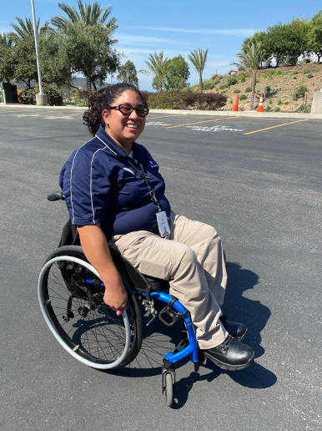
Mirella Solis
Hometown: San Diego, Calif.
Center: San Diego Job Corps
Training Area: Security and Protective Services, Office Administration
Graduated: 2018
Employer: High-security company, security specialist
Mirella Solis is a security specialist for a high-security company where her primary responsibilities include access control and ensuring the building, employees and guests remain safe at all times. She trained in both Security and Office Administration so she could combine skills and put them into practice.
Job Corps gave her the opportunity to train in a field and work toward goals that she had always aspired to. Not only did Mirella embrace her time at Job Corps professionally, but she also became a part of the Job Corps community and attended center activities, with her fondest memories being the community bonfires.
“Job Corps helped train me for success and get hands-on experience through internship opportunities. It prepared me for a job that I love.”
Notes:
Here’s what the template might look like when you fill out everything. I’m not suggesting you put all of this on a slide, but this shows what it could look like.
I included direct quotes as the last bullet on the previous slide. If you can get a quote from the alum, it’s a nice touch, something that breathes more life into these profiles and reflect the personality and journey of the alumni.
At the very least, please confirm with any alumni that you plan to submit their information for a Job Corps success story and that it could be included in Job Corps’ outreach, marketing or social media. Please also include their graduation year with any submission along with a high-quality photo.
In the next few slides, I’ll also highlight a few other success stories and some of the different ways we use them to promote Job Corps.

Slide 8
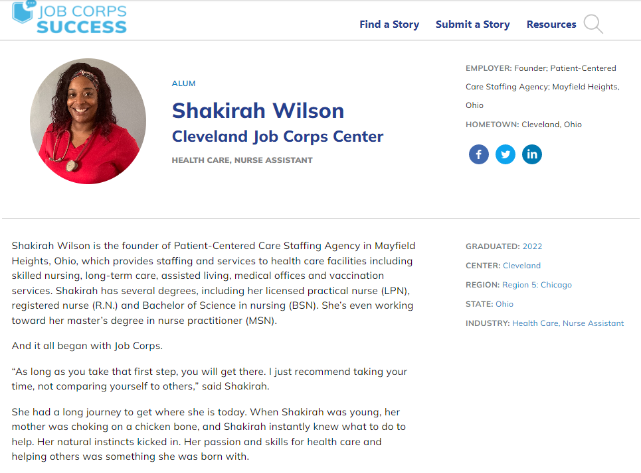
Notes:
On this slide, you can see a long-form success story about Shakirah, a Job Corps alum. This success story is great for a few reasons.
One, this story is a job training match. She currently works in the same industry she studied at Job Corps.
Two, this story includes direct quotes from Shakirah about her experience at Job Corps and how it prepared her for a career. As I mentioned, direct quotes are always a great way for a grad to tell their story in their own words. Direct quotes are a great opportunity to highlight the skills Job Corps students gain outside of the classroom, such as working with others. While career training and current employment are critical components to a strong success story, any time we can spotlight the “soft skills” students earn at Job Corps is a great bonus.
Three, Shakirah's story highlights how Job Corps alumni can continue to advance in their careers several years after graduating from the program. Her story shows how Job Corps was the first step in her career path and that she’s been able to progress even further in her career and expand her options by continuing her education and using what she learned while at Job Corps.
And lastly, this photo both is high-res and shows Shakirah in her workplace attire. In addition to professional photos of alumni, it’s always useful if we can share photos of them “in action” in their careers as well.

Slide 9
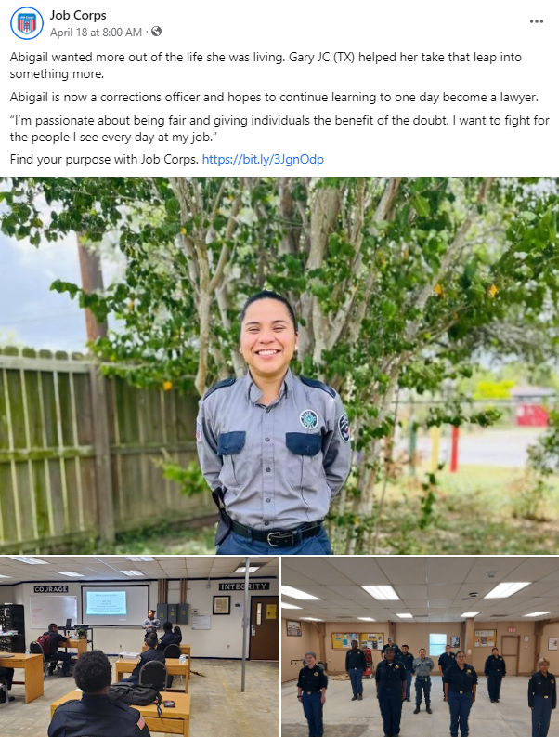
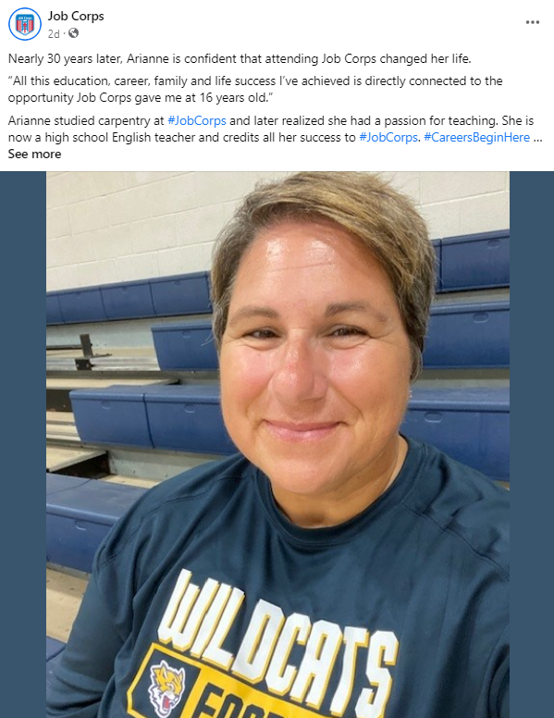
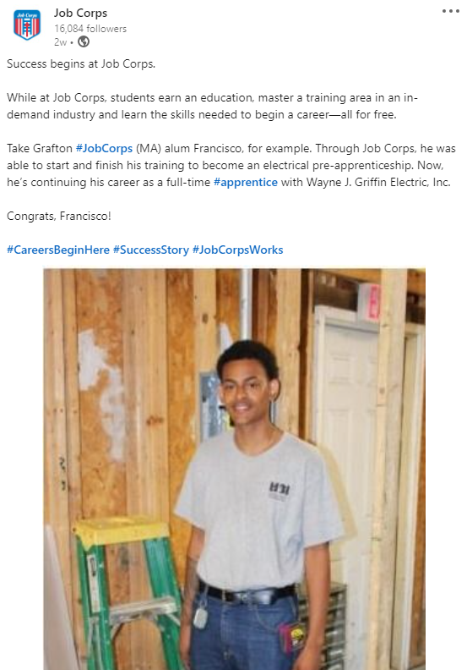
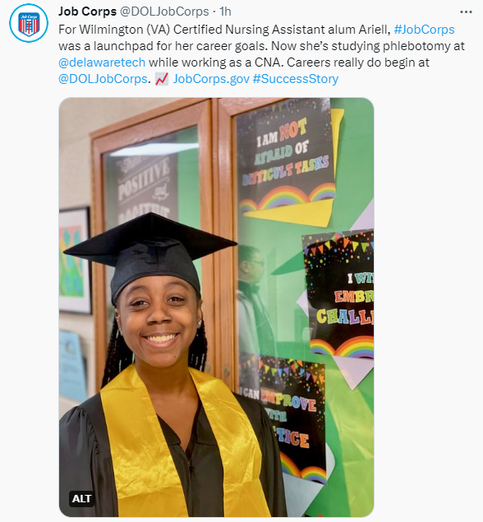
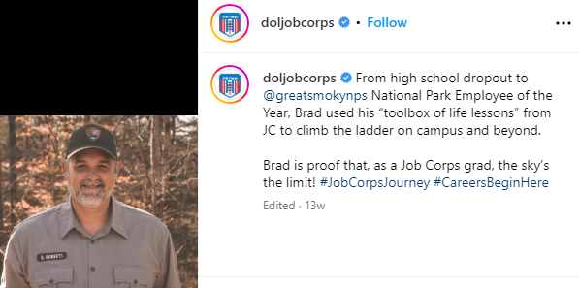
Notes:
On this slide, you can see several alumni-focused social posts that were featured on Job Corps' social media platforms, including Facebook, Instagram, LinkedIn, Twitter and YouTube. You can see these photos are high-quality and professional and even feature training area-specific photos.
We use the alumni's success stories to create engaging content on social media. The content is tailored to what performs best on each specific platform. The posts include the alumni's story, tags, hashtags, quotes, locations, calls to action, and of course a photo or a few photos. All of these elements can help boost engagement (likes, shares, comments) on social posts, strengthening the reach of these incredible stories.
Success story content is a great way to vary the types of content we feature on social media between students, alumni, partnerships and more.

Slide 10
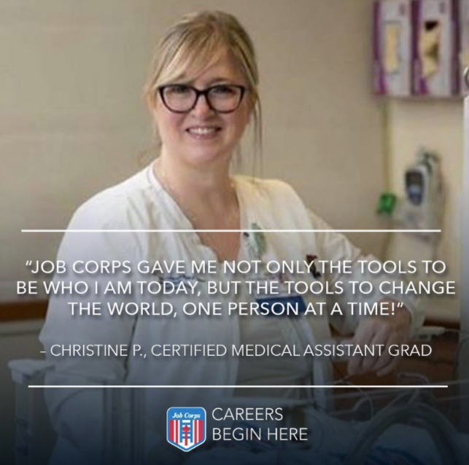
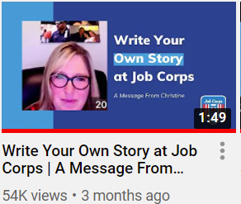
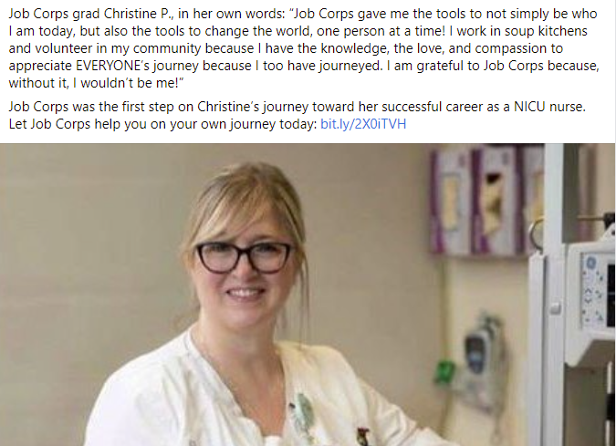
One Success Story → Multiple Paths
Christine – Clinical Medical Assistant alum
Long-form success story
Notes:
Christine is a great example of all of the ways we can use your Job Corps success stories. We began with drafting a long-form success story about her Job Corps experience, mirroring the format of the template I shared on a previous slide.
We then distilled the essential elements of her success story to draft posts across Job Corps’ social media platforms. On this slide, you can see how we featured her across different platforms. Since we had a quote from Christine, we were even able to develop an engaging quote graphic. Even better? We interviewed Christine a second time and recorded the interview to develop video content. On Job Corps’ YouTube page, there are several videos featuring Christine, including one about her Job Corps success story and another video encouraging students to stay motivated.
Putting all of this info on the last few slides, you start to see some of the different ways you can use success stories.

Slide 11
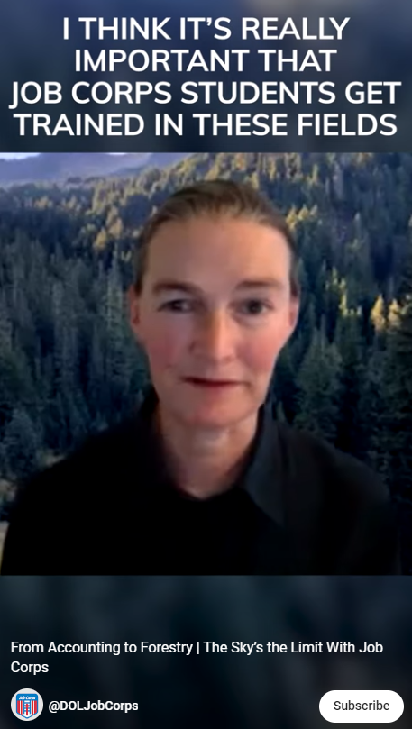
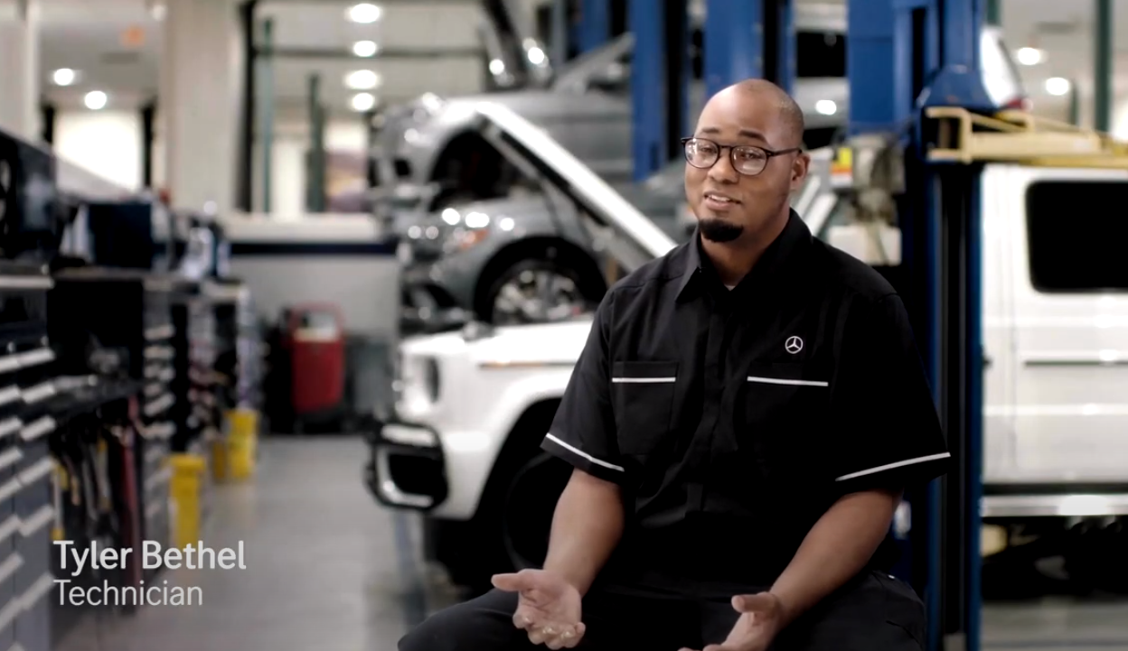
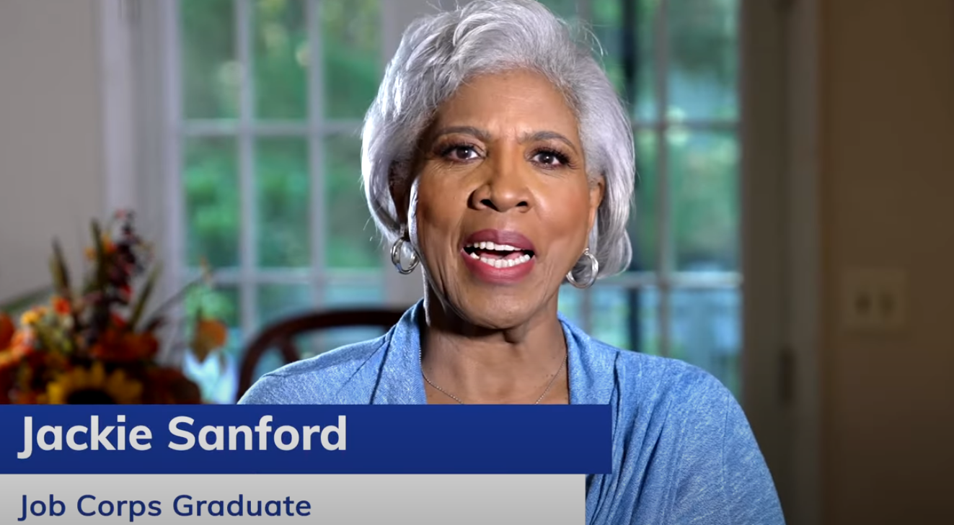
Video Testimonials
Notes:
Sharing Job Corps student and alumni testimonials through video has always been an important component of our social media strategy for the program. If you take a look at the videos we shared on Job Corps’ YouTube page, you will see several alumni testimonials.
On this slide, there are just a few examples of these types of videos we’ve shared on YouTube. If you have an alum who you think would be willing to speak with our team for a video testimonial, please let us know! We would love to highlight alumni especially with selfie-style videos, since we know this is the type of content that is performing well across social media.
Please note, if you have a video to share with our team, we will need the alum’s permission to share their video. If any music is used in the video, you’ll also need to secure the licensing to use that music, and share that with us, as well.

Slide 12
Where to Share Success Stories
1. Owned and Earned Media
    Social media
    Newsletter distribution lists
    Local media
2. Presentations
    Show them your star alumni and students.
    Let them know that Job Corps is a good investment.
Notes:
Facebook, Twitter or 'X', YouTube, Instagram, LinkedIn and your own newsletters are examples of media channels that Job Corps owns and controls.
Make sure you leverage these channels by sending your success stories and good news to us, and once posted, share the links with your network once posted. Also, when you see a post that you think your students or community contacts would be interested in, especially if it’s about your center, let them know about it—share it on your own Facebook page—and encourage them to like the page to stay up to date on the program.
Many of you produce your own newsletters. We’re on the mailing list for many of them, but not all. Please add us if you can. Those newsletters are a great source of information for us, and often point us in the right direction for more success stories.
And remember your relationships with local media representatives in print, radio and television. If you have a success story that you would like to share with your local media, that’s great! Just be sure to run it through the proper channels and work through the Regional Office and your regional OPA representative.
Success stories can make your outreach presentations so much stronger. Yes, talk about your centers’ training areas, your facilities and your partnerships. But don’t forget to share stories, because they stay with your audience longer than anything else.
They create that connection between successful students and prospective students or partners. Show them your star alumni and students. Let them know that Job Corps is a good investment.

Slide 13
3. Share with Job Corps
  Internal
  External
4. Share with MP&F
  Send to jcdigital@mpf.com
  Submit at jcsuccess.org
5. Share with DOL
  Secretary's Newsletter
  Secretary's Blog
Notes:
Share your success story with your entire Job Corps family. This means staff across the center—counselors, instructors, anyone. Everybody wants to see the results of their good work.
And please, please remember to send them to us at MP&F. The National Office asks us for success stories on a regular basis, and we want to be sure your centers and your alumni are represented. We are always looking for success stories that encompass every industry, center and region.
You can send any stories to jcdigital@mpf.com. You can also submit stories to JC Success, which we will go into more detail about in a few slides.
I’d be curious to know how many of you are aware of the DOL publications: the Secretary's newsletter and blog.
These aren't the kinds of things you can pitch directly. You’ll need to run it through the chain of command – the Regional Office, then the National Office. But I wanted you to be aware of it because these are two great platforms. Job Corps news is periodically featured in the DOL newsletter and blog.
If you’ve got something strong, something you think can be featured in either of these two publications, please send them to us, too. When you send them to us and to the Regional Office, some of those stories will find their way to these DOL pages.

Slide 14
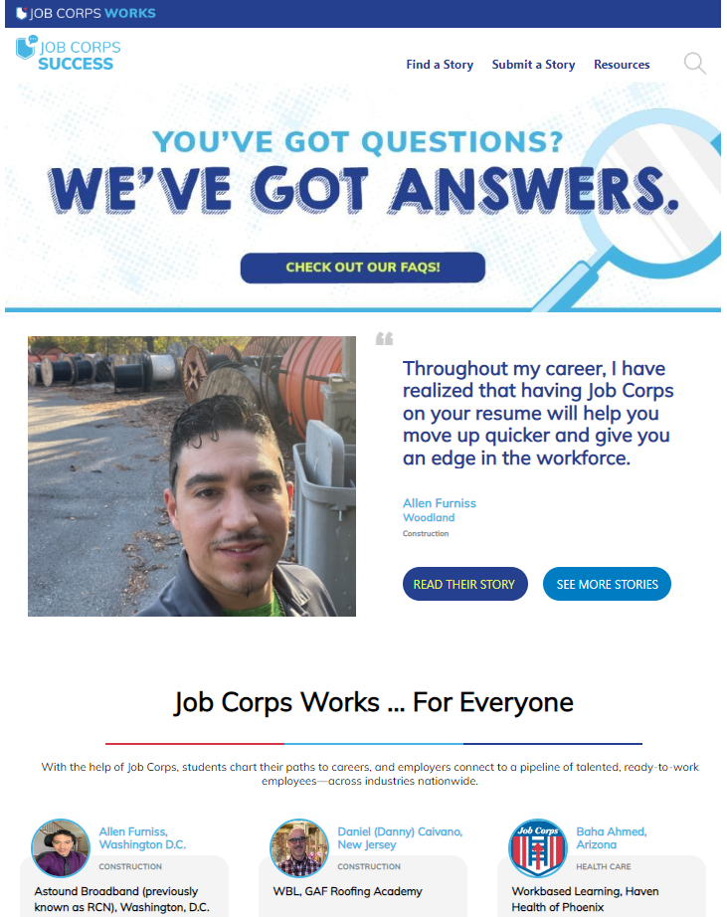
Job Corps Success
https://jcsuccess.org/
Username: doljobcorps
Password: CareersBeginHere
Notes:
The JC Success site is the one-stop shop for all Job Corps Success Stories! You will easily find alumni success stories by searching a number of categories, including Job Corps center, training area, region and much more. From there, you can download and share these stories with prospects, celebrate the successes with current students, or post to your own social media platforms. JC Success also includes other success stories from stakeholders, like employer partners, and you can submit those too!
On the screen is the homepage of the JC Success site. You'll see there's a Find a Story tab, Submit a Story tab and a Resources tab. We'll dive into these in the next few slides. I want to emphasize that Job Corps Success lives as a standalone site, meaning you can access it directly using the login information on the screen.
As we previously mentioned, it's important to share success stories with your prospective students. With JC Success, you will be able to search for the specific stories you're looking to highlight and share them with others, and create a connection between their story so far and Job Corps.

Slide 15
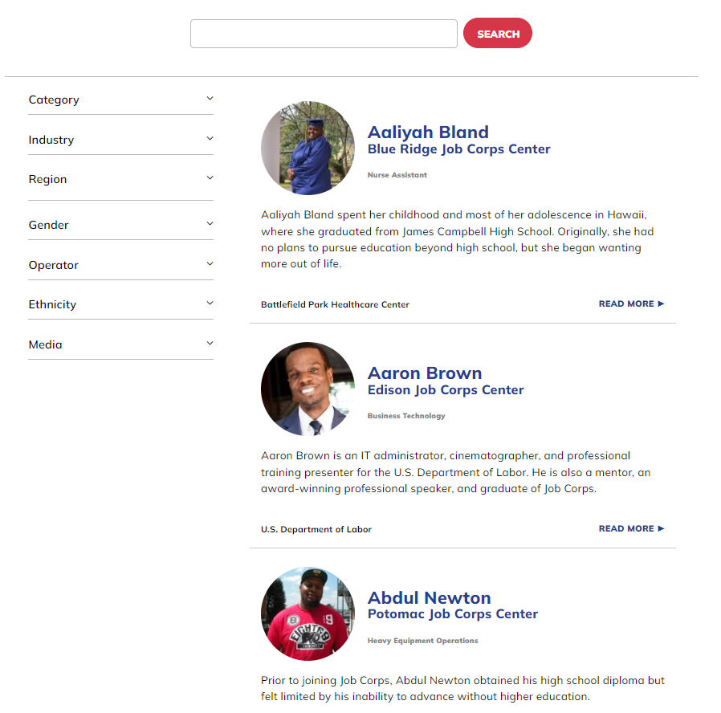
Find a Story
Notes:
Now that you've seen the homepage for this new website, I want to take a few minutes to talk about finding a specific success story. This is the page you should visit to locate the exact type of story you want, which can be as broad as a training area or as specified as the name of the JC alumni who is the subject of a success story.
At the top of the page, you'll see the search bar. Here, you can search for the story you are looking for in as broad or as specific terms as you'd like. Interested in finding a story from the Laredo Job Corps Center? Type "Laredo" into the search bar and every story we have from the Laredo Job Corps Center will populate below.
Or, if you're looking for a wide range of stories that fit certain criteria, the filter options on the left will help you narrow down what you are searching for while giving you as many options as you'd like. You can filter by industry or training area, region, gender, and more.
You'll be given the option to download the PDF of each story to share on your socials, post around campus and share with potential students, alumni, and stakeholders such as business leaders and partners around the country.

Slide 16
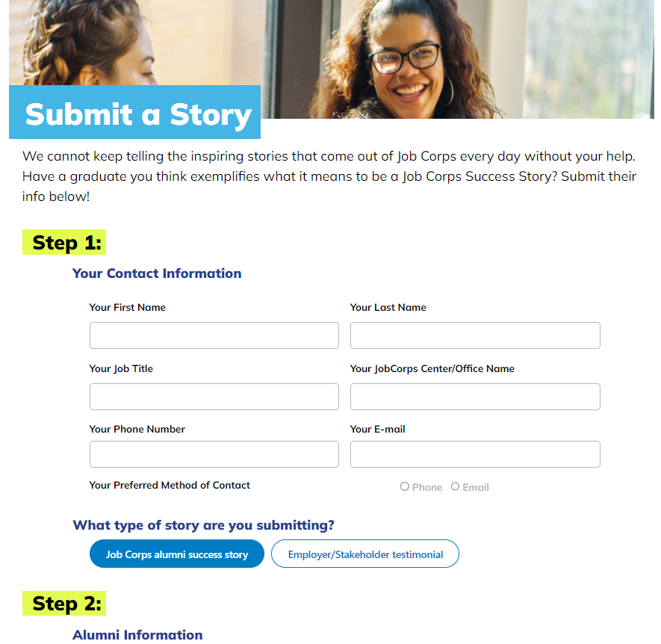
Submit a Story
Notes:
Our growing roster of success stories is only made possible thanks to you and other centers from around the country. On the "Submit a Story" page, you'll find the form to submit the inspiring stories of alumni or stakeholder stories to be added to our database. Once you have submitted all of the relevant information into the form, a member of the MP&F team will reach out to the subject to conduct a formal interview in order to capture their story.
We are always looking for success stories and employer testimonials that encompass every industry, center and region. While health care and construction stories are typically shared most frequently, we are always looking to ensure that we tell a variety of stories that capture exactly what Job Corps can offer.
If you know of any students at your center who are studying in fields that may not be as represented by our stories, such as renewable resources (or green) energy, advanced manufacturing or computer networking, please let us know. We want to show how Job Corps is preparing students not only for in-demand jobs now, but for jobs that will grow in the future.

Slide 17
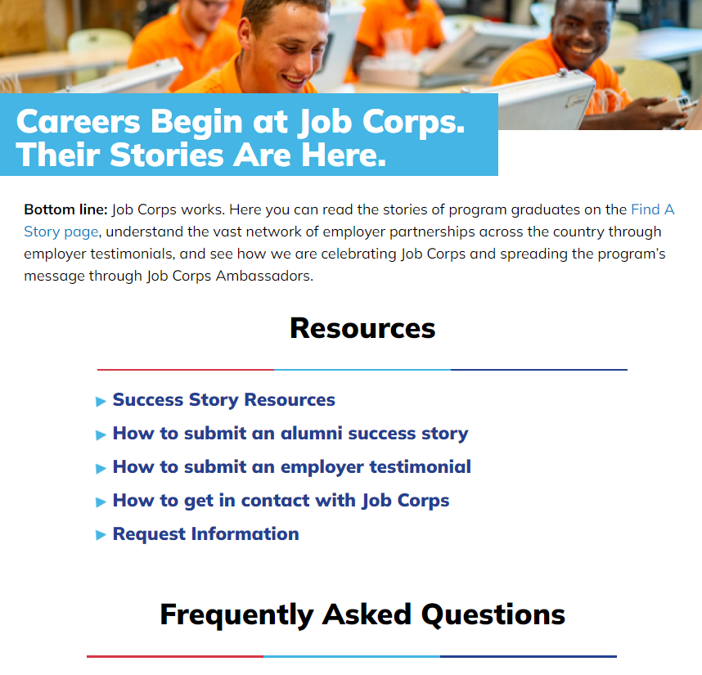
Resources, FAQs and More
Notes:
Finally, the Resources page is here to answer any questions related to success stories and how the site works. If you're having trouble accessing certain stories, have questions about the story submission process, or just need to get in touch with our team about anything success story-related, this is the page to reference.

Slide 18

Job Corps Hall of Fame
Notes:
Job Corps’ best advocates are the students and staff who have experienced firsthand the impact the program can have. That’s why, this year, Job Corps has relaunched Job Corps Hall of Fame to formally recognize Job Corps’ most exceptional success stories, from current students to alumni achieving their dreams, to the staff who help make it all happen.

Slide 19
Questions?
Please send success story leads to jcsuccess.org/submit-a-story
or e-mail jcdigital@mpf.com.
For questions or to share other social media content leads, e-mail jcdigital@mpf.com.
Call us at (615) 259-4000.
Notes:
I hope you agree how important success stories are for Job Corps – both in recruiting and retaining students and attracting prospective partnerships. If you have a lead on an alum of the program who has found full-time employment, ask them if you can share their phone number with MP&F. We can call and interview them.
The slides from today’s webinar will be available for download from the Materials Marketplace at j-c-marketplace.com if you or your colleagues are interested in reviewing the information we’ve discussed here.
Does anyone have any questions?
And before you leave, please help us improve this webinar for future participants by participating in a quick online survey. We’ve pasted the URL in the chat box. There are only a few questions, and it should take you only a few minutes to complete.
Thank you!

