Slide 1
JOB CORPS’ LEAD NURTURE STRATEGY
Notes:
Hi, everyone. Thank you for joining me. My name is xx, and I work for MP&F Strategic Communications.
We are the strategic communications and marketing contractor for Job Corps, and are responsible for creating national recruitment materials, coordinating Job Corps’ national advertising campaigns, and managing the program’s social media accounts on Facebook, YouTube, Instagram, and now Twitter. We also handle many other things, but these are some of the main efforts we coordinate.
This webinar will last about 45 minutes, including some time for Q&A at the end of the webinar. We definitely want this presentation to be a discussion, meaning we want to hear your feedback and thoughts throughout this training—so please feel free to put a question or comment in the chat box at any time. A member from our MP&F team will address any concerns or questions.
Does anyone have any questions or comments before we get started? OK, let’s jump in so we can keep this to 45 minutes.

Slide 2
Overview
Prospective leads
E-Mail Campaigns
Text Message Campaigns
You will be able to find this presentation under the “Trainings” section at JCMarketplace.com.
Notes:
We’ve divided this presentation into three sections.
First, we'll discuss Job Corps’ process for gathering prospective student leads via national advertising efforts. Then we'll discuss two different ways Job Corps is nurturing those leads through e-mails and text message campaigns. And we'll talk about how they work (and why they're important) in coordinating with your existing outreach efforts.
We’ll also discuss landing pages and how they play a role in lead nurture, responding to the inquiries received from prospective and current students through the various campaigns, and how we’ve incorporated messaging related to the pandemic into the e-mail and text message campaigns.
Are there any questions about this information before we begin? OK, let’s dive in!

Slide 3
Prospective Lead Funnel
Notes:
So, let’s jump into how Job Corps gets leads, otherwise known as prospective students. On this slide, you see a diagram of the Job Corps recruitment funnel, or prospective student journey. With the help of outreach by OAs, Job Corps brings prospective students to the top of the recruitment funnel through many integrated communications tools – advertising, social media, video, websites, marketing materials for OAs, and more.
We bring both cool and warm prospective leads to the top of the recruitment funnel. A cool lead is a prospective student who hasn’t necessarily sought out information about Job Corps – they haven’t clicked on an ad, engaged with social channels, or reached out to ask questions. A warm lead is a prospective student who has expressed interest in Job Corps and engaged with the program somehow. Lead nurture campaigns are an important way for Job Corps to communicate with prospective leads throughout the recruitment decision-making process, and nurture or “nudge” them along until they become an arrival.
We use both e-mail and text campaigns to support this nurture process. Each campaign involves a series of communications distributed over the course of several weeks to drip out information about Job Corps to prospective students considering enrolling. I’ll talk more about those in just a bit.
The main way Job Corps receives leads for the nurture campaigns is from Job Corps digital ads, the enrollment interest form on the jobcorps.gov website, and the new Back to Job Corps webpage that is being promoted on the jobcorps.gov site, social media channels, and marketing materials.
Job Corps added a sign-up for the e-mail and text nurture campaigns to all advertising landing pages in June and has seen many leads enter the campaigns since then. From June through January, Job Corps received 23,780 prospective leads in the text message campaign alone.

Slide 4
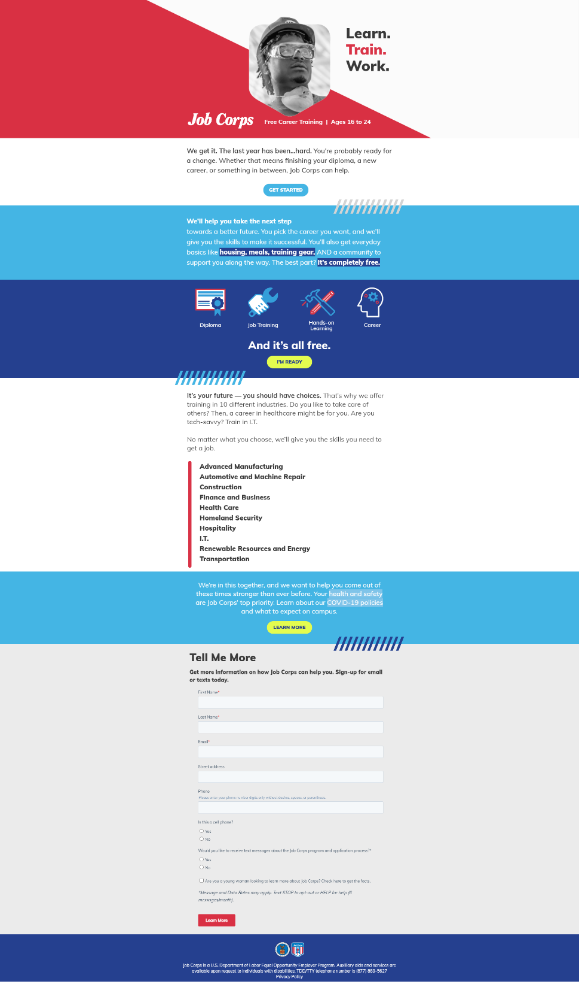
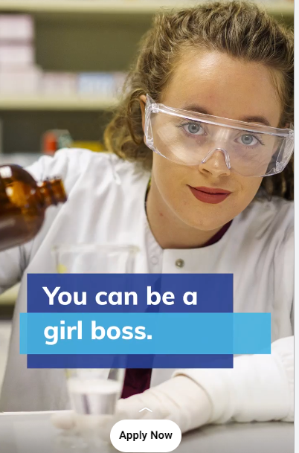
Student Information
Notes:
Let’s talk a bit more about how prospective students sign up to be a part of the e-mail and text nurture campaigns.
When prospective students see a Job Corps ad either on Google or on one of their social media channels, like Instagram, and it piques their interest, they click on the ad, and it will take them to a customized Job Corps landing page.
This landing page has brief information about Job Corps and offers potential students the option to click on a button taking them to the online enrollment interest form on the jobcorps.gov website, OR they can choose to sign up to learn more about Job Corps via e-mail and/or text. When they sign up, they submit their e-mail address or phone number through a form on the landing page and give Job Corps permission to send them communication.
Similar landing pages are also linked in organic, or unpaid, posts on Job Corps’ social media channels.

Slide 5
Notes:
You can see on the screen the section of the landing page that asks for contact information and if you would like to opt-in to receive e-mail and/or text messages as well as an option to indicate they’d like more information specifically about women in Job Corps.
In the campaigns for prospects – or those who have completed the enrollment interest form, but not yet finished their application and joined Job Corps - potential students provide either an e-mail or phone number or both on the online enrollment interest form they complete via jobcorps.gov. Prospective students can check a box on the form requesting to receive text messages about Job Corps. This is how they opt-in and give Job Corps permission to communicate with them via text.

Slide 6
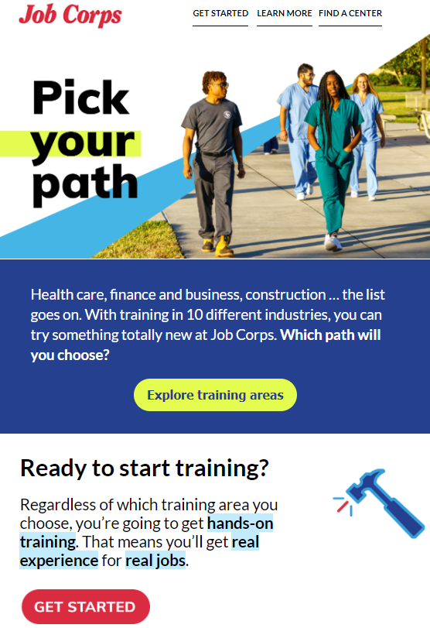
Lead Nurture Overview
Notes:
Again, when I refer to lead nurture, I mean ways that Job Corps can help nurture prospective students through the recruitment process ... from their very first interaction with Job Corps to the point where they complete an enrollment interest form, get connected with an admissions counselor, and ultimately arrive on a campus.
Joining Job Corps is a big commitment, and we know that many students need more time and more information before they are prepared to officially apply to the program. Students may not be ready to fill out the enrollment interest form the first time they see or hear about Job Corps. Yes, they are interested; but they want more details about the training and education programs, and what it’s like to live on campus. They want to see the stories of real Job Corps students and graduates. That’s where a lead nurture strategy comes in.
Lead nurture campaigns offer prospective students opportunities to learn more about the different aspects of the program and to stay engaged with Job Corps throughout their decision-making process. We will get into this in more detail in the coming slides; but after students choose to opt-in to either an e-mail or text campaign, marketing automation allows communication to be sent and customized with content based on information they provide, such as interest in female content or their age. We plan to continue to expand this customization to include training area information in the future.
So on the screen you can see examples of an e-mail and text message that prospective students can opt-in to receiving. You can see the e-mail talks about Job Corps training areas and the text message talks about center life and training areas. These examples are part of the national campaign, which we will explain further in the coming slides.
And now, given Job Corps’ need to communicate with current students about campus resumption efforts and to encourage them to stay focused on completing the program, the same e-mail and text technology is being used to distribute important information and messaging to that audience.
Again, we will explain these campaigns more later in the training; but we wanted to make sure everyone understands the big picture of lead nurture.

Slide 7
Current E-Mail Campaigns
National – directed to all potential students ages 16 to 24
Female – directed to female potential students ages 16 to 24
Older Student – directed to potential students ages 20 to 24
Center-Specific – directed to potential students in the targeted area of a center-specific ad buy
Notes:
OK … hopefully at this point everyone has a general understanding of Job Corps’ overall lead nurture strategy and how it is designed to work. If anyone does not, please don’t hesitate to put a question in the chat box. We are more than happy to address any questions or clarify anything further before we move on.
OK, now let’s go into more detail about the lead nurture e-mail campaigns.
As I have already mentioned, e-mail campaigns provide information to prospective students who are interested in Job Corps but are not yet ready to apply and commit to the program. They want more information.
Job Corps currently has four main e-mail campaigns running that provide prospective leads with more information about Job Corps. These include the National, Female, Older Student, and Center-Specific e-mail campaigns. You can see on the slide the potential students who are targeted through these different campaigns.
All prospective students actively enrolled in the e-mail campaigns have opted-in to the specific campaigns through Job Corps ads or social posts.

Slide 8
National E-Mail Campaign
Over 3 weeks, prospects receive:
When E-Mail
Completes Form &
Sends Immediately FAQ
3 days later Careers/Industry
3 days later Virtual Enrollment
3 days later Center Life
3 days later Day in the Life
5 days later Success Stories
3 days later Call an AC
1. FAQ
2. Careers Training
3. Virtual Enrollment
4. Center Life
5. Day in the Life
6. Success Stories
7. Call an AC
Notes:
First up, the national e-mail campaign. The national campaign is the broadest of Job Corps’ lead nurture e-mail series in that it is targeted to all prospects ages 16 through 24 and provides very top-line, general information about the program in each e-mail.
Once a prospective student sees a Job Corps ad, clicks through to a landing page, and completes the form to learn more, they are immediately sent the first e-mail.
The national campaign is composed of seven e-mails. We will show you examples of some of these in the coming slides.
The first is the FAQ e-mail. The FAQ e-mail explains what Job Corps is all about. It provides a link to some of the most frequently asked questions so prospective students can see if they’re eligible, how to apply, what training options they have, and more. Of course, the Job Corps website and the enrollment interest form are also linked in every e-mail.
The second is about career training. This e-mail provides prospective students with more information about choosing their path and the link to explore Job Corps’ training areas.
The third email is about virtual enrollment. This was recently added to the national, female, older student, and center-specific campaigns. This e-mail provides information about completing the orientation and career preparation courses needed for training, all 100% online.
The fourth is about center life. The center life e-mail provides prospective students with more information about what they will receive at Job Corps beyond career training, including living arrangements, meals, and supplies, and provides a link to take a virtual center tour.
The fifth features a day in the life of a Job Corps student. This e-mail provides information firsthand from Job Corps students, including a video showing what their days look like.
The sixth is all about success stories and features three students’ stories of their time at Job Corps and what they’re doing now.
And the seventh and final e-mail is a call to action to reach out to an admissions counselor. This e-mail provides information about the enrollment interest form to encourage prospective students to get started with Job Corps.
So as I said, prospective students will receive the FAQ e-mail immediately and then will receive each one in the series over a 3-week time frame. The career training e-mail is sent three days after the FAQ e-mail, and so on the journey they go.
Several of the e-mails in the lead nurture campaigns (national, female, older student, and center-specific) contain links to landing pages - also known as customized webpages. These webpages are designed to encourage prospective students to learn more about Job Corps and give them additional information about different aspects of the program. The landing pages are customized to the specific campaign.

Slide 9
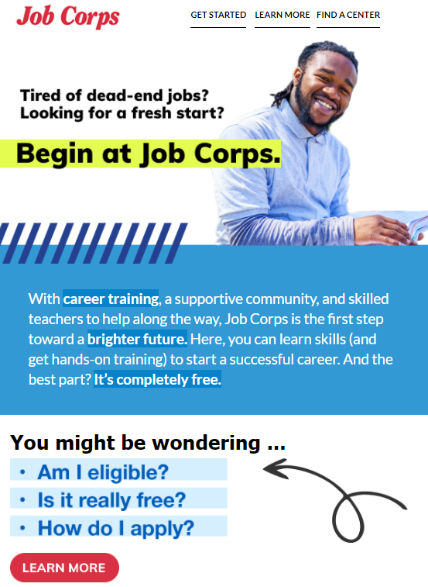
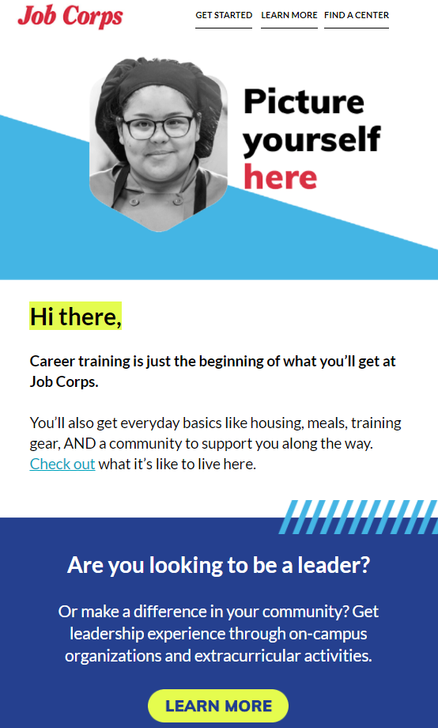
Notes:
On the screen, you will see two examples of the national e-mail campaigns. The first is the FAQ e-mail, and the one on the right is the center life e-mail.
The lead nurture e-mails are designed to work in tandem with your recruitment efforts. While you are reaching out to your assigned prospects via text, e-mail, phone, or in-person, they are hopefully also receiving this e-mail series encouraging them to get in touch with you and finish the application process.
MP&F also regularly tests subject lines and preheader text to see what types of content are more attractive for prospective students to open and click through the e-mails.
And for reference, we also created a Spanish-language version of the national e-mail campaign. That e-mail campaign is associated with any Spanish advertising, such as the campaign we run every day of the year on Google.

Slide 10
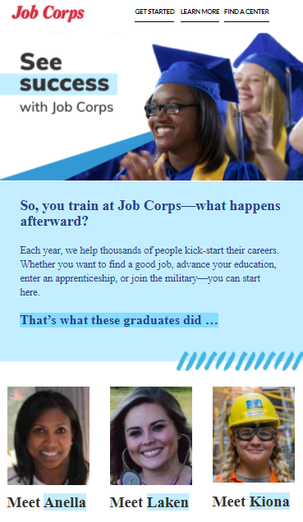
Female E-Mail Campaign
Over 3 weeks, prospects receive:
When E-Mail
Completes Form &
Sends Immediately FAQ
3 days later Career Training
3 days later Virtual Enrollment
3 days later Center Life
3 days later Day in the Life
5 days later Success Stories
3 days later Call an AC
Notes:
Next up is the female e-mail campaign.
Once a prospective student sees a Job Corps ad, and clicks through to a landing page to complete the form to learn more, there is an option in the form to indicate that they’d like to see information for young women. Potential students can receive either the national or female campaign. It all depends on what content the student is interested in receiving and what they select to opt-in to.
The female campaign is also composed of seven e-mails and follows a pattern similar to that of the national campaign.
The first e-mail is again an FAQ e-mail, the second is about career training, then virtual enrollment, center life, day in the life, success stories, and finally the encouragement to call an admissions counselor.
While the information is similar to the national campaign, the information and content are tailored specifically for women. The e-mails are branded differently, as you can see on the screen, and they include links to download or order the female recruitment flier and female magazine if the prospects are interested in those materials.
As I’m sure many of you are aware, the content in these materials is female-specific and helps young women get a sense of what life is like at Job Corps, what opportunities are available to them, and the success that other women like themselves have found as a result of Job Corps.
The order and timing of these e-mails mirrors the national campaign. They will receive the FAQ immediately and then will go through the series. The career training e-mail is sent three days after the FAQ e-mail, and so on the journey they go. The entire series takes about 3 weeks.

Slide 11
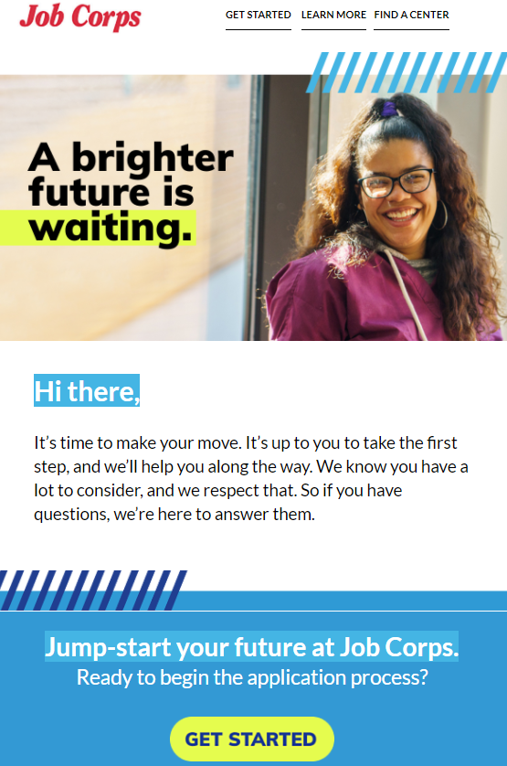
Older Student E-Mail Campaign
Over 2.5 weeks, prospects receive:
When E-Mail
Completes Form &
Sends Immediately FAQ
3 days later Career Training
3 days later Virtual Enrollment
3 days later Success Stories
3 days later Center Life
5 days later Call an AC
Notes:
An older student e-mail campaign was also created because we know this group tends to have very specific reasons for wanting to attend a program like Job Corps.
This campaign is also like the national and female campaigns, with the exception that prospective students who are a part of the national campaign can opt-in to the older student campaign after receiving the first e-mail in the national campaign.
Prospective students have the option to let us know their age range in the first e-mail, which determines if they will receive the older student e-mail campaign.
This campaign started in March 2021. The goal is to provide the kinds of career-driven messages and content that Job Corps research shows older students are most interested in.

Slide 12
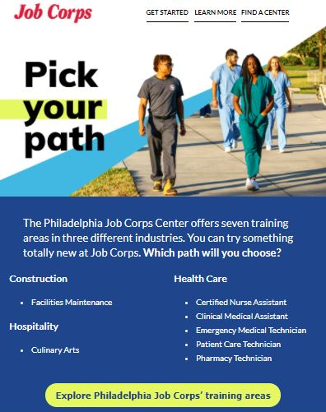
Center-Specific E-Mail Campaign
Notes:
OK. We have covered the broader campaigns; now let’s move on to the center-specific e-mail campaigns.
The center-specific e-mail campaigns are created to run alongside targeted center ad buys that are planned in conjunction with the center and MP&F. If a center runs a geo-targeted campaign with center/operator funding, an e-mail lead nurture campaign will begin when the buy starts. Instead of being connected to the national campaign and national landing pages, prospects will be directed to a center-specific landing page where they can opt-in to receive more information about Job Corps and that particular center.
The center-specific campaign is composed of six e-mails - the FAQ e-mail, the center life e-mail with the center virtual tour, virtual enrollment, career training information specific to the center’s offerings, success stories from the center if possible, and encouragement to call an admissions counselor.
Once a lead has seen a Job Corps center-specific ad, clicked through to a landing page, and completed the form to learn more, they are then immediately sent the center-specific e-mail campaign.
The center life e-mail is sent three days after the FAQ e-mail and so on. The entire series take about two and a half weeks.

Slide 13
Correspondence
To find out more about the Job Corps program, visit https://www.jobcorps.gov/recruiting/enrollment-interest. Please reach out to an Admissions Counselor for more information by calling 800-733-JOBS [5627].
Notes:
At this point, some of you may be wondering if potential students can respond to the e-mails and make specific requests or ask follow-up questions.
The answer is yes. MP&F replies to every e-mail inquiry that requires a response. Our main/standard message is “To find out more about the Job Corps program, visit https://www.jobcorps.gov/recruiting/enrollment-interest. Please reach out to an Admissions Counselor for more information by calling 800-733-JOBS [5627].”
In other words, we are trying to get them connected with an admissions counselor and encourage them to take the next step in the process. This is why it is so important for admission counselors to be communicating regularly with prospective leads since most of the questions are about applying and learning more about the program.
We also collect data for the e-mail campaigns. We track how many e-mails were sent, bounced, opened, clicked, and how many opt-outs there were. We use this data to confirm we are getting good engagement and to see what information resonates with potential students or if adjustments need to be made.

Slide 14
Reopening E-Mail Campaign
Each week, current students receive:
When E-Mail
Week 1 Good News!
Week 2 Your Time Is Coming
Week 3 We’ve Missed You
Week 4 Here’s How You Can Help
Week 5 We’re in This Together
Week 6 Your Success Matters
Subject
We’ve got good news ...
Preheader
and we’re so
excited to let you know!
Notes:
I mentioned in the beginning of the webinar that it’s been incredibly important for Job Corps to nurture current students, in addition to potential students, while centers have been in the process of resuming operations.
To help keep current students engaged with the program while they were away from campus and to encourage them to come back to campus when it was their time, Job Corps created an e-mail campaign for current students not yet back on campus.
This reopening e-mail campaign has six e-mails that include information about the resumption schedule of centers across the country, new health safety protocols, expectations for returning to campus, and practicing the three W’s - wash hands, wear a face covering, and watch your distance.
These e-mails contain broad information about the resources available to learn more about Job Corps’ safety protocols, such as the Back to Job Corps webpage, plus the videos and social media content available to them. They also give an overview of what students can expect when they arrive on campus.
The first e-mail links to the Back to Job Corps webpage that has information on the resumption schedule and FAQs related to Job Corps’ new health and safety policies and procedures.
Additional e-mails each link to a specific video for students to receive more information about what to expect when they arrive on campus and how they can help keep themselves and everyone safe and healthy. These e-mails are sent weekly and began April 1.
We know that all of you are already in frequent communication with your current students regarding your specific center plans. The point of these e-mails is to simply offer additional message touch points with the students while they are waiting to get back on campus. We update the list weekly to remove students once they have returned to campus.

Slide 15
Questions?
Notes:
We know that was a lot of information. Does anyone have any questions about the e-mail campaigns? We are happy to clarify anything, so just let us know.
Great, let’s dive into the text message campaigns.

Slide 16
Current Text Message Campaigns
National – directed to all potential students ages 16 to 24
Female – directed to female potential students ages 16 to 24
Older Student – directed to potential students ages 20 to 24
Center-Specific – directed to potential students in the targeted area of a center-specific ad buy
Notes:
So in general, the text message campaigns serve the same purpose as the e-mail lead nurture campaigns - it’s just a different way to reach the same audiences in a more immediate way with condensed information. Additionally, we know young adults are much more likely to read and respond to a text message rather than e-mail.
The information in these text messages overlaps with the e-mail campaigns to provide prospective students an additional opportunity to receive the most important information in a concise text message.
Just as with the e-mail campaigns, we have four main types of text message campaigns that provide prospective leads with more information about Job Corps. These include the National, Female, Older Student, and Center-Specific text message campaigns, and just like e-mail lead nurture, we also track and document how many text message responses we receive based on the categories we attribute to each message … all of which we will explain further in an upcoming slide, as well as the number of text messages that warrant a response.

Slide 17
National Text Campaign
At Job Corps, we've got you covered. From everyday basics 🛏️🍴 to leadership opportunities, see what it's like to learn here.
Over 2 weeks, prospects receive:
When Text Message
Completes Form &
Sends Immediately FAQ
2 days later Career Training
2 days later Virtual Enrollment
2 days later Center Life
1 day later Day in the Life
3 days later Success Stories
2 days later Call an AC
Notes:
Let’s begin with the national text campaign. This campaign is composed of seven text messages. These text messages go along with the same FAQ, career training, virtual enrollment, center life, day in the life, success stories, and call an admissions counselor messages from the e-mail campaigns.
The difference is we use very concise messages that focus on the main point we want to get across and emojis to make them more interesting and appealing to potential students. An example is on the screen.
And like the e-mail campaign process, once a lead or potential student has seen a Job Corps ad, clicked through to a landing page, and completed the form to say they want to opt-in to text messages, they are then sent the national text message campaign.
They will receive the FAQ text immediately (this directs them to a webpage that breaks down the FAQs) and then will go through the series. The career training text message is sent two days after the FAQ text message, and so on the journey they go. The entire series takes about two weeks – about a week shorter than the e-mail campaign.
Each text message in every lead nurture series includes a link for prospective students to click to learn more about Job Corps and give them additional information about different aspects of the program.
And for reference, we also created a Spanish-language version of the national text message campaign just as we did for the e-mail campaign.

Slide 18
Female Text Campaign
We help 1,000s of women every year kick-start their careers & find success. Check out stories of grads 🎓 & imagine what your future could look like‼️
Over 2 weeks, prospects receive:
When Text Message
Completes Form
Sends Immediately FAQ
2 days later Career Training
2 days later Virtual Enrollment
2 days later Center Life
1 day later Day in the Life
3 days later Success Stories
2 days later Call an AC
Notes:
Now let’s discuss the female text message campaign. This campaign is also composed of seven text messages.
Once a prospective student sees a Job Corps ad, clicks through to a landing page, and fills out the form to learn more, they have the option to indicate that they’d like to see information for young women and to opt-in to text messages. If they check that box when submitting their form, they are then immediately sent the first text message. Potential students will receive either the national or female text message campaign. It all depends on what content the student is interested in receiving and what they select to opt-in to.
These text messages have the same FAQ, career training, virtual enrollment, center life, day in the life, success stories, and call an admissions counselor message content as the e-mail campaign.
While these text messages are similar to the national text message campaign, the information is tailored to females. The links in the text messages go to specific female landing pages where appropriate, instead of the general ones in the national campaign.
They will receive the FAQ text message immediately and then go through the same journey as the national campaign – just all with more female content.

Slide 19
Older Student Text Campaign
Ready to get started? Still have ❓ We are ready to help you reach your goals. Call 📞 800-733-JOBS or jump right in & get started!!
Over 1.5 weeks, prospects receive:
When Text Message
Completes Form
Sends Immediately FAQ
2 days later Career Training
2 days later Virtual Enrollment
2 days later Success Stories
2 days later Center Life
3 days later Call an AC
Notes:
We’ve also created an older student text message campaign, which will work alongside the older student e-mail campaign.
This text message campaign began in March 2021.
Much like the e-mail campaign, the text message campaign will focus on content that we know speaks best to potential students in the 20 to 24 age range.

Slide 20
Center-Specific Text Campaign
Miami Job Corps center offers 6 trades in 3 different industries. 🔨🩺🚚 💻⚙️ Explore them & know you'll get hands-on training & REAL experience.
At Keystone Job Corps, we've got you covered. From everyday basics 🛏️🍴 to leadership opportunities, see what it's like to learn here.
Notes:
With the center-specific e-mail campaigns, we have developed text campaigns that run alongside the e-mails and help support the targeted ad buy.
So when centers have funds for the center-specific ad campaigns, they receive customized landing pages, e-mails, and text message campaigns that work together to maximize the results of the targeted buys.
The center-specific campaign is composed of six text messages. These include FAQ, center life, virtual enrollment, careers training, success stories, and call an admissions counselor text messages.
Similar to the e-mail campaign, once a lead has seen a Job Corps center-specific ad, clicked through to a customized landing page, and completed the form to say they want to opt-in to text messages, they are then sent the center-specific text message campaign.
They will receive the FAQ immediately and then will go through the series. The center life text message is sent two days after the FAQ e-mail, and so on the journey they go. The entire series take about two weeks.

Slide 21
Correspondence
This is Job Corps! Job Corps is the nation’s largest career technical training and education program for students ages 16 through 24.
Hello! If you have not heard from your admissions counselor, we would be happy to check on that for you. Could you please provide your name and ZIP code?
Notes:
And if you are wondering – do the potential students respond and text back just like in e-mails? Yes, they do!
Oftentimes, prospective students receive the text messages and send responses or questions back.
Every text message is responded to in a timely manner. It is important for us to be responsive, so the prospective students are getting the information they need to apply to Job Corps as quickly as possible.
Once again, we are trying to get them connected with an admissions counselor and encourage them to take the next step in the process.

Slide 22
GIFs
Notes:
We also have GIFs we often use to respond to text messages. This creates an interactive element to our responses, so they don’t come across automated or cold. You’ll see three examples on the screen of GIFs we use.
Text messages are a great way to incorporate GIFs, but they can also be used in e-mails and social media responses.
And you can use them too with your communication with students. Go to the Materials Marketplace for all the GIFs we offer.

Slide 23
Applied Text Message Campaign
Thanks for completing your enrollment interest form! You should hear from an Admissions Counselor within 3 days about next steps.
Want to learn more about campus life? Hear from a few of our very own students.
Notes:
OK, let’s discuss three additional text message campaigns that have been created.
The Applied text message campaign is a completely different type of text campaign, and it is sent only to prospective students who fill out the enrollment interest form. Job Corps receive leads through the online form on its website daily.
These messages are designed to work in tandem with your recruitment efforts. While you are reaching out to your assigned prospects via text, e-mail, phone, or in-person, they are hopefully also receiving this series encouraging them to respond to you and finish the application process.
The first message sets the expectations for the application process and next steps. We say “Thanks for completing your Job Corps enrollment interest form! You should hear from an Admissions Counselor within 3 days about next steps.”
The second message is sent the next day and says, “Want to learn more about campus life? Hear from a few of our very own students.” and includes a link to the video of students.
The third message is sent four days after the initial message and says, “Have you heard from your Job Corps Admissions Counselor yet? Let us know if you haven’t!”
And so on the series goes. There are nine main text messages over the course of 6.5 weeks and three additional “Finished” text messages if the prospective student has replied that they finished their enrollment interest form.
We get a lot of interaction from students during this campaign. Generally, they are positive and are students thanking us for the information or asking questions related to the process or Job Corps. We reply with answers when available and encourage them to reach out to their Admissions Counselor for all their questions. Occasionally, we’ll hear from a student that they haven’t heard from an Admissions Counselor. In those cases, we collect their information and share it with the contractors to follow up.
These campaigns rely on admissions counselors’ being responsive.

Slide 24
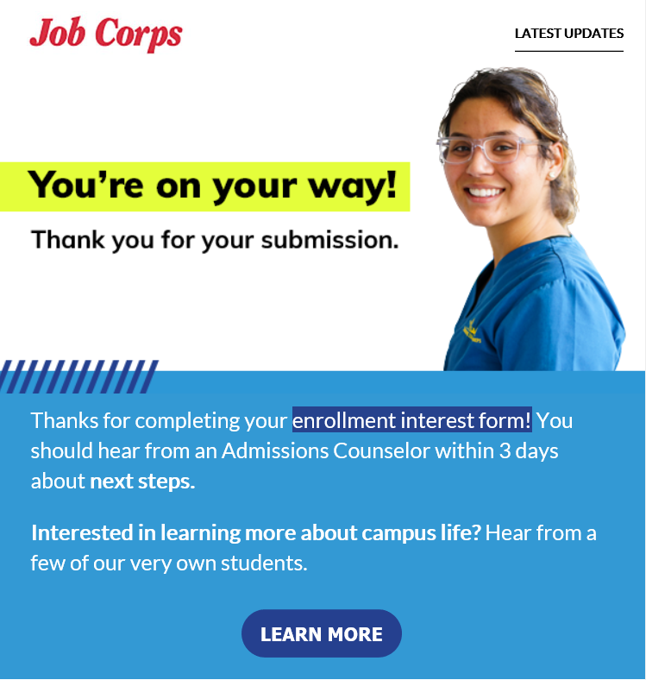
Applied E-Mail Campaign
Over 3 weeks, prospects receive:
When | E-Mail
1 day after EIF submission | Campus Life & FAQ
1 week later | Virtual Tour & Success Stories
1 week later | Stay Connected
Notes:
We have recently added an e-mail component to this campaign.
The Applied e-mail message campaign is also sent to prospective students who fill out the enrollment interest form. Job Corps receives leads through the online form on its website daily.
We send these messages beginning the day after their form submission and then weekly.
The messages are meant both to encourage students to complete their application and to provide information they may want to reference later such as links to virtual tours and FAQ.

Slide 25
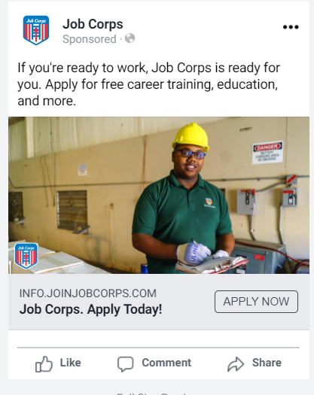
Learn More Text Message Campaign
Turn those setbacks into comebacks. Hear from real Job Corps students on how Job Corps changed their lives!
Over 2.5 weeks, prospects receive:
When Text Message
Texts LEARN MORE
Sends immediately Enrollment Interest Form
3 days later Back to Job Corps
3 days later Training Areas
3 days later Center Life
3 days later YouTube Video
3 days later Back to Job Corps
3 days later Enrollment Interest Form
Notes:
Next up is the Learn More text message campaign.
This campaign is sent to prospective students who see a Job Corps ad and text LEARN MORE to 53508 instead of completing the form on a landing page.
This campaign features specific information for prospective students to stay up to date with the program, including FAQs, career training program information, and center life info. It also encourages prospects to complete the enrollment interest form.
There are seven texts in the series that go out every three days.

Slide 26
Updates Text Message Campaign
Over 7 weeks, current students receive:
When Text Message
Sends Immediately Back to Job Corps 1 day later Video–Do Your Part
1 week later Video–What to Expect
1 week later Video–What We’re Doing
1 week later Facebook Group
1 week later Back to Job Corps
1 week later Social Media Games
1 week later Back to Job Corps
1 week later Facebook Group
Thank you for signing up for Job Corps updates! Select centers are starting to welcome students back on campus. Here is our game plan on how we are going to do it safely.
Notes:
Last but not least is the Updates text message campaign. This campaign offers current students the most up-to-date information about Job Corps. This text message campaign has templated responses and will include any “breaking news” about Job Corps and the resumption of operations on center.
Current students opt-in to this campaign after viewing the Back to Job Corps webpage we have mentioned several times and by texting UPDATES to 53508. Prospective students can also join this campaign if they view the Back to Job Corps site and text the short code.
This campaign provides information about Job Corps’ resumption schedule, the current student Facebook group, FAQs, and more.
There are nine texts in the series that go out once per week after the initial two.

Slide 27
Results
Learn More Campaign (2020)
Sent 39,860 e-mails (50% receiving female-specific)
Sent 26,089 texts (65% receiving female-specific)
Driven 5,500 users to the Enrollment Interest Form
Applied Campaign for new prospects (began in October)
66,410 participants
Updates Campaign for current students (began in January)
730 participants
Notes:
The e-mail and text nurture campaigns are allowing Job Corps to stay in touch with many prospective students. Here are a few numbers that show the reach of these campaigns.
Over the last year, Job Corps has seen almost 40,000 people opt in to receive Learn More e-mails. The text portion of the Learn More campaign launched in late May, and since then, 26,000 people have opted in to receive text messages. Our original goal was to have 25% of these students raise their hand for female-specific content, but many more – 50% of e-mail sign-ups and 65% of text sign-ups – have shown interest.
The Learn More e-mail and text campaign has led 5,500 people to the enrollment interest form to start the journey of becoming a Job Corps student.
Over 66,000 new prospects have been enrolled in the Applied text campaign since it launched in October. This campaign has generated a lot of conversation with prospects about the recruitment process – we’ve answered thousands of questions and helped connect students to their admissions counselors.
Lastly, over 700 students have signed up to receive text updates on Job Corps’ resumption plans. As a reminder, students are learning about this text campaign via the Back to Job Corps webpage. We are continuing to add updates to this text campaign as new information is available.

Slide 28
Questions?
Notes:
Well, that wraps up all the information about Job Corps’ lead nurture efforts. I know that was a lot of information to digest, and I understand that some of you may not be familiar with e-mail or text marketing, so please feel free to ask any questions about any of the items I’ve just discussed. We are more than happy to explain anything in further detail.
Thank you all for sharing your questions and thoughts. This really gives us insight into the program, and we really appreciate this feedback.

Slide 29
Contact Us
615-259-4000
enroll@joinjobcorps.com
Thank you!
Notes:
OK, well, if that’s it, we’ve dropped a survey link into the chat box. Please complete this—it takes 2 minutes and provides us with feedback that we can use to further refine this training and our training process as a whole.
Just as a reminder, this training is located on the JC Marketplace under the Trainings tab.
We’ve also shared our contact information on the screen, so please feel free to reach out with any questions after the conclusion of this training. Thank you again for joining us!

