Slide 1
Video Marketing Strategies
Notes:
Hi, everyone. Thank you so much for joining us today.
My name is Shawna McIntosh, and I work for MP&F Strategic Communications. We are the communications support contractor for Job Corps, and are responsible for creating national recruitment materials, coordinating Job Corps’ national advertising campaigns, and managing the program’s social media accounts.

Slide 2
/// Introduction
We will discuss:
Videos in today’s digital landscape
Job Corps’ Instagram and YouTube channels
Tips and best practices for recording videos
This webinar will last around 30 minutes.
There is opportunity for Q&A at the end of the webinar.
Notes:
Today’s training topic is all about “Job Corps Videos”—the different types of content featured in Job Corps videos on the program’s YouTube Channel and other social media platforms, how they are used to help promote the program, where staff can access the videos, how you can use specific videos to recruit and nurture prospects during their application process, … AND even how staff like you can record videos on your campus and send them to us to consider promoting them on social media.
This webinar will last around 30 minutes.
There will be time for questions at the end, but feel free to type a question in the chat box at any point during the presentation. We will be monitoring it and can give you an answer after the session.

Slide 3
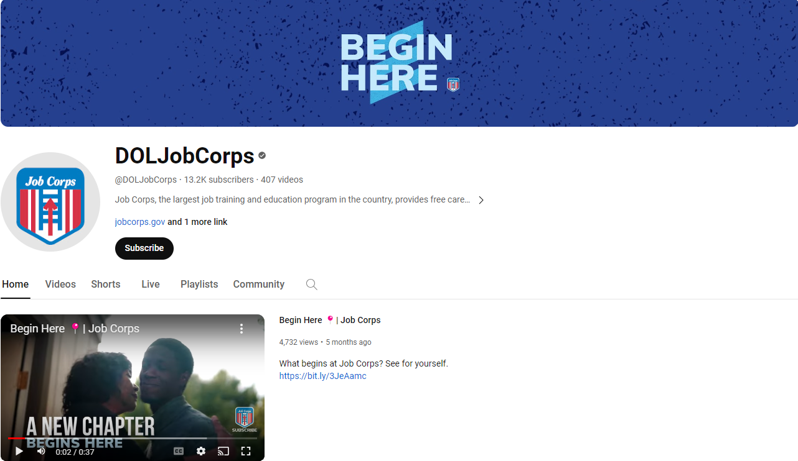
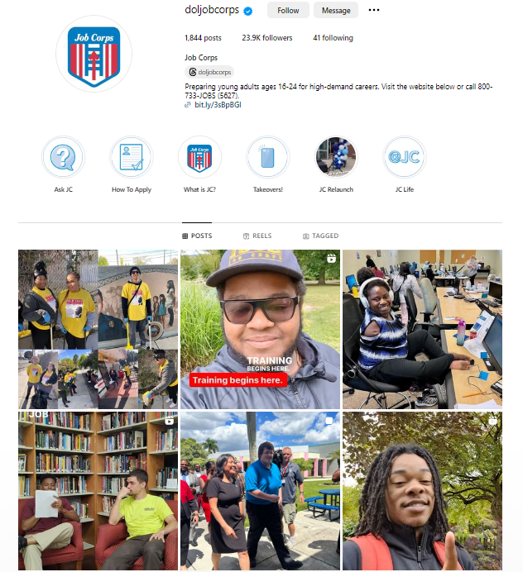
/// Job Corps Social Channels
Notes:
I’m sure most of you are aware of this already—especially if you have taken any of our other trainings—but Job Corps has five official social media platforms: Facebook, X (previously known as Twitter), Instagram, YouTube and LinkedIn. You can find these channels by searching “DOLJobCorps.”
These channels are all great points of reference for prospective students and serve as excellent recruiting tools.
We promote video content on every single channel, but YouTube and Instagram are the two platforms Job Corps' videos receive the most views and engagement on.

Slide 4
/// Why Videos?
People watch an average of 17 hours of online videos per week.
People are 52% more likely to share video content than any other type of content.
77% of U.S. teens use YouTube daily.
Notes:
Before I get too deep into Job Corps’ video strategy, I want to provide some context as to why video content is so important in today’s digital landscape.
According to research done by Wyzowl in 2023, people on average watch 17 hours of online video content per week.
This same study found that people are 52% more likely to share video content than any other type of content.
I'm sure this isn't brand-new information to many, but YouTube dominates the online landscape.
And according to another study conducted in 2023 by the Pew Research Center, 77% of U.S. teens say they use YouTube daily.
These stats help paint the picture and give you a better idea of why videos in general have become such critical parts of Job Corps’ recruitment and marketing efforts and brand presence overall. Bottom line—videos are an excellent way to tell Job Corps’ story!

Slide 5
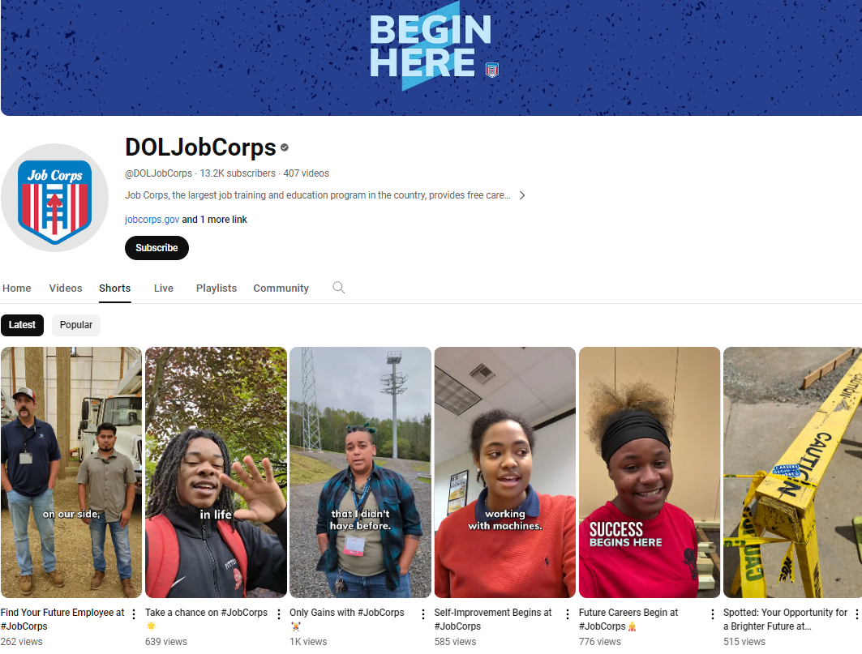
/// YouTube Channel
45+ million views
13,300+ subscribers
900,000+ hours
Click-through rate: 5.3%
Viewed vs. swiped away: 68%
Notes:
And speaking of YouTube—the Job Corps YouTube channel has been around since 2013, and over its lifetime has received over 45 million views. It also has over 13,000 subscribers, and viewers have spent over 900,000 hours watching the videos. To put that in perspective, that’s over 37,000 days of watching our content.
In 2023 alone, the Job Corps channel has had 8.7 million views and grown subscribers by over 3,000.
As I mentioned, the channel boasts a video watch time of over 900,000 hours—over 170,000 of those hours were in 2023. In other words, a lot of people have turned to YouTube when seeking out information about Job Corps.
While views are still an important measurement, Click-Through Rate and Viewed vs. Swiped Away have become important indicators of a video's success.
Click-through rate (CTR) is how often viewers watched a video after seeing a registered impression (every time a video thumbnail is a least 50% visible on a user's screen for over one second on YouTube).
CTR applies to regular videos only, and the industry standard is 4%-5%. Right now, the channel is at a 5.3%, which is above industry standard.
Viewed vs. Swiped Away (VVSA) is the rate at which people view a Short rather than swiping it away. Anything above 60% is considered a good VVSA. We're at 68%, which means people are watching the videos.
The channel's CTR and VVSA rates show that this platform is helping increase brand awareness efforts.

Slide 6
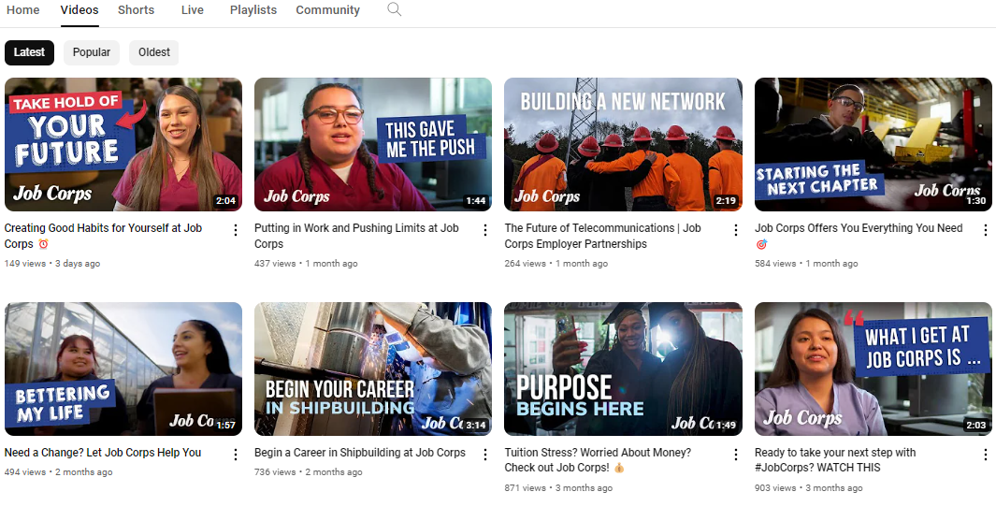
/// YouTube Channel
Example of Job Corps’ YouTube Channel Homepage Screen
Notes:
In terms of content for videos shared on YouTube and the other platforms, the goal is to show real students and graduates sharing their real Job Corps experiences. Job Corps always strives to share footage that is authentic. This includes interviews with students or graduates that are unscripted with editing kept to a bare minimum.
Videos are one of the best tools out there when it comes to sharing an inside, behind-the-scenes look at Job Corps. With videos, and all content for that matter, Job Corps tries to take a cue from students and what they’re into online. For example, the “Day in the Life”/blogger-style photos and videos are incredibly popular across social media, so we thought ‘why not apply this model to Job Corps?’
Based on how the videos perform on YouTube, we know that YouTube Shorts consistently receive more views than regular YouTube videos; but people continue to watch the regular videos as well. Knowing this, we have shifted to sharing more Shorts. The content is about 60% Shorts and 40% regular videos.
On the right of the screen, you'll see a screenshot of a video that was shared with us by Hubert H. Humphrey Job Corps Center. They shared the raw footage with us, and we sliced and diced it into a video that we shared as a YouTube Short. The video shows a Culinary student talking about the different types of eggs he learned to cook. So far, this 25-second video has over 1,200 views, and this number is continuing to grow. This proves that viewers want to see student-generated content. Center-submitted content is so valuable!
We're also always looking to share success stories. If you have a success story lead, please e-mail jcdigital@mpf.com and let us know. We share success story content across all platforms, so even if video content doesn’t work out, we can still share a photo or quote.
Again, you can find all these videos and much more on the YouTube page!

Slide 7
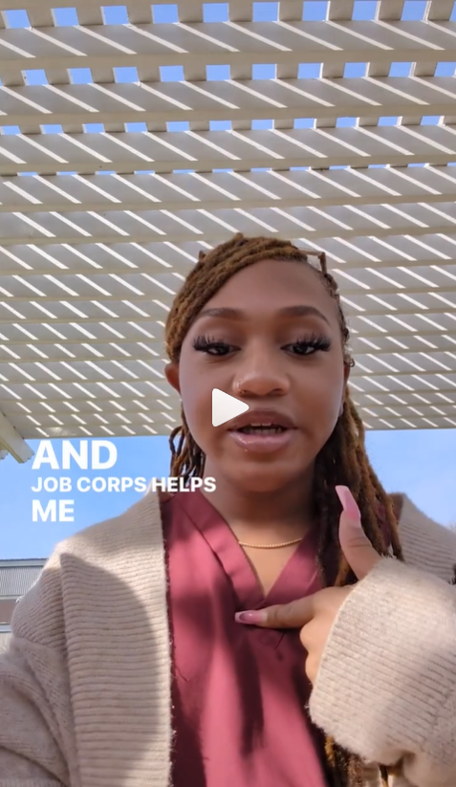
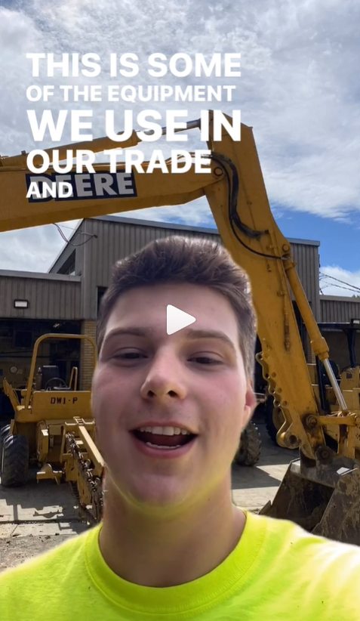
/// Instagram Channel
Notes:
The Instagram channel has over 23,000 followers, and it's where Reels are shared.
Reels, which are short videos on IG/FB, have become a huge part of the content we share on those platforms. Each week, two or three Reels are posted, so this goes to say we are always looking for video content to share. The content can be anything – students answering questions, students giving a tour of a space at your center, students showcasing a talent, or even students at an event on center. Some centers are great about already sharing this type of content with us – as I mentioned on the previous slide – but we're always looking for more.
Reels that perform the best are typically less than 30 seconds long, include a trending song, showcase students on campus and are very minimally edited.
On the screen, you’ll see a screenshot of the Instagram channel's homepage and some recent top performers. The video on the far right is a green screen video, which was is a popular type of video on both IG and TikTok. We decided to test it out, and it performed really well with over 6,000 views.
The content we share typically falls into two categories: "hype" content or student testimonials. Hype content includes dancing videos, pointing videos, sign toss videos or just high-energy videos in general. Even though Job Corps does not have a TikTok account, Job Corps is still sharing TikTok-style content. So that includes dancing videos and just really high-energy videos overall. Examples of "hype" content are found in the screenshot on the left.
The student testimonials consist of students holding a phone and speaking directly to the camera, talking about anything they want to talk about. Both screenshots on the right are student testimonials that performed well with over 7,000 and 6,000 views.
We also post videos on LinkedIn, as Instagram stories and to the closed student Facebook groups. Needless to say, we appreciate any and all video content you send our way.

Slide 8
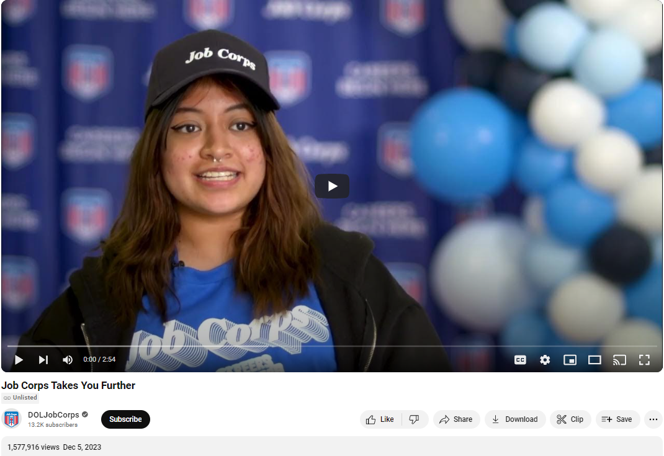
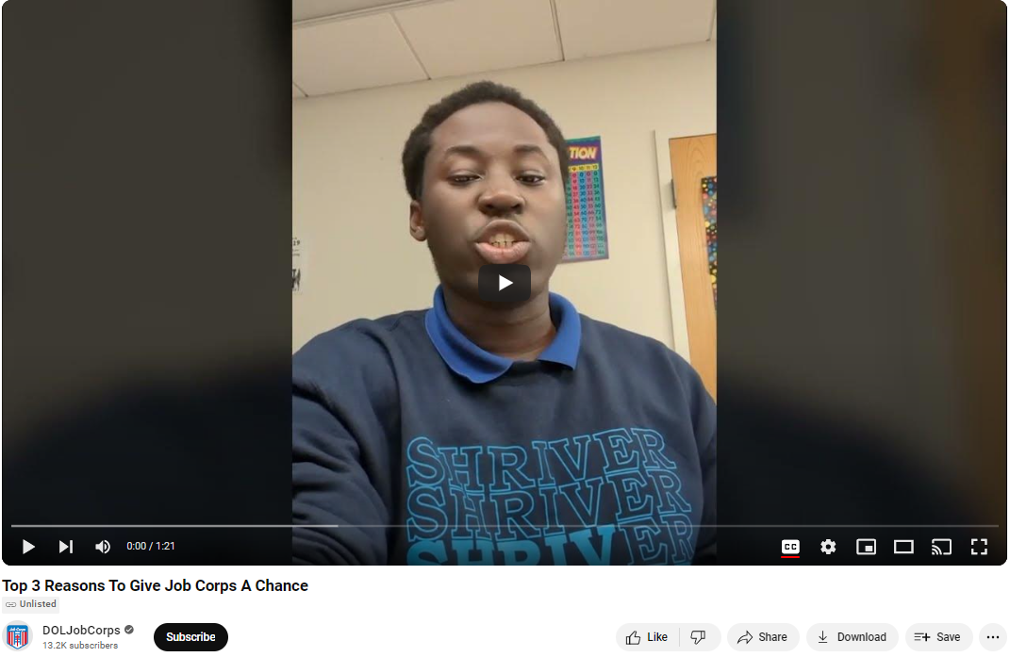
/// Advertising on YouTube
Notes:
We cover advertising on social media more in depth in our Engaging With Job Corps' Social Media webinar and our Targeted Advertising webinar, but I’ll briefly go over advertising on YouTube now.
When someone in Job Corps’ target demographic searches a topic or category that falls within the custom targeting Job Corps has set up on the platform, they will be served a Job Corps video ad. For example, if a young man or woman age 16 to 24 searches “Welding training” on YouTube, they will be served a couple of “recommended” Job Corps training videos. While YouTube is search-term-based, it’s also possible to target by household income. Job Corps targets as close to “under $40k” as possible to try to ensure eligible students see the content.
The video ads that pop up can be shown on all devices—mobile and desktop—and Job Corps ads are designed to pop up before a potential student is going to watch a video or show of their choice. All videos also include a button or option that allows viewers to click through to one of Job Corps’ advertising landing pages—essentially a webpage that provides them with more information about the program and how to start the application process.
On the screen, you’ll see two videos that are used as ads on YouTube. The first video, “Job Corps Takes You Further” was a video filmed professionally at Shriver Job Corps Center, and it has just over 500,000 views. The second video, “Top 3 Reasons To Give Job Corps a Chance,” is a video of a Job Corps student filmed in his classroom. It has nearly 900,000 views.
If you haven’t watched these videos, you should definitely check them out.

Slide 9
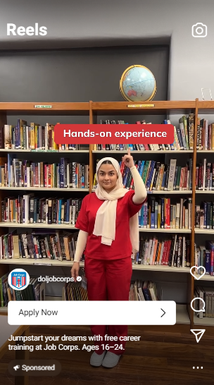
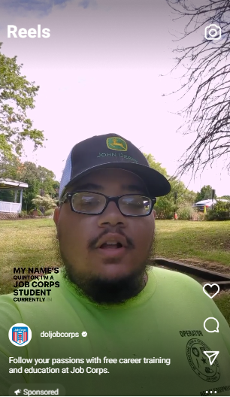
/// Advertising using Videos
Instagram
Snapchat
Notes:
We already talked about advertising on YouTube, but Job Corps also advertises using videos on Snapchat and Instagram Reels.
Instagram video ads are run on both Stories and Reels, and are targeted to the 16- to 24-year-old age group with interest targeting layered in (this includes interests in training areas like welding, health care, information technology, etc., as well as community college, apprenticeship, vocational school, etc.). When potential students are logged into Instagram, these ads appear in their news feeds, or while they're clicking through their stories. These are “landing page view ads,” which means the ad is optimized to be served to those more likely to click on the ad and go to the Job Corps landing page, which has more information about Job Corps and a link to the online enrollment interest form.
On Snapchat, ads are tailored to look similar to the organic content potential students might come across, using the same font and gray banner behind the text.

Slide 10
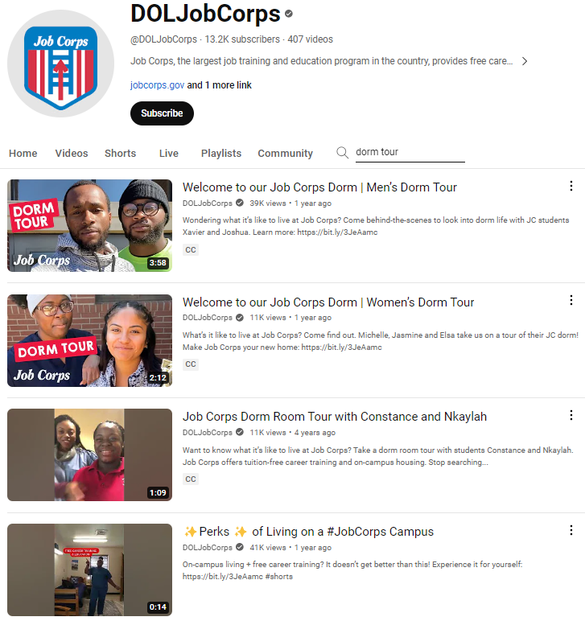
/// Using Videos in Your Recruitment Efforts
Notes:
Before I get into all the ways to incorporate videos in your recruitment and outreach efforts, I wanted to mention that we do offer Recruiting 101 and Recruiting 201 trainings that go over the best recruitment practices admissions staff members should utilize in the field and discusses how to recruit on a budget and how to access and order materials through the Materials Marketplace. If you haven’t already taken this training, we highly suggest signing up, especially if you are new to Job Corps.
OK, so for those of you who have worked in Outreach and Admissions or with students for a long time, you know that, when it comes to promoting Job Corps to the target age group of 16- through 24-year-olds, you have to be timely, flexible and personable in all your outreach efforts.
Well, videos are a great resource to use in your outreach efforts, because they can easily be shared via e-mail or text or even shown at a recruitment or community event. And they add a personal touch to your outreach methods by showcasing an authentic view of the program—especially if you are sharing a success story video.
The Job Corps YouTube page has videos that showcase students with diverse background experiences and a variety of training areas available at centers across the country. They also show what life is like on center or after graduating from Job Corps. Whether you’ve been communicating with a student who faced homelessness or a student who wants to be a nurse, you should be able to find videos that will resonate with your prospective students and their specific situations.
Anyone and everyone can search for specific content on the YouTube page—after going to the DOLJobCorps YouTube channel—to find videos. On the screen, you’ll see that I searched the word “dorm tour” and several different video options surfaced. You can choose to include whichever video you feel your prospective student will connect with.
You can even share playlists, which we’ll go over in the next slide.

Slide 11
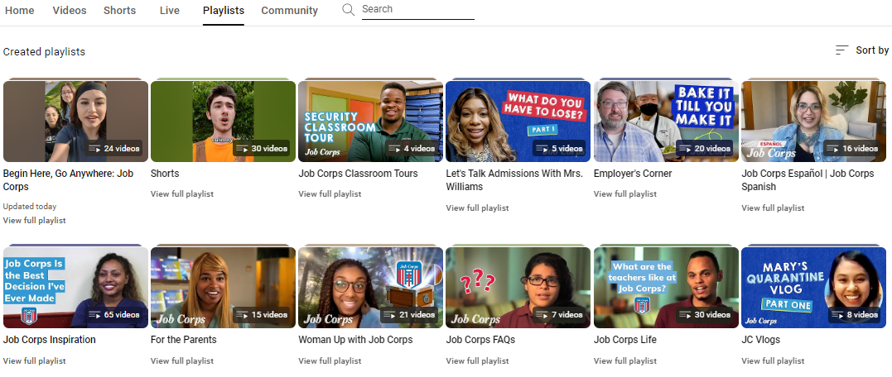
/// YouTube Playlists
Notes:
So playlists aren’t just made up of songs anymore!
On YouTube, Job Corps offers playlists that cater to specific groups. These playlists are great to share with prospective students and stakeholder groups, including parents and employers, over e-mail or text. And since these videos highlight real students sharing their stories, Job Corps also links to the relevant YouTube playlists when answering prospective students’ questions about the program that come in through social media.
You can find these playlists by going to the Job Corps YouTube Channel homepage and clicking on the “playlists” tab. You can see what it looks like on this slide. I encourage you to check this section out and watch the different videos found in each playlist.
You'll see playlists such as:
Begin Here, Go Anywhere: Job Corps
Shorts
Job Corps Classroom Tours
Employer's Corner
Job Corps Espanol
Job Corps Inspiration
For the Parents
Woman Up with Job Corps
Job Corps FAQs
And
Job Corps Life
I'll briefly talk about a few I just listed.
"Employer’s Corner” is a playlist made for sharing information about Job Corps with employers. This playlist can also be shared with other stakeholder groups such as parents or school counselors. The videos in this playlist have employer testimonials in them, which really speak to how hardworking Job Corps students are.
“Job Corps Life" is a playlist that includes videos that cover topics such as tips for living on a Job Corps campus and advice for prospective students from current students. Ideally, this playlist is one that can be shared with prospective students during their enrollment process.
“Job Corps FAQs” is a playlist of videos that cover some frequently asked questions, including “What can the Job Corps experience give you?” and “What are the teachers like at Job Corps?” Again, this is a great playlist to share with anyone interested in learning more about Job Corps.
The “Job Corps Works” playlist is a success stories playlist that features mostly graduates with a few current student testimonials sprinkled in. In this playlist, you’ll hear from Job Corps grads who went to college, experienced homelessness and completely turned their lives around with Job Corps, joined the military, and so much more. This is a playlist you can share with prospective students, school counselors and parents.

Slide 12
///
Tips and Best Practices for Recording Videos
Notes:
Now that we’ve talked about how Job Corps uses videos and why they’re so important for recruitment and outreach efforts, we’re going to shift over to discussing best practices for recording videos at your own center that can be shared with us.
Some centers and operators are already really great about sharing this type of content with us, but we'll go over tips for recording videos in these next few slides.

Slide 13
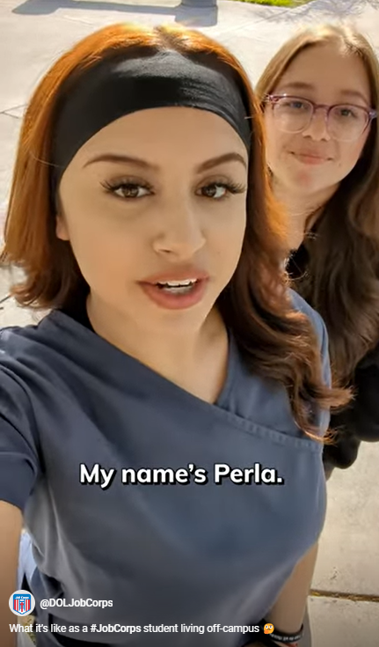
/// Choose a Student "Ambassador"
Are they engaging? Comfortable on camera?
Notes:
First things first: You'll need to choose a student to serve as a Job Corps "ambassador" and be the subject of the video.
Whether you're filming the video or you're asking a student to share a video with you that they record on their own, you'll want to make sure the student you ask to participate is engaging and articulate. And you want to make sure the student is comfortable in front of the camera; sometimes the students with the biggest personalities end up being the most camera-shy.
I've mentioned this before, but prospective students want to hear from real Job Corps students, which is why a majority of what we share showcases real students on campus. And the content we're filming isn't scripted. Oftentimes we'll tell the students what we want them to do in the video, whether it's giving us a classroom tour or speaking to certain topics; but the students are saying what they want to say in the videos.

Slide 14
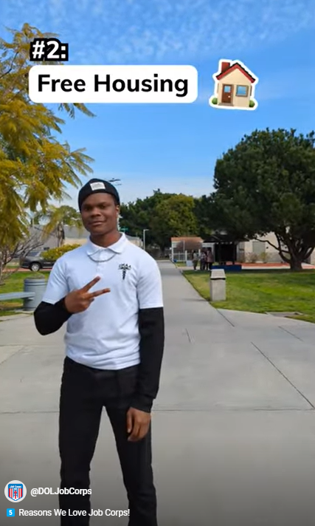
/// Location, Location, Location
Film in an area that shows off your campus!​
Notes:
We really encourage you to share content with us that showcases your Job Corps center. We get a lot of comments or messages from prospective students asking us what "blank" Job Corps Center looks like, and it's always so helpful if we can point them to a video in addition to the virtual tour.
When recording a video or asking a student to record a video of themselves, it’s so important to pick a location that will not be too distracting. You want to avoid crowded areas, because it’s difficult to cut down on background noises, but you also want to make sure you're showcasing what campus looks like!
Examples of great locations to film at around your center would be in a classroom, in a dorm, outside on campus and in a library.
The videos that perform the best on socials are the videos that allow prospective students to see what a Job Corps campus looks like.
The image on the screen is a screenshot from a YouTube Short/Instagram Reel that performed really well. You'll see that it's filmed outside, and viewers are able to see what that campus looks like.

Slide 15
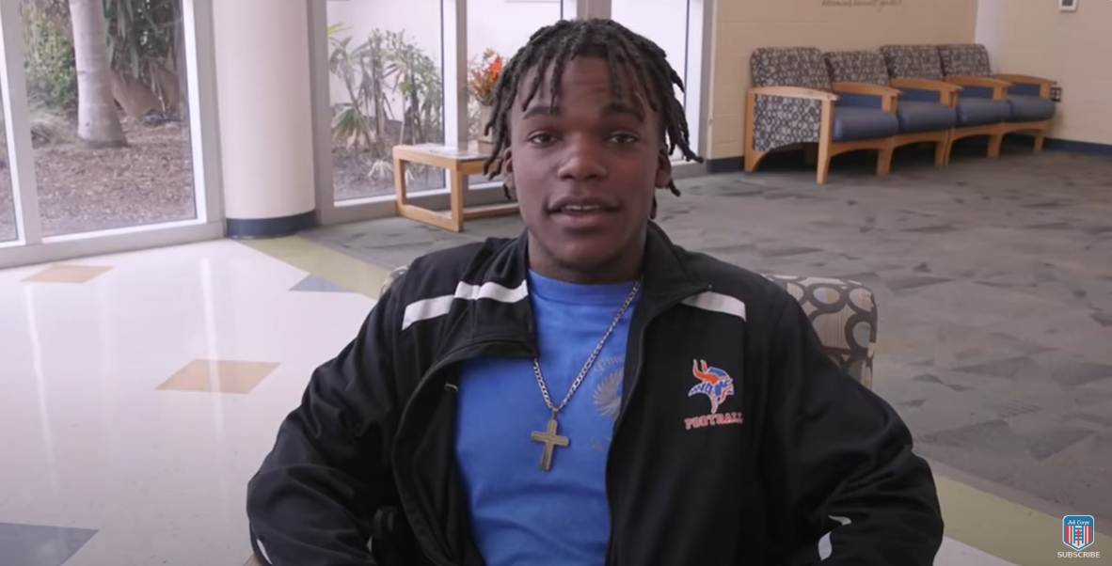
/// Background
Your background should not be too distracting.​ ​
Notes:
It’s important for the background to be clean, simple and not the focus of the camera; but it's also totally fine for things to be happening in the background as long as it's not demanding too much attention.
You definitely want to avoid distracting elements such as trash cans, exit signs, blinking lights, wires and general clutter; but having people simply walking in the background for example is OK.
The photo on the screen shows a screenshot from a video on the YouTube channel, and you can see that the background is simple and not distracting. The student is the main focal point.

Slide 16
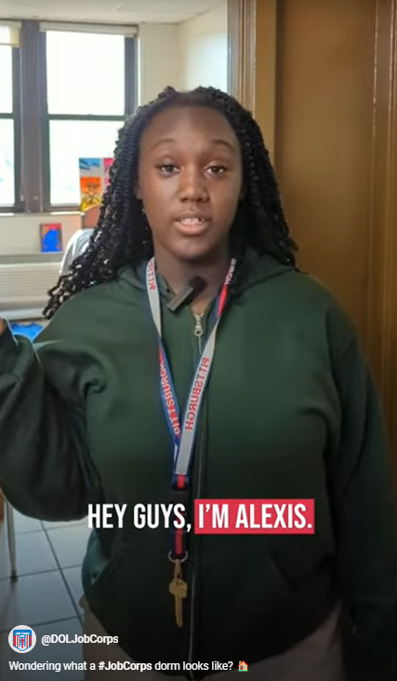
/// Lights, Camera, Action
Use a window or natural light for best illumination.​ ​ ​
Notes:
Let’s talk briefly about lighting. Using a window or natural light creates the best illumination; but it’s important to remember to keep light on the subject’s face, not on their back. If you put someone directly in front of a window, they’re going to look like a shadow and you’re not going to be able to see their face. And if a student is filming in their dorm, for example, you want to make sure the viewer can see what the student is trying to show them.
In the example on the screen, you see that Alexis' room is well lit up. There is a window in the background, but she's not standing too close to it and the lighting on her face is bright.

Slide 17
/// Quick Tips
Choose a quality device.​
Make sure your device is stabilized while recording.​
Always film in the same orientation.
​Wipe off the camera lens.​
Turn off your notifications.
Notes:
So we’ve talked about location, background and lighting when it comes to filming; but I have a few more tips to share with you that will help when you’re preparing to film. These tips are just to ensure that you are capturing the best content possible.
First, you’ll want to choose a quality device. Older phones or tablets may not provide a high-resolution video. When our team is filming video content on campus, we use Google Pixel phones.
Next, you’ll want to make sure your device is stabilized while recording. This can be done using a tripod, a coffee mug, books or whatever you have at your disposal. If a student is taking a selfie-style video, just make sure they’re not shaking the camera when they film.
Another tip is to always record in the same orientation. For example, if you’re recording a classroom tour vertically, you don’t want to film another take horizontally in case we need to slice and dice the content together to create one video.
Before you begin filming, wipe off your camera lens. This will help. Trust me.
And if you’re using a phone to film, it’s always a good idea to turn off your notifications so your filming isn’t interrupted with a phone call or text.

Slide 18
/// Quick Tips
The shorter the content, the better!
Complete an audio test before recording.
Have a good idea of what will be said in the video.
Share content with us via a video file sharing tool.
Notes:
OK, just a few more. I know this is a lot to remember, so keep in mind this entire presentation is available on the Materials Marketplace for you to reference at any time.
The videos we share on socials are typically less than a minute, so we highly encourage you to share short videos with us. If your video is longer, do not stress – we can clip it or trim it down.
To ensure that you’re capturing a video with high-quality audio, you should complete an audio test beforehand. You can take a practice video from where you plan to record to check that the audio is clear and audible and that the filming environment is quiet.
And finally, the last tip is to be sure to practice what will be said in the video. The goal is to make sure things flow well, but we also don’t want students reading directly from a script. It should be authentic and feel natural. We tell students who are recording videos selfie-style that they should pretend they’re on FaceTime with their friends – that’s how the video should feel.
When sharing video content with us, we highly recommend using a video file sharing tool such as Dropbox to ensure that the quality remains the same. Sometimes when video content is shared via e-mail or text, the quality becomes poor, and we can no longer use the video. We try to avoid this by using tools like Dropbox.
We’re going to share the e-mail address on the next slide, but please share all video content with jcdigital@mpf.com. Even if you have questions about capturing content, feel free to shoot us an e-mail and we’ll help as best as we can.

Slide 19
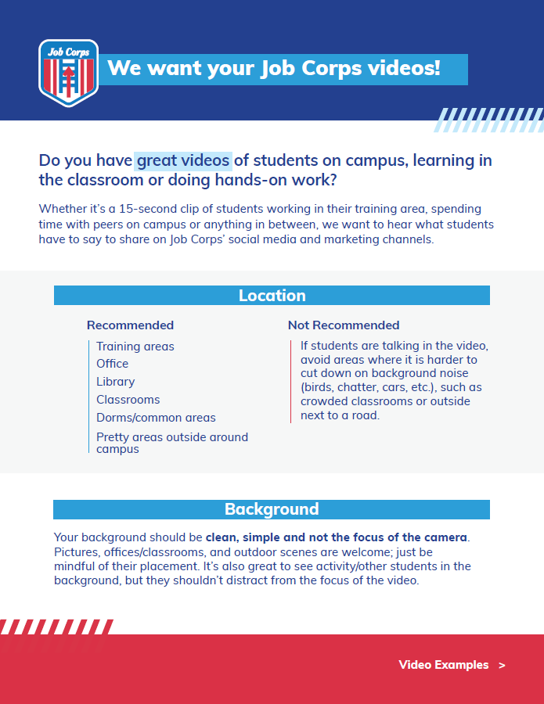
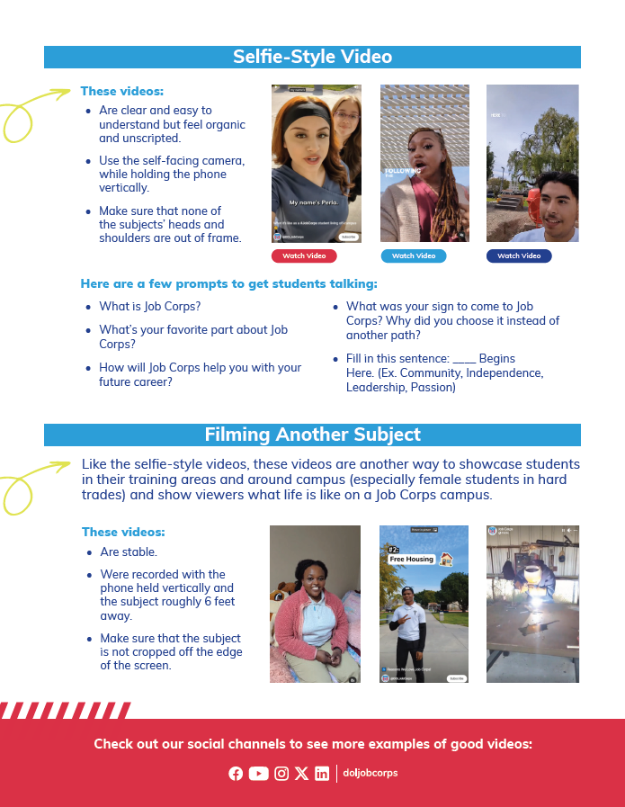
/// Video Tip Sheet
Notes:
All of the helpful video content submission tips I just discussed can be found on this flier you see on the screen that will be distributed to you all after the training.

Slide 20
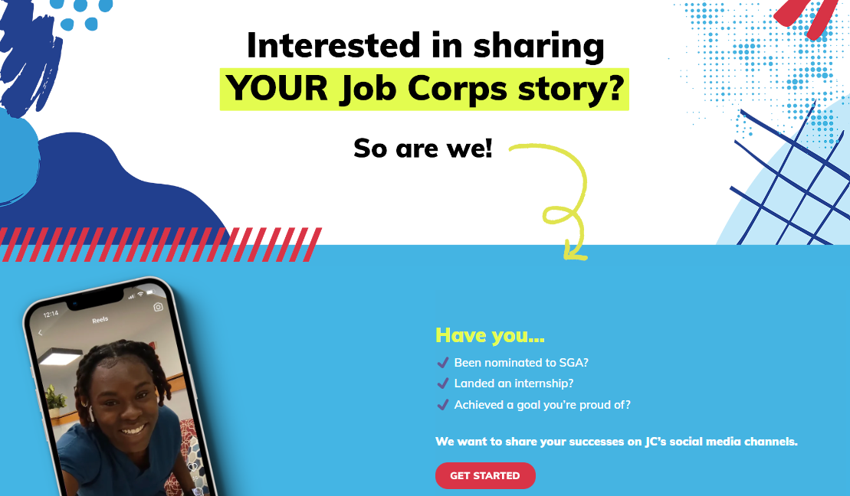
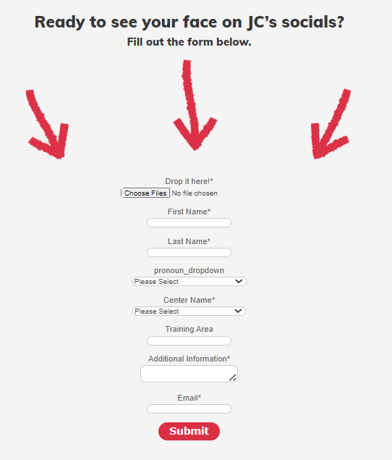
/// Social Landing Page
Info.joinjobcorps.com/social
Notes:
On the screen, you'll see a landing page that students can use to submit content to us. This landing page was created because we really want to curate videos that are reflective of what this audience is posting and consuming.
If you have students who would like to share content with us, we highly encourage you to have them upload videos to this page or tag @DOLJobCorps in their videos. They may also share in the JC Students FB group.

Slide 21
Questions?
Notes:
We know that getting students to participate or share video content can sometimes be difficult, so we wanted to make sure you all have everything you need to make the process as easy as possible.
Thank you for all your great answers and participation today.
This will conclude the training.
I now want to open it up to any questions. Please put those in the chat box, and we’ll respond to them!
[Take questions]

Slide 22
/// CONTACT US
615-259-4000
JCdigital@mpf.com
Thank you!
Notes:
So—that’s Job Corps and all things videos. I hope you have found this webinar informative and helpful.
Always feel free to call MP&F at the number you see on the screen—(615) 259-4000—and we will make sure you are put in touch with the right person. You may also e-mail us at jcdigital@mpf.com.
We covered a lot of information today, but we will be posting a recording of this training along with all of the other trainings we give on the Materials Marketplace under 'Webinars.' We will also be sending everyone a follow-up e-mail this week that will include the recording along with the resources mentioned in this webinar.
Thank you so much for your time!

