Slide 1
Local Media Outreach 101
Notes:
Thanks to everyone for joining us. Today’s training topic is about media outreach. My name is Javier Solano, and I work for MP&F Strategic Communications.
We are the national communications contractor for Job Corps, and are responsible for creating the program’s national recruitment materials and coordinating its national advertising campaign. And we manage Job Corps’ social media accounts on Facebook, YouTube, Instagram and Twitter. We also offer regular trainings like this one to make sure staff like you have the tools and resources you need to support your recruiting efforts.
The webinar should last about 45 minutes, and there will be time for questions at the end; but feel free to type a question in the chat box at the bottom of your screen at any time. We have someone monitoring the chat box throughout the webinar.
I understand some of you on the line may be longtime Job Corps veterans, while others may be brand-new to the program. Either way, we hope you’ll learn some valuable information and what media outreach resources are available to you.
If there is an overarching message to this presentation, it’s this: You have the green light to pursue media relations. You have the full support of the National Office and the Department of Labor to tell your story. As long as you follow the process. Because there is a process involved. And that’s what we’re talking about here.
This PowerPoint is going to cover a lot of information. It will be posted on Job Corps’ Materials Marketplace, so you can download it for future reference if you’d like.

Slide 2
Three Types of Media
Owned Media
Your digital properties: website, social
Your marketing materials
Paid Media
Advertising
EARNED MEDIA
Media relations, media outreach
Notes:
Regarding today’s topic, sometimes it’s helpful to think about mass communications as divided into three kinds of media. There’s the media you own. That’s your website, your Facebook page, your other social media, your marketing materials. You control the message.
There’s the media you pay for. That’s advertising. Paying a news outlet some money in return for displaying your message. Again, you control the message.
And then there’s the media you EARN through media relations. It’s the only one of the three where you don’t control the message. But it has more validity since it’s coming from a credible third party. That’s what we’re talking about today.
I’ve been working for MP&F and on behalf of Job Corps for about 22 years now. Before I arrived at MP&F, I was a reporter for 10 years, most of that with the Orlando Sentinel. This subject matter today is where my two careers intersect, the subject of media relations. I’ve been on both sides of the phone – as a reporter covering the news and as a communications pro working with the media to try to get positive coverage.

Slide 3
Agenda
Working With the OPA
State of the Media
Getting Ready: 5 Strategies
Get a Reporter on Center
Notes:
Here's a look at what we're going to cover in this session.
We’re going to start with a quick review of the rules of the road and working with the Office of Public Affairs.
Then I’ll give you a quick pulse-check of the media, basically the State of the Media in three slides.
From there, we’ll get into strategies and, specifically, how to play this game in the modern age, where you have many media outlets but few with the resources they used to have.
And finally, we’ll close with some do’s and don’ts.
With that, let’s start with the Office of Public Affairs and the approval loop.

Slide 4
Working With the OPA
Notes:
OK, let’s start here, with the approval loop. The rules of the road with media outreach.
This will be a quick review for most of you. If we have any newcomers on the line, let me introduce you to the OPA, the Office of Public Affairs. The OPA is the media voice of the Department of Labor and the primary point of contact for media relations.
But local reporters covering Job Corps will start by contacting the center, not the Office of Public Affairs. So, let’s take a look at what the PRH says about media contact.

Slide 5
Media Contact Approval Loop PRH Chapter 5.11
When the media contacts you with a request for info, or if you are preparing to contact them proactively, get approval first.
Center Director
Regional Office of Job Corps
RO contacts National Office of Job Corps and the Office of Public Affairs (regional contact)
Notes:
When the media calls, or before you call them, here’s a look at who needs to know. At minimum. More folks and more agencies may get involved, depending on what it is. But for most media inquiries, this is the progression.
You get the call from the media. You notify your leadership on center. Then your leadership on center notifies the Regional Office. In most cases, this is your program manager or whoever has oversight for your contract at the Regional Office.
Then the Regional Office notifies the National Office of Job Corps and the regional Office of Public Affairs officer. In most cases, if not all, that regional Public Affairs officer works in the same building as the Job Corps Regional Office.
Now, this isn’t you making all of these calls. Your end of it is usually over after you tell your director. But when that e-mail comes in from a reporter, save it and share it with your CD. If this is a phone call, that means some note-taking. Write down who it is, who they work for, why they’re calling, what they’re working on and any deadline info.
The key takeaway here is, when you get a call from the media, tell your CD and go through the proper channels to tell OPA. The proper channel is the Regional Office. They are the ones who contact the Office of Public Affairs, along with the National Office, if necessary.
Look, this process is not exactly built for speed. It’s built for security. Remember what I said at the top about earned media being the type of media where you don’t control the message? That’s why there’s an approval loop. But on your end, you can move things along by documenting that initial media contact and getting that information to your leadership as soon as possible. In other words, YOU be fast. Make sure you have good contact info for your leadership on center. That includes cellphone numbers for after hours in case something breaks at a weird time. Which it sometimes does.

Slide 6
Responding to Media Inquiries
Do not do the interview right away.
Find out basic info and offer to get back with the reporter.
What is the story about?
Whom does the reporter want to interview?
What is the reporter’s deadline?
Notes:
OK, so you get a call you weren’t expecting from the media, and as usual, the reporter wants information and interviews right now. You’re not going to give that to him or her, not yet.
What you should do instead is take down the basic information, go through the approval loop, and get back to the reporter as quickly as you can. But you don’t do the interview right there and then.
Instead, you want to find out the basics: What’s the story about? Who do you want to interview? What’s your deadline?
Don’t be afraid to buy yourself some time here. Most reporters will understand that you don’t speak for the government and that you may need to turn this over to someone else, especially if it’s a crisis. That’s the truth. You’ll need to resist the urge to provide answers right away. A better response is "Hey, I’m running to a meeting. Can you tell me what this is about?" "Hey, I can’t help you right now, but what’s your deadline and what are you looking for – will get back to you ASAP." Or you can let the machine pick up. Train admin staff on this sort of thing, because they may get that first call or email.
There are many ways to do it. Just buy yourself some time so that you can notify your leaders and so that you can prepare a bit for the questions that are coming.
Collecting the information you see here on the slide will be very helpful to your leadership and to the OPA. In fact, you could easily build a form to do it. If you don’t have one on center, check with your Regional Office. They’ve got a media request form. This is about streamlining and speeding up the approval process, making things easy on OPA.
A form should at minimum include your name, the name of the media organization and reporter, what the story is about, and deadline information.

Slide 7
Why?
Privacy Act
Seeing the whole board
Help with elected officials
Adding value
Because OPA doesn’t like surprises
Our No. 1 concern is to provide for the safety of the students and the campuses.
Notes:
OK, so why is this approval loop here? Why do all these people need to know?
Part of the answer here is that earned media involves some risk, since we don’t control the message. So, we need to be careful. The rest of the answer is that Job Corps needs to protect the centers and the students, some of whom are minors, with regard to Privacy Act concerns.
Also, the OPA and the National Office oftentimes have the benefit of seeing the whole board. They see some things that maybe you can’t see at the local level. Sometimes that means they can see a predatory piece of reporting coming before you can. Sometimes it means they can add value to a media event at your center because they know that a Department of Labor official is going to be in the area at the same time.
I would see this loop as something that helps both you and the OPA do your jobs. One thing that makes it harder for the OPA to do its job? Surprises. Nobody in their line of work likes surprises. Nobody in your line of work as communicators likes surprises. So, this is about helping everyone be less surprised.

Slide 8
Common Questions
How much time does the vetting process take?
What if a reporter has a tight deadline?
What about proactive media relations? Do we need approval to reach out, make first contact?
What happens if media contact us after-hours? Can we still get through to OPA?
Notes:
OK, here are some common questions about working with OPA, and I’ll try to go through each.
How much time does the vetting process take?
That depends. It depends on what the story is. It depends on what the reporter’s deadline is. It depends on how well you did collecting some basic information on the phone. If you want to speed things along, be quick and thorough on your end.
What if a reporter has a tight deadline?
If that’s the case, contact your director and the RO as soon as possible, and give them the deadline information. The faster you are on your end, the faster you’ll be able to get back to a reporter. But please understand that the media cycle doesn’t supersede the approval cycle. Resist the temptation to get in front of this process. Sometimes that takes discipline. I understand. But in this case, it’s better to be right than to be fast.
What about proactive media relations?
This depends, but let’s put it this way: If you’re having coffee with a reporter, you probably don’t need run that through the approval loop all the way to OPA. If you’re inviting an elected official over for a visit, or if you’ve got a reporter coming to your Signing Day ceremony, yeah, that’s a call. In between those two things, I would err on the side of overcommunicating with your leadership rather than under-communicating.
What happens if media contact us after hours? Can I still get through to OPA?
The answer is yes, and I would encourage you to contact leadership as soon as you can. It doesn’t matter what time it is. Just have those cell phone numbers ready. Don’t let it sit until morning.

Slide 9
State of the Media
Notes:
OK, PRH review is over. Let’s get into the subject matter, starting with a brief diagnostic. The state of the media is weighty enough to be its own webinar by itself, and I can spend hours on this topic. Today, I’m doing it in three slides.

Slide 10
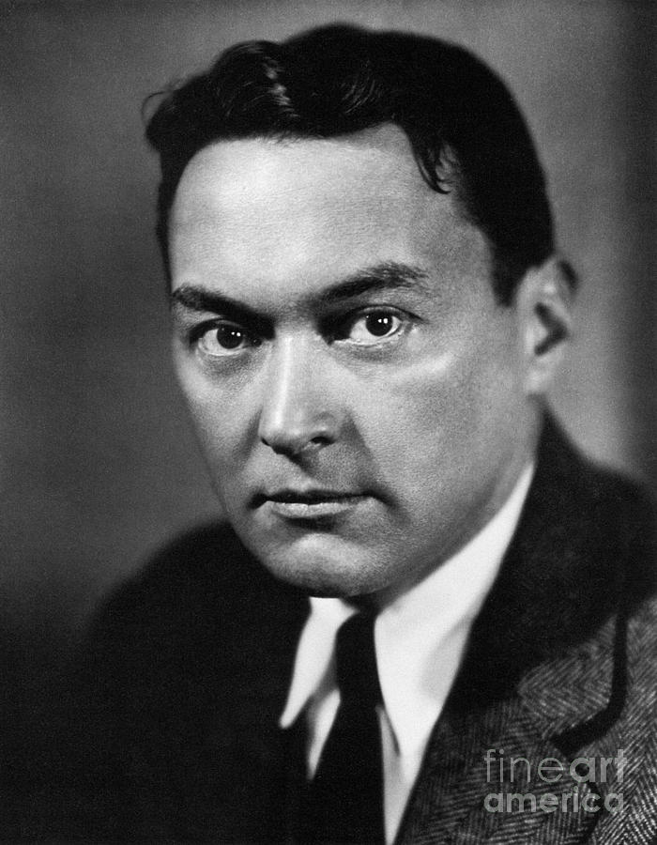
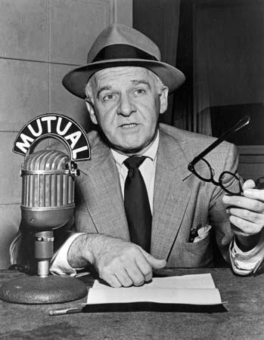
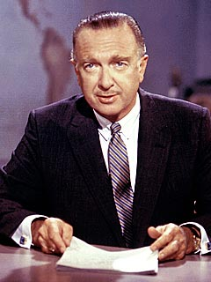
Yesterday
Print: Walter Lippmann Radio: Walter Winchell TV: Walter Cronkite
Notes:
Let’s start with the media of yesterday. This slide is a look at the giants of the 20th century. In our lifetimes, some of you probably remember a day when there only three TV channels, maybe four if you had a UHF. You got up to change the channel. Your hometown had a daily paper, and almost everybody read it or at least a section of it. My section was sports.
Some Characteristics:
These were knowledgeable reporters who dominated their media.
They spoke to large audiences.
They were very influential with the general public and government leaders.
In effect, most of the country was reading, listening and watching the same stuff.
The advent of radio and then television changed the way we access information. But these media were still driven by a few dominant players.
That was yesterday.

Slide 11
Today
And YOU!
Notes:
This is today.
The news is fragmented into many specialized streams. Instead of subscribing to the old daily newspaper to get more sports info, maybe I subscribe to The Athletic instead.
More outlets. Not necessarily more reporters. And by reporters, I mean people who actually dig for the news and not just comment on it. There are many of those in the digital age.
The news cycle is 24/7, whenever you can post.
There’s constant sharing across social networks, where stories can go viral.
There are so many options that it’s easy to find echo chambers – people tend to gravitate to the media that reflects their own point of view.
Every person has the capacity to be their own media channel. Think about how stories break these days and how they spread. The social media storm doesn’t follow a news story. It’s the other way around. Media use social to see where the conversation is and even what the news is.
To the extent that young people are getting the news at all, they’re getting it through social, which doesn’t cost a thing.
The advertising that used to sustain newspapers and make them really cheap to buy … virtually all of that has left the barn and gone to social.
And as a result, a lot of the newspapers of our childhood have gone away.

Slide 12
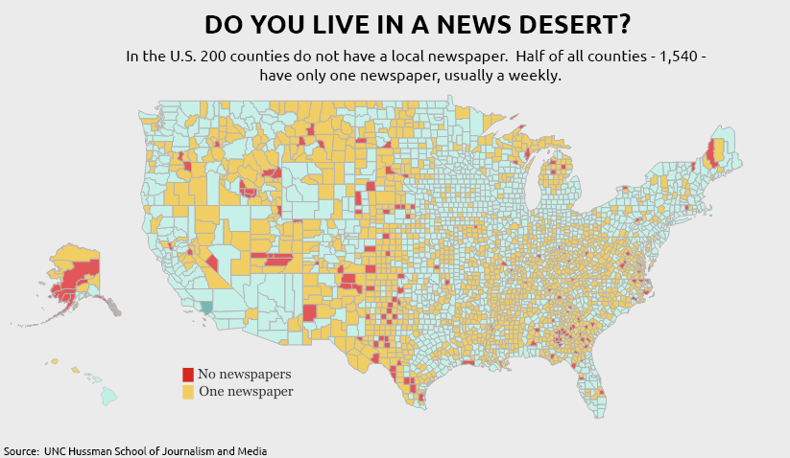
Since 2005, some 2,500 newspapers have closed.
Notes:
This is a map from UNC’s journalism school, which has been tracking the contraction of the newspaper industry for many years now.
Since 2005, some 2,500 newspapers have closed. In a 15-year span, between 2005 and 2020, one-quarter of all U.S. newspapers and half of all local reporters disappeared, impacting more than 1,800 communities across the country. At this pace, we’re on track to lose one-third of all U.S. newspapers by 2025. And the ones that are left are shells of their former selves (unless you’re the New York Times, Washington Post or Wall Street Journal).
OK, so what? What’s the danger? What do we lose when we lose local media? Some of the impacts are a loss of civics. Lower engagement with local issues and elections. More attention to national news, where polarization is nonstop.
And add to that, fewer opportunities to engage mainstream media reporters on topics like Job Corps because there are fewer reporters, and the ones that are left are stretched thin. Instead of one beat, like education, reporters are balancing three or four.

Slide 13
Take the shot. Here’s why.
Builds credibility
Reaches the influencers
Helps fill the centers
Job Corps has built-in advantages
The voice of 16-24s (interviews: 18-24s)
Education + workforce, two hot-button issues
DEIA in action
Good video and audio
Where setbacks become comebacks
Notes:
Despite all that, I think you should take the shot and invest some time in media outreach. Here’s why.
It’s one way to build some credibility. Yes, the consumers of this media are way out of the Job Corps-eligible age range. You’re talking to older people here. But they influence your target audience. So don’t worry if only 15 people saw the story. Maybe they’re the right 15 people. And once you have the link, you can grow that audience by sharing it with lots of people.
Obviously there’s a need. We’ve got empty beds. So every little bit of positive outreach helps.
And I think Job Corps has some built-in advantages when it comes time to pitch the media. You represent a hard-to-reach audience. You are the intersection of education and workforce, both very much top-of-mind in today’s news cycle. To the extent that media are trying to do a much better job at reflecting the diverse voices in their community, Job Corps has a lot to offer. That includes good video and audio, which are important to digital media.
And last but not least, you have a lot of success stories. People who come from nothing and are making something. The homeless. Foster kids. Most media love comeback stories, and you guys have lots of them. … One note on setting up student interviews, once you have approval. Advise media organizations that Job Corps prefers they only interview students 18 years of age and older. It’s in that parenthetical on the slide.

Slide 14
5 Strategies
Notes:
OK, I started with the dry stuff, the approval loop, because it’s very important … and maybe it’s hard to appreciate how important it is unless you’ve been in a crisis. When you’ve got hundreds of young adults in a residential training program, whether it’s called college or Job Corps, you’re never too far from a crisis. But you’re also never too far from amazing, incredible, inspirational stories.
Media relations is a mixed bag, pitching the good and mitigating the bad. It’s a very important job. Yes, OPA is the public voice of Job Corps, and they handle the messaging. But that doesn’t mean you don’t have a voice, and that doesn’t mean you can’t enable opportunities through proactive media relations.
There are some of you on the line who are very experienced in this area. And there are some of you who may be learning this stuff on the fly.
To help both groups, I’m going to run through five things I’d do if I were sitting where you are, my first day on the job as the BCL or another staff member who wears many hats, one of them being communications.

Slide 15
1. Build a media list
Local print/digital, TV, radio
Education and business reporters (and editors)
Don’t forget smaller but targeted publications
MP&F can help
Expand the spreadsheet
Have they ever covered Job Corps? Positive/negative?
Last Job Corps story? Ever been to campus?
How do they like to be contacted? Best times to reach?
Notes:
The first thing I’d do is know who I’m talking to. We’re talking about building a media list here. Most of you probably have this already, but I’d encourage you to make this as detailed as possible. This isn’t just a list of names and e-mail addresses. If you set it up correctly, this document will guide your media relations efforts moving forward because it includes some detail:
What are the best times to reach the reporter?
How do they like to be contacted? Phone? E-mail?
Have they ever been on center before?
If they have, what did their last story about Job Corps look like? Was it positive or negative?
You can even add some detail about likes, dislikes and what they’re working on right now.
When you’ve got something like this, it’s easier to focus your attention strategically, spread the love a little bit, target folks who are friends of the program or who haven’t been there in a while. If they’ve never been, you have an opportunity to plant a first impression.
The list itself is something you can cobble together from visiting media websites and collecting contact information. Or you can use a list-building program. MP&F has one of those. If you want us to build you a media list, just let us know.
This list should include business and education reporters from the various media: television, print, radio, digital. It should be local folks, obviously; but if your center is in a remote location, I would include the nearest large city’s media. Don’t forget about niche publications that have smaller audiences but may be more targeted. Think about publications that serve Latino or Black audiences, for example.

Slide 16
2. Build a news calendar
School calendar plus events
Graduation
Career fairs
Other special events, like Signing Day
Community service projects
Open houses
VIP visits and tours
Launch of new programs, facilities, partnerships
Student/staff awards, center milestones
Develop media advisories and news releases
Advisories: Inviting media to an event. Who, what, where, when.
Releases: A summary of an event or official announcement.
Examples: See media outreach toolkit and Signing Day toolkit at jcmarketplace.com.
Notes:
OK, so if we’ve already covered who we want to talk to, let’s discuss what we want to talk about.
I’d work on my calendar and event schedule as the second step, but it’s more than open houses and graduations. Signing Day is a good example. Also Career Fairs, certain community service projects, the launch of new programs or facilities.
These are all calendar items, and once you have this list together, you’ll see some good opportunities to invite media on center or flag an off-center event that might be of interest to media. Something where they can see the program in action.
The format for an invitation can be a simple email, but oftentimes for bigger events we use a media advisory. This is a formatted document, not much different than an Evite. It’s basic information – who, what, when, where and why – with contact information and RSVP info at the bottom. These are usually no more than one page of a Word document.
A news release is a summary of an event that already took place, or a summary of an official announcement. Basically this is the document that shares the news, whatever the news is. These are also not very long, usually a page, sometimes two. They almost always include a quote. They’re written very much in the style of a news story you might read on the website.
Think of the advisory as the before, and the release as the after. One is an invitation. The other is a summary of what happened.
There are examples of media advisories and releases in the media outreach toolkit. You can find it in the toolkits section of the materials marketplace at jcmaterials.com.

Slide 17
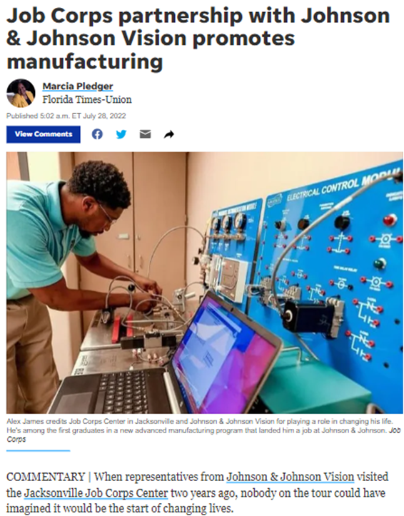
Jacksonville Job Corps Center + Johnson & Johnson Vision
The Florida Times-Union: Jacksonville Job Corps partners with Johnson & Johnson Vision. July 28, 2022
Audience: 98,580
Additional coverage:
National Cybersecurity News: Jacksonville Job Corps partners with Johnson & Johnson Vision | #education | #technology | #training - NATIONAL CYBER SECURITY NEWS TODAY
Yahoo: Job Corps partnership with Johnson & Johnson Vision promotes manufacturing (yahoo.com)
Notes:
I’m running through some examples of Job Corps stories in the media in 2022 and what this can look like for your center.
This one is about a new advanced training program at Jacksonville Job Corps, working with an employer to build a new worker pipeline to manufacture contact lenses.
That’s a very sticky story right now, and we see this trend everywhere. Businesses working directly with high schools, community colleges and training programs like Job Corps. All to address labor shortages and falling college enrollment rates. It’s a good time to pitch these new relationships to media. And it’s a good time for Job Corps to be having these conversations with local businesses. They’re looking for workers. Job Corps has them.

Slide 18
Hawaii Job Corps Center and CVS Health Partnership
MidWeek, Trian to be a Future Pharmacy Tech. June 29, 2022
Audience: 58,119
Unique Visitors per Month (UVM): 37,255
Impressions: 1,242
Notes:
This is the same type of story, except out of Hawaii. There is nothing new about the CVS partnership with Job Corps from a national sense. But it’s new in Hawaii, the story got some pickup and the center got some new students because of it.
I’m showing some of the reach numbers here, but bigger isn’t always better. You could be pitching a smaller media outlet, but its consumers may be more aligned with influencers for your target audience.

Slide 19
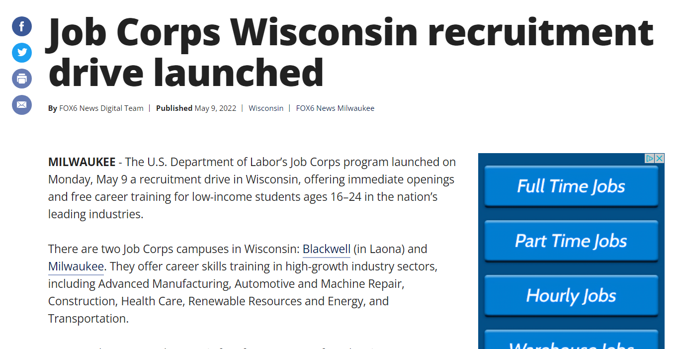
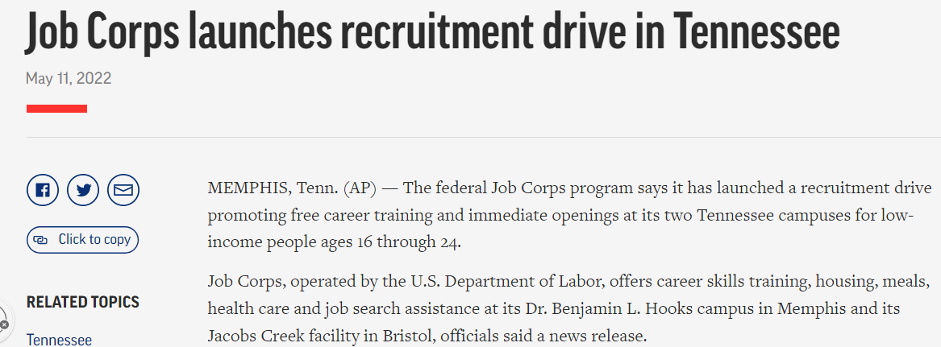
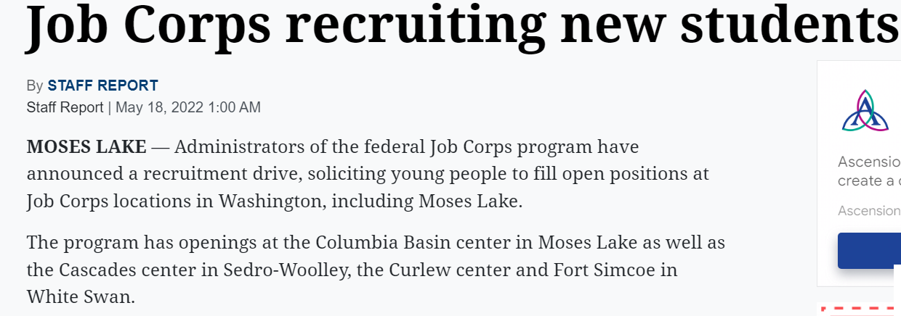
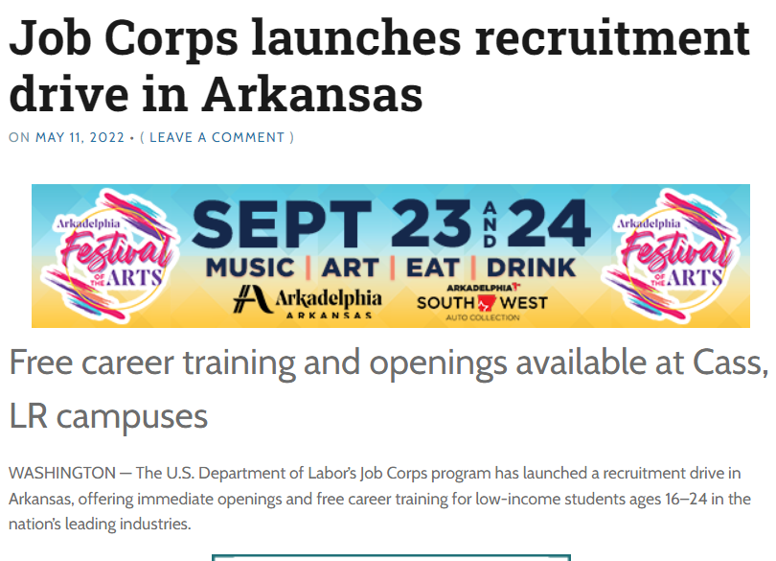
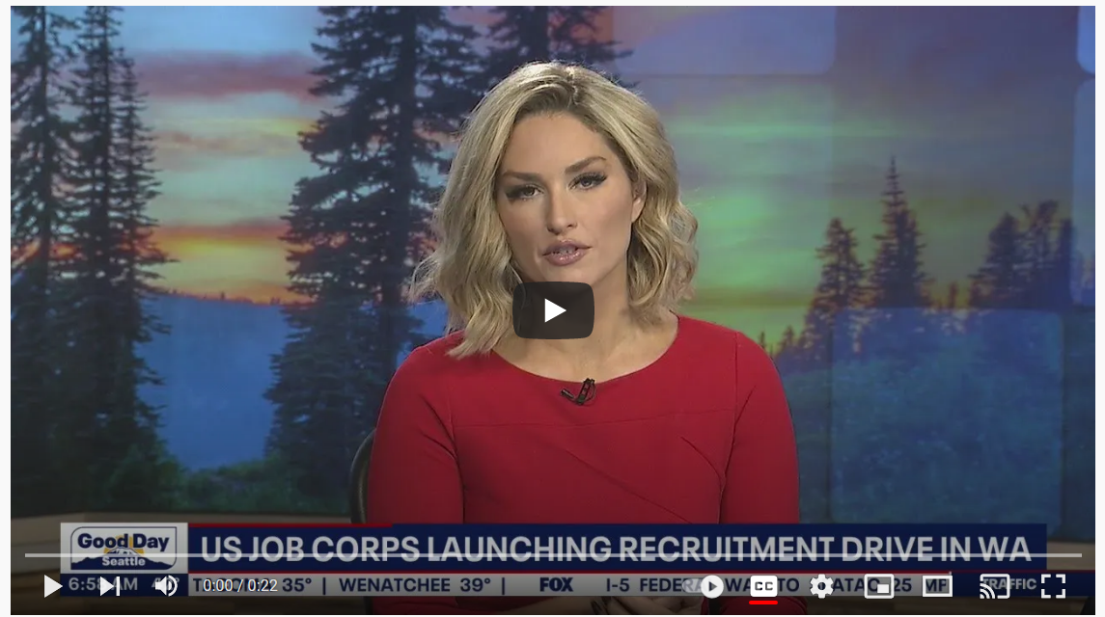
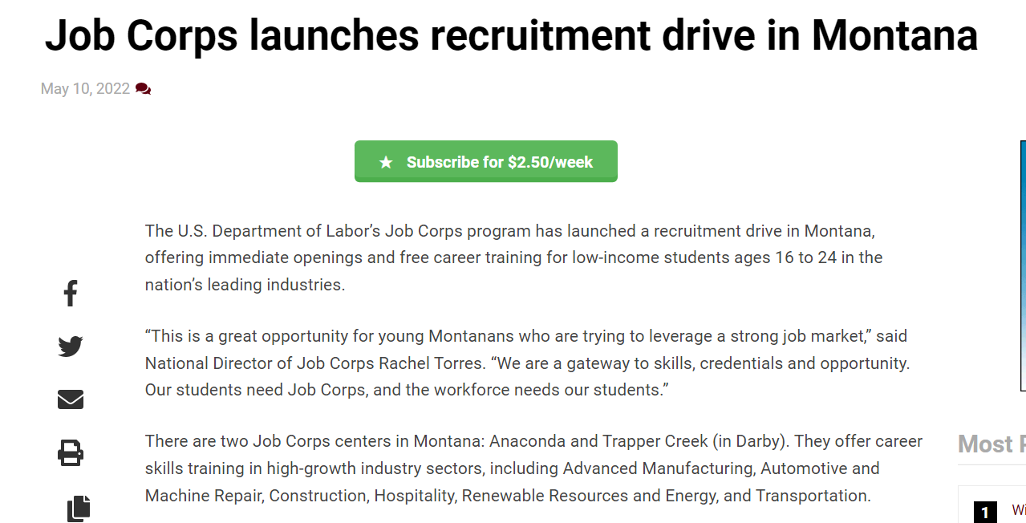
Summer Recruitment Drive 2022 57 articles. UVM: 44.6 million.
Notes:
This one here is an example of inventing news, in a way. It’s an example of taking a program-wide effort, calling it something, and then turning it into news.
Since everyone was pushing on the OBS front, we just gave the effort a name and turned it into a national release: Job Corps’ summer recruitment drive.
We worked with the National Office to do state-specific versions of this release and one for Puerto Rico. This was early May.
It resulted in 57 stories in two weeks, including some hits on the Associated Press. That’s a really valuable hit if you can get something on Associated Press, because the content is shared with many publications. That’s where one pitch can result in multiple stories in different places. Same thing with your local public radio station. A local NPR hit can easily turn into a weekend story on national NPR.
We’re probably going to do a recruitment drive release again this summer.

Slide 20
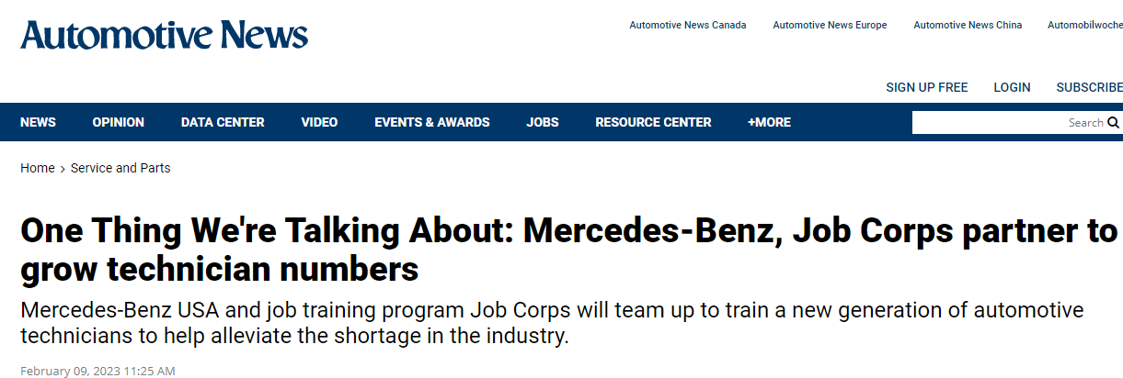
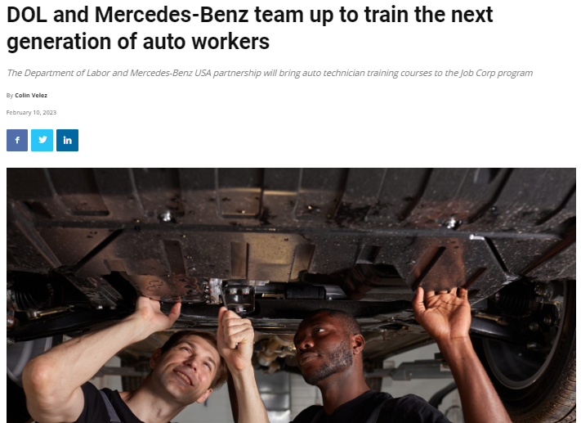
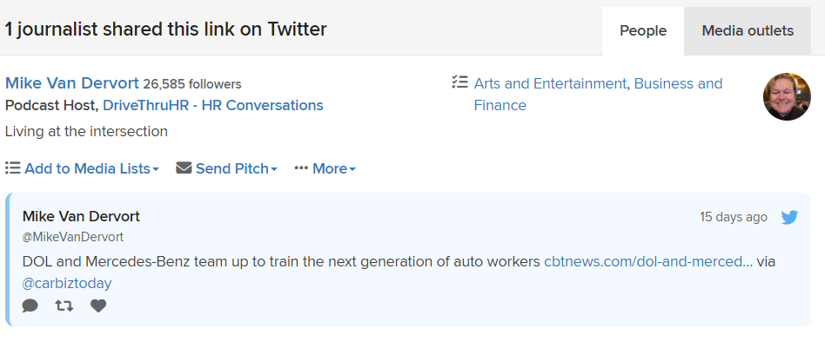
Job Corps partnership with Mercedes-Benz
Number of articles: 6
Date range: Feb. 8-10, 2023
UVM: 2,326,325
1 Journalist Share: Mike Van Devort, 26,585 followers on Twitter
DOL and Mercedes-Benz team up to train the next generation of auto workers
Notes:
This one is another example of a partnership release, but more recent and on a national scale. Job Corps has established a working relationship with Mercedes Benz to help train the next generation of auto mechanics, with an emphasis on emerging technologies like servicing electric vehicles.
This impacts automotive training in four states: Kentucky, Massachusetts, New Jersey and Utah.
The Department of Labor sent the release, and it got picked up in a few places, including some trade publications with national reach.

Slide 21
3. Find your success stories
Personal stories
Not necessarily your SGA president
Successful graduates, current students, staff
Signs: good wages, higher ed, JTM, leadership, comebacks
Extra points: women, recent, compelling, local to media target
Organize as one-page profiles
Does Job Corps work? Why should your center stay open?
Notes:
OK on to Step 3. We’re still getting organized with regard to what we’re talking about. Only now, we’re less focused on events and more focused on people.
Before reaching out to media, I’d have a good handle on my success stories. These are your best graduates, your best students, the ones with a compelling personal story, the ones who are engaging and excited about their Job Corps experience, the ones who are local to my media target.
How do you define success? That’s up to you. I put some of the tells in those fourth and fifth bullets. Let’s just say it isn’t always your SGA president.
I would organize these things as profiles that I keep in a folder or even a slide deck, and I’d keep these up-to-date. Some of these stories will be unfolding, your current students. Some of them will be further down the path, and they’ve long since left the center, but you’ve kept in touch and they have great things to say about their Job Corps experience.
One way to look at these profiles – they’re your answer to the question "Why should my center stay open?" The National Office asks us from time to time if we know of a success story in a particular market. I’d have these ready and expect the question.
So how do these success stories relate to media outreach? Sometimes you can turn them into news releases. Other times, they’re part of the pitch. And other times, they’re part of the show and tell. Let me explain. When a reporter is on center and asks to speak with a student or graduate, you know where to go. You know who can come with you while you’re giving a reporter a tour. Or maybe the student can lead the tour.
Nine times out of 10, this student is not the reason that the reporter came on center. But if you have the right stories and you make the introduction, the reporter leaves with a story idea.
We focus on success stories because nothing sells the program like a successful student or graduate. We know that because we ask the target audience, 16 to 24s, over and over again. And their response is that they want to hear from their peers.

Slide 22
Success stories - sample profile
Name
Age
Hometown
Job Corps center
Graduation date
Achievements on center
Training areas completed
Certifications
Other accomplishments
Current occupation, wage
Photo
Why is he/she a success story
Contact information
Student/grad contact info
Job Corps staff contact
Employer
Organize success stories in a spreadsheet
Notes:
Once you’ve finished identifying your success stories, you’re going to collect some basic information about that person. I’d plug that information into a formatted document of some kind for easy reference and so that it’s consistent with your other profiles. Make it as easy as possible for your center director or the Regional Office – or the media, if you have permission – make it easy for those folks to review the story. The easier it is for leadership to digest, the more actionable it becomes on their end.
You can organize profiles as Word documents or even PowerPoint slides. And it’s helpful to keep a running spreadsheet so that you can reference all of them at once and have the contact info at your fingertips.
How many of these do you do? That’s up to you. How many compelling success stories do you have? If I were you, I’d do a lot of them but maybe not share all of them with Job Corps leadership or the local media – only the best ones or the ones most relevant to the reporter’s story.

Slide 23
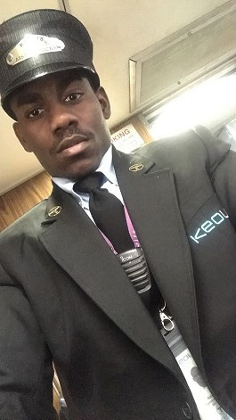
Ralph Jean Baptiste
Moved to the U.S. as a teenager in 2014 from Haiti
Joined Shriver Job Corps Center (Mass.) to learn English, adjust to American culture and gain employment after being denied by Connecticut schools
Currently working as an assistant conductor at Keolis Commuter Rail Services
Notes:
Here’s an example of what some of this info might look like if you turn it into a PowerPoint slide for an outreach presentation. This is Shriver Job Corps graduate Ralph Jean Baptiste.
Born and raised in Haiti, Ralph Jean arrived in the United States as a teenager and found Job Corps after being denied by the Connecticut school system due to language barriers.
After graduating from the Transportation Communications Union training area, Ralph Jean started as a ticketing agent with Keolis Commuter Rail Services. He was offered the opportunity to interview for an assistant conductor position and has been working there since 2017.
One thing I might add to something like this is his current wage or salary. Maybe even a quote.
A slide like this might come in handy for any sort of Shriver recruitment presentation, but it speaks to larger issues like refugee outreach and talking about how Job Corps serves new Americans.

Slide 24
4. Build relationships with media
Yes, they have time for this, even in today’s media landscape
Center visits and tours
Invite for lunch
Speaking opportunities
Research target before you talk
What can you do for them?
Vocational training
Workforce issues
Education issues
16-24s
Notes:
OK, number 4.
No doubt, this sort of thing is tougher than it used to be. Reporters don’t have time for things they used to. And there are a lot more of us, a lot more communicators than there are reporters. Want to know the ratio? For every reporter, there are six public relations professionals.
But I’ll tell you this: Reporters still have time for a good story. They have time for lunch. I wouldn’t wear them out by blasting every little thing in their direction, generating a ton of releases, blowing up their inbox. You wear out your welcome that way, and they start to tune you out. But an invitation to lunch? Or to take a look at a demonstration or special project – maybe around the same time as lunch? Sure. These people eat, trust me.
If you’re living in one of the regional office cities, or close by, you may even want to extend an invitation to your regional OPA rep, to get that person on center so that they see how Job Corps works and so that you get a better understanding of their world. It’s a good relationship to develop.
Why would reporters want to develop a relationship with you? Because you offer a window into some subject matter areas that are important to them. The resurgence of vocational training. Workforce issues. Education issues. A window into 16-to-24s and how they think.
I think you’ve got a lot to offer.

Slide 25
5. Tell your story
Letters to the editor
Op-Eds
PSAs
Get a reporter on center
Notes:
OK, so what if you’ve done all these things and your pitch to media falls flat. Your invitation goes nowhere. You’ve tried and tried, and you don’t get a response. That leads to this slide. Take the opportunities within earned media to tell your own story in your own way. I’m talking about letters to the editor, guest columns, Op-Eds. Print and digital media are increasingly dependent on community voices, both as an outreach tool to drive engagement and perhaps also as a necessity because its own ranks are dwindling. In either case, this is an opportunity for you.
And when I say you, I could actually mean you. Or your CD. Or your SGA president. Or one of your instructors. Whoever can tell your success story. As long as the leadership and OPA is cool with it, this sort of thing is wide open. It’s especially impactful when it comes from a student or graduate.
I think this is a good play no matter what size your media market is. It’s always good to tell your own story, because you have a bit more control there. But a reporter can tell your story, too. And that’s been the goal here with these five steps. What sort of things do I need to do to get a reporter on center? I want to finish by talking about that a little bit.

Slide 26
Get a Reporter on Center
Notes:
Many of you have long working relationships with your local media.
But maybe you don’t have any. Or maybe a new reporter has been hired, and you’d like to develop a new relationship. But this person doesn’t know who you are.
Let’s take a closer look at making first contact.

Slide 27
The Approach
How do reporters like to be contacted?
E-Mail: Subject line matters, get to the point
Photos and video help. Show me.
Cut through the clutter: phone, letter
Following up
When is the best time to make contact?
Not on deadline
Morning is usually better
Soft news: Friday isn’t a bad day to pitch
Notes:
The approach in most cases is an email, sometimes a call, sometimes both things.
Many reporters receive hundreds of emails per day, even in the smaller markets. Make your email count. Things that help: A good subject line, a short invitation message, a message that has a photo or video link in the body of the email (don’t attach). And of course, if the reporter already knows who you are, that helps too. If you want to cut through the clutter, phone calls or even sending a hand-written note or invitation sometimes works.
If you’re developing a new relationship, you may need to work a little harder, but that situation gives you a great excuse to make contact: You want to introduce yourself and introduce the program, you know this reporter has an interest in the job market and education, you offer something many reporters want – access to 16-to-24s. In other words, you don’t need to be embarrassed sending an email like that. It’s a legit pitch, a good opportunity. You’re not bothering the reporter. You’re giving the reporter an opportunity.
When to make contact? Mornings are usually better. Afternoons and evenings are trickier because that’s getting closer to deadlines, and that’s when most of these folks are writing. In general, if it isn’t urgent news, Fridays are good days for soft pitches. Folks are happier. Not as many emails to sift through. A bit more room on their schedules.

Slide 28
The Hook
Graduations and ceremonies (e.g., Signing Day)
Community service projects
Career technical skills training projects
Open houses
Success stories
New student arrival/orientation
Mentoring, speaking opportunities
Lunch on center + tour works, too
Notes:
So we talked about how to make contact. Now let’s talk a little about the what – what are we contacting the reporter about? What’s the invitation? What’s the hook?
Here are some things you can use. All of them are good excuses to make contact and show the program in action. These things don’t call for building a news release. It’s just an email or phone call. What helps is if you can follow the reporter for awhile BEFORE you make first contact. Read the reporter’s last few stories, follow them on Twitter – and then connect your pitch to something the reporter has recently done. Or you can throw in a comment like “loved your story on X, by the way.” Something that shows you know who this reporter is, and this isn’t a cattle call, this isn’t an email merge. Don’t try to herd reporters. Go one at a time.
OK, mentoring and speaking opportunities – that’s kind of a back door. Oftentimes you bring in professionals to talk to the students, right? Why not have a reporter be a graduation keynote or talk to the students about communication skills? While they’re there, the reporter’s eyes and ears are open, looking for story ideas. You didn’t ask them to do that. They do that because that’s who they are. Just get them on center.
If you don’t have anything solid to use as the hook, try a tour and lunch invitation on center. If you have culinary, maybe those students can help prepare something. That leaves a good impression on the reporter. So do student tour guides. Don’t hide your students if you have a reporter on center. Just the opposite. You may want to be selective about who you introduce, but allow some time with your best students at least.

Slide 29
The Goal
Get the reporter on center
Why?
This is where perception meets reality.
If no perception, this is where you make a first impression.
This is where you introduce your success stories.
No expectation of coverage. Play it cool.
Notes:
The goal here is not necessarily coverage, at least not right away. This is about relationship-building. You’re not asking for anything. But oftentimes, when you play it cool like that and maybe steer the reporter toward some interesting people and programs, the story will take care of itself.
When a reporter comes to a Job Corps center for the first time, they start to see the program in a different light. This is where perception gives way to reality. Or this is where you get to plant a first impression – those opportunities are gold. Not always but oftentimes in the communications business, first punch wins. Or at least sets the tone for a long time.
Don’t run from reporters you don’t know. Those are opportunities. And pay attention to changes in the local media that bring new reporters, most of them young and unfamiliar with the program. That’s an opportunity right there to build a relationship from the ground up.

Slide 30
Questions?
Call MP&F (615) 259-4000
E-mail Jobcorpsmaterials@mpf.com
Jsolano@mpf.com
Notes:
We’re at the end now, gang. And we’ll hold here for questions. But if you want more info, advice, whatever, please feel free to contact your MP&F rep or me at this phone number.
There’s a lot we didn’t talk about here: crisis communications, do’s and don’ts of dealing with the media, interview prep. That’s all media relations 201, and if you’re interested in a session like that, let us know in the survey that will be coming to you after this webinar. We wanted to focus on the basics here because we haven’t given this webinar in a while and there are a lot of new Job Corps communications staff who may be familiar with media outreach but perhaps not Job Corps protocol and process.
I hope this webinar has been helpful. Again, it will be posted on the Materials Marketplace under the “Trainings” tab. Reminder to everyone that we offer regular training webinars. Be on the lookout for other training announcements as well.
We do have a quick survey on this webinar that we would love for you to fill out. You can find the link to it on the right-hand side of the screen. This will help us make sure our webinars are helpful, and we can incorporate suggestions into future ones.
I'll pause here and see if we have any questions in the chat box …
If you think of something later, reach out to us anytime. There's our contact information on screen.
Thanks again for joining us here today.

