Slide 1
Back to Job Corps: Marketing Strategies for current and prospective students
Notes:
Hi, everyone. Thank you for joining me. My name is XX, and I work for MP&F Strategic Communications.
We are the communications support contractor for Job Corps, and are responsible for creating national recruitment materials, coordinating Job Corps’ national advertising campaigns, and managing the program’s social media accounts on Facebook, YouTube, Instagram, and now Twitter. We also do many other things as well, but these are some of the main efforts we coordinate.
Before we begin, please add your name, center (or organization), and e-mail address into the chat box. This webinar will last about 45 minutes, including some time for Q&A at the end of the webinar. At any point throughout the webinar, feel free to type questions in the chat box at the bottom of your screen. Someone from MP&F will be monitoring the chat box and will respond to you or flag your question for discussion at the end.
Does anyone have any questions or comments before we get started? OK, let’s jump in so we can keep this to 45 minutes.

Slide 2
Overview
Job Corps’ resumption of on-campus operation strategies
Key messages from the communications plan
Job Corps Materials Marketplace
You will be able to find this presentation under the “Trainings” section at JCMarketplace.com.
Notes:
Today, we’ll be discussing the materials and tools available to inform students of the status of Job Corps centers as the program continues to resume on-campus operations and welcome students back to centers in small groups and in phases.
First, I’d like to provide a big-picture overview of Job Corps’ communication and marketing strategies, and how the program will update different target audiences of the program’s operational schedule and its new health safety protocols.
Then, I’ll outline key messages and resources available to communicate these messages over several different platforms to all of Job Corps’ target audiences.
And lastly, I’ll go over where all new materials and resources can be found on the Materials Marketplace. I’ll discuss how to use these materials in your recruitment efforts and how to order or download the materials you might need.
We’ll be covering a lot of information today, but don’t worry. We will e-mail each of you link to this presentation. This presentation is being recorded, and the PowerPoint will also be available on the Job Corps Materials Marketplace under “Training,” so you can download or watch it for future reference at any time.
So let’s get started…

Slide 3
Resuming On-Campus Operations: Key Messages
Job Corps has resumed on-campus operations and is welcoming students back to centers in small groups.
What can students expect on campus?
What will be expected of students when they arrive?
Notes:
Job Corps’ communications plan for phased resumption of on-campus operations focuses on three main messages:
The first message is that Job Corps has resumed on-campus operations and is welcoming students back to centers in small groups and in phases. In order for students to continue to return to campus, centers are implementing new health safety protocols to ensure the health and safety of its students and staff.
The second message is that Job Corps is closely monitoring health and safety recommendations to determine which center locations are safe to resume operations. The program is actively working directly with centers on plans for resuming classes on campus that include pre-admission health screens and COVID testing, new guidelines for social distancing and protective face coverings, and additional safety precautions in classrooms, dorms, recreational facilities, the cafeteria, and other spaces you use on campus.
The third message focuses on what will be expected of students when they arrive on campus, and how they can help keep their campuses safe and healthy for everyone. This includes mandatory face coverings, frequent hand washing, social distancing, and complying with all testing and health screening practices on center.
These main messages will now be in all Job Corps communications, including digital content, e-mail and text campaigns, websites, materials, and social media posts.

Slide 4
Communication Tactics
A new webpage
E-mail and text campaigns
Geo-targeted social media content
National Director communication
COVID-19-specific informational videos
Updated materials
*New virtual enrolment materials
Notes:
And these key messages will be communicated to Job Corps’ target audiences, including current students, prospects, stakeholders, and the general public through several different tactics:
A new webpage features which centers have resumed on-campus operations, outlines new health safety protocols, and offers COVID-related frequently asked questions. The site URL will be on all digital content, jobcorps.gov, and social media posts, and added to several recruitment materials. It’s important to note that MP&F is working closely with the National Office to keep the site updated in terms of which centers have resumed operations, which centers have resumed operations but temporarily paused welcoming students back, and which centers are expected to resume operations soon.
There are also e-mails and text campaigns for current students and prospects to support enrollment.
Geotargeted social media posts on Facebook, Instagram, Twitter, and YouTube will help support OBS and share information in real time with Job Corps audiences.
A series of informational e-mails from Job Corps’ National Office will be shared with current students regarding the program’s operational status and other important announcements and words of encouragement.
Different COVID-related informational videos are available that focus on what centers are doing to prepare for the return of students, what students can expect when they arrive on campus, why these rules are being implemented, and how they will help keep everyone safe on campus. These videos were unavailable for a short period of time, but we’ve recently finished updating the footage and they can now be accessed.
And lastly, language about Job Corps’ commitment to safety and the new microsite URL have been added to more than 100 marketing materials, including the center fliers.
AND… we have just added three materials to the Materials Marketplace to help promote Job Corps recent announcement of offering virtual enrollment. We have developed two fliers and a post card that I’ll discuss in more detail in a few slides.
I want to dig into each of these in a bit more detail.

Slide 5
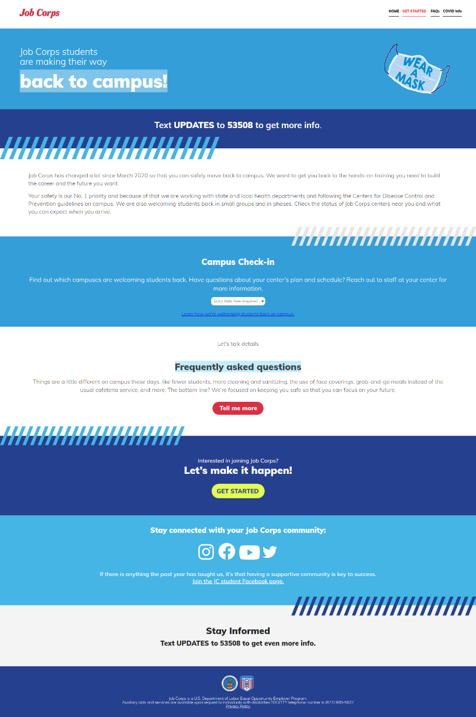
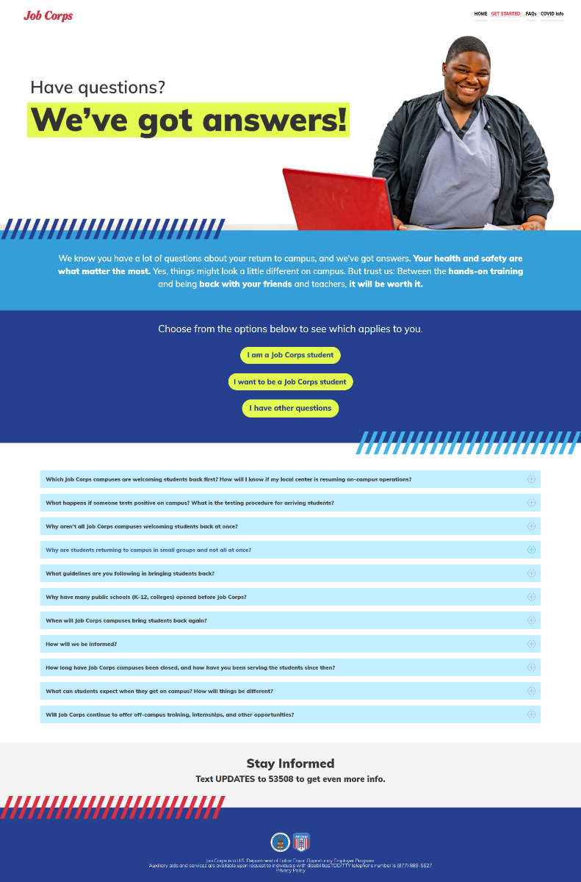
New Webpage
backtojobcorps.com
Notes:
Perhaps the most important resource available is the new COVID-specific webpage.
The page serves as a hub for all information regarding which centers have resumed on-campus operations and the program’s new safety protocols.
It also includes an FAQ section that addresses topics of interest to current students, potential students, and other external audiences. It has also just recently been updated to include FAQs about Virtual Enrollment options. These FAQs are on the COVID page and also on Jobcorps.gov
And if you’re thinking, “Great, another website URL I need to remember.” Don’t. The URL has already been added to:
The jobcorps.gov site
The remote recruitment, audience-specific landing pages that have been available on the Materials Marketplace
All ad-related landing pages for prospects
All posts on Job Corps’ national social media accounts
Lead nurture e-mails and texts to both prospects and current students
And to more than 100 recruitment materials

Slide 6
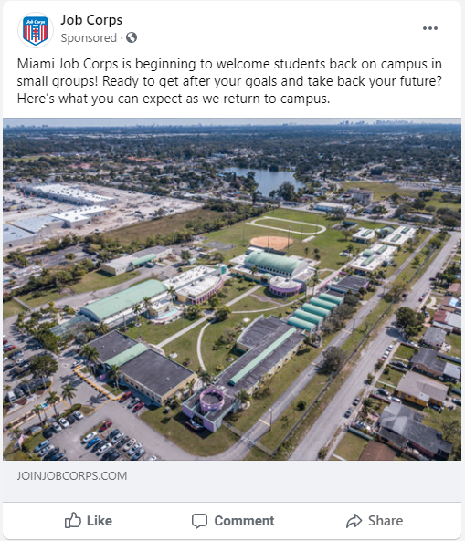
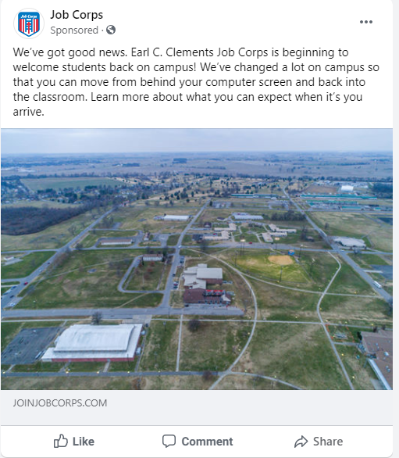
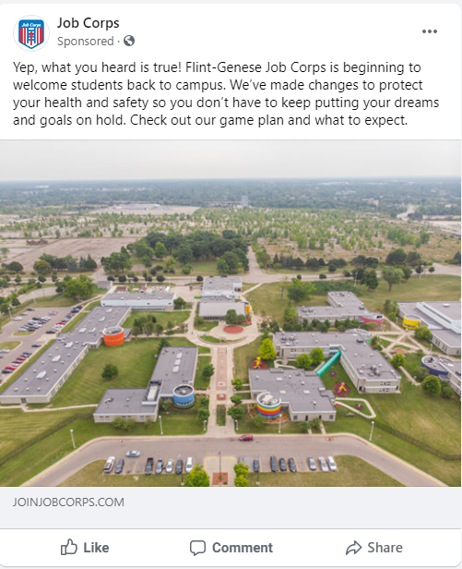
Geo-targeted social content
www.facebook.com/doljobcorps/
www.instagram.com/doljobcorps/
www.twitter.com/doljobcorps/
Notes:
Geo-targeted social media posts will also run on Facebook for centers that have resumed physical operations and continue to welcome students back to campuses in small groups and in phases.
If you’re not familiar with the term, a geo-targeted post just means the content is targeted to a specific geographic location. For example, if we were to run a targeted post for the Gary Job Corps Center, we would target the post only to the San Marcos and Austin, Texas, area. This way, only individuals living in these areas would see the post on Facebook.
Here are a couple examples of the messaging and imagery for these posts.

Slide 7
Lead Nurture E-Mails
E-mail 1: Job Corps has announced the resumption of on-campus operations at select centers.
E-mail 2: Students will be welcomed back on select campuses in phases and in small groups.
E-mail 3: Here is what to expect when you arrive on campus and how you can do your part to keep yourself and your peers safe and healthy.
E-mail 4: Your center is scheduled to open very soon. You will notice daily schedule adjustments and a new “no leave” policy.
Notes:
E-mails have been developed for both prospects and current students. What you see on the screen are messages for current students since the priority is getting them back on campuses first.
We know that all of you are in frequent communication with your current students on a regular basis regarding your specific center plans, so these e-mails are just to supplement that communication and remind them about resources available to them whether they are on campus or at home participating in distance learning.
Please note that these e-mails will be distributed by MP&F. The first e-mail will be sent to all current students. The second, third, and fourth e-mails will be sent to students at specific centers based on the resumption schedule.
The e-mails contain broad information about the different resources available to learn more about Job Corps safety protocols such as the COVID webpage, plus the videos and social media content available to them. They also give an overview of what students can expect when they arrive on campus.
And like I said earlier, we know that all of you are already in frequent communications with your current students regarding your specific center plans. The point of these e-mails is to simply offer additional message touch points with the students while they are waiting to get back on campus.

Slide 8
Text Campaigns
Thank you for signing up for Job Corps updates! Students are starting to make their way back to campus. Here (https://bit.ly/2ZWDAFC) is our game plan on how we are going to do it safely.
Want to connect with other Job Corps students? Check out this Facebook page (https://www.facebook.com/groups/jobcorpsstudents)! If you are a new student, use PENDING for question 3 when joining the group.
Notes:
We have also implemented opt-in text message campaigns for both current students and prospects to receive updates about Job Corps’ operational status. Examples of these texts are on the screen.
Links where current students can opt in to receive these texts updates will be available on various digital resources, including the jobcorps.gov site and the new COVID web page. All they need to do is text “UPDATES” to a five-digit short code.
Once they do so, they’ll receive updates on how and when Job Corps will welcome students back, what safety procedures and protocols the program has put in place, how they can stay connected through the student Facebook page, and more.
Prospects can also opt in from various digital resources like the jobcorps.gov site, national ad landing pages, and geo-targeted ads.
Once a current student or prospect opts in, they will receive an immediate text with information about Job Corps’ operational schedule and then start receiving a series of seven text messages with information about the program’s policies and procedures, how Job Corps is welcoming students back in phases, and more information on training programs and distance learning options.

Slide 9
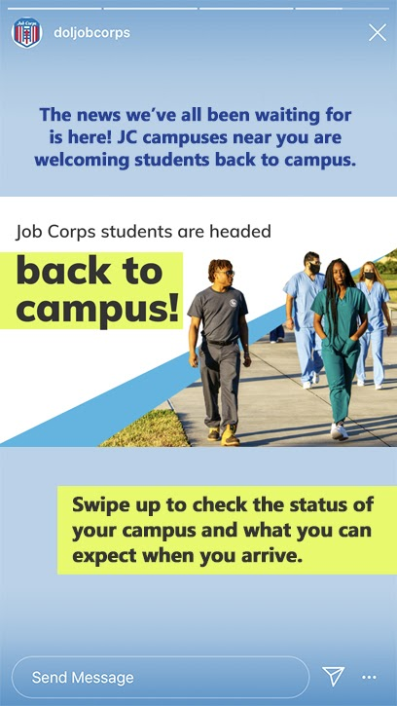
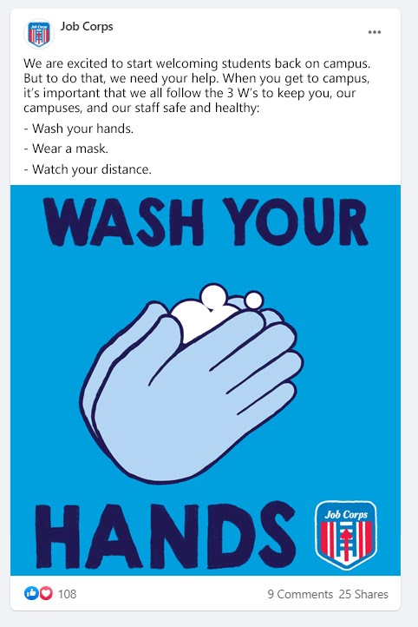
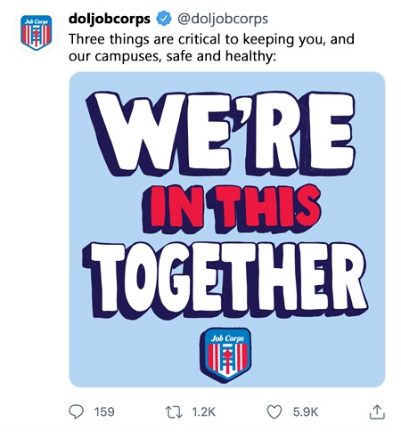
Social Media
Facebook
Instagram
Twitter
YouTube
jcdigital@mpf.com
Notes:
We’ll also be using social media to communicate about Job Corps’ future plans.
Here are some examples of posts to the national pages.
As Job Corps continues to welcome students back on centers in small groups, we have added several social media resources to help you keep this momentum going. Some of these include fun graphics that ask students to share what they’ve learned in their time away from campus, GIFs that represent how they are feeling about being able to go back to campus, prompts for students to share new life hacks, and more.
I mentioned videos earlier. A series of updated videos about Job Corps’ new health safety protocols have been created and will be shared on social media as well. The videos focus on 1) what centers are doing to prepare for the return of students, 2) what students can expect when they arrive on campus, and 3) why these new rules are in place and how they will help keep everyone safe on campus.
And of course, if any of you have information or photos about 1) what it’s been like to have students back on campus, 2) what your centers are doing to keep your students entertained during quarantine, or even 3) how you are preparing to welcome students back, please send them to us at jcdigital@mpf.com.

Slide 10
Material Updates
Notes:
Moving on to marketing materials… If you visit the Marketplace after this training, you’ll notice a new COVID banner has been added to several materials. It emphasizes Job Corps’ commitment to the safety of its students and directs people to the new webpage for more information. Here’s an example of the recruitment flier on the left with these messages added at the top of it in red.
On the right is a new Job Corps COVID fact sheet has also been developed. The flier highlights the program’s new policies and procedures and promotes the URL to the webpage. This flier can be found both in the Recruitment Materials section of the Marketplace and the new Back to Job Corps section that I’ll discuss next in our training.
You can download the COVID fact sheet from the Marketplace and print it as needed. You may want to consider e-mailing or texting the flier to students. You can also share it on your own social channels.

Slide 11
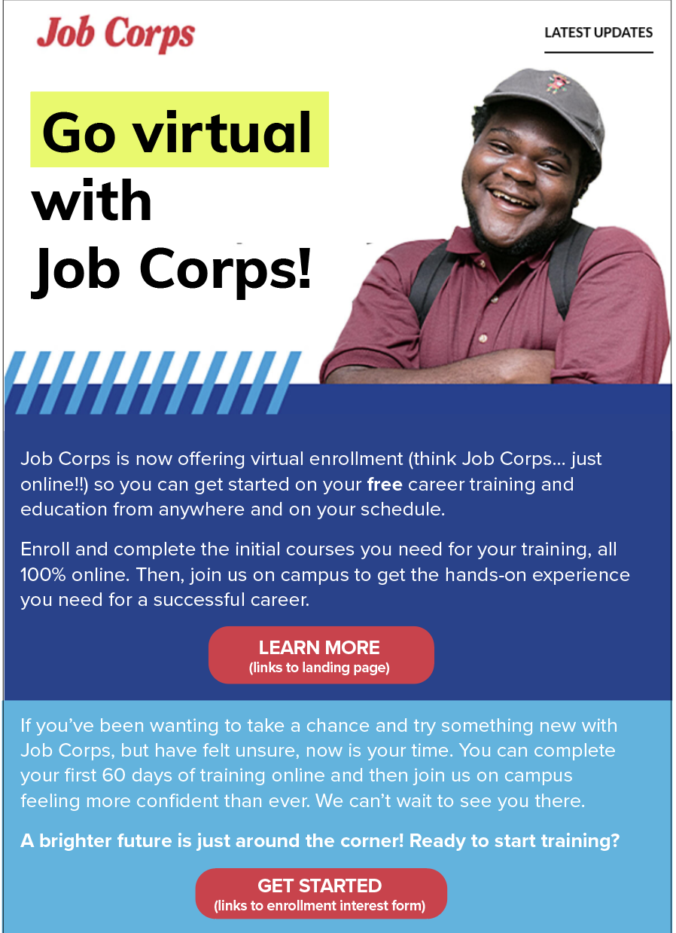
Virtual Enrollment Promotion
Advertising
Social Media
Email and text campaigns
Messaging added to websites
Materials
Stakeholder Outreach
Notes:
I mentioned the new virtual enrollment materials earlier and I think now is a great time to tell you about those as well as how Job Corps is promoting virtual enrollment overall.
With the announcement and launch of virtual enrollment , Job Corps developed a marketing and communications strategy to promote this opportunity to the program’s target audiences and help them understand how virtual enrollment works and what it entails for new enrollees.
In order to both promote and explain Job Corps’ virtual enrollment options and the characteristics a potential student will need to be successful in a virtual learning environment, Job Corps has carefully crafted new messages that have been incorporated into a variety of marketing and communication tactics, including:
Updated FAQs on the Job Corps website and COVID webpage now address questions regarding virtual enrollment.
Digital Ads on Google, Facebook, and Instagram now highlight virtual enrollment opportunities and the benefits it offers students who need flexible options.
Digital advertisements and social media posts direct users to the Virtual Enrollment webpage, which serves as homebase for all information regarding virtual enrollment.
Social Media posts on Facebook, Instagram, and Twitter now regularly share content about virtual enrollment and where students can learn more about their online options with Job Corps.
Text and Email Campaigns targeted at potential students include messages about virtual enrollment, answer questions about the program, and direct prospects to resources where they can obtain additional information.
Virtual Enrollment materials -- including two new fliers (one specifically for prospective females) and a postcard -- have been added to the Materials Marketplace and explain the benefits of virtual enrollment and what students can expect to learn online in their first 60 days.
Outreach to stakeholder audiences have been updated to address virtual enrollment, its benefits and what students can expect in an online learning program.

Slide 12
COVID Safety Posters
Notes:
Also – new COVID safety posters have just been added to the Materials Marketplace as well. This is a set of posters that focus on the W’s – Wash your hands, Wear a mask, and Watch you Distance. When you order these on the Marketplace you will receive a bundle of all three posters.
These are great to display on campus in common areas such as dorms, classrooms, cafeteria, etc.
These can be found in the Back to Job Corps section of the Marketplace – in the Back to Campus Messages section.

Slide 13
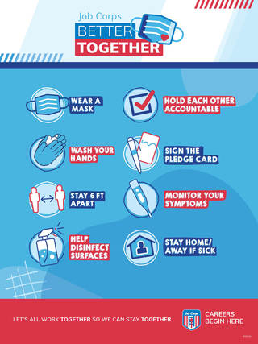
Better Together Initiative & Webinars
Staff Training Webinars
Tuesday, May 4, at 10:30 a.m. CST
Tuesday, May 11, at 2 p.m. CST
Thursday, May 20, at 2 p.m. CST
Notes:
And speaking of posters, I hope everyone has had a chance to check out the Better Together materials that been added to the Materials Marketplace. The Better Together Initiative was created to help promote the importance of Job Corps new health safety protocols and why they are so important for the future success of the program.
There are several materials available on the Marketplace including posters, fliers, a palm card, pledge cards and several tips and resource guides. The descriptions of all these materials and how to use them will be covered in some upcoming training webinars. I’ve included the dates on the screen. You can register for them through JCDC, so be sure to be on the lookout for the weekly training email and sign up for one of these sessions n May.
And of course you can always contact us with questions as well.

Slide 14
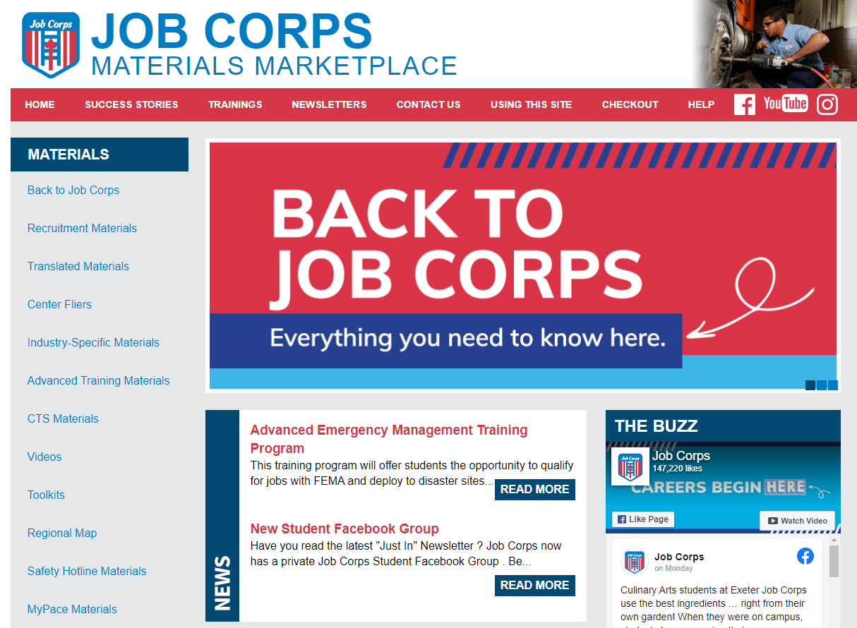
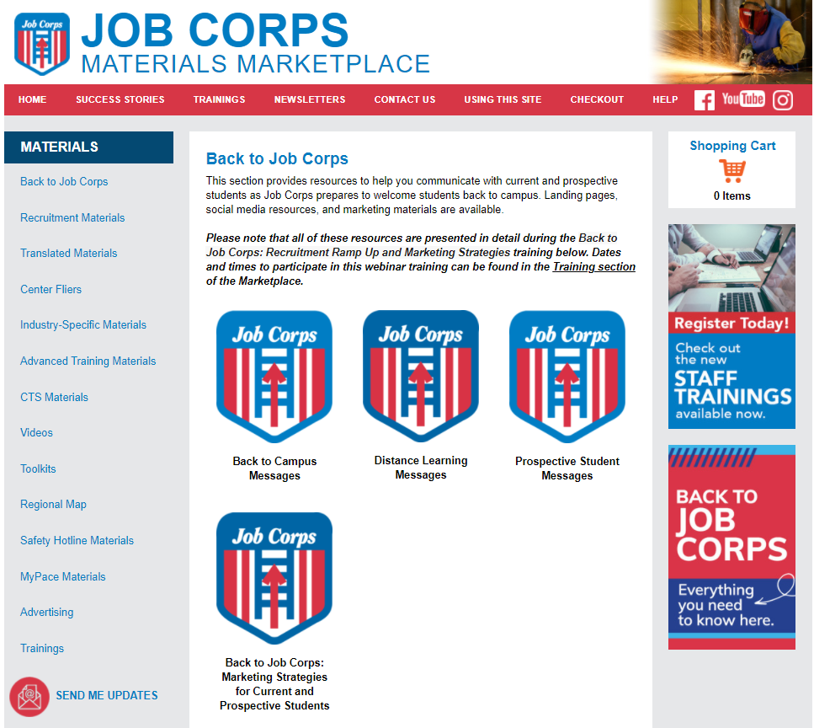
Back to Job Corps Section
Notes:
All of the resources I’ve mentioned thus far – the webpage, the emails, updated landing pages, all of the social media assets, videos, and the COVID fact sheet – will be available in a new Back to Job Corps section on the Materials Marketplace.
Once you visit the Materials Marketplace, the Back to Job Corps section is the first section on the left-hand side under Materials. There is also a banner on the homepage that takes you directly to the updated section.
I also wanted to point out that we made some slight adjustments to the landing pages that were created for each specific audience when Job Corps’ extended break began.
The landing pages for current students, prospects, female prospects, parents and guardians, and influencers/stakeholders are still relevant for you all to be sending via emails and/or texts to connect with these audiences. Each landing page now has a link to the COVID-specific fact sheet that provides general information about the program’s new safety protocols to help keep everyone safe.
So make sure you continue to visit this section of the Materials Marketplace to check out all the new outreach tools we just went over, and then be sure to visit it each week to see what new content has been added so you can communicate with your prospects and current students on a regular basis about Job Corps’ operational status and how they can stay informed.

Slide 15
Materials Marketplace
jcmarketplace.com/
Notes:
If anyone here is relatively new to Job Corps and is wondering what the Materials Marketplace is, I want to take a quick minute to make sure you know about this website and how to access it because it’s the central location to download and order all the materials and resources we just discussed.
The URL to the site is up on the screen, but the Materials Marketplace can be found at jcmarketplace.com. I encourage all staff to visit the site at least weekly. The Job Corps National Office covers the cost of producing, printing, and shipping all of the materials found on this site, so never worry about ordering too much or too little. As you can see on the screen, there are several sections of the Marketplace.
For those of you who are new to using the site, we created a “Using This Site” feature, which will help you with navigating the site, ordering materials, and troubleshooting issues, should you have them during the checkout process.
Again, you can find this site at jcmarketplace.com. If you have questions about a specific material or need a bulk order of materials, you can also reach out to our team at jobcorpsmaterials@mpf.com.

Slide 16
How To Use Your Materials
Current Students
Retention Flier
Office Hours Template
Retention Postcard (digital or print)
Retention Motivational Card
Motivational Phone Wallpapers
Social Media Graphics
Social Media Activities
Video Chat Backgrounds
Prospective Students
Messages to Prospective Students
Landing Page Outreach: Prospective Student, Female Prospective Student, and Spanish Prospective Student
Influencers and Stakeholders
Landing pages
Other resources coming soon
Notes:
Once you have received your materials, it is important to understand how best to use and distribute them. We know most of you are probably still working remotely; but if you are meeting with prospects in admissions offices with face coverings and practicing social distancing, we suggest using many of these materials in your outreach and recruitment efforts—and making sure your own offices are fully stocked with these materials so you can give them to prospects.
And keep in mind that individuals are still going to doctor appointments, clinics, and even hair and nail salons, and these are great spaces to display Job Corps materials, as people are often more likely to pick them up and engage with them while they are waiting.
It is important to leave materials that are especially informative, like the recruitment brochure and flier, and to always include contact information for people to reach out. The recruitment brochure has a blank white box on the back where you can leave your contact information.
Again, I know that this was probably a lot of repeat information for many of you, but we always want to make sure any new staff are aware of what’s available to them and to remind seasoned staff to keep checking the Marketplace on a regular basis for new materials and updates.
Admissions counselors are often a student’s first experience with Job Corps, so it is critical that you are prepared with the right information and materials.

Slide 17
MyPACE Resources Reminder
My Pathway to Achieving Career Excellence is a comprehensive, student-centered career planning system that empowers Job Corps students to take ownership of their career pathway planning experience and to set, track, and achieve their individualized career goals.
Resources on Materials Marketplace
Brochure
Flier
Poster
Notes:
Finally, I just want to quickly remind everyone that now is a great time to remind current and prospective students about the MyPACE program. MyPACE is such a great tool that students can be using either in distance learning or on campus to explore their career interests, track their career goals and progress, and develop their own comprehensive career plan.
There are frequent MyPACE trainings offered through JCDC, and there is a brochure, flier, and poster available for staff to use on the Materials Marketplace.

Slide 18
Questions?
Notes:
I’m going to pause here. What questions do you have about the information we discussed today?
Is there anything we did not address in the chat box or that needs further clarification?
I know this has been a lot of information to take in, so don’t forget that this entire presentation is available on the Materials Marketplace under the Trainings tab.

Slide 19
Contact Us
615-259-4000
jobcorpsmaterials@mpf.com
Thank you!
Notes:
If you have any questions, you can either call or e-mail us and we’d be happy to help you. Our phone number and e-mail address are on the screen.
If there are no more questions, I will close by reminding everyone to check the weekly JCDC training e-mails to see all of the other training topics currently being offered and when. You can register through the JCDC. Some of the upcoming trainings and dates are listed on this slide.
We do have a quick survey we just dropped into the chat box that we’d love for everyone to fill out. It takes about 5 minutes to complete. This will help us make sure our webinars are helpful, and we can incorporate suggestions into future ones.
With that, I want to thank you so much for joining me today. I’ll stick around for a few more minutes to make sure there aren’t any other questions, but if not, I hope you have a great day.

