Slide 1
Hispanic Outreach
Notes:
Thanks to everyone for joining us. Today’s training topic is all about supporting Hispanic outreach efforts. My name is Javier Solano, and I work for MP&F Strategic Communications.
We are the national communications contractor for Job Corps, and are responsible for creating the program’s national recruitment materials and coordinating its national advertising campaign. We also manage Job Corps’ social media accounts on Facebook, YouTube, Instagram and Twitter. We also offer regular trainings like this one to make sure staff like you have the tools and resources you need to support your recruiting efforts.
The webinar should last about 45 minutes, and there will be time for questions at the end; but feel free to type a question in the chat box at the bottom of your screen at any time. We have someone monitoring the chat box throughout the webinar.
I understand some of you on the line may be longtime Job Corps veterans, while others may be brand-new to the program. Either way, we hope you’ll learn some valuable information and what resources are available to you.
This PowerPoint will be posted on Job Corps’ Materials Marketplace, so you can download it for future reference if you’d like.

Slide 2
Agenda
Framing and introduction
Eligibility
Inside the numbers: Census 2020
Materials
Strategies
Myths
Questions
Notes:
Here's a look at what we're going to cover in this session. I'm going to open with some framing thoughts, some insights about this target audience. We'll touch on eligibility and then take you inside the new numbers from the 2020 Census. We'll take a look at our Spanish-language materials and resources. We'll talk a little bit about outreach strategies and reaching the influencers before closing by busting few myths and then leaving time for questions.
OK, let's get into it.

Slide 3
Who am I?
I am an American, pero no soy Americano.
Soy Colombiano, but I am not Colombian.
“ni de aquí ni de allá”
Notes:
First, some framing thoughts and a little bit of an introduction.
I’m a first-generation American. I was born somewhere else. But I’ve lived all my life here. I have a small family here in the States, and a big family in Colombia. Culturally speaking, I live between these two worlds.
Your target audience is a lot like me in many ways.
They speak English, but maybe their parents don’t. They live here, but they have a big family someplace else. They have a foot in one world, a foot in the other world and maybe don’t feel completely comfortable in either. They’re looking for family. They’re looking for brothers and sisters. They’re searching for their identity. They’re looking for home.
I think it’s important to remember those things as you’re reaching out to this audience because you’ll be a lot more effective in your outreach and in the delivery of Job Corps services if you can create, foster and project this sense of family at your centers. They’re looking for home. Job Corps can be home.
That phrase at the bottom – ni de aqui ni de alla – that means “not from here, not from there.” That’s the world your target audience lives in.

Slide 4
Eligibility
Must be a legal U.S. resident
But DACA opens some opportunities
About DACA (The Dreamers)
Deferred Action for Childhood Arrivals
Non-immigrant legal status but no path to citizenship
Entered U.S. before age 16 and before June 2007
More than 825,000 permitted since 2012
DACA recipients are eligible for Job Corps
Declared “illegal” July 16, 2021, by Texas judge, but current recipients and renewals unaffected
What it means You can recruit first-generation Latinos.
Notes:
OK, before we get into the numbers and a few outreach strategies, let’s spend a moment on eligibility. As most of you are aware, you need to be a U.S. citizen or legal resident to join Job Corps. But that includes The Dreamers, who are here legally through the Deferred Action for Childhood Arrivals program, commonly known as DACA.
DACA was created in 2012. It allows people who entered the country as children and met certain requirements to have relief from deportation and request a two-year renewable work permit.
Approval for DACA is not a slam dunk. There is a list of requirements, among them, that the applicant entered the U.S. before age 16 and before June 2007. Another requirement is that the applicant must be a high school graduate, someone with a GED or someone who is “currently in school.” The "currently in school" requirement includes career-training programs like Job Corps.
Some of you may be thinking, "but wait, wasn’t DACA declared illegal?" It was, by a Texas judge last July. The court order blocked the immigration authorities from approving NEW applications for the program; but current DACA recipients are unaffected, and renewals are still being granted. The Department of Justice is appealing the Texas decision.
Look, from a recruitment standpoint, this isn’t going to be a ton of people. But it opens the door for a few. And for you. I think that’s the big takeaway. It means you can approach undocumenteds and first-generation Americans with Job Corps as a viable option, if the applicant is DACA-approved. There are already DACA students in Job Corps, and there have been for the past 10 years. Let’s move on to some numbers so that you can see why this is important.

Slide 5
Census 2020: Hispanic Snapshot
62.1 million people of Hispanic origin in the U.S. (likely 2 of 3 Mexican)
18.7% of the U.S. population
2nd-largest racial or ethnic group (white non-Hispanic: 204.3 million, 57.8%, down by 8.6% since 2010)
Between 2010 and 2020, the Hispanic population grew by 23% (non-Hispanic population grew by 4.3% since 2010; Hispanic +43% 2000-2010)
More than half (51%) of U.S. population growth came from Latinos
Latinos reporting more than one race increased 567%, now 20.3M (32.7%)
Statistics from census.gov
Notes:
OK, as I show you the new numbers from the Census Bureau, note that the actual numbers are bigger. There is always going to be an undercount. This one is pretty big, though. Biggest in three decades. The 2020 Census missed 18.8 million people. Why? Lots of reasons. This was the first online Census, fear over a possible citizenship question, pandemic, hurricanes, forest fires. People who identified as Hispanic were undercounted by almost 5 percent -- three times as much as they were in 2010 Census.
Even with that undercount, the Latino population is the second-largest racial ethnic group in the U.S., comprising 18.7% of the total population. Almost one in five. And that's almost exactly what you find in the Job Corps student population. Right now, it's 18.5% Latinos in Job Corps. That percentage has stayed around that mark for the past five years.
The Latino population grew 23% since 2010, while everyone else grew only 4.3%. But it’s important to note that the growth rate here for Latinos has slowed since the first decade of the millennium, when it was 43%. Why? The recession in the early years, and tougher immigration laws in the later years. Downturns in fertility and immigration, basically.)
Between 2010 and 2020, the number of Latinos reporting more than one race increased 567%, from 3 million to 20.3 million. So, one in three Latinos identify as multiracial. Race can be a complicated issue for Latinos. The Census asks people if they are Hispanic and then, in another question, whether they are Black. PEW Research Center released a study this week where they asked the question more directly – do you identify as Afro Latino. According to the survey responses, PEW estimates that about 6 million people in the U.S. identify as Afro Latino. But of those, 30 percent said their race is white. About one-in-seven Afro-Latinos do not even identify as Hispanic. So, it’s complicated.
Let’s take a look at the some of the key takeaways from the new Census data.

Slide 6
Census 2020: Key Takeaways
The nation is becoming far more racially and ethnically diverse
All of the nation’s 2010-to-2020 growth is attributable to people of color, now 40% of the population
Decline in white population—the first in any census since 1790
1 in 4: Latinos are now 25.7 percent of the total youth population (under 18)
Statistics from census.gov
Notes:
1. The 2020 census makes more clear than any survey to date that, while slow-growing and aging, the U.S. is becoming far more racially and ethnically diverse—especially among its young and the Job Corps eligible population.
2. All of the nation’s 2010-to-2020 growth is attributable to people of color—those identifying as Latino or Hispanic, Black, Asian American, Native Hawaiian or Pacific Islander, Native American, and as two or more races. Together, these people of color groups now comprise more than 40% of the U.S. population.
3. The new numbers show that there was a decade-long loss in the number of white Americans who do not identify with other racial and ethnic groups. This is the first time that’s happened since the Census began in 1790. Overall, the nation’s 2010-to-2020 growth rate of 7.4% was lower than any decade since the 1930s.
4. That last bullet really impacts Job Corps. Want to reach Gen Z? About a quarter of them identify as Latino.

Slide 7
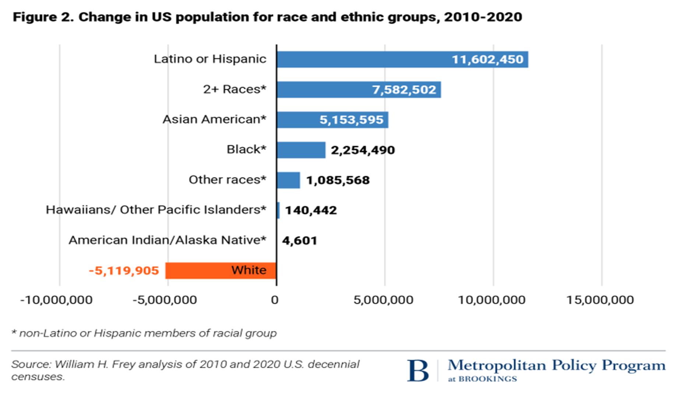
Statistics from census.gov
Notes:
This really shows you the growth of the Latino population over the past 10 years, relative to other groups. By sheer numbers, Latinos are the fastest-growing population.
And you can see what’s happening to the white non-Latino population.

Slide 8
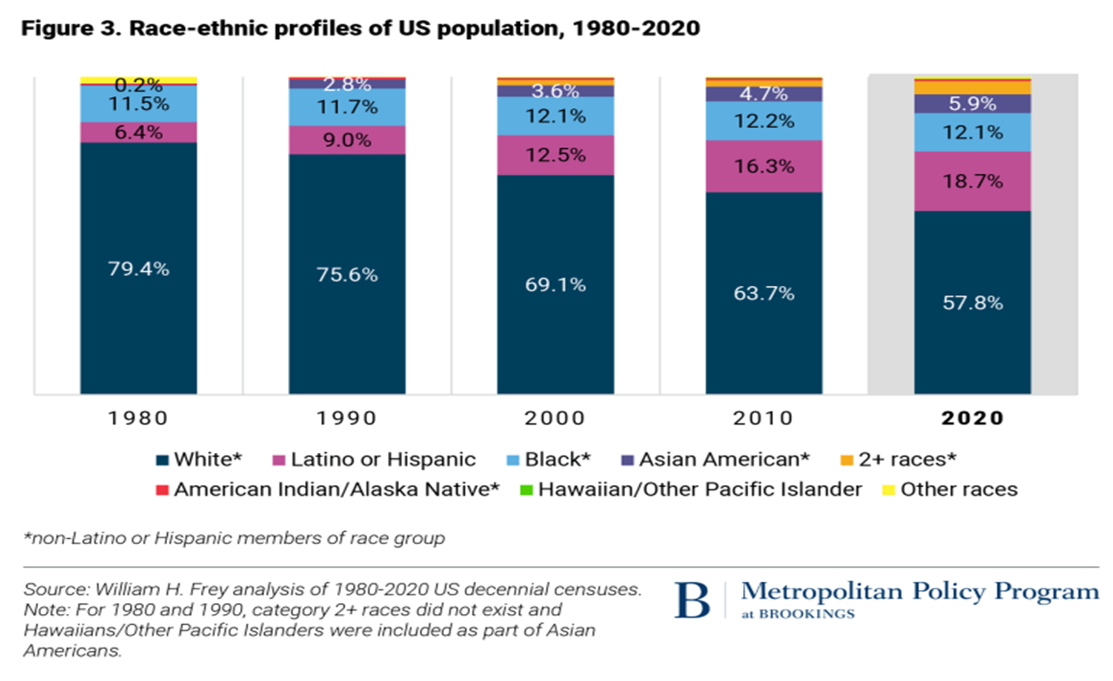
Statistics from census.gov
Notes:
Here’s another way to look at that data, taking a longer view that stretches back to 1980.
Check out the PURPLE bars. By percentage of the overall U.S. population, the Latino share of the population has almost tripled since 1980.
Now check out what this looks like when we focus on the under-18 population.

Slide 9
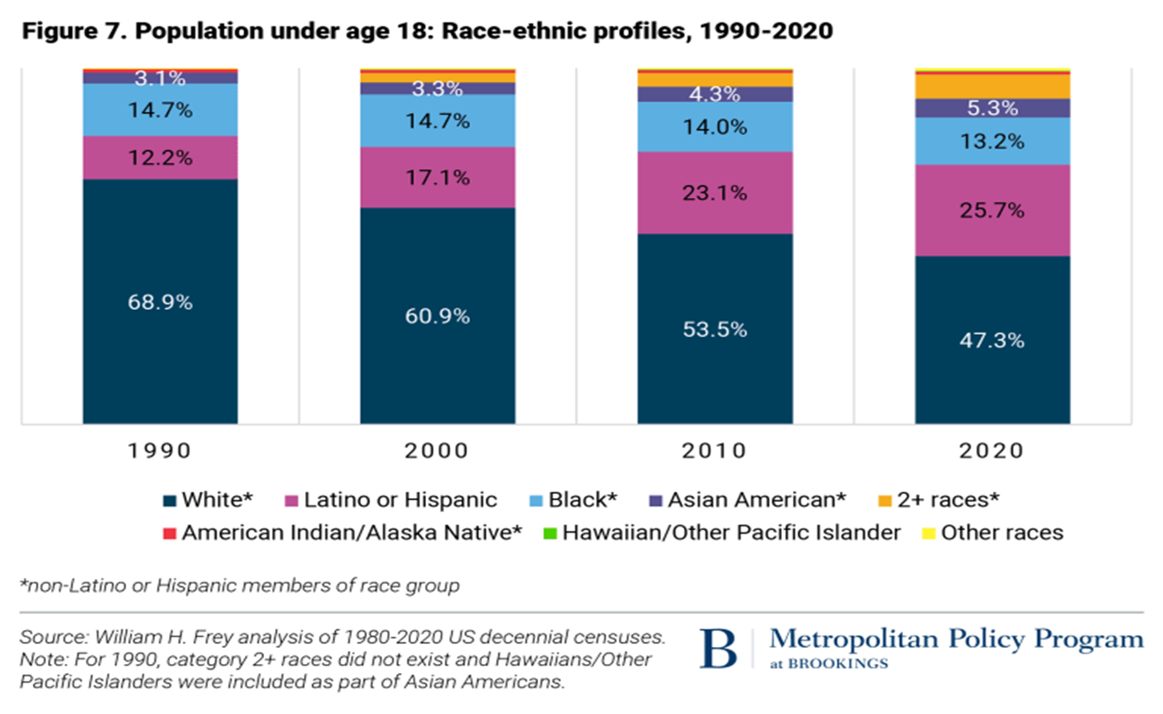
Statistics from census.gov
Notes:
The Latino numbers are even bigger for the Job Corps eligible youth population.
If you look at the far-right column, you’ll see that the white non-Latino youth population represented in DARK BLUE is no longer the majority, when compared with all the other groups combined.
And you see how these numbers have changed with each passing census. Latino youth numbers are in PURPLE.

Slide 10
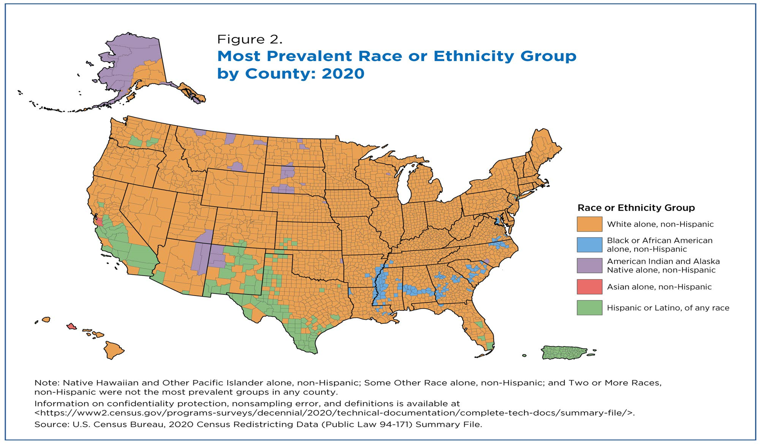
Statistics from census.gov
Notes:
This is what it looks like if you break down the numbers by county and look at the dominant group in each county.
The orange represents the white non-Latino population. They are by far the most dominant group. Latinos are the green color.
But let’s take a look at what happens to the map if you focus on the second-biggest group in each county.

Slide 11
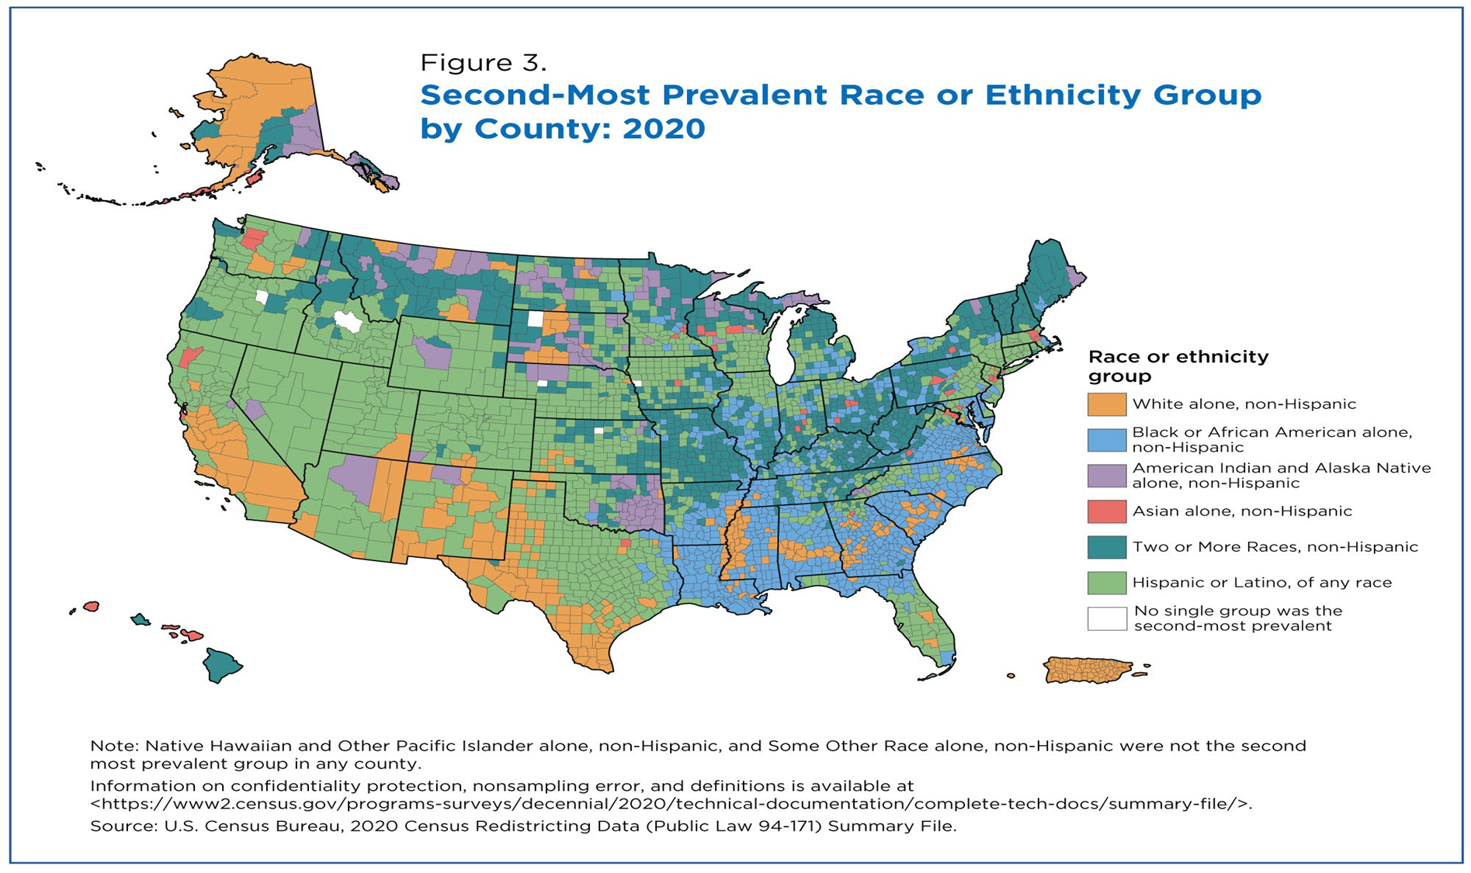
Statistics from census.gov
Notes:
It looks like this. Very green. That’s the Latino population.
My favorite part of this map are those little white spaces. Those are places where no single group was the second-most prevalent. In other words, they’re the least diverse places in the country.
So the point I'm trying to make is that this isn't a border state thing. It's an everywhere thing. Except for central Idaho.

Slide 12
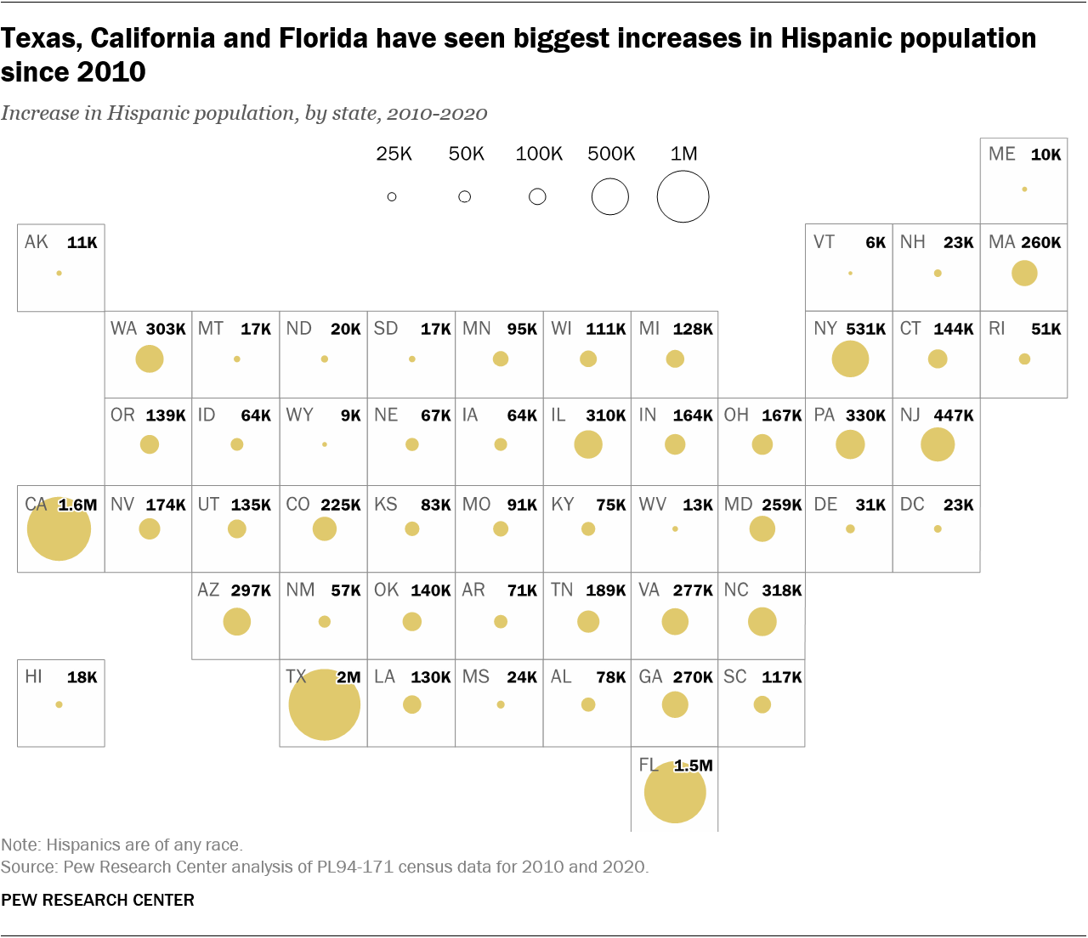
Statistics from census.gov
Notes:
OK, last ones from Pew. This is a pretty cool visualization. The bigger the dot, the bigger the increase in Latino population since 2010.
So this is a look at sheer numbers where most of the growth is in the places that make sense: Texas, California, Florida.
Compared to those states, the growth in North Dakota looks really small. Only 20,000. But when you only had like a couple thousand Latinos to start with, and you live in a state that doesn't have many people, that kind of growth is huge. So let's take a look at growth in a different way, this time by percentage of the population.

Slide 13
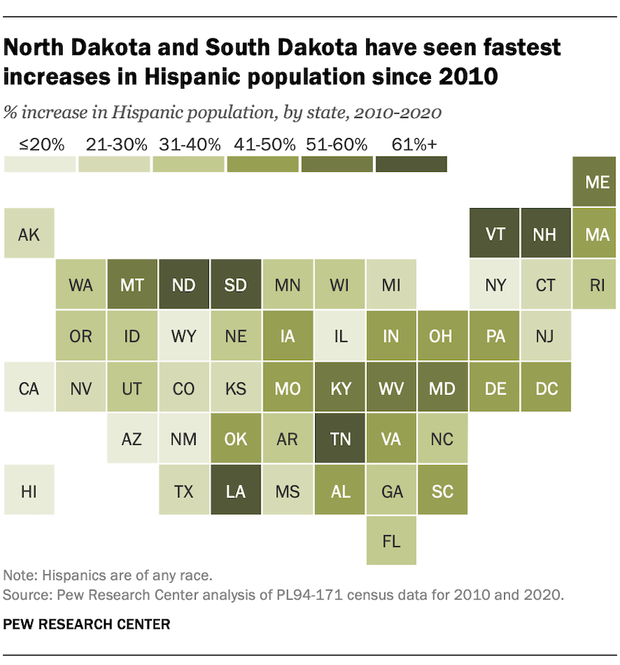
Statistics from census.gov
Notes:
The darker squares are the places where the Latino population has grown the most as a percentage of the state's overall population.
So here, take another look at North Dakota. Especially the western part of the state. You look at its neighbor, South Dakota. You look at most of the Southeast and mid-South, especially in Tennessee. Look at places like Vermont and New Hampshire. My dad lives in Vermont. I think he was the only Latino there for a while.
The darker boxes on this map are the places where the Latino population has grown the most by percentage of the overall population. These are all places where you probably never had to think about Latino outreach 10-15 years ago. Now it's becoming more relevant. The Latino populations that live in these places, I’m guessing that most of them know little to nothing about Job Corps. It's an opportunity to make a first impression.
So with that, let's talk about some things that will help you make first impressions.

Slide 14
Materials
Notes:
I'm going to show you some of our Spanish-language marketing materials in this next segment. You're probably familiar with a lot of these pieces. But maybe you didn't know they were available in Spanish. And if something is not available in Spanish, but you wish it were, contact us. We can work on it.

Slide 15
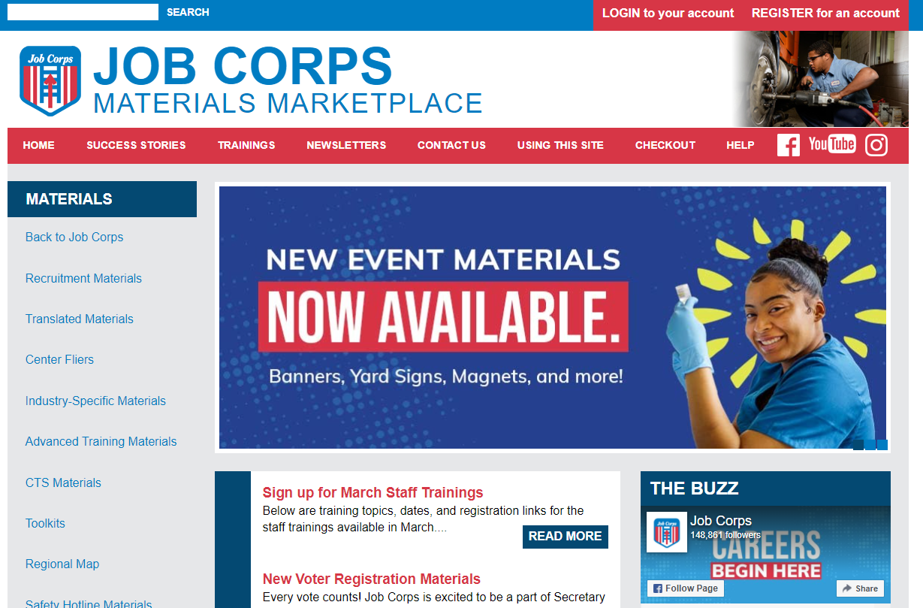
Materials Marketplace
www.jcmarketplace.com
Notes:
OK, so this is where you find program materials. This is the Materials Marketplace. We may have some newcomers on the line – this is where you go to download and order Job Corps marketing materials. The URL is www.jcmarketplace.com. If you've never been there before, find the USING THIS SITE link in the top navigation. That's the place to start. It will walk you through the site map and how to order materials.
In the left-side navigation, where you see that red arrow? There’s the link to the Translated Materials section of the website.

Slide 16
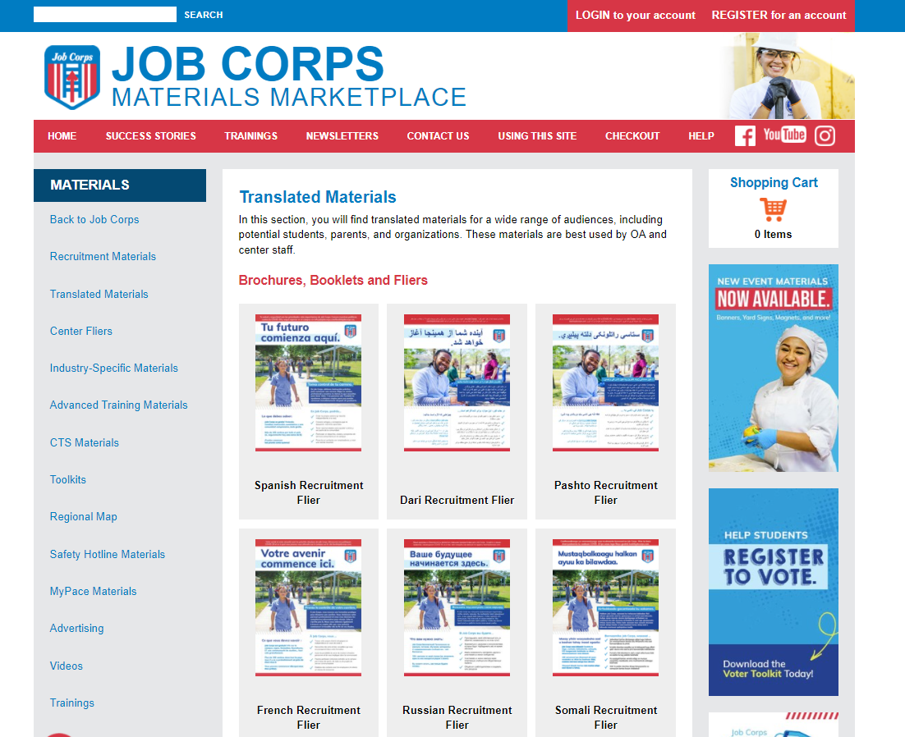
Translated Materials
Notes:
Click the Translated Materials link and it takes you here to this page. Most of what you see on this page is translated into Spanish, but we do have materials in other languages here too.

Slide 17
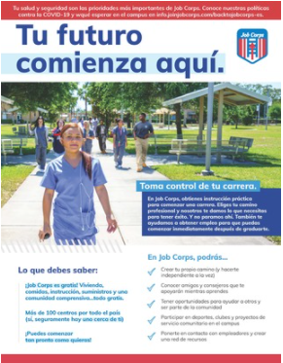
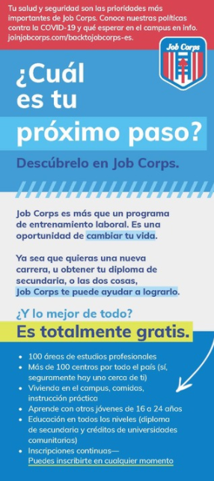
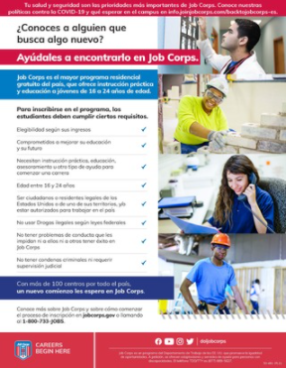
Spanish Materials
Notes:
This is a look at some of the most popular Spanish materials. You might be familiar with the English versions of these.
You're looking at the ...
Recruitment Flier
Eligibility flier
Recruitment Brochure
Enrollment Card
and Female Magazine
There’s another piece that you don’t see here as part of this collage, but I’m breaking it out in the next slide, because it’s my favorite.

Slide 18
Bilingual Parents Guide
Notes:
Of all the pieces, I really wanted to flag this one on screen. It's a bilingual piece, a booklet. Half of it is in English, half in Spanish. Why would we do that? Remember the beginning of this presentation, when I was talking about having a foot in one culture and a foot in another? This kind of hits the sweet spot.
Look at it this way. The English part of this booklet is for your 16- to 24-year-olds. Most Latinos in that age group speak English and prefer to communicate that way. But their parents? Many of them speak Spanish. So, the Spanish part of this booklet is for them.
Personally speaking, I like the bilingual approach. Whether I see it on a printed piece or I see it in an advertisement, which is becoming more common. When I see something like that, I kind of feel like someone is talking to me. Talking to both sides of me – the American me and the Colombian me.

Slide 19
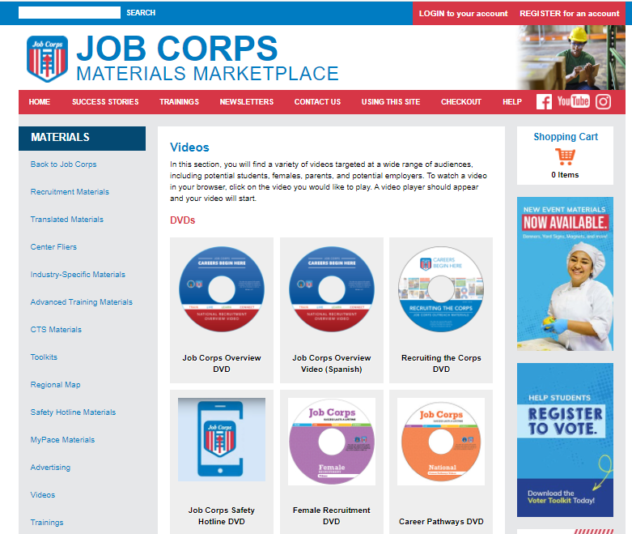
Videos on the Materials Marketplace
Notes:
OK check this out. There's a Videos section in the marketplace. Click on Videos in the left-side nav, and it takes you here. There are some Spanish-language resources on this page.
Some Job Corps recruiters like discs. Other folks are like, what are those things, coasters? So, if you’re in that second group and you want to use some video in your outreach, check out the Job Corps YouTube channel.

Slide 20
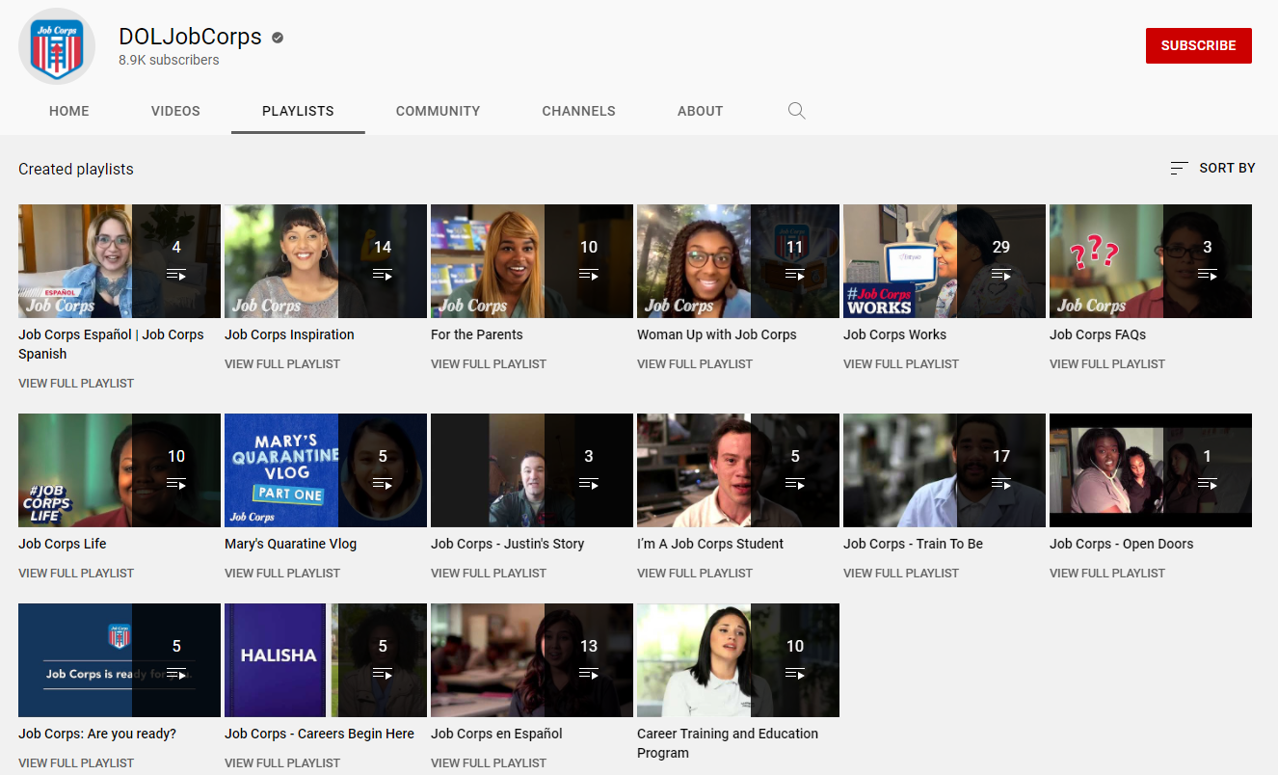
Job Corps YouTube Playlists
Notes:
If you’ve never been to the Job Corps YouTube channel, I highly recommend visiting and clicking through to find your favorites or the most recent.
Go to YouTube, and type DOLJobCorps in the search box. The top link will take you to the Job Corps YouTube channel.
There are lots of videos that you can share from the Job Corps YouTube channel. Once you're on the Job Corps page, click the Playlists link in the top navigation.
There are Spanish-language Job Corps videos here and entire playlists in Spanish, featuring real Job Corps students talking about their experience in Spanish.

Slide 21
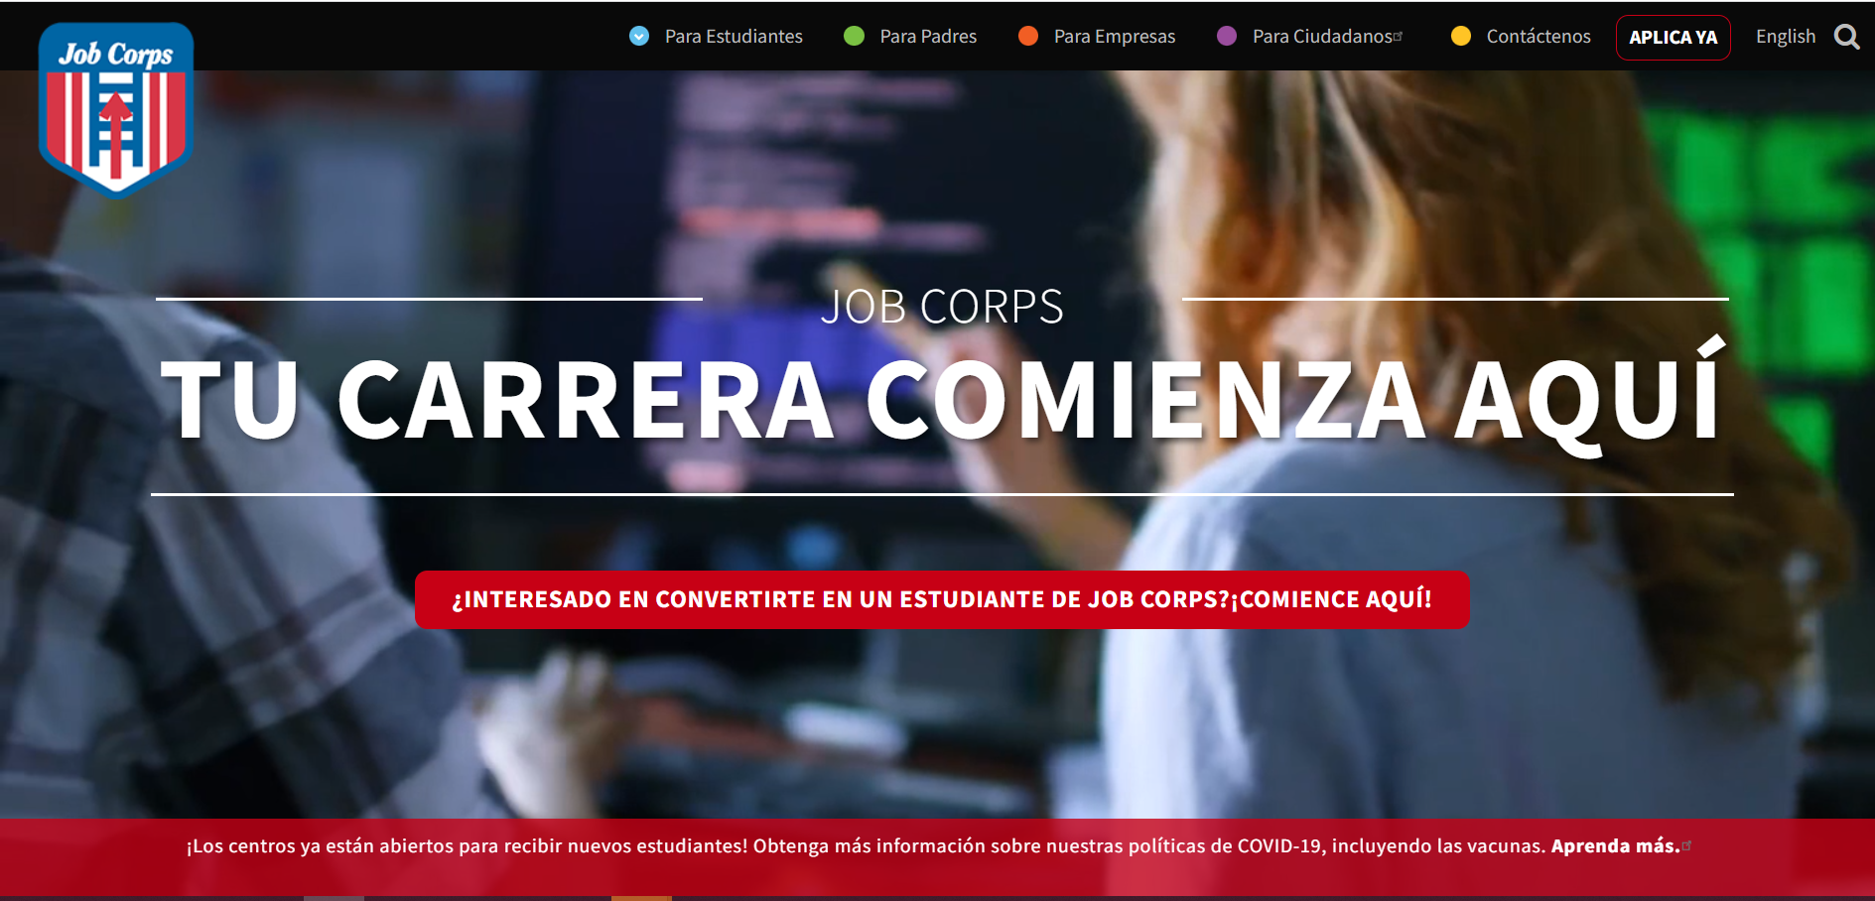
Spanish-Language Website
www.jobcorps.gov/es
Notes:
Did you know there's a Spanish version of the website? Here it is, along with the URL.
The other way to get here is by going to the English version of the site, and clicking the ESPANOL button in the top navigation.

Slide 22
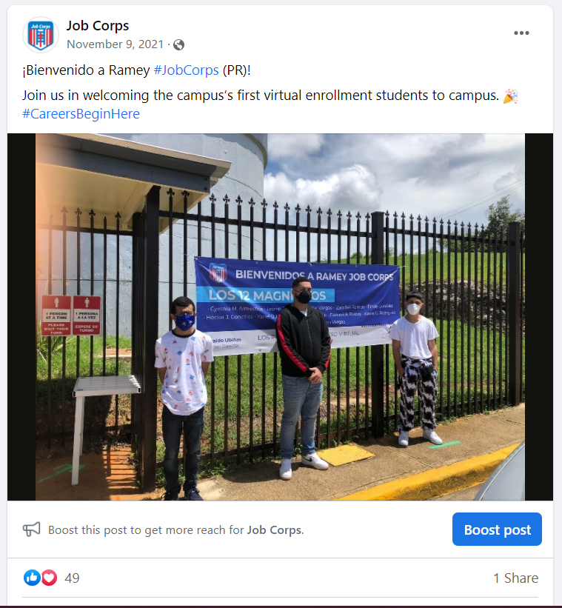
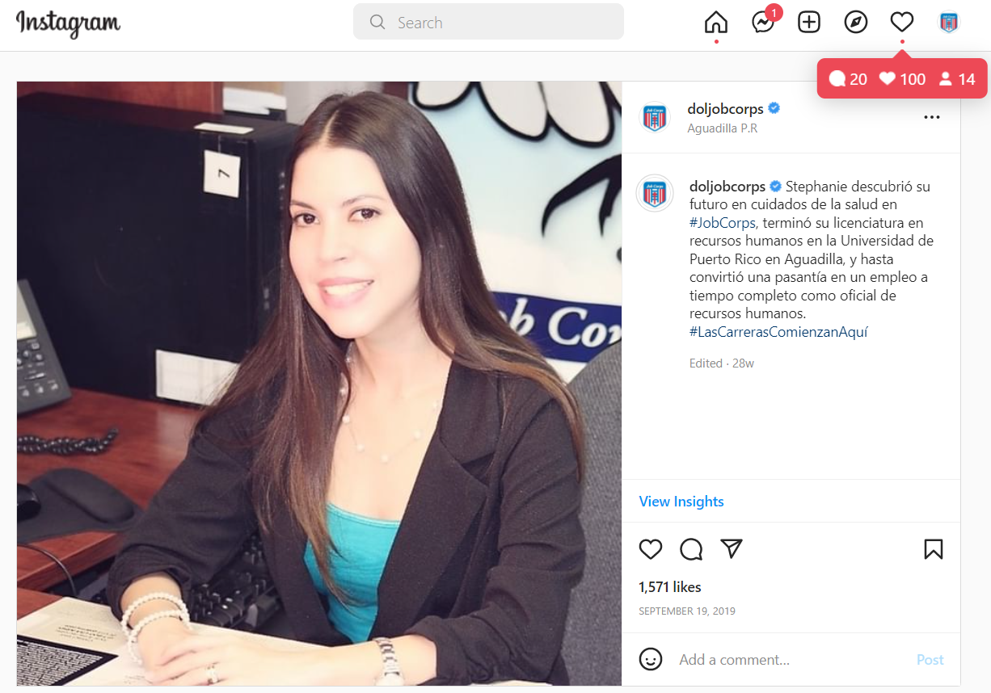
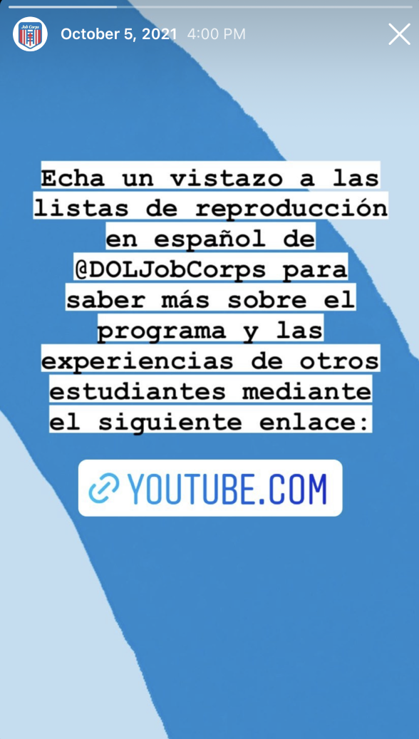
Spanish Social Posts
Notes:
If you're looking for success stories, you can find those too on the Materials Marketplace, but they’re also here on our social channels.
Remember that posts on Facebook and Instagram automatically translate into Spanish if that's your preferred language in your settings.
We're looking for content here always – let us know if you've got something.

Slide 23
Strategies
Notes:
OK, I wanted to spend a couple of minutes talking about outreach strategies and where I would begin if I were sitting in your chair.

Slide 24
Header
Text placeholder
Text placeholder
Take inventory of your resources in Spanish
Staff
Students/graduates
Materials
Notes:
The first thing I’d do is take inventory of my Spanish resources. Not just materials. People. People who may be able to help you with outreach. Other staff members. Current students and in some cases maybe former students, if you’re still in touch with them.
I’d make a list of staff and student Spanish-speakers on center and ask them if they’d be willing to help me on outreach, maybe join me for recruiting visits if the timing’s right, help me with center tours, help me with correspondence, even perhaps assigning an email buddy to a prospective student.
If they can’t join you, maybe they’d be willing to write a letter or say a few words on video. There are many ways to do it, all with the idea that you’re creating something familiar, projecting a sense of family and home.

Slide 25
Header
Text placeholder
Text placeholder
2. Build a target list for outreach
Go after the influencers
Notes:
This is so basic but so important. Organize your outreach efforts by building a target list for outreach and engagement. Let me show you what I mean.

Slide 26
Influencers
Hispanic/Latino Chambers of Commerce
Nonprofit organizations (e.g., YMCA, YWCA)
Spanish-language churches
Community centers
School programs and departments
Latino restaurants and stores
Clinics, medical centers, nursing homes
Spanish-language media (especially radio)
Soccer leagues
Notes:
Here are a few potential targets for you. Not so different from a standard outreach target list, but keep an eye open for Latino businesses, churches and nonprofits. They can be great referral sources for you. A good place to start is your local Hispanic or Latino Chamber of Commerce. I'd join. The cost is minimal, and the payoff can be very big. The chamber is a good resource to connect with Latino youth-focused organizations.
Be active with these groups. Serve as mentors. Host them on center for meetings and tours.
I think Rule 1 for this sort of outreach is: Be there. Show up at meetings, events. Over and over. That’s how you build a connection to the community and not seem like you’re there for a drive-by. Think about what you can do for THEM. Can the center host events? You’ll need permission from your leadership, but it’s an easy ask with a purpose. Find ways to get these groups on center so they can see the program in action.

Slide 27
More Influencers: Youth-Focused
YMCA Latino Achievers
ASPIRA
SER
National Latino Children’s Institute
MANA
National Hispana Leadership Institute
Catholic Charities
Notes:
This slide shows you some Latino youth-focused organizations with a national presence. That includes the YMCA Latino Achievers program, ASPIRA, SER, the National Latino Children’s Institute, and groups like MANA and the National Hispana Leadership Institute, which focus on opportunities and resources for young Latinas.
If you don’t know exactly where to look, your local Latino chamber is a good resource to connect with Latino youth-focused organizations.
Be active with these groups, if you can. Serve as mentors. Find out if you can host one of their meetings on center. If you have culinary, even better. You can feed them.
I know something like this isn’t very specific for you. So I wanted to show you what it looks like if we apply it to a city. Let’s go to Omaha, Nebraska.

Slide 28
Bienvenidos a Omaha
Omaha Hispanic Chamber of Commerce
Latino Center of the Midlands
Archdiocese of Omaha-Hispanic Ministry
Our Lady of Guadalupe Church
El Museo Latino
University of Nebraska-Omaha OLLAS
Omaha Cinco de Mayo
Omaha Latino Peace Officers Association
South Omaha Interligas (soccer)
Notes:
There’s a pretty strong Latino presence in Omaha, actually. This is a good mix of social work groups, churches, museums, school programs, special events and other networking organizations. These are some of your targets, especially with regard to reaching influencers and setting up referral networks. I would try to sit down with representatives from each of these organizations and invite them on center for tours.
I picked Omaha because I wanted to focus on a place where you wouldn’t think there was much. And really, there’s a lot.

Slide 29
Header
Text placeholder
Text placeholder
3. Pitch families
Not just individuals
Notes:
We talked a little bit about the importance of family at the top. What you’re asking a prospect to do here is a pretty big sacrifice. You’re asking them to leave their families and join yours. That’s a pretty big ask, notwithstanding all the benefits the program offers.
I think you improve your chances in outreach if you expand the pitch a little bit to include other family members. Instead of a one-on-one meeting, make it one-on-two or one-on-three. Talk to their families. Talk to Mom and Dad, abuelo y abuela. If nonresidential is an option for you, talk about that. Because that’s a good option for some families who might be hesitant about sending one of their kids to a boarding school in a new country.
I know Job Corps doesn’t refer to itself as a boarding school. But I’m doing that intentionally to make a point. You may need to simplify your language a bit, especially if there’s a bit of a language barrier. Government terms can be pretty difficult to translate. Keep it simple. Job Corps is a school. A very special school, but fundamentally it’s a school.
Like all other schools, you do tours and open houses at certain times of year. That’s going to help you here. One thing I’s consider doing is a special open house for Latino students, using bilingual or Spanish-speaking tour guides. That sort of thing might be something for Spanish-language media, something they might be interested in. Here at MP&F, we can of course help you with social posts and other supporting materials to help you spread the word.

Slide 30
Header
4. Be present, persistent and patient
Text placeholder
Text placeholder
Notes:
OK, last thing. Which is actually three things. The three P's.
Being present is important. I think that, if you're looking to connect with a local Latino support group, it can't be from afar. Show up to meetings and events. Make connections in person, when you can. And definitely bring folks to your center if you can through open houses, tours, hosting meetings. Job Corps might be a little like hockey. You've got to be there to fully get it. You've got to bring them to the building once, and then they'll come back for more.
Being persistent and being patient. Part of the same thing. Look, if you're starting from basically ground zero, building a recruitment pipeline to Latino students takes a little time.
This is not always easy in the Job Corps world, playing the long game. Contracts change. Positions change. Priorities change. The easy thing to do would be to spend a little time on Latino outreach, do just enough to say you did it, and then walk away from the results aren’t coming fast enough.
But I think carving out some time for Latino outreach will be worth the effort (unless you're from central Idaho). The demographics say it's worth the effort. Make no mistake, everybody else looks at the same Census numbers and is going after this population too. But I like your chances of success, because you’re not selling soap. You’re selling opportunity.
You know the cliché: a hand up, not a handout. I think that's important to remember with this population. It's a hand up, not a handout. You pay with your sweat and your time. You earn it.

Slide 31
Myths
Notes:
We're going to close here by debunking a few myths ...

Slide 32
1. Hispanic Latino LATINX!
Notes:
Do you need to use the word LATINX now?
The answer is, sure, if you like. But you won’t have much company from people who self-identify as Hispanic.

Slide 33
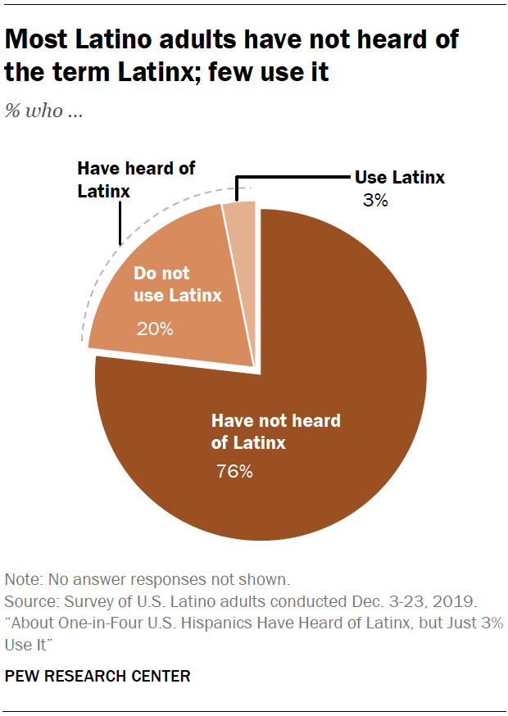
Notes:
This is from a PEW survey at the end of 2019. At that time, only a quarter of survey respondents who self-identify as Hispanic had ever heard the term Latinx. And only 3 percent were actually using it.
Now, note that this survey is from 2019. Axios asked this question a different way and more recently. The latest Axios-Ipsos Latino poll found a majority of Mexican Americans say they are comfortable with the term Latinx, while Central Americans are less so. 50% of the 1,005 U.S. Latino adults surveyed said they were comfortable with people of Spanish-speaking origin being referred to as Latinx in the United States, the poll shows. But those numbers increase to 89 percent when you ask them about using “Latino” or “Hispanic.”
The term Latinx probably seems more popular than it is. The reason for that is that academia and media types like it. You could say that it's more of a top-down movement than a bottom-up movement.
Ages 16-24 are more likely to use it than older folks. Young women seem to like it.
Latinx is gender-neutral and perhaps more inclusive. Except that excludes the Spanish-speaking population that may find this word difficult to pronounce. And it may exclude other folks who think this is a paternal thing to do, to basically quote-unquote fix Spanish.
Other people may disagree with me on this, but whatever pan-ethnic word you use here doesn’t really matter. In other words, don’t get bent out of shape trying to decide between Latino, Hispanic or Latinx. East of the Mississippi River tends to use Hispanic. Hispanic the most common of the three. Western U.S. tends to use Latino. If you’re asking what the target audience prefers, it’s probably their first name. Or their country of origin. Or perhaps even being called American, without hyphenation.

Slide 34
2. You need to speak Spanish
Notes:
OK, myth #2 and it’s a biggie. You need to speak Spanish to connect. You need to speak Spanish to self-identify as Latino.
You don’t.

Slide 35
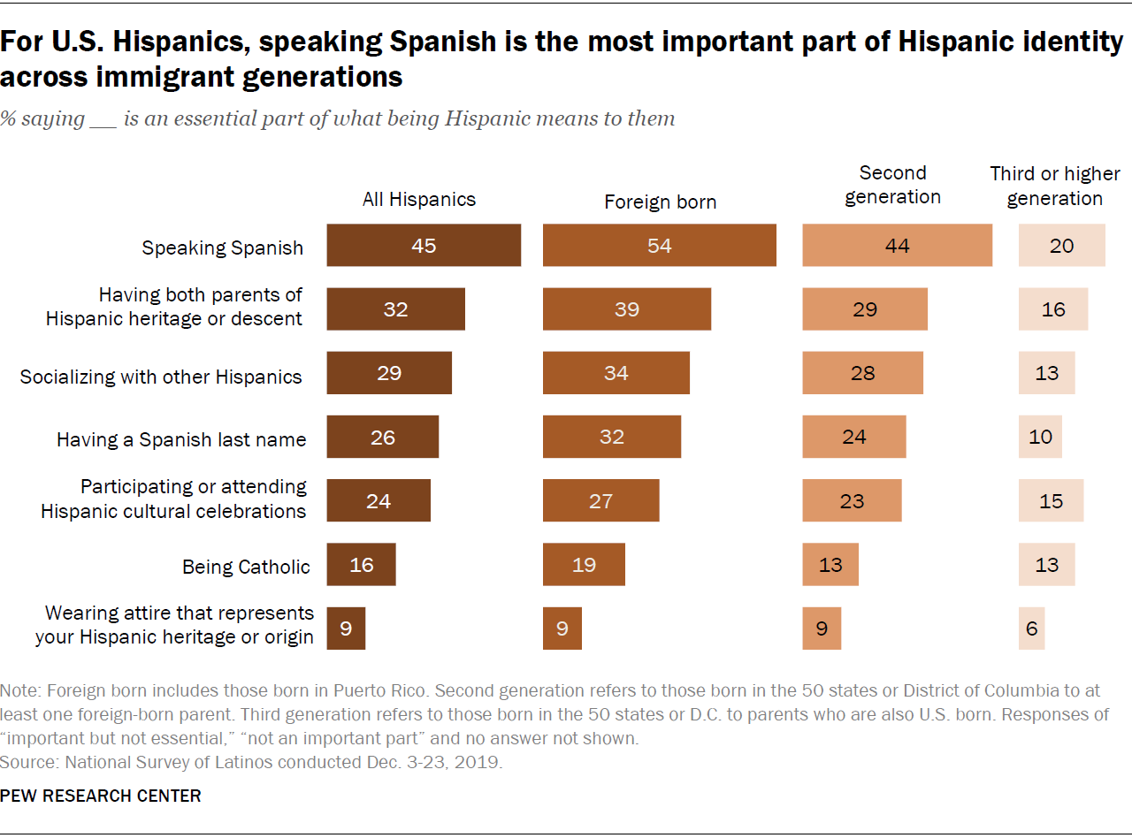
Notes:
Speaking Spanish is an important part – maybe THE most important part – of what it means to be Hispanic or Latino.
That doesn’t mean you need to speak it to make a connection. Everyone, and especially the group you're trying to recruit, they'll understand your English. Spanish will help you a bit in certain situations, but don't be intimidated by the language barrier.
One thing that's striking about a graphic like this is that it's telling you how long it takes for new Americans to, if you'll pardon the word, assimilate. By the third generation. And as you look at charts like this, remember that you're focusing on those columns to the right – those second- and third-generation Latinos. The children and grandchildren of immigrants.

Slide 36
3. Translation? I've got a friend ...
Notes:
OK, this last one is just a reminder to be careful with translations, even through programs like Google Translate. And especially in the Job Corps world where we use these clunky phrases that are difficult to translate. The more you simplify the English, the better your translation will be. But it's a science. I'm not good enough to do it. Chances are your buddy who majored in Spanish isn't good enough to do it. I'd use pros here. We do that with our materials.
A translation program is better than nothing, but it's imprecise. There are like five different Spanish words for orange, depending on where you are in Latin America.
So my advice here is keep the English simple. Your translator should be empowered to translate the meaning, not the word. When you go word for word and translate literally or carelessly, bad things happen.
How bad? Let’s take a look.

Slide 37
Lost in Translation
Pope John Paul II's Miami visit T-shirt:
I saw the Pope! potato! (el Papa – la papa)
Parker Pen's new ballpoint in Mexico:
It won’t leak in your pocket and embarrass you make you pregnant. (embarazar does not mean "embarrass")
Chevy Nova:
no va means "does not go"
Notes:
When Pope John Paul II visited Miami many years ago, a T-shirt vendor made a mistake. They were trying to sell T-shirts that said I saw the pope in Spanish. But "la papa" doesn't mean The Pope. The T shirt instead said I saw the potato (la papa). If anyone has seen the new Batman movie, Colin Farrell as the Penguin puts it eloquently – don’t you know the difference between el and la?
No. 2: Parker Pen marketed a new ballpoint in Mexico: It won’t leak in your pocket and embarrass you. What came out in the translation was that it won’t leak in your pocket and make you pregnant.
No. 3: Chevy introduced a compact car but might have considered changing the name for the Latin American market. No va means "does not go."
This is all more of a cautionary tale than anything else and maybe a little levity to end this presentation.

Slide 38
Questions?
Call MP&F (615) 259-4000
E-mail jobcorpsmaterials@mpf.com
Jsolano@mpf.com
Notes:
I hope this webinar has been helpful.
Again, it will be posted on the Materials Marketplace under the “Trainings” tab.
Always feel free to call MP&F at the number you see on the screen—(615) 259-4000—and we will make sure you are put in touch with the right person.
If you need to order materials, you can do so on the Materials Marketplace, or call and ask to speak to someone on the Job Corps Materials team.
I do want to remind everyone that we offer regular training webinars. Be on the lookout for other training announcements as well.
We do have a quick survey on this webinar that we would love for you to fill out. You can find the link to it on the left-hand side of the screen. This will help us make sure our webinars are helpful, and we can incorporate suggestions into future ones.
I'll pause here and see if we have any questions in the chat box.
And if you think of something later, reach out to us anytime. There's our contact information on screen.
Thanks again for joining us here today.

